Slide 1
Analysis of Spotify Data
Presented by
Rehapriadarsini Manikandasamy
Coursework: 64101-Visualization of Complex Data

Slide 2
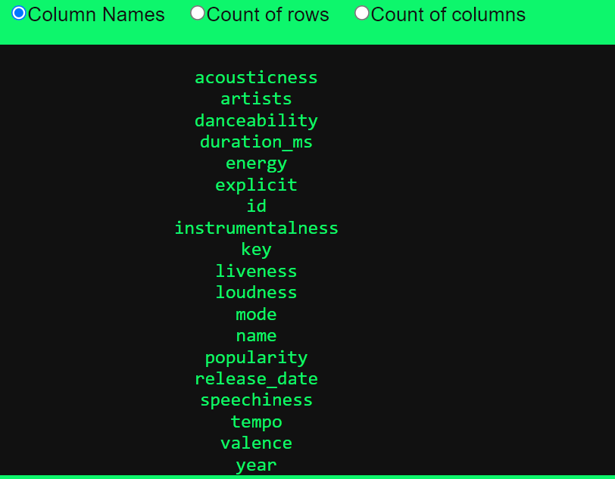


Description of Dataset
The dataset contains more than 160,000 songs collected from Spotify Web API. The dataset is from Spotify and contains 169k songs from the year 1921 to year 2020. Each year got top 100 songs
Data Source: KAGGLE
Link: https://www.kaggle.com/datasets/ektanegi/spotifydata-19212020/code

Slide 3
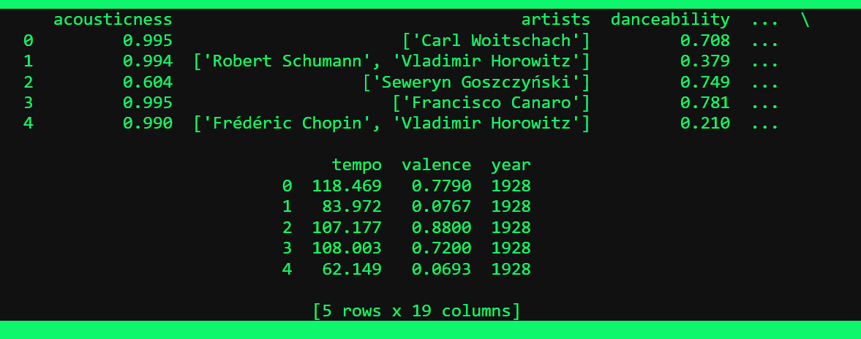
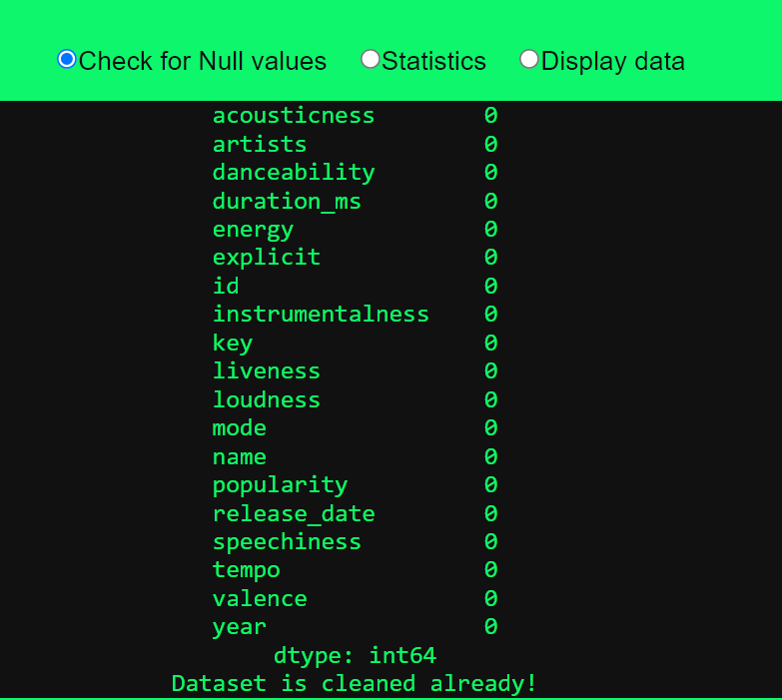
Data Preprocessing

Slide 4
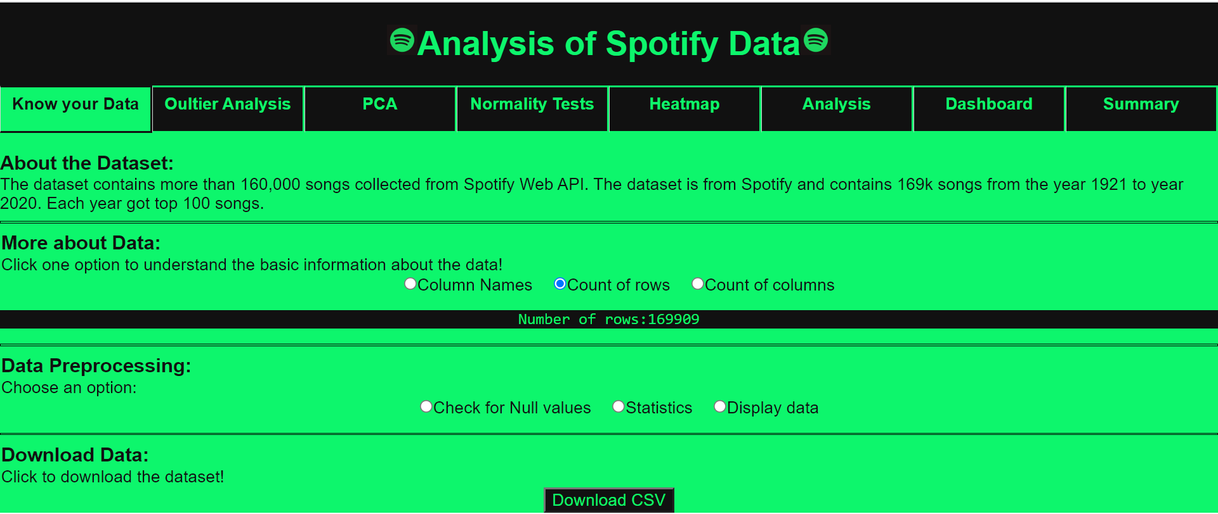
App Layout
Tabs with layouts with answers for FTP questions
Options to visualize data
Download’s Data to local system

Slide 5
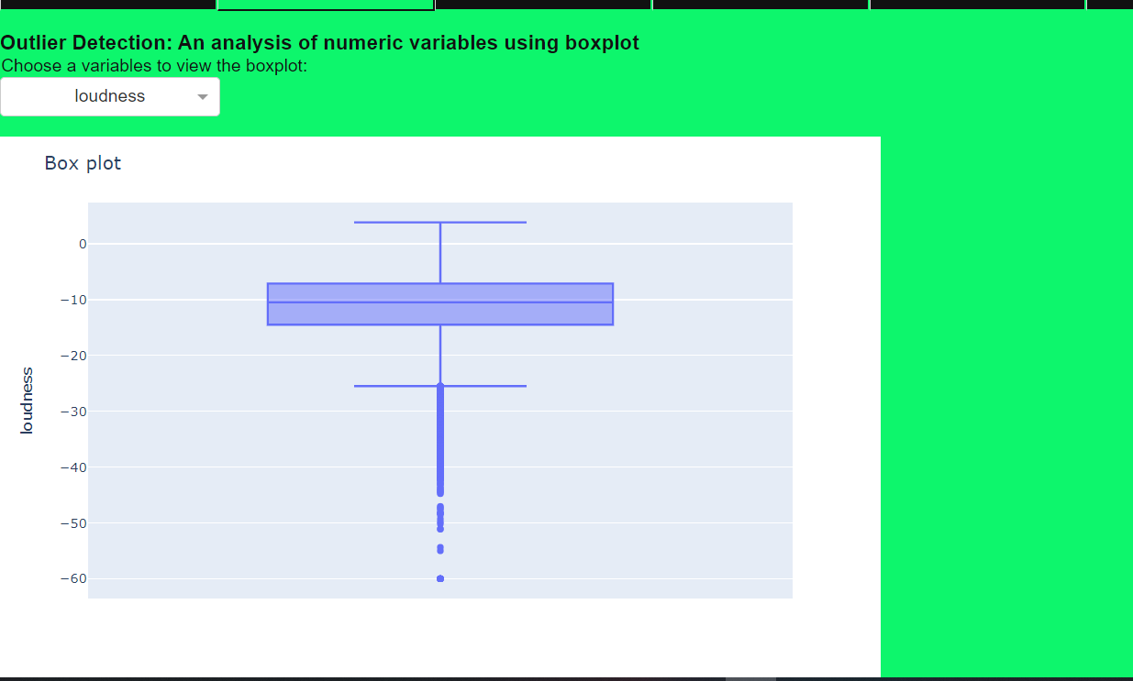
Outlier Detection
Boxplot is used to detect the presence of outliers in the dataset

Slide 6
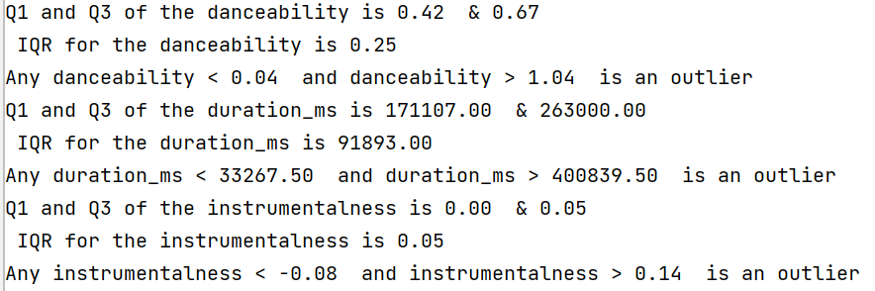
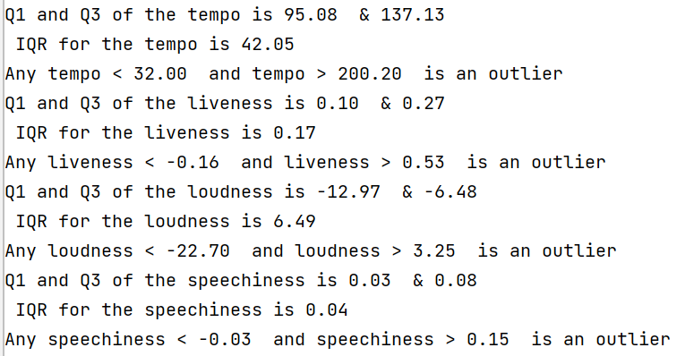
Outlier Detection

Slide 7
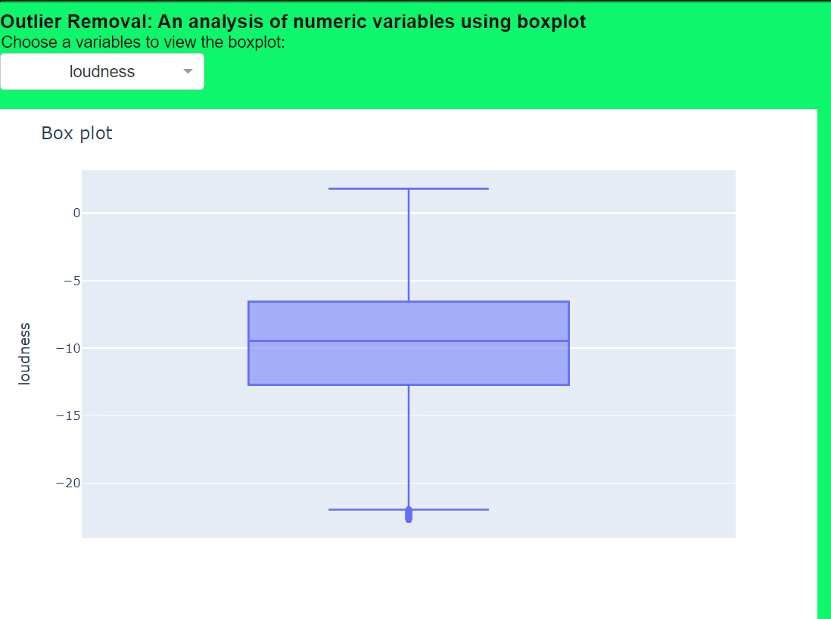
Outlier Removal

Slide 8
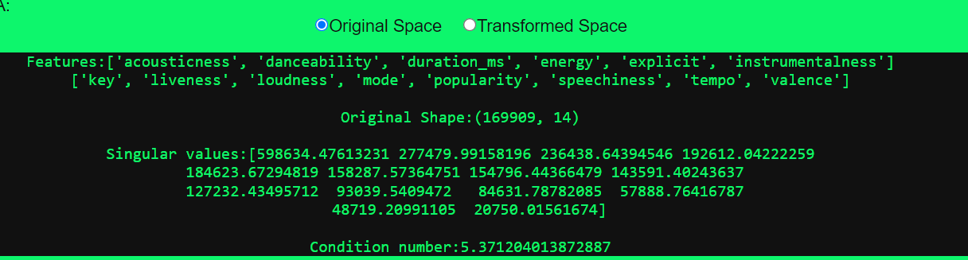
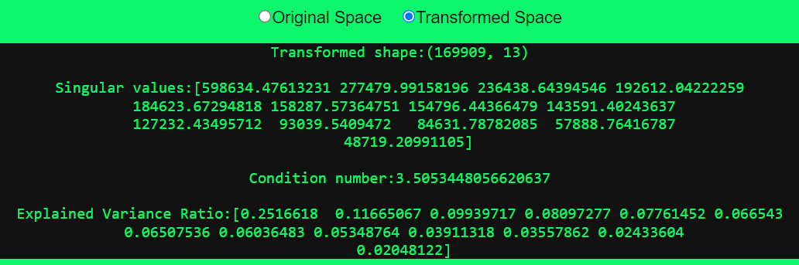
Principal Component Analysis

Slide 9
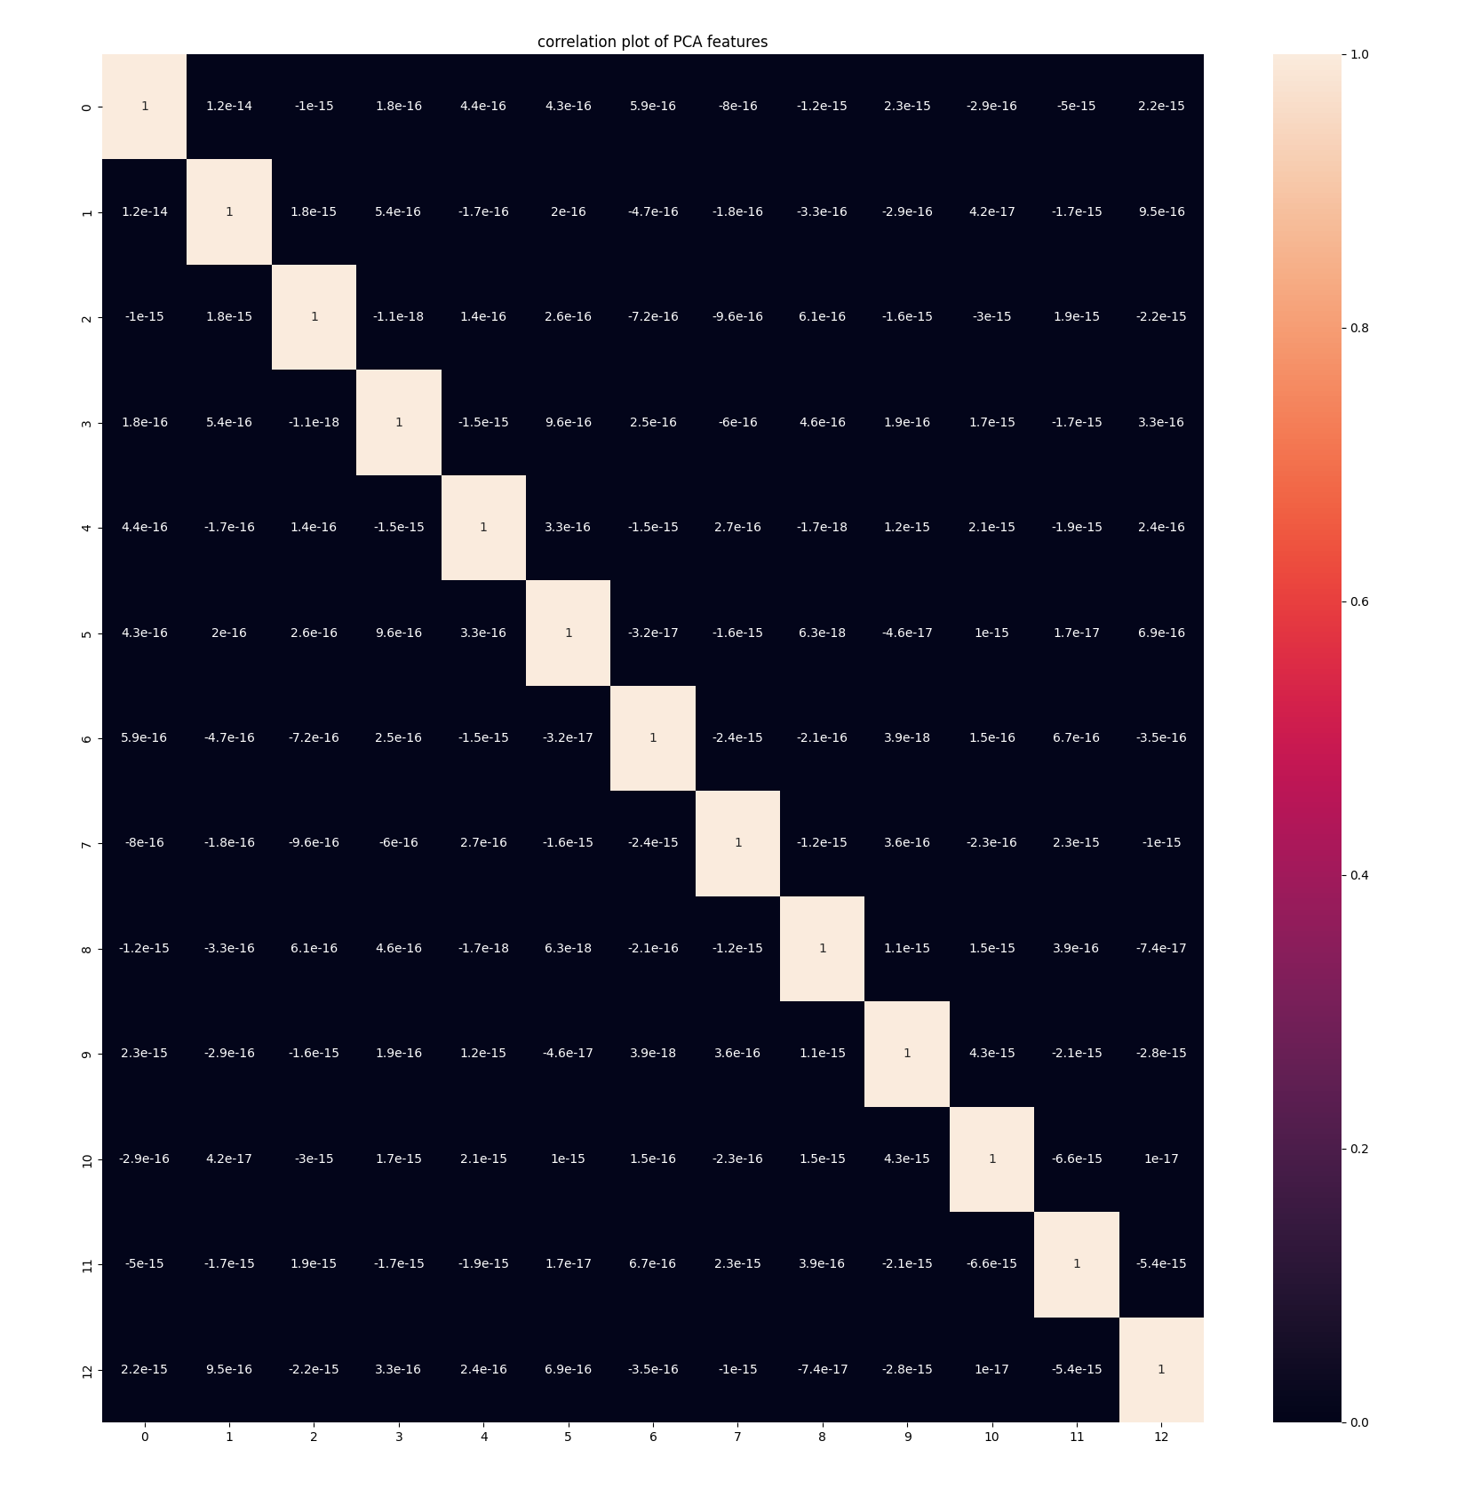
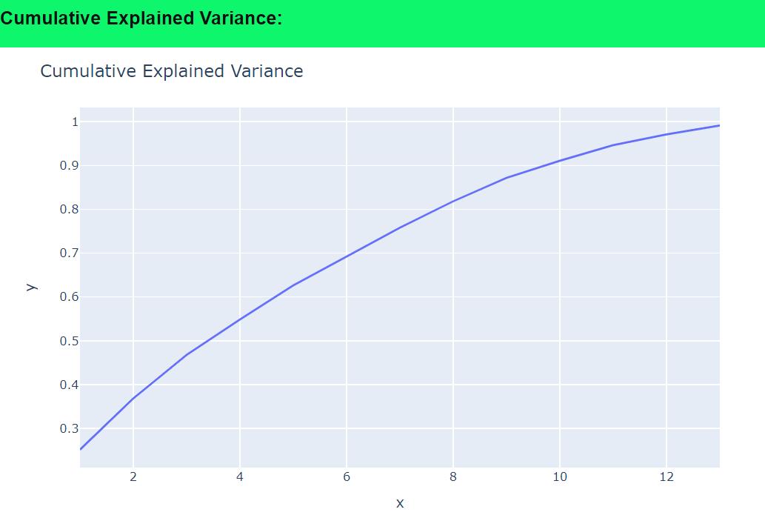
Principal Component Analysis

Slide 10
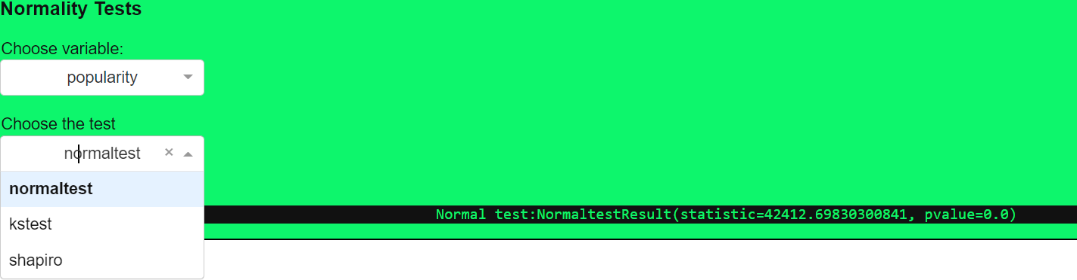
Normality Tests

Slide 11
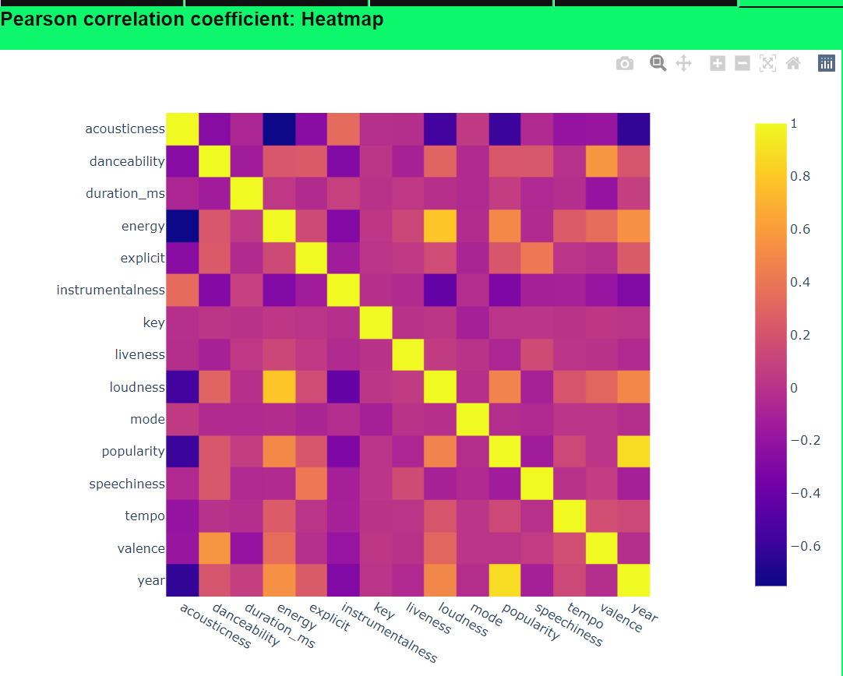
Heatmap

Slide 12
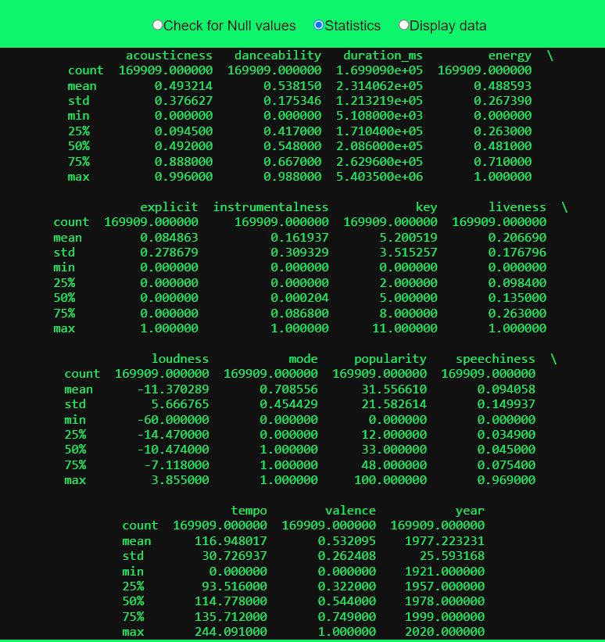
Statistics

Slide 13
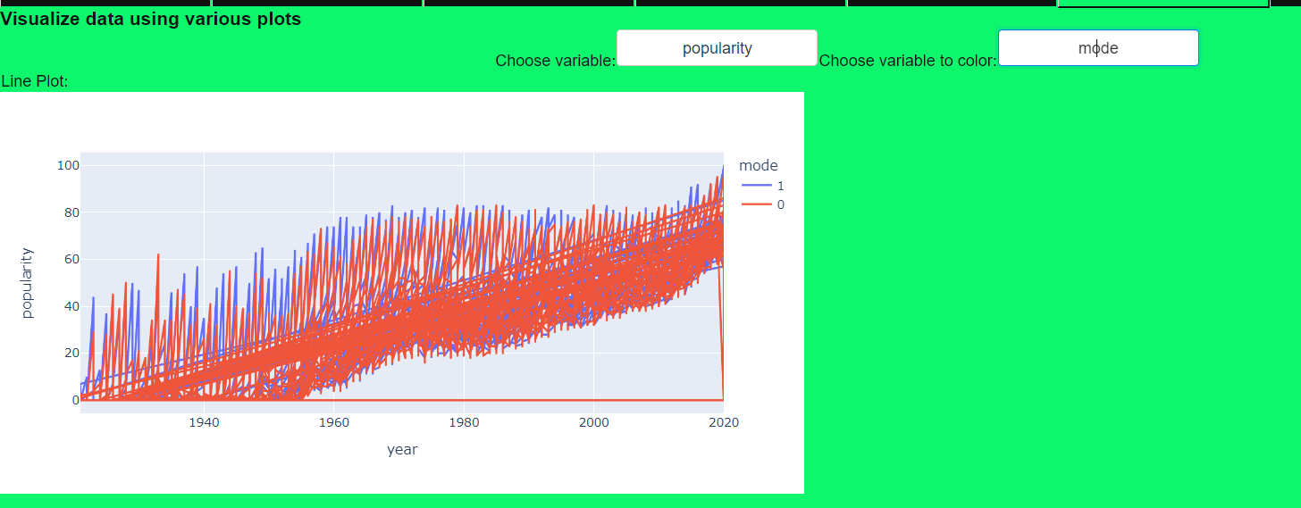
Data Visualization

Slide 14
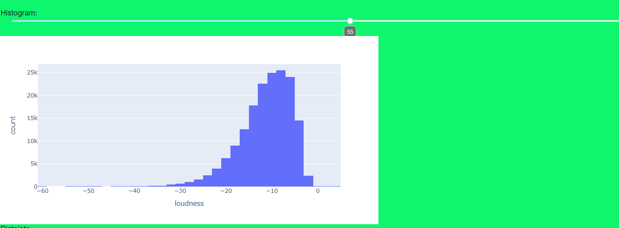
Data Visualization

Slide 15
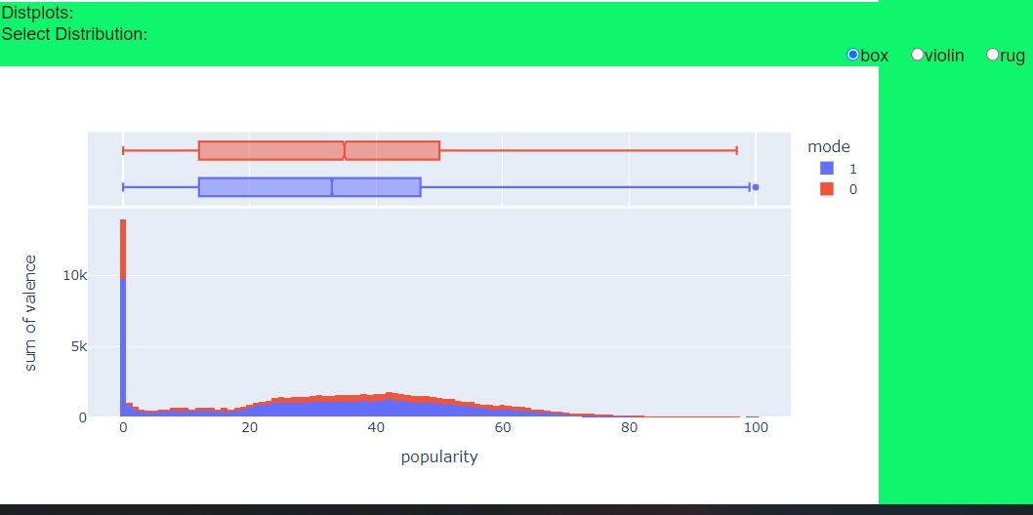
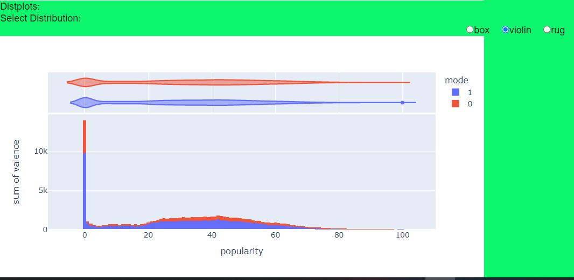
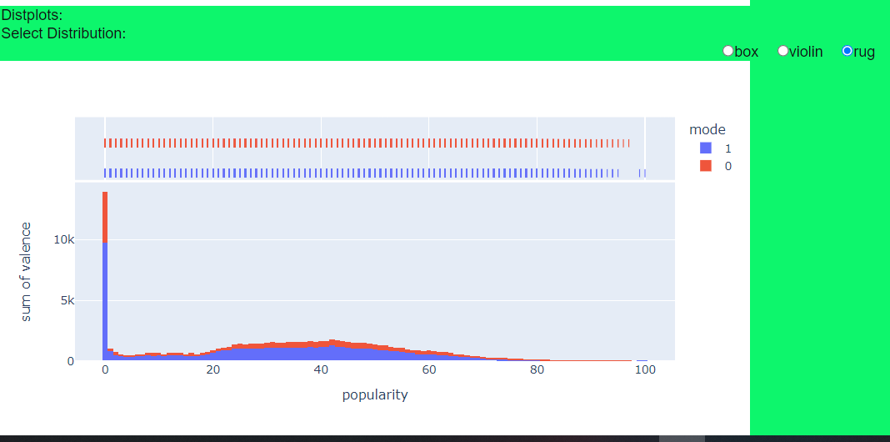
Data Visualization

Slide 16
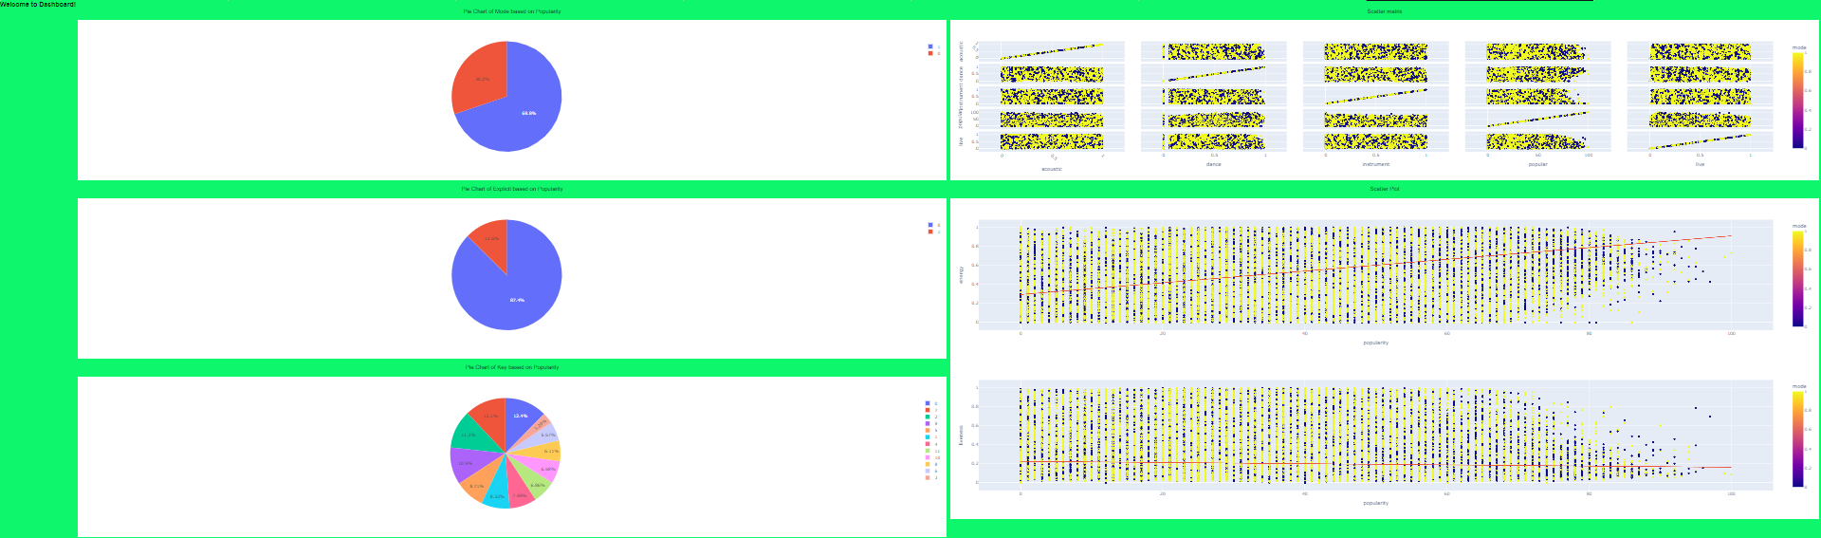
Dashboard

Slide 17
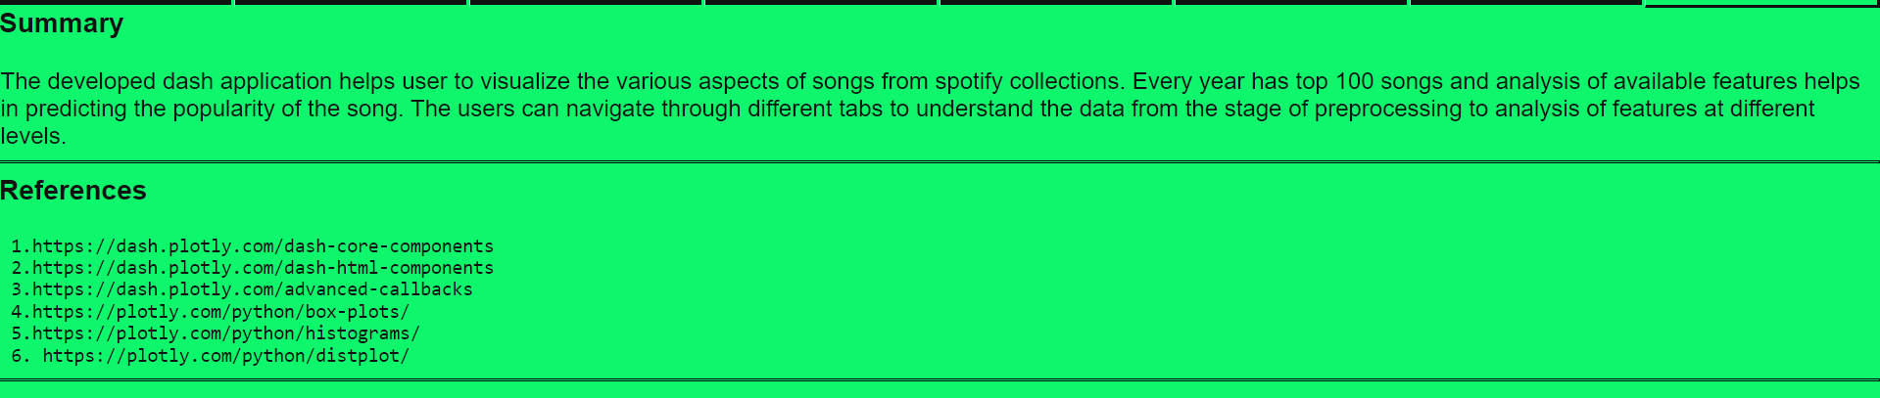
Summary

