Slide 1
COVID-19 ICU Bed Prediction Analysis
Presented by
Adina Dingankar
Daria Chylak
Rehapriadarsini Manikandasamy

Slide 2
Table of contents
01
02
03
04
Introduction & Dataset
Exploratory Data Analaysis
Data Preprocessing
Modelling & Prediction

Slide 3

Introduction
Health care systems are currently overwhelmed with the high demand in ICU beds, professionals and other health care resources.
There is an urgency to make better predictions to prepare and avoid the collapse in health care systems.
AIM: To predict admission to the ICU of confirmed
COVID19 cases.

Slide 4


Motivation
Used artificial intelligence (AI) to predict Covid patients' oxygen needs on a global scale
The research was sparked by the pandemic and set out to build an AI tool to predict how much extra oxygen a Covid-19 patient may need in the first days of hospital care, using data from four continents
Article: https://www-news--medical-net.cdn.ampproject.org/c/s/www.news-medical.net/amp/news/20210915/Hospitals-use-artificial-intelligence-to-predict-Covid-patientse28099-oxygen-needs.aspx

Slide 5
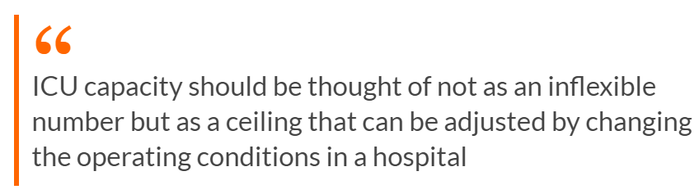
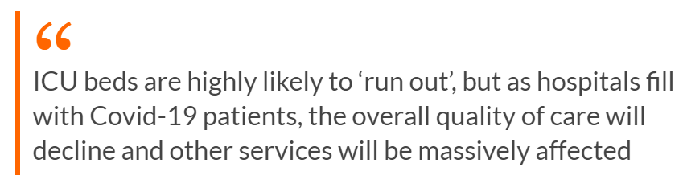

Why ICU prediction is important now?
Article: The Irish Times - What happens if ICU beds run out in Irish hospitals?

Slide 6
Dataset
The dataset contains anonymized data from Hospital Sírio-Libanês, São Paulo and Brasilia. All data were anonymized following the best international practices and recommendations.
Source: Kaggle
https://www.kaggle.com/S%C3%ADrio-Libanes/covid19
Shape: 1925 Rows X 231 Columns
Features: 54 features
Patient demographic information (03)
Patient previous grouped diseases (09)
Blood results (36)
Vital signs (06)
The features are expanded to mean, median, min, max and relative difference
Except 6 columns, all the other columns have null values
Data has been cleaned and scaled by column according to Min Max Scaler to fit between -1 and 1.

Slide 7
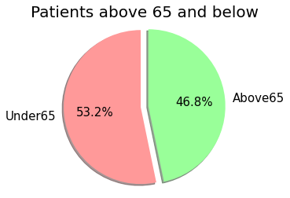
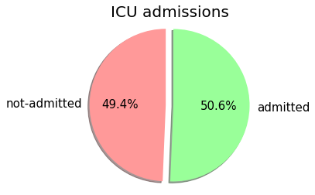
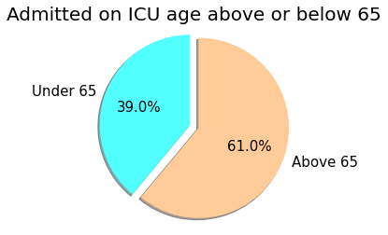
EDA
Distribution of patients based on age group admitted into ICU after 12 hours
(Total number of patients =385)

Slide 8
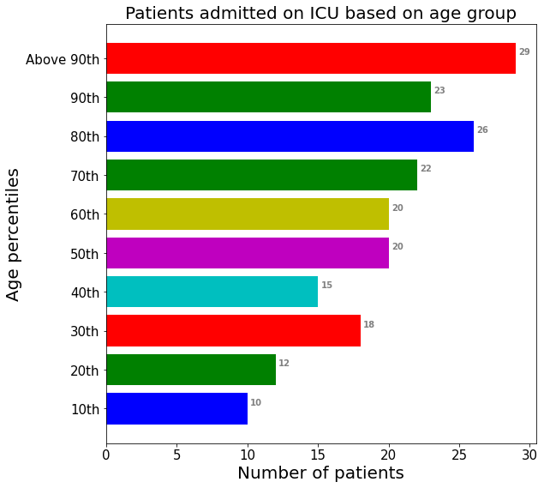
EDA
Patients admitted to ICU based on different age percentile

Slide 9
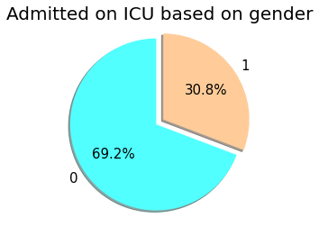
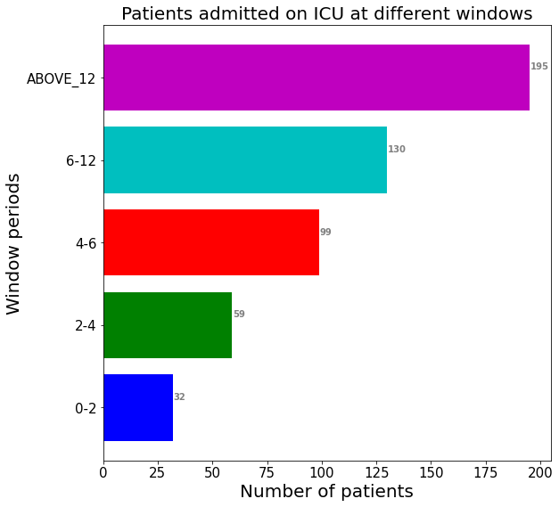
EDA
*The gender column has been already encoded in numerical format so the values '0' and '1' aren't clear what gender category they refer to i.e: male or females

Slide 10
Data Preprocessing
Missing values are imputed using next or previous entry
Missingness in data was more on the expanded column – Analysis based on scatter plot showed ‘mean’ values are the best choice
Remove the expanded columns (only columns with mean values are considered), the data now has 1925 rows and 56 columns
Converted target 'ICU’ to ‘ICU_SUM’ based on whether a patient has been eventually shifted to ICU
To build a clinically relevant model author has advised only to use data related to WINDOW (0-2)
One hot encoded the Categorical column ‘AGE_PERCENTIL’
Drop the columns: "PATIENT_VISIT_IDENTIFIER", "WINDOW", "ICU"

Slide 11

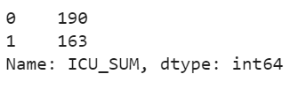
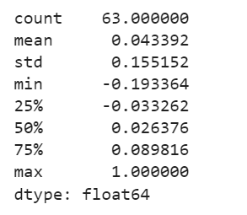
Data Preprocessing
Previously discussed preprocessing techniques helped in handling class imbalance and multi-collinearity issue
Descriptive statistics of correlation between target and other variables show the high collinearity has been reduced
The final data has 353 Rows and 57 Columns
Train-test-validation set ratio is 80%-20%-20%

Slide 12
Modelling & Prediction
Target : ICU_SUM
Hyper parameter tuning : Grid Search CV
Models used:
Logistic Regression
Decision Tree Classifier
Random Forest Classifier
XGB Classifier
Hist Gradient Boosting Classifier

Slide 13
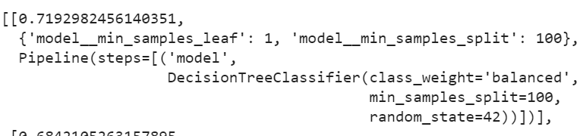
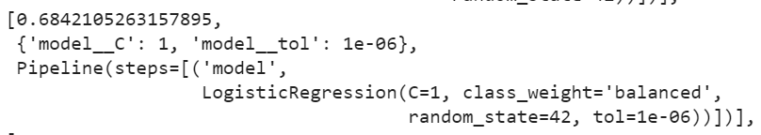
Modelling & Prediction
Best model (based on best score) : Decision Tree Classifier
Decision Tree Classifier
Logistic Regression

Slide 14
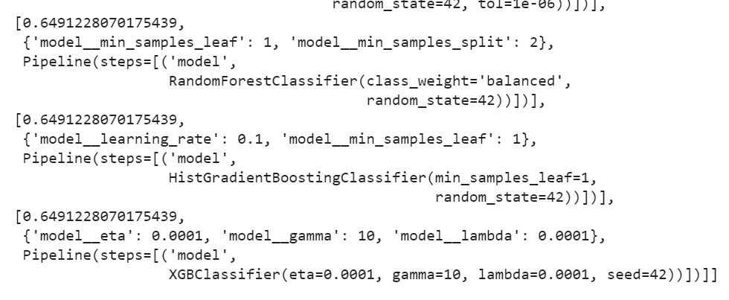
Modelling & Prediction
Random Forest Classifier
Hist Gradient Boosting
Classifier
XGB Classifier

Slide 15
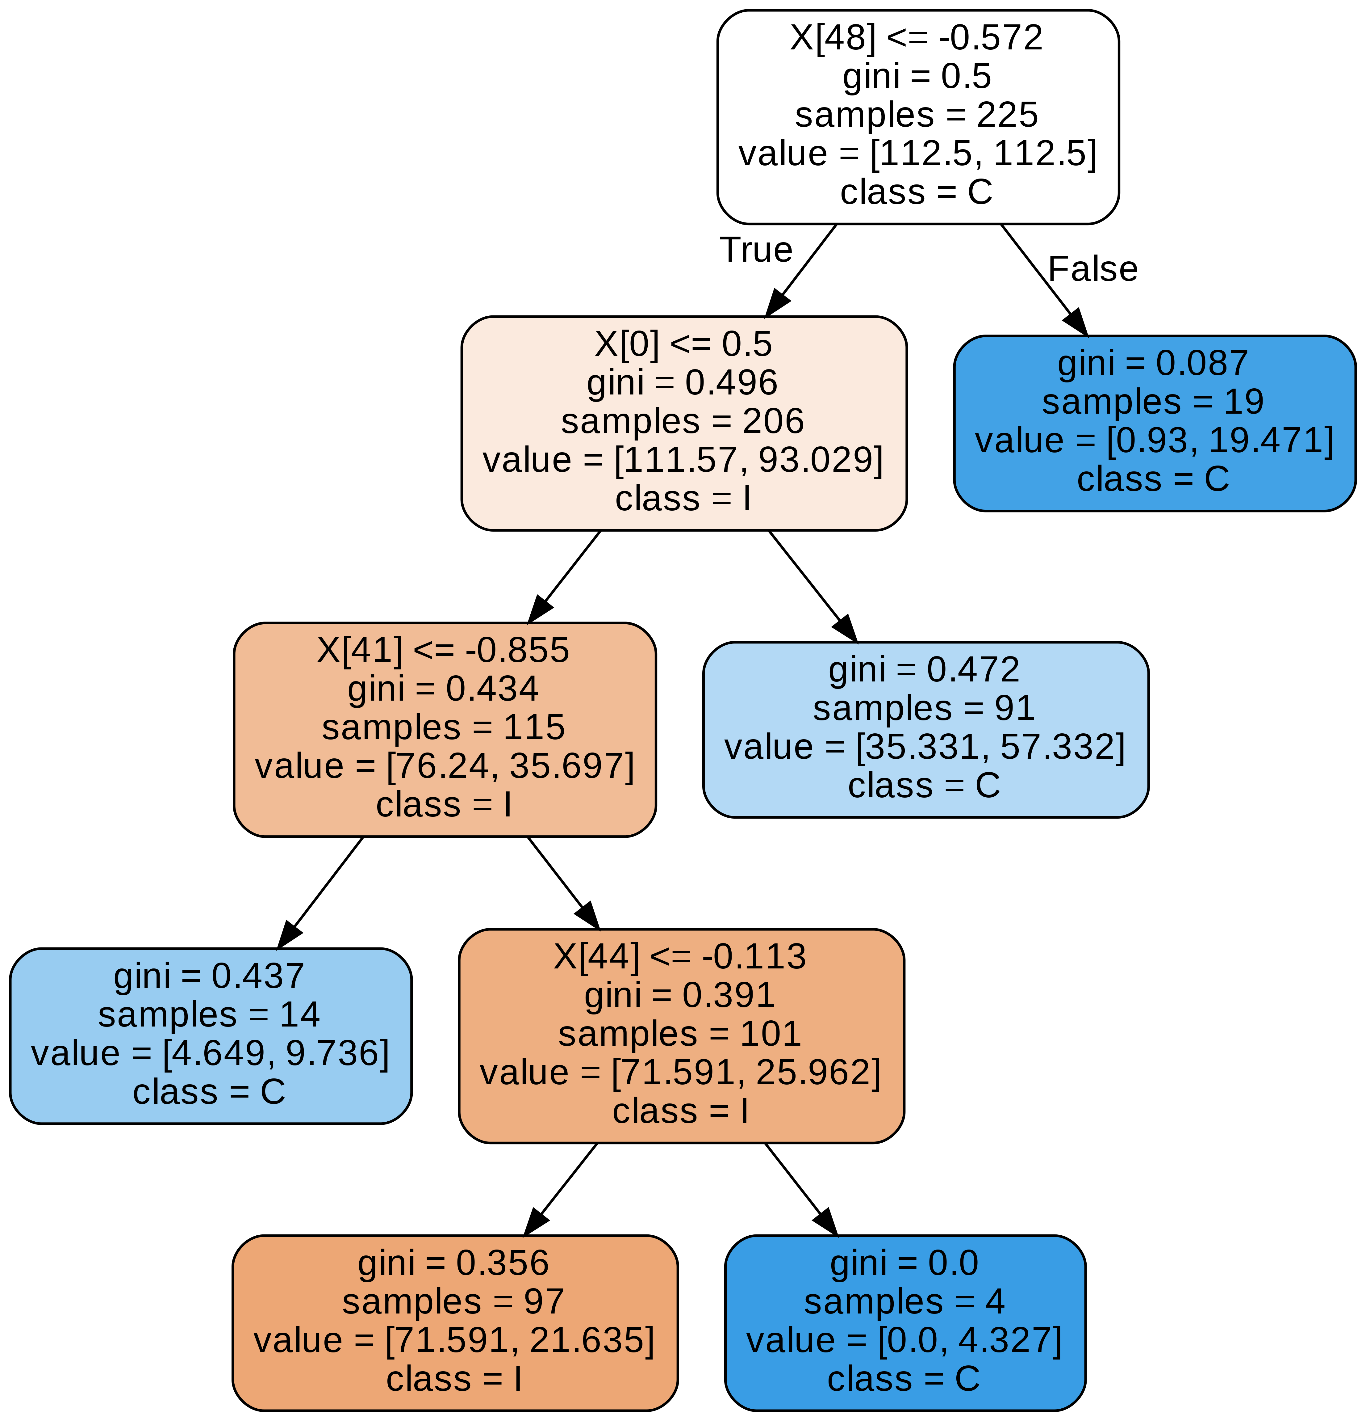
Decision Tree

Slide 16
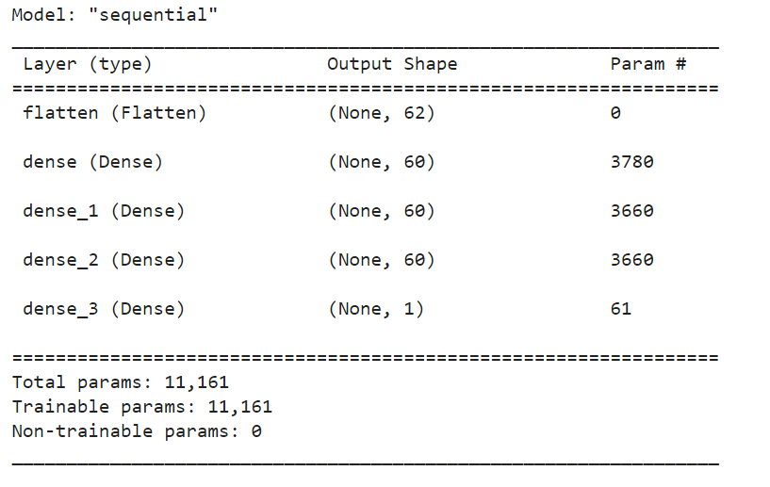
Modelling & Prediction
Deep Neural Network Model: Accuracy – 0.633

Slide 17
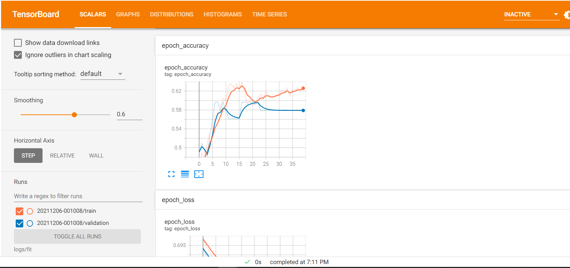
Modelling & Prediction
TensorBoard dashboard has been used to visualize the model performance
Dashboard link: https://tensorboard.dev/experiment/QZbuBkvfQSWL348eGatpeg/

Slide 18
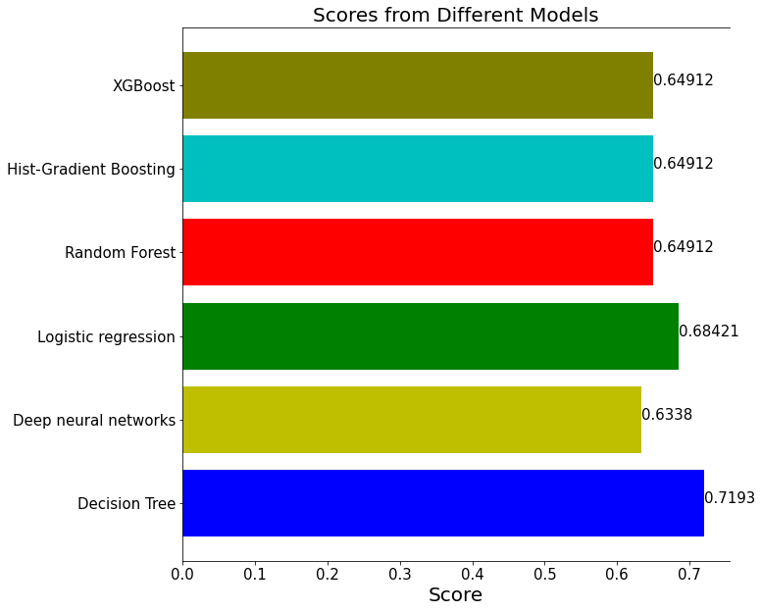
Scores of Models

Slide 19
Conclusion & Future Scope
Conclusion: The Decision Tree Classifier is the best model with an accuracy 0f 0.719 which can be used for ICU bed prediction for COVID19 patients.
Challenges: One of the major challenges of working with health care data is that the sampling rate varies across different type of measurements. For instance, vital signs are sampled more frequently (usually hourly) than blood labs (usually daily).
Future Scope: Web portal integrated using API and can be given to the hospitals where in they can feed the new entry data into the database and the best model after completion will be fed to perform the processing and retrieve the results.

