Slide 1

DoorDash
Design Sprint
Product Manager: Reham Dakhel Almaghathawi
© 2019 Udacity. All rights reserved.

Slide 2
Set the stage
Set the stage for the Design Sprint by framing the problem
© 2019 Udacity. All rights reserved.
Notes:
[ALL PARTICIPATION]

Slide 3

Initial PRD

Slide 4
Understand
Create a shared understanding of the space, problem, and goals
© 2019 Udacity. All rights reserved.
Notes:
[ALL PARTICIPATION]

Slide 5
Routing and delivery
How might we mitigate accidents between robots and pedestrians?
How might we confirm that the robot is at the right address?
How might we teach robots to avoid trouble?
How might we make robots not scary for dogs?
How might we keep vermin away from the robots?
How might we program robots to address delays in deliveries?
How might we make routes more efficient?
How might we teach robots to avoid obstacles?
How might we move robots to a safe place before stopping?
How might we have robots signal distress when something goes wrong?
How might we make our robots tamperproof?
How might we allow robots to detect real-time traffic patterns?
How might we establish preferred routes?
How might we see real-time traffic on the route?
Issues on route
Environmental Factors
Routing

Slide 6
How might we alert operators of need for robot intervention conveniently?
How might we handle edge case issues that may arise?
How might we deal with accidents that might occur?
When things go wrong
How might we share robot progress with consumers?
How might we enable robots to detect missing items in the order during pickup?
How might we confirm that the robot is at the address for user?
How might we overcome technical glitches during a delivery?
How might we ensure food gets delivered without incident?
How might we get food to people quickly when the robot fails?
How might we address a sudden power outage?
How might we keep robots odor free, even when carrying smelly food?
How might we allow users to help us with tracking and feedback?
How might we program robots to address customer returns?
How might we detect when a robot needs help?
How might we build redundancy into our system?
How might we determine when to recharge robot batteries?
How might we anticipate mechanical failures?
How might we alert consumers if their delivery is delayed?
How might we program robots to address order cancellations?
Incident Prevention and Recovery
How might we control robots?
How might we track each robot?
How might we monitor robot progress?
Maintenance and mechanical issues
Delays, Missing Items, and Cancellations
Tracking and Remote Control

Slide 7
Human/Robot Interaction
How might we prepare robot to handle deliveries to persons with disabilities?
How might we enable robots to interpret and speak different languages?
How might we have robots entertain customers at delivery?
How might we give robots a personality?
How might we help robots talk to people?
How might we communicate with humans around the robot?
Deliveries for everyone
How might we change robot’s appearance?
How might we make interacting with robots more fun?
How might we teach users to interact with humans?
How might we teach robots manners?
How might we use robots to make people excited about our brand?
How might we make our robots act like people?
How might we teach empathy to robots?
How might we enable “emotion” modes in robots?
Delight
Communication with people
Human-like

Slide 8
Sprint Focus
Focus | When things go wrong
Slide # | 6
I selected this theme because | Most product managers focus on Functionality when building a robot, but don't pay much attention to other things. such as when things go wrong by Delays, Missing Items, and Cancellations Or Maintenance and mechanical issues, and have sliven for Incident Prevention and Recovery with Tracking and Remote Control So, the main goals here are to help those operations improve to build better robots

Slide 9
Define
With an understanding of the problem space, create focus and align on specific outcomes for the Design Sprint
Notes:
[ALL PARTICIPATION]

Slide 10
DoorDash App for Food Delivery
Robodash
..We offer this service to any user who has an incompleteness, lack of order,
or defect with an order problem by enabling them to choose one of these options.
and with restaurant owners, particularly those who would have their meals delivered by food robots
..There is a significant difference between regular delivery and robot delivery;
it is more responsive and can be available at all times rather than waiting for Dasher to be available at the time,
And furthermore, given the possibility of some errors in the orders placed by the robot, providing a service like this is extremely beneficial
Many users are therefore satisfied and guarantee their right to use our application because it offers you many options in the event of any problem.
..We always said at DoorDash that delivery works at the intersection of a mathematical problem and a human problem.
We always test different ways to make deliveries faster in that spirit. We are aware that innovative technology combined
with the highest levels of DoorDash can help reduce delivery times, increase efficiency, and improve quality,
from machine learning and artificial intelligence to electric bikes.
We started testing robot supply on the platform of DoorDash earlier this year, in addition to other modes of transport such as cars, bikes and scooters.
We are excited about the progress we have made so far, and robot deliveries have already expanded to four US cities
We’ve learned the strengths and weaknesses of these robots, improved operations,
and developed new technology to directly integrate our delivery platform into the robot’s software.
..I have two options for resolving the problem, but it is a refund service that I liked the most
to avoid re-sending a bot and you can repay your wallet money on your app account.
..We plan to launch these services across the United States on August 22, 2021. Please stay tuned and rating us on the app stores.
Published by PM: Reham Dakhel Almaghathawi 25th July 2021

Slide 11
Sketch
Generate tons of ideas, then narrow them down to two in depth solution sketches
Notes:
[ALL PARTICIPATION]

Slide 12
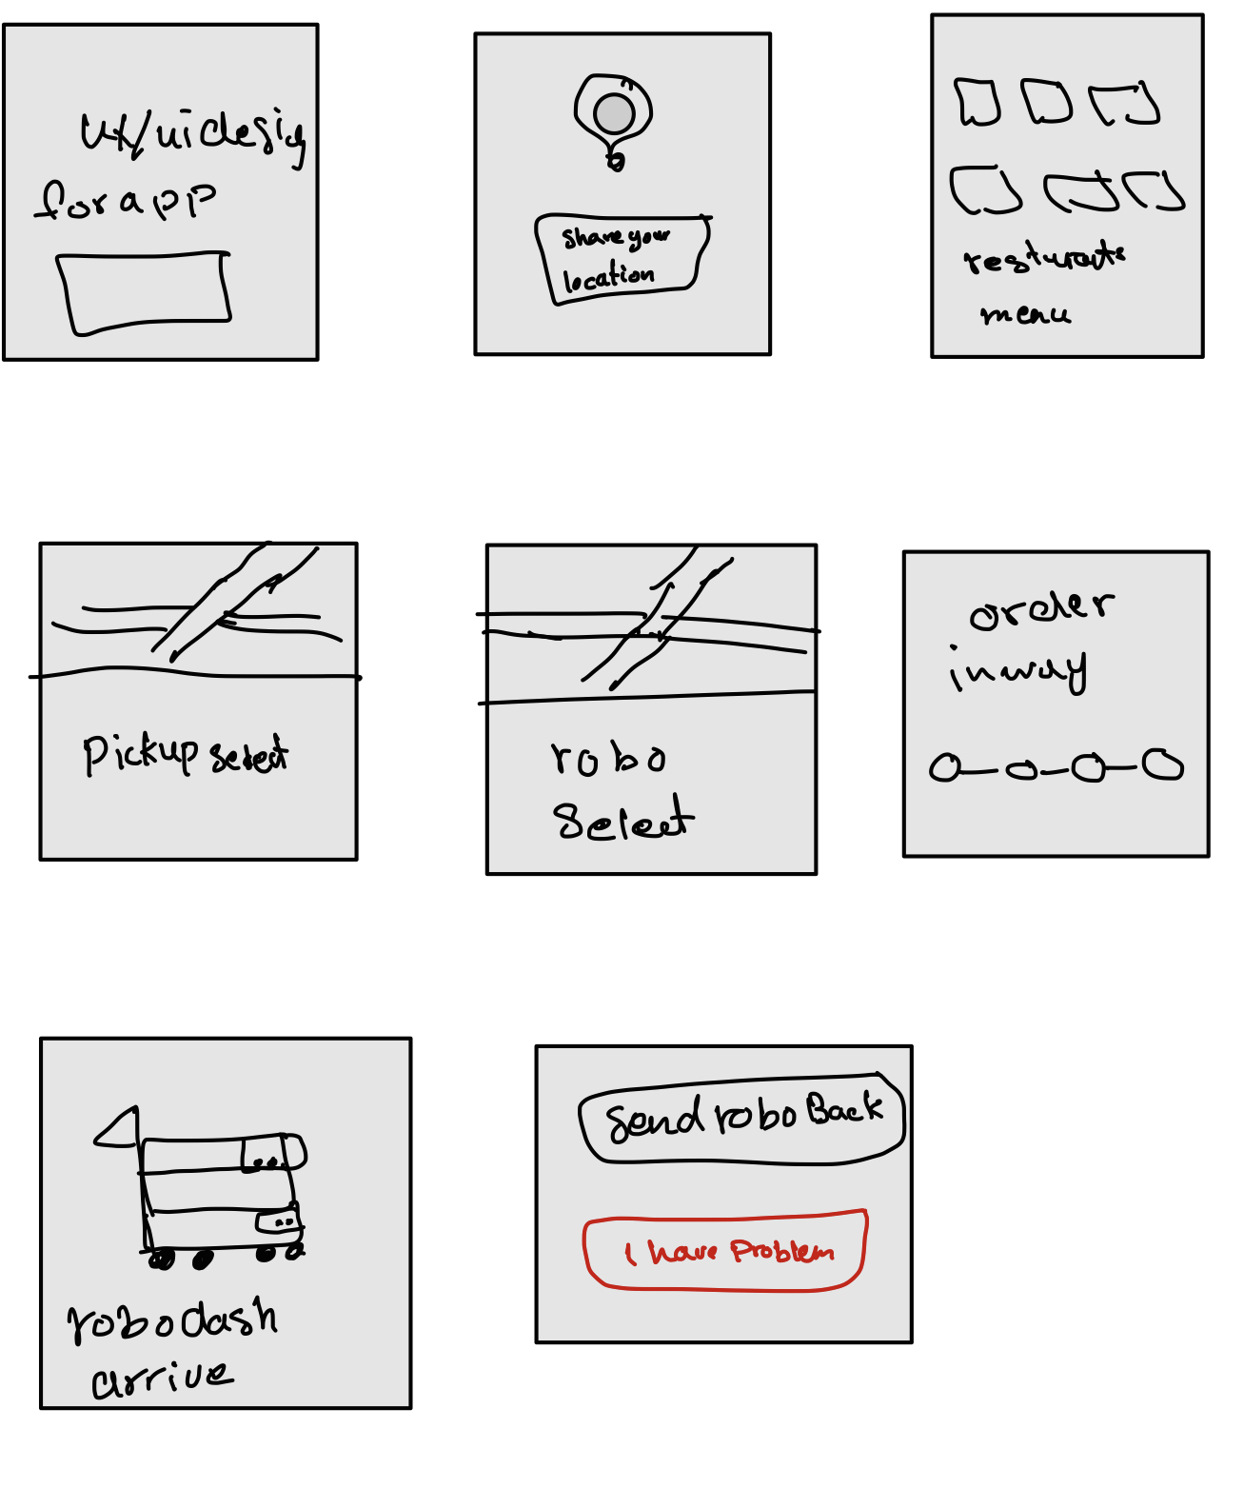
8 Sketches

Slide 13
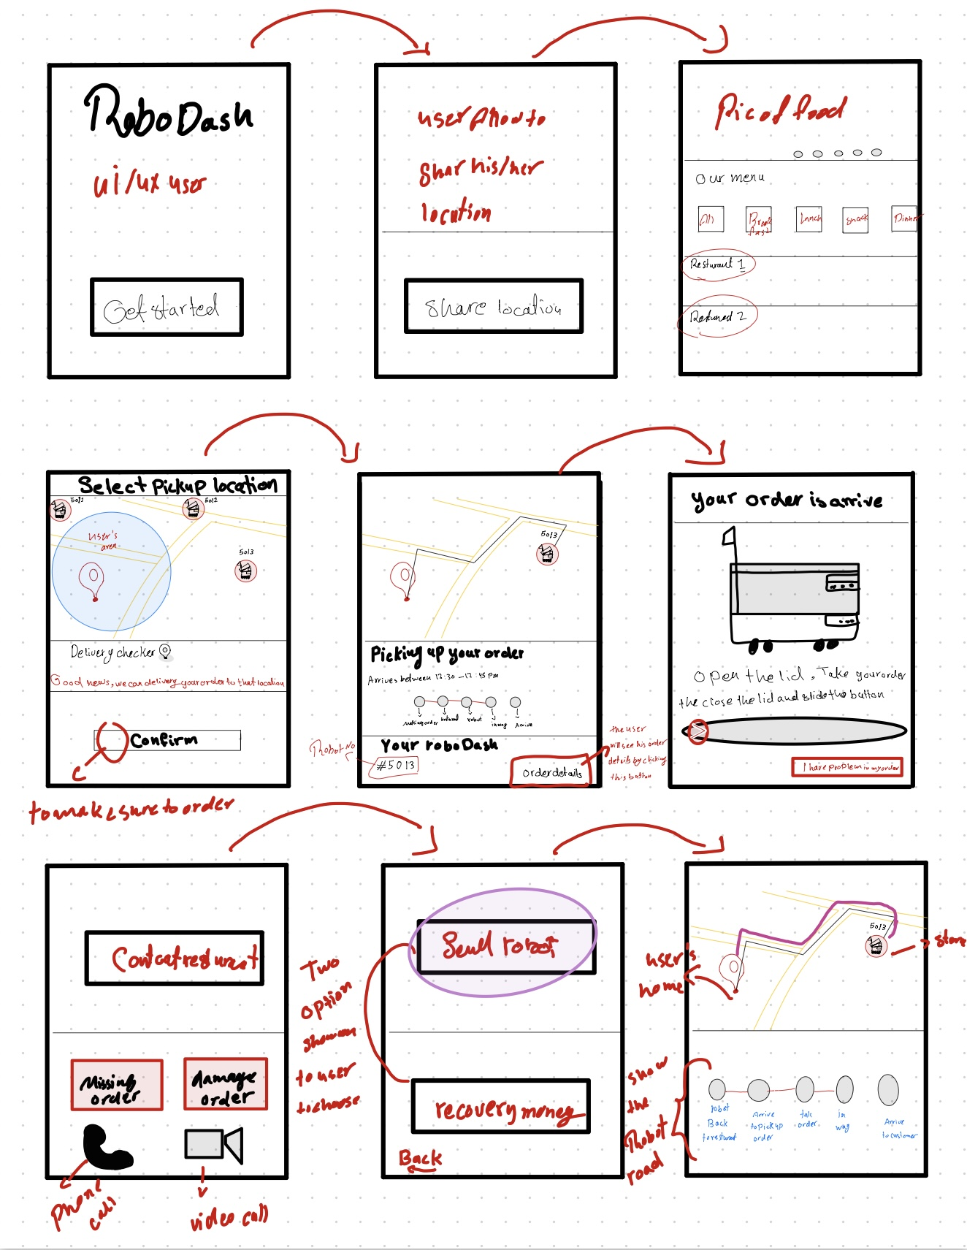
Solution Sketch 1: send robot back
The user first opens the app to search for the desired store, then allows his location to be shared, then adds things to the basket, selects a payment option, and last selects a delivery mode. When the user completes the order, he can wait and monitor it via the map on the screen, and when the order arrives, he will receive a notification. If there are problems with the order, the user sends the robot, and if the order is complete, the user sends the robot. If the order have problem
The user has two choices for solving the order problem on this screen, The robot will automatically return to the shop if the user chooses the first option (Robot sending)

Slide 14
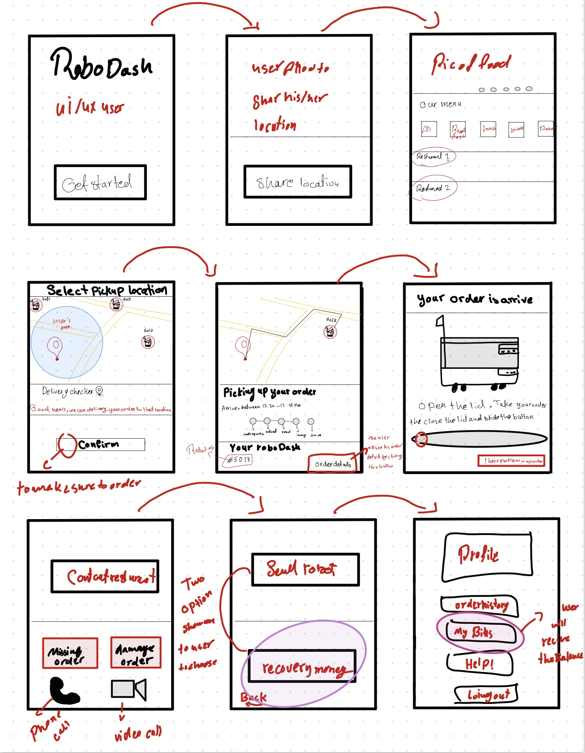
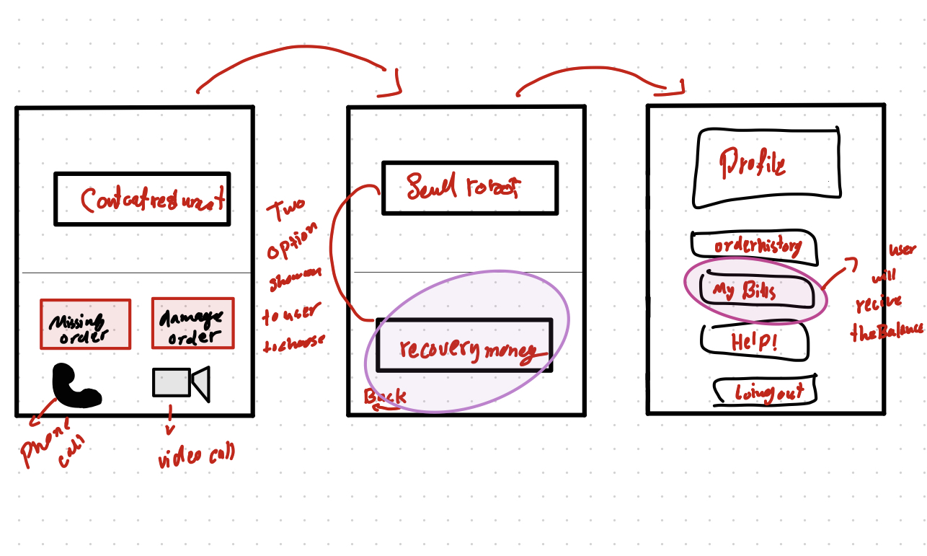
Solution Sketch 2: Recovery money
The user first opens the app to search for the desired store, then allows his location to be shared, then adds items to the basket, selects a payment option, and last selects a delivery mode. When the user completes the order, he can wait and monitor it via the map on the screen, and when the order arrives, he will receive a notification. If there are problems with the order, the user sends the robot, and if the order is complete, the user sends the robot. If the order have problem
The user has two choices for solving the order problem on this screen, If the user selects the second option (recovery money), the funds will be automatically refunded to the wallet to bills in the account.

Slide 15
Decide
Pick the final concept that you develop into a prototype
Notes:
[ALL PARTICIPATION]

Slide 16
Decision
Decision | Missing \damage order and returning robot or refunding money
Rationale | show how the robot handles the missing of the order And How to handle a user's refund

Slide 17
Prototype
Turn your concept into a realistic, interactive prototype that you will use to validate your assumptions and ideas
Notes:
[ALL PARTICIPATION]

Slide 18
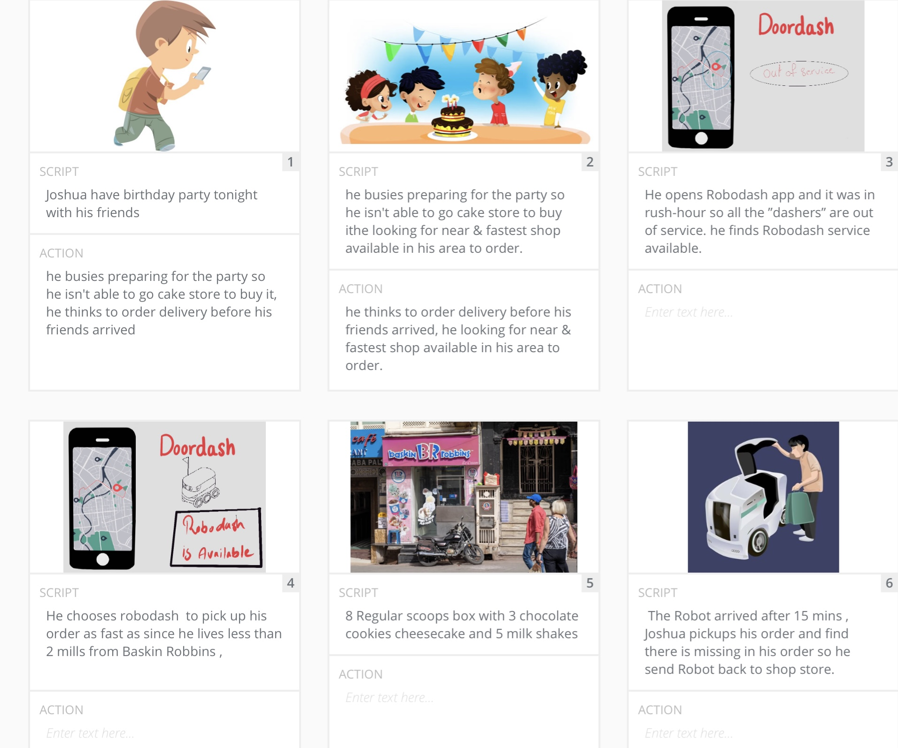
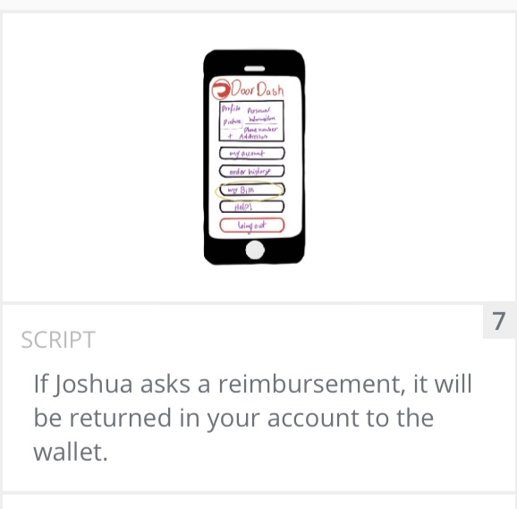

Slide 19

Prototype
Description High level overview of the prototype What does it do? | Show an overview of the app screen and use case for cancellation and missing orders
Assumptions Any assumptions within the prototype | explore how can solution the missing \ cancelling orders the user using two an operation (send the robot back\ recovery money)
Tasks What are the tasks that a user can complete in the prototype? | View profile and can edit it View payments ways Back to home page Click the order button to see robot road "which will show track the order" emergency responses are clickable explore restaurants menu find a near & fast robot in map
Link your prototype

Slide 20
Validate
Users will go through your prototype and provide feedback on your concept. This is also an opportunity to have an engineering feasibility discussion
Notes:
[ALL PARTICIPATION]

Slide 21

User Testing: Participant 1 Key Findings
What worked well | The button layout was appropriate. screen transitions The size of graphs is ideal.
Where participants got stuck | Understanding the significance of each button Recognizing how to interpret graphs Map display and understanding why each one is there
Other observations | The user has numerous options.

Slide 22
User Testing: Participant 2 Key Findings
What worked well | Liked the schedule mood (dark at night/ Light in the day) The color palette, contrast, buttons, and font design all worked well together.
Where participants got stuck | At first glance, understanding graph titles available button alerts you when a service is unavailable
Other observations | Because the user had a missing order experience, he selects the button to send a robot back or refund money.

Slide 23
Iterate
Leverage learnings from your first two user interviews to make changes to your prototype. Then run another round of user interviews.
Notes:
[ALL PARTICIPATION]

Slide 24
Improvements
Improvement #1 | Employment rates for people are should be increased
Rationale | Solve the problem of drivers unavailability
Improvement #2 | Add more options button for payments and delivery method
Rationale | There are two improvements needed : 1. Make payments by Applepay and other new payments way 2. Add notifications when the robot get wrong address

Slide 25
Handoff
© 2019 Udacity. All rights reserved.
Notes:
[ALL PARTICIPATION]

Slide 26
Updated PRD
https://drive.google.com/file/d/1K_yuPII5fzTnSouNxPgN7ibIoiNAmA70/view?usp=sharing

