Slide 1
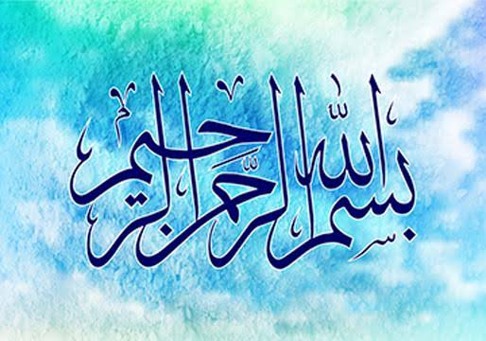

Slide 2
Introduction
Group members:
Noor-ul-haya
Aysha
Rishma
hurrian
Govt Girls high school phuljari

