Slide 1
♫
RevPlay
Music Streaming Application
Spring Boot
Angular
MySQL

Slide 2
Table of Contents
01
Introduction & Objective
05
Security — JWT Flow
02
System Architecture
06
Findings & Observations
03
Methodology
07
Challenges & Learnings
04
Core Features
08
Conclusion

Slide 3
Introduction & Objective
RevPlay is a full-stack music streaming web application built using Spring Boot and Angular, featuring JWT authentication, role-based access, file uploads, and playlist management.
2
Roles
Secure user authentication using JWT tokens
Role-based access — USER and ARTIST roles
Upload, stream songs and manage playlists
RESTful API consumed by Angular SPA
4
Entities
10+
Endpoints

Slide 4
System Architecture
Angular SPA
HTTP Interceptor
Spring Boot API
MySQL Database
Components · Services
→
JWT Token Injection
→
Controllers · JPA
→
Users · Songs · Playlists
User action in Angular triggers an HTTP request
HTTP Interceptor attaches the Bearer JWT token automatically
Spring Security validates the token before reaching the Controller
JPA/Hibernate executes queries against MySQL, response returned as JSON

Slide 5
Methodology
Backend
Frontend
Database
Spring Boot — REST controllers, Service layer
Spring Security — JWT filter chain, RBAC
JPA/Hibernate — ORM with MySQL
Multipart upload for audio & images
Angular standalone components + Router
HTTP Interceptor for JWT attachment
ChangeDetectorRef for reactive updates
Bootstrap for responsive layout
4 tables: User, Song, Playlist, PlaylistSong
Foreign keys for referential integrity
play_count column per song
JPA auto DDL for schema management

Slide 6
Core Features
🔐 Auth & Roles
🎵 Song Management
📋 Playlists
JWT login & registration
USER and ARTIST roles
Conditional UI per role
Upload audio + cover image
Stream via HTML5 audio player
Play count tracked in DB
Create & delete playlists
Add / remove songs
User-scoped ownership
🛡️ Secure API
🎨 Angular UI
🗄️ Data Layer
Spring Security filter chain
Role-secured endpoints
@PreAuthorize on methods
Standalone components + Router
Services for API calls
Reactive ChangeDetectorRef
MySQL relational schema
JPA/Hibernate ORM
FK-enforced relationships

Slide 7
Security — JWT Authentication Flow
1
→
2
→
3
→
4
→
5
→
6
Login
Token Issued
Stored
Interceptor
Validated
Access
POST /auth/login
Signed JWT returned
Saved in localStorage
Bearer token attached
Spring checks signature
Controller responds
JWT Structure
Spring Security
Header: Algorithm (HS256)
Payload: userId, role, expiry
Signature: HMAC-SHA256
Stateless — no server sessions
JwtAuthFilter before auth chain
Public: /auth/register, /auth/login

Slide 8
Findings & Observations
🔐 Authentication
🎵 Streaming
JWT correctly secures all protected routes
Role checks block unauthorized ARTIST actions
Token expiry triggers Angular logout
HTML5 audio streams songs via Spring endpoints
Multipart upload handles audio + images reliably
Cover images render dynamically on song cards
📋 Playlists
📊 Play Count
CRUD operations work with user-scoped ownership
Join table prevents duplicate song additions
Removals cascade without orphan records
play_count increments reliably on each stream
Enables analytics on most-played songs
Persisted in DB across sessions

Slide 9
Challenges Faced & Key Learnings
Challenges
Key Learnings
JWT wiring between Angular interceptor and Spring Security headers
CORS setup between Angular (4200) and Spring Boot (8080)
Multipart upload — file size limits and content-type handling
Conditional UI rendering based on decoded JWT role
Stateless JWT scales better than server-side sessions
HTTP Interceptor is the cleanest pattern for auth headers
Spring Security filter chain gives fine-grained control
Service layer separation improves testability and clarity
Join tables are the right model for many-to-many relations

Slide 10
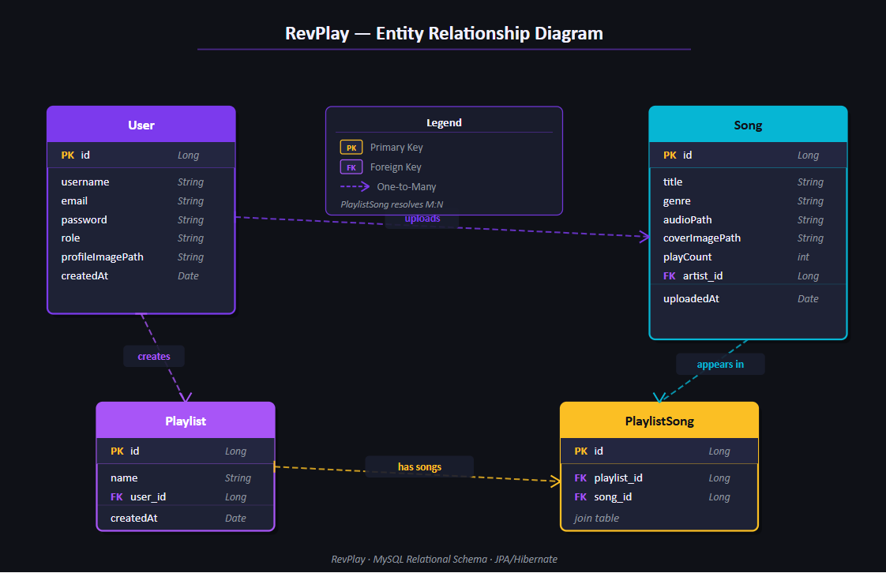

Slide 11
Conclusion
RevPlay demonstrates a production-ready full-stack application covering authentication, role-based access, file handling, streaming, and playlist management.
What was achieved
Future Scope
JWT-secured RESTful API with Spring Boot
Role-based UI and endpoint protection
Full CRUD for songs and playlists
Angular SPA with HTTP Interceptor pattern
Real-time notifications via WebSockets
Cloud storage (AWS S3) for media files
Search and filter using Elasticsearch
Like, comment and follow features
Thank You

