Slide 1
PyGPT
A Python code-completion assistant, trained from scratch
Every stage built and measured by hand: data → tokenizer → model → training → evaluation → deployment
Rehan · Machine Learning · Bennett University · October 2026

Slide 2
The problem and the end goal
• Task: given the start of a Python function, predict what comes next — next-token prediction is code completion
• Goal: a working assistant powered by a model we trained ourselves — not an API call, not a fine-tune
• “Working” means three things:
  – a live demo that completes code in seconds
  – measured results against baselines (perplexity, syntactic validity, functional tests)
  – a public repo whose structure matches the design in this deck
• Constraints: 3 days, free compute only (Kaggle 2× T4, 30 GPU-h/week), solo

Slide 3
Existing systems — and the gap
Criterion 1
System | Year | Params | Open? | Relevance
GPT-2 (Radford et al.) | 2019 | 124M–1.5B | Yes | Architecture we reuse; English-only → our baseline
Codex / Copilot (Chen et al.) | 2021 | 12B | No | Defined the task and pass@k evaluation
CodeParrot (HF) | 2021 | 110M / 1.5B | Yes | Closest prior work: same data family, 50–100× our compute
SantaCoder / StarCoder (BigCode) | 2022–23 | 1.1B / 15.5B | Yes | License-filtered data pipeline we follow in spirit
Code Llama (Meta) | 2023 | 7B–70B | Yes | Open state of the art
PyGPT (ours) | 2026 | 110.5M | Yes | Complete, reproducible, measured pipeline at student scale
Gap: everything above is closed-source or needs 100–10,000× a student's compute. None of it teaches how a code LM is built. PyGPT's contribution is honest numbers on what ~7 GPU-hours buys — with every stage visible.

Slide 4
Feasibility: do the math before burning GPU hours
Criterion 1
• Scaling-law estimate: FLOPs ≈ 6·N·D = 6 × 1.1e8 × 8e8 ≈ 5.3e17 → ~6 h on 2× T4 at 20–30% utilization
• Measured on the day: 34,000 tok/s (fp16, DDP) → 799.5M tokens in 6 h 45 min — one full epoch
• Chinchilla-optimal for 110M params ≈ 2.2B tokens → we are ~3× under-trained by design (limitations slide)
• The free-tier landscape is a moving target — verify, don't assume:
  – AWS: GPU quota denied twice (new account) → dead end
  – Hugging Face: free Gradio Spaces discontinued mid-project (402) → laptop demo instead
  – Kaggle: 30 GPU-h/week free — total project spend 7.3 h, leaving 22.7 h reserve
• Session-death insurance: checkpoint every 250 steps + tested kill-and-resume before the long run

Slide 5
Objectives — all measurable, all measured
Criterion 2
# | Objective | Target | Achieved
O1 | GPT-2-class model from scratch in PyTorch | init loss ≈ ln(32768)=10.4; causal-mask test | 10.42 ✓ · mask test ✓ · 110.5M params ✓
O2 | Clean Python pretraining corpus | ≥800M train tokens + held-out val | 800M + 5M (codeparrot-clean) ✓
O3 | Useful loss on free GPUs | val loss < 1.8 in ≤ 10 GPU-h | 1.685 in 6.75 h ✓ (ppl 5.24)
O4 | Quantitative eval vs baselines | ppl, AST-validity, pass@k | 59% AST-valid vs GPT-2 10% ✓ · pass@10 = 0 (honest)
O5 | Deployed completion app | 30-token prompt answered < 15 s | 2.4 s for 96 tokens on laptop CPU ✓
O6 | Design ↔ implementation sync | map table + public repo | slide 11 + github.com/Rehan123-bash/pygpt ✓
O7 | (stretch) VS Code extension | 60-s video | future work

Slide 6
Methodology: the pipeline
Criterion 2 — every box is a file in the repo
HF Hub: codeparrot-clean (streamed, never fully downloaded)
│ filters: size, line length, %alpha, auto-generated
▼
data/prepare_data.py ── BPE tokenize (32k code vocab) ── <|endoftext|> joins files
▼
train.bin / val.bin (uint16 memmap — vocab 32,768 fits exactly)
▼
train.py AdamW · warmup+cosine · fp16+GradScaler · grad-accum · DDP on 2× T4
│ checkpoints every 250 steps · resume · CSV log
▼
ckpt_best.pt ──► eval.py val ppl · AST-validity · pass@k · baselines
▼
export.py fp16 weights-only (212 MB) ──► app/app.py (Gradio, runs on a laptop CPU)

Slide 7
Architecture: GPT-2 Small, written from scratch
Criteria 3+4 — file and class names on every box
tokens ──► wte (32768×768) + wpe (512×768) model.py: GPT
▼
12 × Block: x = x + CausalSelfAttention(LN(x)) model.py: Block, CausalSelfAttention
x = x + MLP(LN(x)) model.py: MLP (768 → 3072 → 768, GELU)
▼
LayerNorm ──► lm_head (tied to wte) weight tying: −25M params
• Parameters: embeddings 25.6M + 12 blocks × 7.1M ≈ 110.5M (“124M-class”: GPT-2's 50k English vocab vs our 32k code vocab)
• Why each choice: pre-LN → stable at 12 layers · SDPA kernel → memory-efficient attention on T4 · ctx 512 → 1.4× faster, functions fit
• Generation: temperature / top-k / nucleus sampling + per-layer KV cache (each step feeds 1 token, not the whole sequence)

Slide 8
Data, tokenizer, training recipe — each row has a why
Criterion 3
Choice | Value | Why
Data | codeparrot-clean, 800M tokens streamed | pre-deduplicated Python; streaming avoids a 50 GB download
Tokenizer | codeparrot BPE, vocab 32,768 | code-trained: indentation + identifiers are single tokens (~35% fewer than GPT-2's)
Optimizer | AdamW β=(0.9, 0.95), wd 0.1 on matrices only | decoupled decay regularizes without fighting Adam
LR schedule | warmup 200 → 6e-4 → cosine → 6e-5 | warmup avoids early divergence; low final LR sharpens the minimum
Precision | fp16 autocast + GradScaler | 2–3× throughput on T4 tensor cores; scaler prevents underflow
Batching | 16 × 512 × 2 GPUs × grad-accum 8 = 131k tok/step | large effective batch within 16 GB
Multi-GPU | DistributedDataParallel (torchrun) | near-linear scaling on the 2 free T4s
Safety | grad clip 1.0 · ckpt/250 steps · tested resume | fp16 spikes; Kaggle 12 h session cap

Slide 9
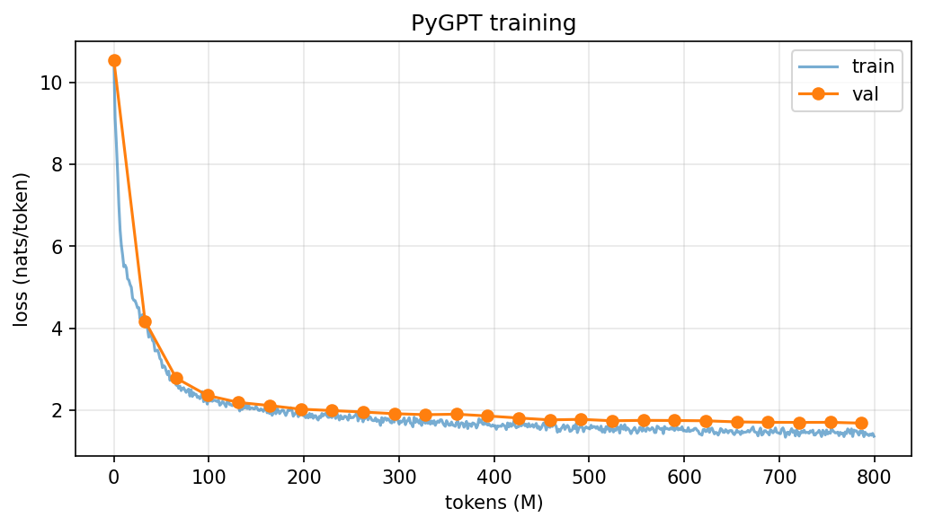
Results — against real baselines
Criteria 2+3 · all numbers in results/metrics.json
Metric | Random init | GPT-2 124M | PyGPT (ours)
Val perplexity | 38,487 | n/a (different vocab) | 5.24
AST-valid samples | 0% | 10% | 59%
pass@1 (5 tasks) | — | 0 | 0
pass@10 (5 tasks) | — | 0 | 0
Loss 10.4 → 1.685 over one epoch (6.75 h).
59% of completions parse as Python — 6× vanilla GPT-2. But 0/5 toy tasks pass hidden tests: 7 GPU-hours buys plausible, not correct. CodeParrot used 50–100× more compute.
Best sample: read_json → idiomatic `with open(path) as f: return json.load(f)` — one missing import from passing.

Slide 10
Live demo
Criterion 4
• python app/app.py — runs offline on this laptop, ~2.4 s per completion (KV cache)
• Prompt A: def fibonacci(n) + docstring — read what it does, not what we hope it does
• Prompt B: NumPy normalize() — has it learned library idioms?
• Prompt C: class Stack with __init__ — multi-method structure
• Same prompt at temperature 0.2 vs 0.9 — sampling in one sentence
• Prompt F: solve_sudoku() — the honest failure case
  – backups, in order: Kaggle public share link · recorded video · screenshots

Slide 11
Design ↔ implementation: nothing on these slides is vaporware
Criterion 4
Design component | File · symbol | Verified by
Data filtering + tokenization | data/prepare_data.py · keep_file, tokenize_stream | token counts re-counted from disk; decoded sample inspected
Causal self-attention | model.py · CausalSelfAttention | test: changing token t+1 never changes logits ≤ t
Full model + init | model.py · GPT | init loss 10.42 ≈ ln(V); overfits one batch to < 0.1; 110.5M params
Training loop | train.py · get_lr, estimate_loss, save_ckpt | smoke run · kill + --resume continues · DDP on 2 GPUs · time-limit exit
Sampling + KV cache | model.py · generate | cached output bit-identical to uncached (sanity check 5)
Evaluation | eval.py · val_loss, ast_validity, functional_test | results/metrics.json — the numbers on slide 9
Export + demo | export.py, app/app.py | fp16 round-trip greedy-identical; this demo
Public repo: github.com/Rehan123-bash/pygpt — 6 sanity checks gate every training run

Slide 12
Limitations and future work
Criterion 1 — knowing the boundary is part of the result
• Under-trained ~3× vs Chinchilla-optimal (0.8B of ~2.2B tokens) — loss was still falling when we stopped
• Completion ≠ correctness: pass@10 = 0 on toy tasks; it autocompletes plausibly, it does not reason
• 512-token context — function-level, not file-level, completion
• No instruction tuning: “write a function that…” prompts will not work
• Future work:
  – longer training — 22 unused free GPU-hours per week were left on the table
  – train our own tokenizer · fill-in-the-middle objective · VS Code inline-completion extension (backend already exists)

Slide 13
References
• Vaswani et al. 2017 — Attention Is All You Need
• Radford et al. 2019 — Language Models are Unsupervised Multitask Learners (GPT-2)
• Chen et al. 2021 — Evaluating LLMs Trained on Code (Codex, HumanEval, pass@k)
• Tunstall, von Werra, Wolf 2022 — NLP with Transformers, ch. 10 (CodeParrot)
• Kocetkov et al. 2022 — The Stack · Li et al. 2023 — StarCoder
• Rozière et al. 2023 — Code Llama
• Kaplan et al. 2020 — Scaling Laws · Hoffmann et al. 2022 — Chinchilla
• Sennrich et al. 2016 — BPE · Press & Wolf 2017 — Weight Tying
• Loshchilov & Hutter 2019 — AdamW · Micikevicius et al. 2018 — Mixed Precision
• Holtzman et al. 2020 — The Curious Case of Neural Text Degeneration (nucleus sampling)
• Karpathy — nanoGPT (reference implementation pattern)

