Slide 1
Data Encryption and Security
Engr. Ayesha Arshad

Slide 2

Motivation
An asset is anything of value.
Digital information is an asset that has a value, hence it needs to be secured from attacks.
Not only should information be secured when it is stored in computers, there should also be ways to maintain security when transmitted from one computer to another.

Slide 3
Cyber Security Incidents
2018, Marriott International, data of approximately 500 million customers stolen.
2016, Uber, data of 57 million users and 600,000 drivers exposed.
2015, Ukraine Power Grid, 30 substations switched off and about 230 thousand people left without electricity for 1 to 6 hours.
2010, Iran Nuclear Program, Stuxnet malware designed to target Siemens SCADA systems, destroying an estimated 984 uranium enrichment centrifuges.
In 2016, 758 Million malicious attacks occurred (KasperskyLab). On average, an attack launched every 40 seconds!

Slide 4
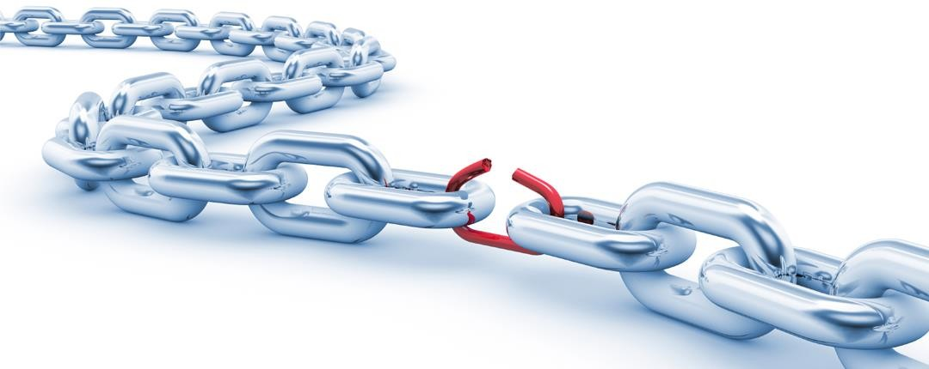
Key Terminologies
The term “security” is used in the sense of minimizing the vulnerabilities of assets and resources.
Vulnerability: any weakness that could be exploited to violate a system or the information it contains.

Slide 5
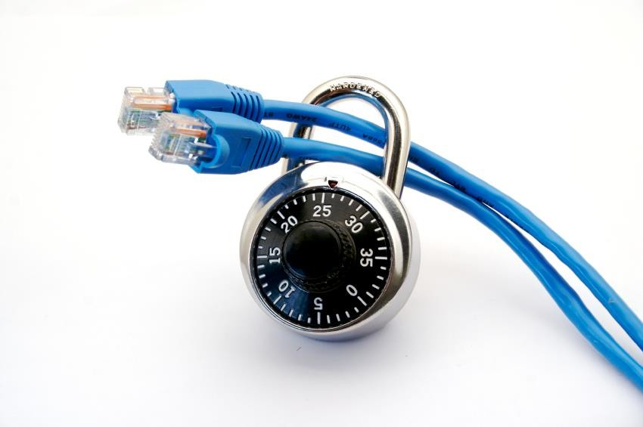
Key Terminologies (Cont.)
Network and Internet Security: measures to deter, prevent, detect, and correct security violations that involve the transmission of information.

Slide 6
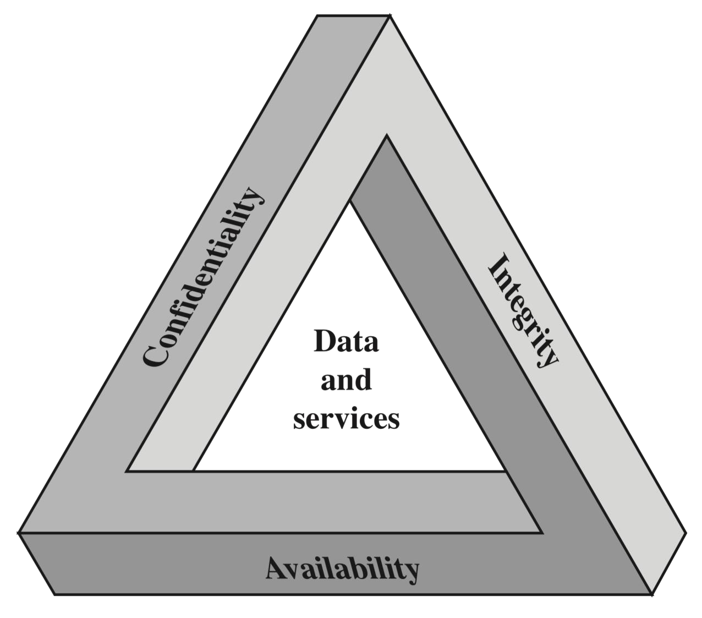
Security Goals
There are three well-established major security goals for both data and for information and computing services (referred to as CIA Triad):
Confidentiality
Integrity
Availability

Slide 7
Security Goals (Cont.)
Confidentiality: maintaining authorized restriction on information access and disclosure.
Integrity: guarding again improper information, modification or destruction, including ensuring information nonrepudiation and authenticity.
Availability: ensuring timely and reliable access to entities when available.

Slide 8


Security Goals (Cont.)
Additional requirements for security goals are:
Authenticity: the property of being genuine and to be verified and trusted; hence confidence in the validity of a transmission, a message, or message originator.
Accountability: the requirement for actions so an entity can be uniquely traceable.

Slide 9
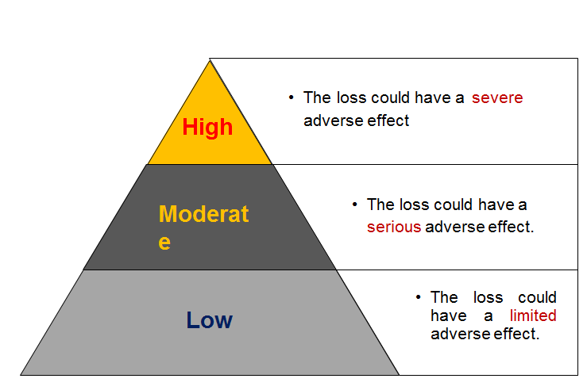
Breach of Security
Levels of Impact on organizational operations, organizational assets, or on individuals.

Slide 10
Breach of Security (Cont.)
Example of High impact: US Northeast blackout (2003)
Cause: a software defect in a control room.
Restoration: some customers after 6 hours, some after 2 days, some remote places after nearly a week.
Consequences (among other):
45M people in 8 US states
10M people in Canada
Healthcare facilities experienced $100M lost revenue
6 hospitals bankrupt one year after

Slide 11
Security Attacks
Threat: a possible danger that might exploit a vulnerability resulting into a breach in security and causing harm.
Security attack: an assault on system security that derives from an intelligent threat, which is a deliberate attempt to evade security services and violate the security policy of a system.
A way of classifying security attacks is in terms of:
Passive attacks
Active attacks

Slide 12
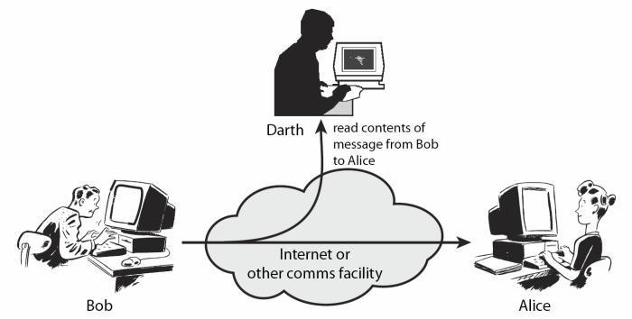
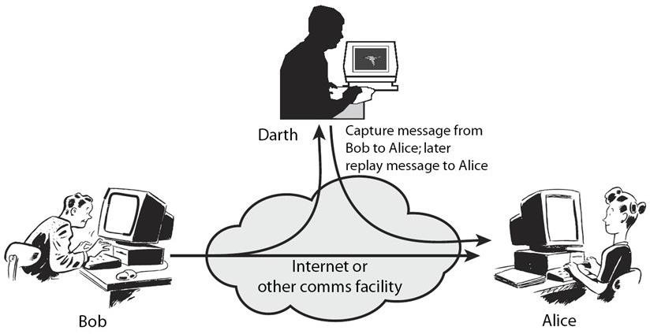
Security Attacks (Cont.)
Passive attack: an attack that attempts to learn or make use of information from the system but does not affect system resources.
Active attack: an attack that attempts to alter system resources or effects their operation.

Slide 13

Passive Attack
Passive attack (Sometimes referred to as “tapping or snooping”) are in the nature of eavesdropping on transmissions.
In passive attack, the attacker cannot interact with any of the parties involved, but attempts to break the system solely based upon observed data.
The goal of the opponent is to obtain information that is being transmitted.
Two main types within passive attacks are:
Release of message contents
Traffic analysis

Slide 14
Passive Attack (Cont.)
Q) Passive attacks are very difficult to detect, why?
A) Typically, the message traffic is sent and received in an apparently normal fashion, and neither the sender nor receiver is aware that a third party has read the messages or observed the traffic pattern. Hence, passive attacks do not involve any alteration of data.
Solution:
It is feasible to prevent the success of such attacks, usually by means of encryption. Thus, the emphasis in dealing with passive attacks is on prevention rather than detection.

Slide 15

Active Attack
Active attacks involve some modification of data stream or creation of a false stream.
Active attacks can be subdivided into four types:
Masquerade (also know as spoofing)
Replay
Modification
Denial of service (DoS)

Slide 16
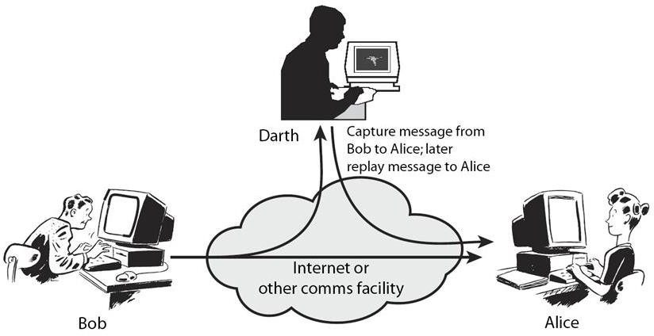
Active Attack (Cont.)
A masquerade or spoofing takes place when an attacker impersonates someone else (path 2 is active).
Replay involves the passive capture of a data unit and its subsequent retransmission to produce an unauthorized effect (paths 1, 2, and 3 are active).

Slide 17
Active Attack (Cont.)
Modification means that some portion of a legitimate message is altered, or that message is delayed or reordered, to produce an unauthorized effect (paths 1 and 2 are active).
The denial of service prevents the normal use or management of a system by slowing them down or totally interrupting the service (path 3 is active).

Slide 18
Active Attack (Cont.)
Q) It is difficult to prevent active attacks absolutely, why?
A) Because of the wide variety of potential physical, software, and network vulnerabilities.
Solution:
The goal is to detect active attacks and to recover from any disruption or delays caused by them. If the detection has a deterrent effect, it may also contribute to prevention.

Slide 19

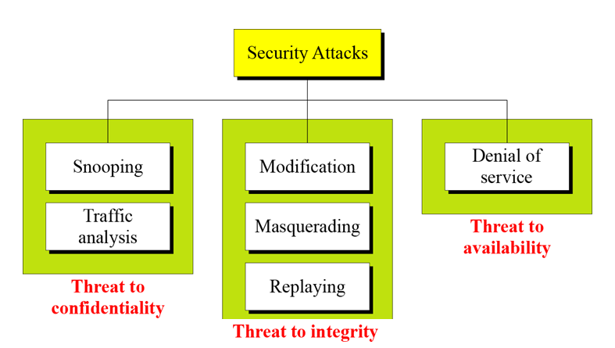
Attack on CIA Triad
Taxonomy of attacks with relation to security goals

Slide 20
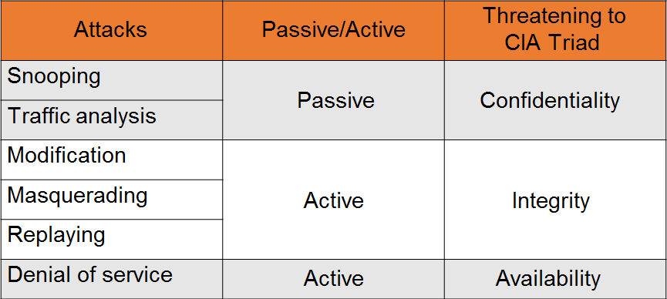
Attack on CIA Triad (Cont.)

Slide 21

Security Services
Security services implement security policies.
Security service is provided by a protocol layer of communicating systems.
X.800 divides these services into five categories:
Authentication
Access control
Data confidentiality
Data integrity
Non-repudiation

Slide 22

Security Services: Nonrepudiation
Prevents either sender or receiver from denying a transmitted message.
When a message is sent, the receiver can prove that the alleged sender in fact sent the message.
When a message is received, the sender can prove that the alleged receiver in fact received the message.

Slide 23
Security Mechanisms
Security policies are implemented by security mechanisms.
The mechanisms are divided into:
Those implemented in a specific protocol layer
Those that are not specific to any particular protocol layer or security service.

Slide 24
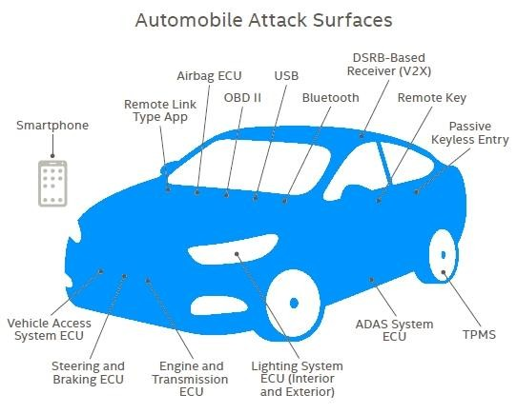
Attack Surfaces
Attack surface: the sum of the different points that are reachable and exploitable vulnerabilities in a system.
Examples: open ports, interfaces, SQL and web forms, code that processes incoming data and social engineering.
Attack surfaces can be categorized as:
Network attack surface
Software attack surface
Human attack surface

Slide 25
Attack Surfaces (Cont.)
Network attack surface refers to vulnerabilities over a network, including network protocol vulnerabilities (can be used for a DoS attack) and disruption of communications links and various forms of intruder attacks.
Software attack surface refers to vulnerabilities in application, utility or operating system code. A particular focus in this category is Web server software.
Human attack surface refers to vulnerabilities created by personnel or outsiders, such as social engineering, human error and trusted insiders.

Slide 26
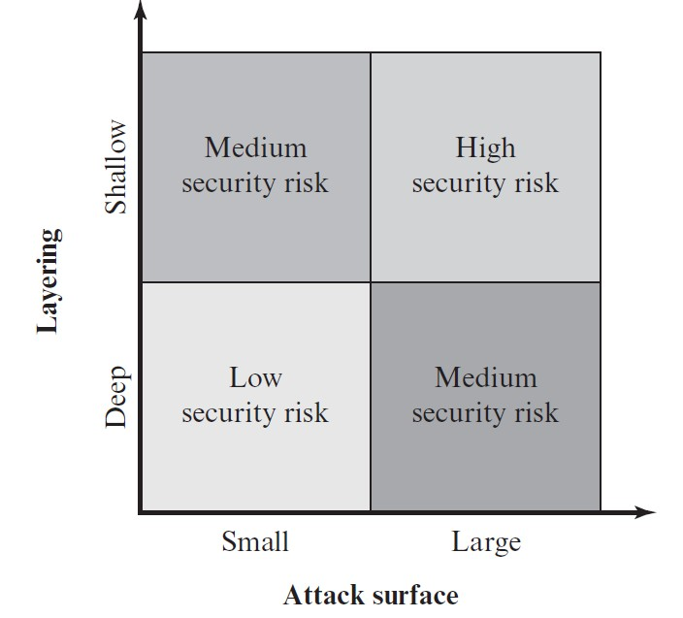
Attack Surfaces (Cont.)
Keep the attack surface as small as possible is a basic security measure.
Use of layering (i.e. defense in depth) with attack surface reduction complements each other in mitigating security risk.

Slide 27
Attack Surfaces (Cont.)
Benefits of Attack Surface Analysis:
Assessing the scale and severity of threats to a system.
Make developers and security analyst aware of where security mechanism are required.
Designers may be able to find ways to make the attack surface smaller, hence making the task of attacker more difficult.
Provides guidance on setting priorities for testing, strengthening security and modifying services or applications.

Slide 28
Thank You!

