Slide 1
<Topic:Static Keyword in Java>
<Batch-LG :AJA 185>
<Group 4>
<Participant Emp ID:1190848
Name:Rehan Raza>
Copyright © 2016 TATA Consultancy Services Limited
TCS INTERNAl

Slide 2
Introduction
1.In Java it is possible to declare methods and variables to belong to a class rather than an object. This is done by declaring them to be static.
2.The static keyword in java is used for memory management mainly.
3.The static keyword is used when a member variable of a class has to be shared between all the instances of the class.
4.When a class is loaded by the virtual machine all the static variables and methods are available for use.
5.main method is static , since it must be accessible for an application to run , before any instantiation takes place.
6.Static methods, which have the static modifier in their declarations, should be invoked with the class name, without the need for creating an instance of the class, as in
ClassName.methodName(args)

Slide 3
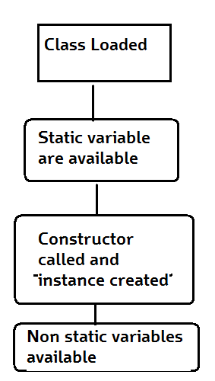
How static works in Java
Basic Steps of how objects are created
1.Class is loaded by JVM.
2.Static variable and methods are loaded and initialized and available for use.
3.Constructor is called to instantiate the non static variables
Non static variables and methods are now available.
As all the non static variable are available only after the constructor is called, there is a restriction on using non static variable in static methods.
Java static block
static Method
static block
class A2{
static{System.out.println("static block is invoked");}
public static void main(String args[]){
System.out.println("Hello main");
}
}
class Calculate{
static int cube(int x){
return x*x*x;
}
public static void main(String args[]){
int result=Calculate.cube(5);
System.out.println(result);
}
}

Slide 4
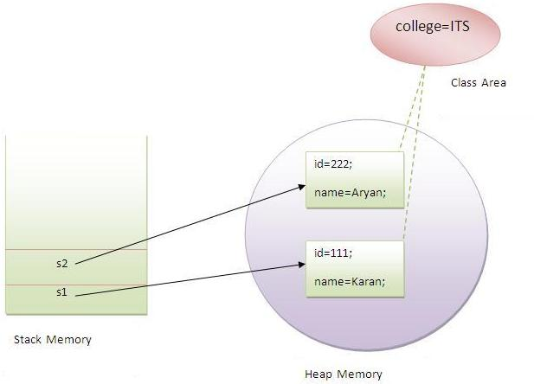
static Variable and Static Method in Java
class A{
int a=40;
public static void main(String args[]){
System.out.println(a);
}
}
A static method can not access a dynamic variable.
A static method can not call a dynamic method.
static Variable
class Student8{
int rollno;
String name;
static String college ="ITS";
Student8(int r,String n){
rollno = r;
name = n;
}
void display (){System.out.println(rollno+" "+name+" "+college);}
public static void main(String args[]){
Student8 s1 = new Student8(111,"Karan");
Student8 s2 = new Student8(222,"Aryan");
s1.display();
s2.display();
}
}

Slide 5
Thank You
Copyright © 2016 TATA Consultancy Services Limited
TCS CONFIDENTIAL

