Slide 1


Excel Number Functions
“ Understanding the Power of Excel Number Functions ”
PRESENTED BY PATHAN REHAN

Slide 2
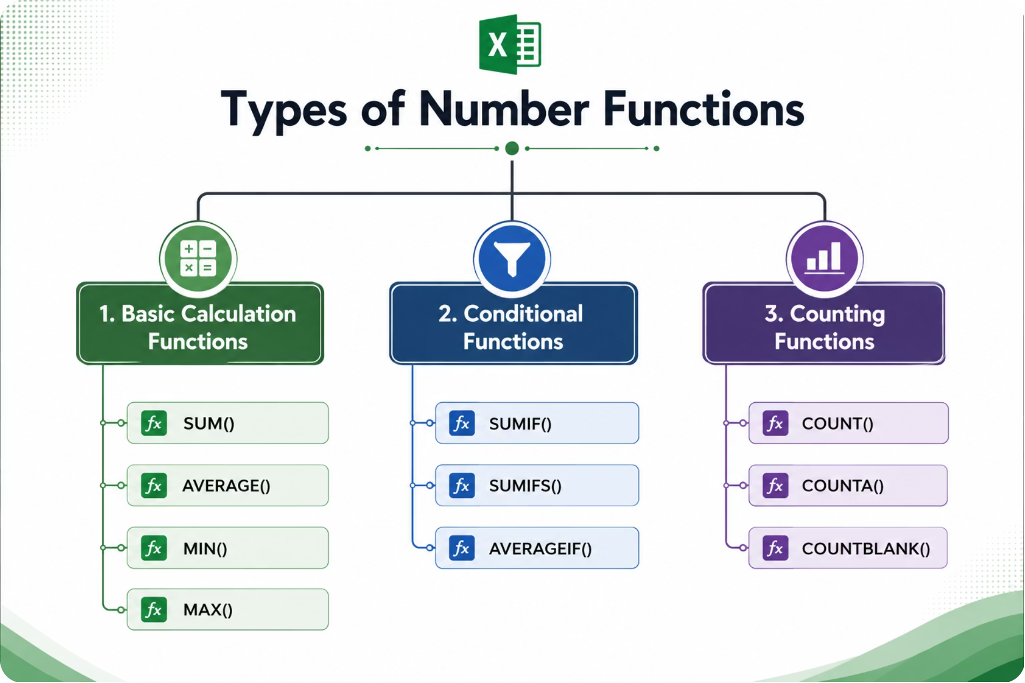
Classification of Excel Number Functions
✅
Number Functions Categories
✔ Basic Calculation Functions
Perform mathematical calculations.
✔ Conditional Functions
Calculate results based on specific conditions.
✔ Counting Functions
Count records, values, and empty cells.

Slide 3
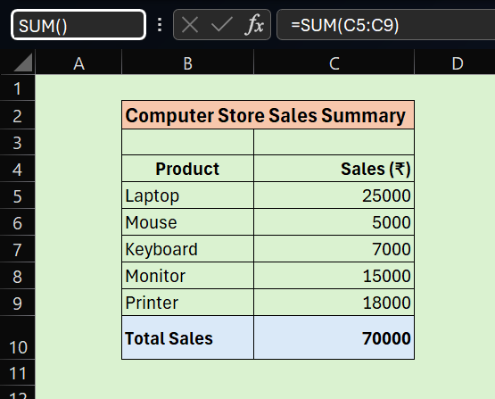


1. “BASIC CALCULATION FUNCTIONS”
SUM() & AVERAGE()
SUM() — Add Values
Adds all numbers in a selected range and returns the total sum.
Syntax: =SUM(number1, [number2], ...)
Example: =SUM(C5:C9)
Real-World Use: Used to calculate the total monthly sales revenue of a store.
AVERAGE() — Find the Mean
Calculates the arithmetic mean of values in a selected range.
Syntax: =AVERAGE(number1, [number2], ...)
Example: =AVERAGE(C5:C9)
Real-World Use: Used to find the average
monthly sales of products in a store.

Slide 4
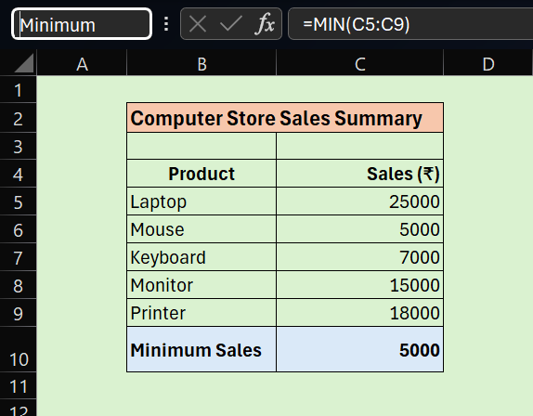
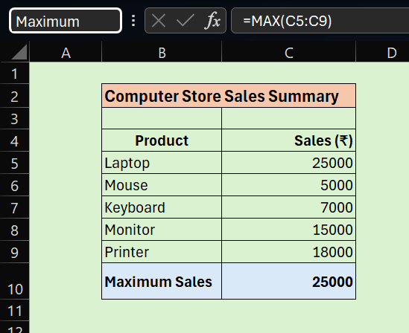
1. “BASIC CALCULATION FUNCTIONS”
MIN() & MAX()
MIN() — Smallest Value
Returns the smallest number in a selected range.
Syntax: =MIN(range)
Example: =MIN(C5:C9)
MAX() — Largest Value
Returns the highest number in a selected range.
Syntax: =MAX(range)
Example: =MAX(C5:C9)

Slide 5
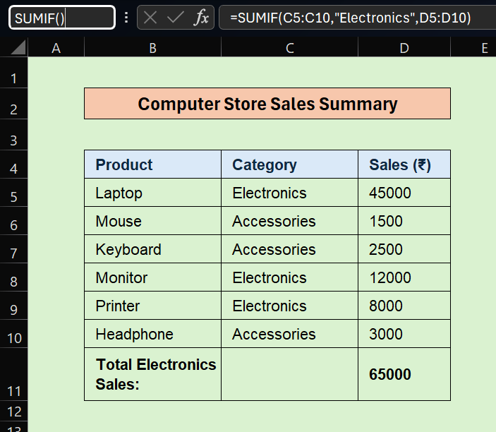

2. ”Conditional Functions”
SUMIF() — Sum with One Condition
“Adds values based on one condition and makes data easier to understand.”
Syntax: =SUMIF(range, criteria, [sum_range])
Example: =SUMIF(C5:C10,”Electronics”,D5:D10)
Real-World Use : Calculating the total sales revenue for a specific product category (e.g., 'Electronics') in a retail store

Slide 6
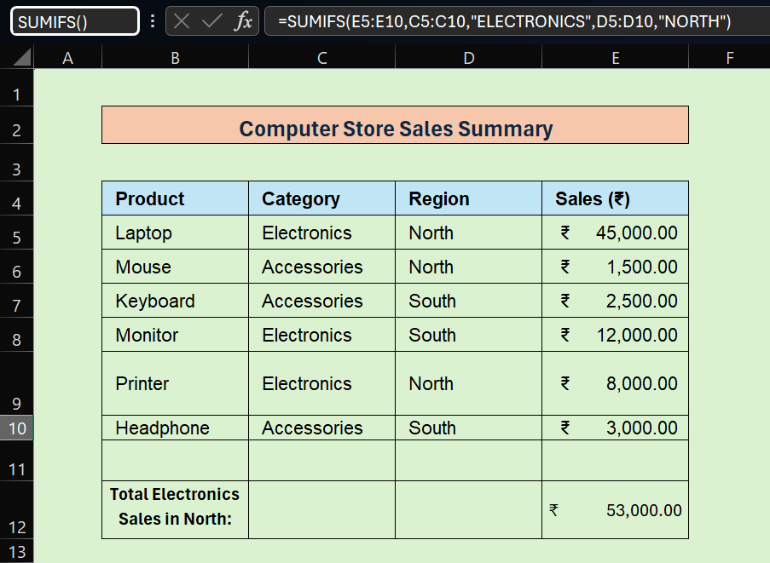
2. ”Conditional Functions”
SUMIFS() — Sum with Multiple Conditions
SUMIFS is used to add values based on multiple conditions.
Syntax: =SUMIFS(sum_range, criteria_range1, criteria1, [criteria_range2, criteria2],...)
Example: =SUMIFS(E5:E10,C5:C10,"ELECTRONICS",D5:D10,"NORTH")
Real-World Use: Calculating the total sales revenue for the 'Electronics' category specifically in the 'North' region.

Slide 7
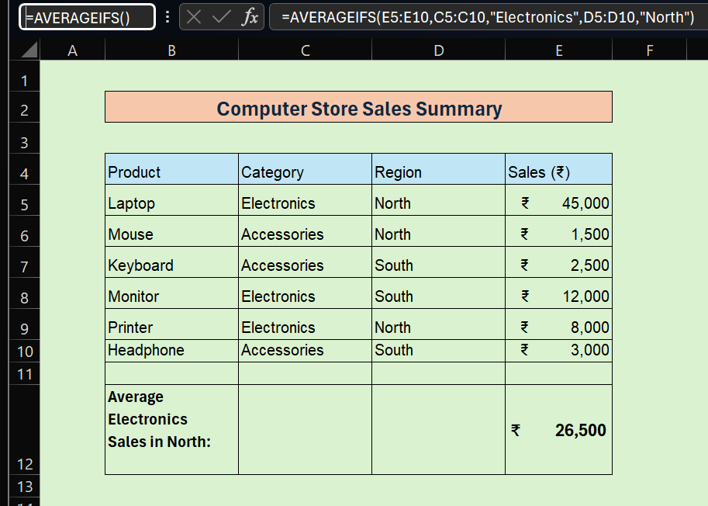
2. “Conditional Functions”
AVERAGEIFS() — Average with Multiple Conditions
Calculates the average (mean) of values based on multiple conditions.
Syntax: =AVERAGEIFS(average_range, criteria_range1, criteria1, [criteria_range2, criteria2], ...)
Example: =AVERAGEIFS(E5:E10, C5:C10, "Electronics", D5:D10, "North")
Real-World Use: Finding the average sales value for 'Electronics' specifically in the 'North' region.

Slide 8
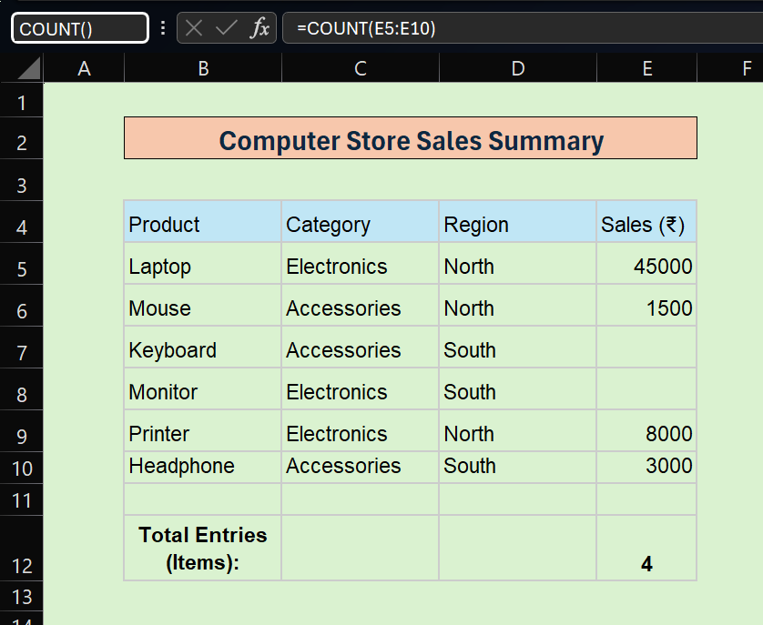
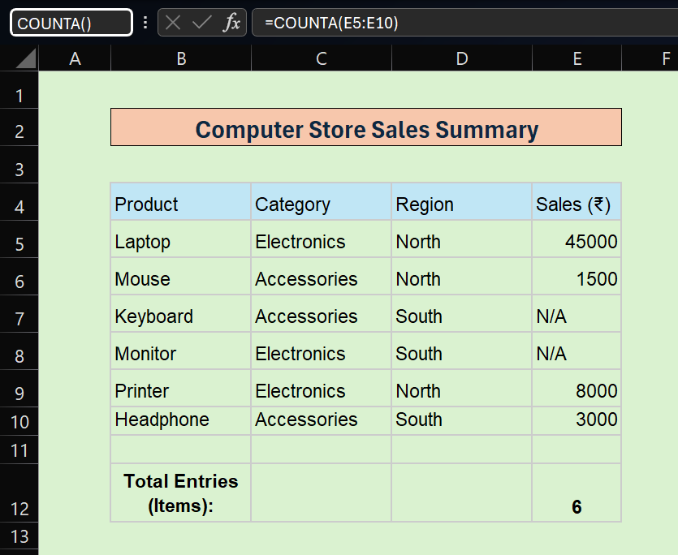
3. “Counting Functions”
COUNT() & COUNTA()
COUNT() — Count Numbers
Counts the number of cells in a range that contain numeric values only.
Syntax: =COUNT(range)
Example: =COUNT(E5:E10)
Real-World Use: Counting the total number of successful sales transactions recorded in a list.
COUNTA() — Count Non-Empty Cells
Counts the number of cells in a range that are not empty (contains text, numbers, or symbols). Ignores only blank cells.
Syntax: =COUNTA(range)
Example: =COUNTA(E5:E10)
Real-World Use: “Use to count all completed records in a dataset”.

Slide 9
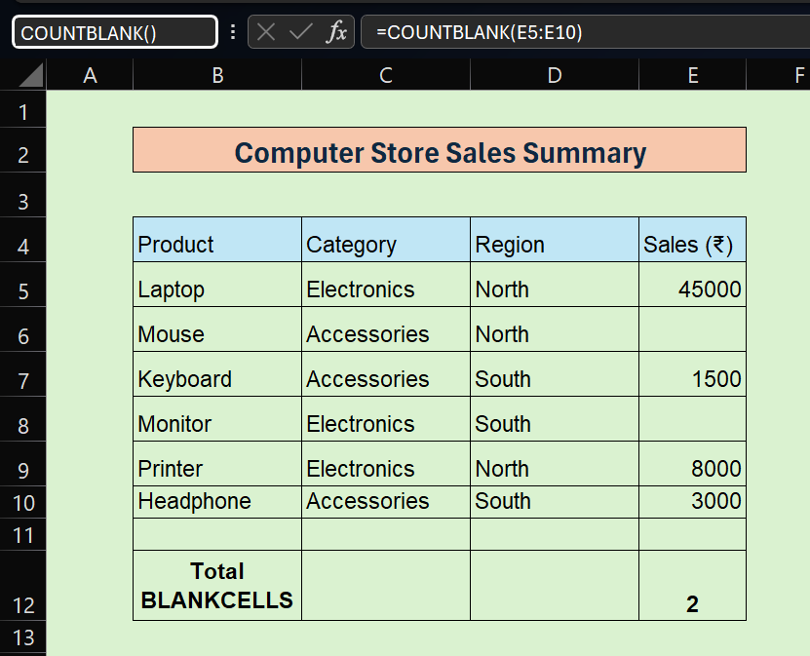
3. “Counting Functions”
COUNTBLANK() — Count Empty Cells
Counts cells that are empty in a range.
Syntax: =COUNTBLANK(range)
Example: =COUNTBLANK(E5:E10)
Real-World Use: “Helps identify missing data in a dataset”.
✅
Note: COUNTBLANK is a key function for data cleaning, validation, and ensuring dataset
completeness before analysis.

Slide 10
Excel Number Functions: Quick Summary
"This table provides a quick overview of the most commonly used Excel Number Functions."
Function
Purpose
Syntax
Example
SUM()
Addition
=SUM(range)
=SUM(B2:B10)
AVERAGE()
Average of values
=AVERAGE(range)
=AVERAGE(B2:B10)
MIN() / MAX()
Smallest / largest
=MIN(range)
=MIN(B2:B10)
SUMIF()
Sum with 1 condition
=SUMIF(range,crit,sum)
=SUMIF(A2:A10,"Sales",B2:B10)
SUMIFS()
Sum with multiple
=SUMIFS(sum,r1,c1,...)
=SUMIFS(Sales,Dept,"Sales",Region,"West")
COUNT()
Count numbers
=COUNT(range)
=COUNT(B2:B20)
COUNTA()
Count non-empty
=COUNTA(range)
=COUNTA(A2:A20)
COUNTBLANK()
Count empty cells
=COUNTBLANK(range)
=COUNTBLANK(A2:A20)

Slide 11
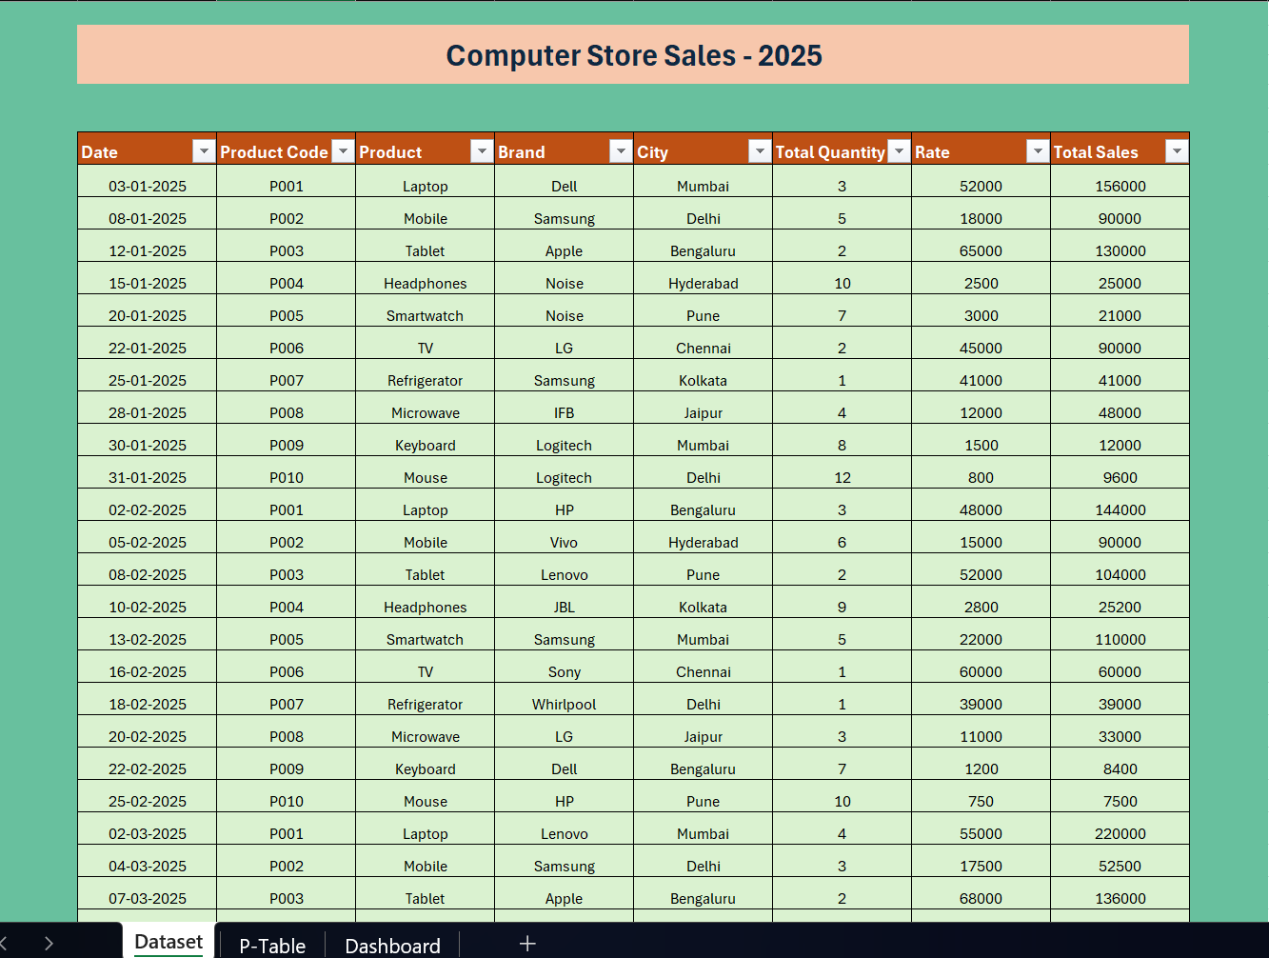

Slide 12
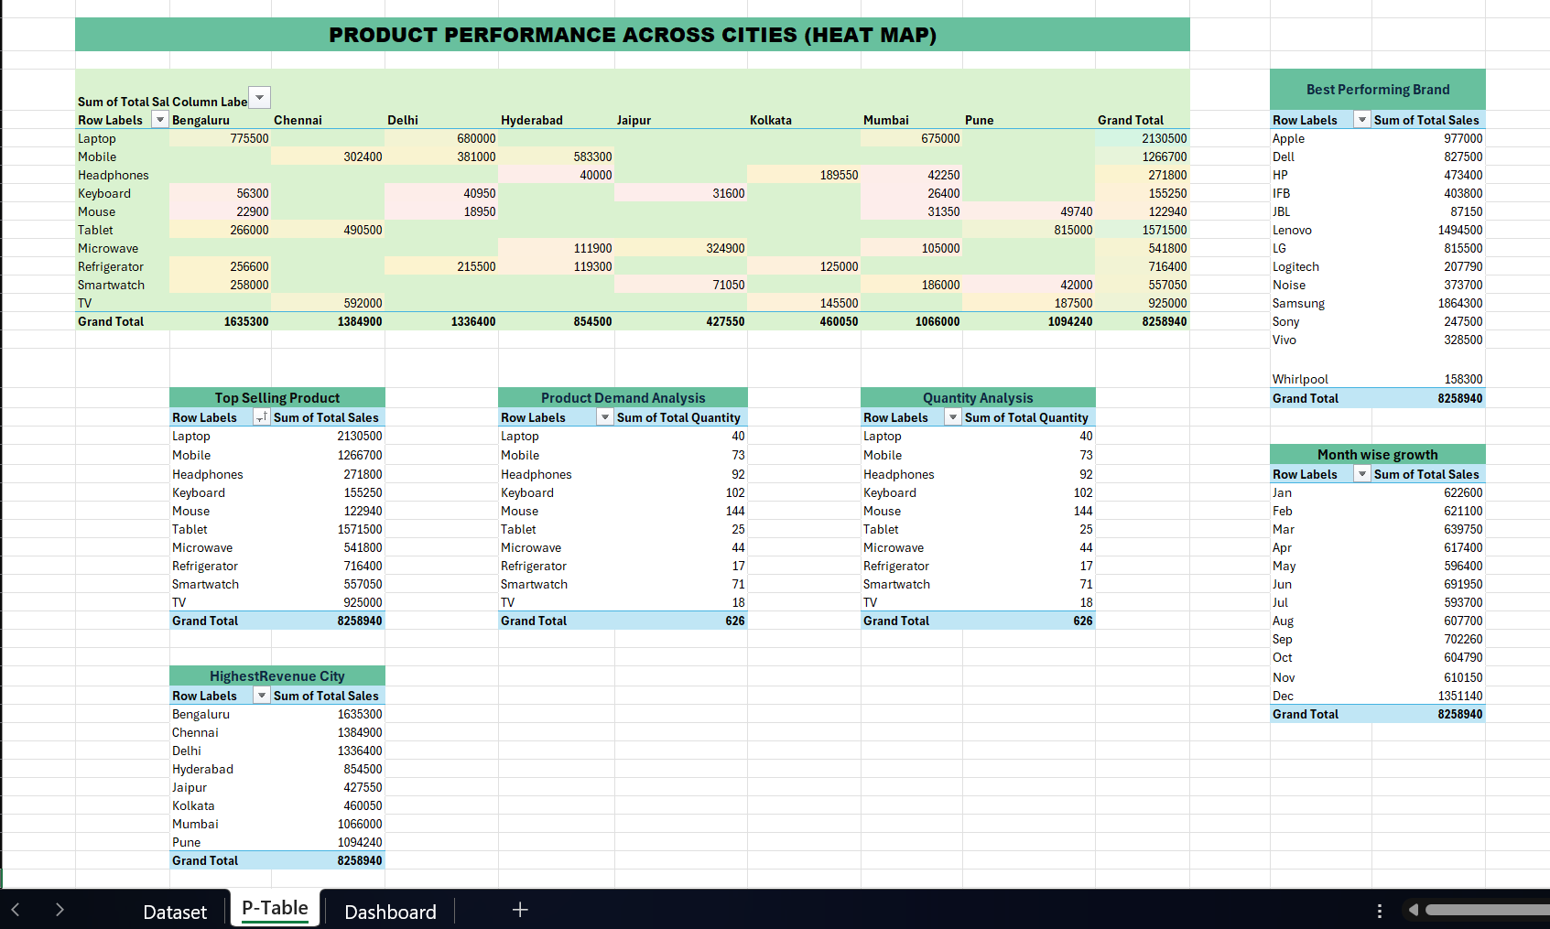
“Pivot Tables”

Slide 13


Slide 14
Thank You

