Slide 1


July 2020
House Prices in Ames, Iowa
By Rehan Daya, Emmanuella Eguche, Sitong Li
Anqi Lou, Soumya Nayak, Matthew Streichler

Slide 2

Project Overview
Develop an algorithm to predict the final price of the houses in Ames, Iowa
79 variables (36 numerical + 43 categorical)
1460 observations in training dataset
1459 observations in test dataset

Slide 3
Data Pre-processing
Numerical Variables
Remove columns with more than 10% of NaN entry
Impute the rest of NaNs with the mean of the column
Scaling
Express “Salesprice” (the Y variable) in log form
Categorical Variables
Replace NaNs with “None”
Create dummy variables (252)
Scaling

Slide 4

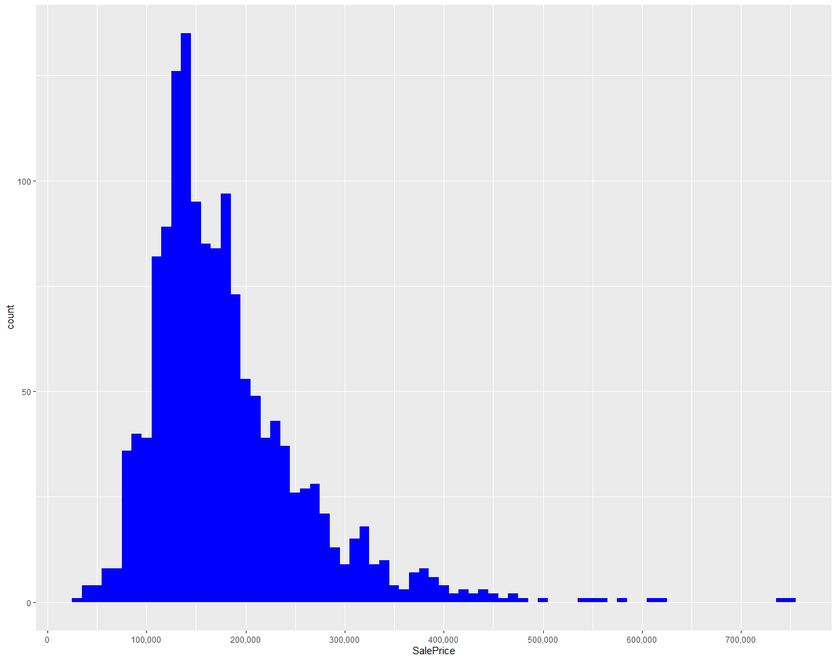
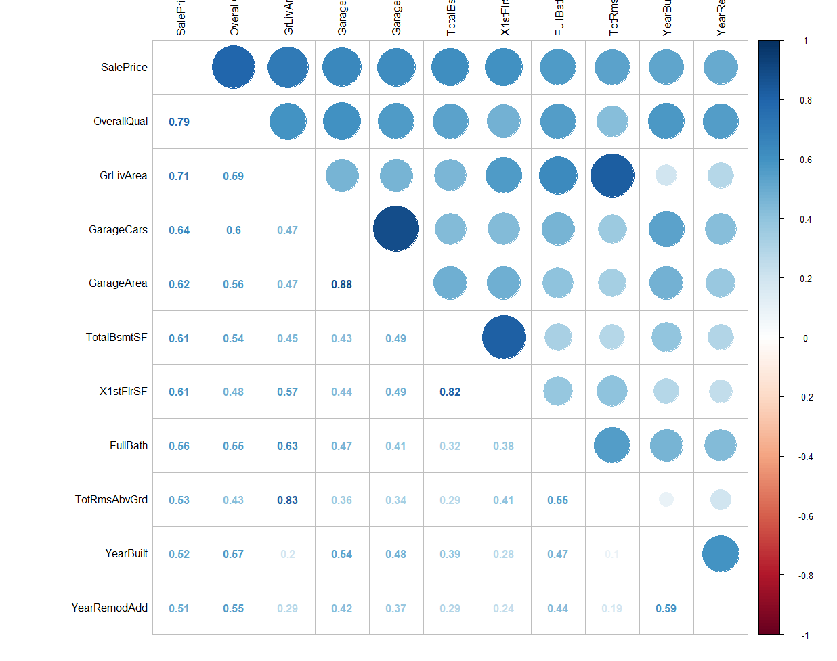
Right-Skewness and Correlation Matrix

Slide 5
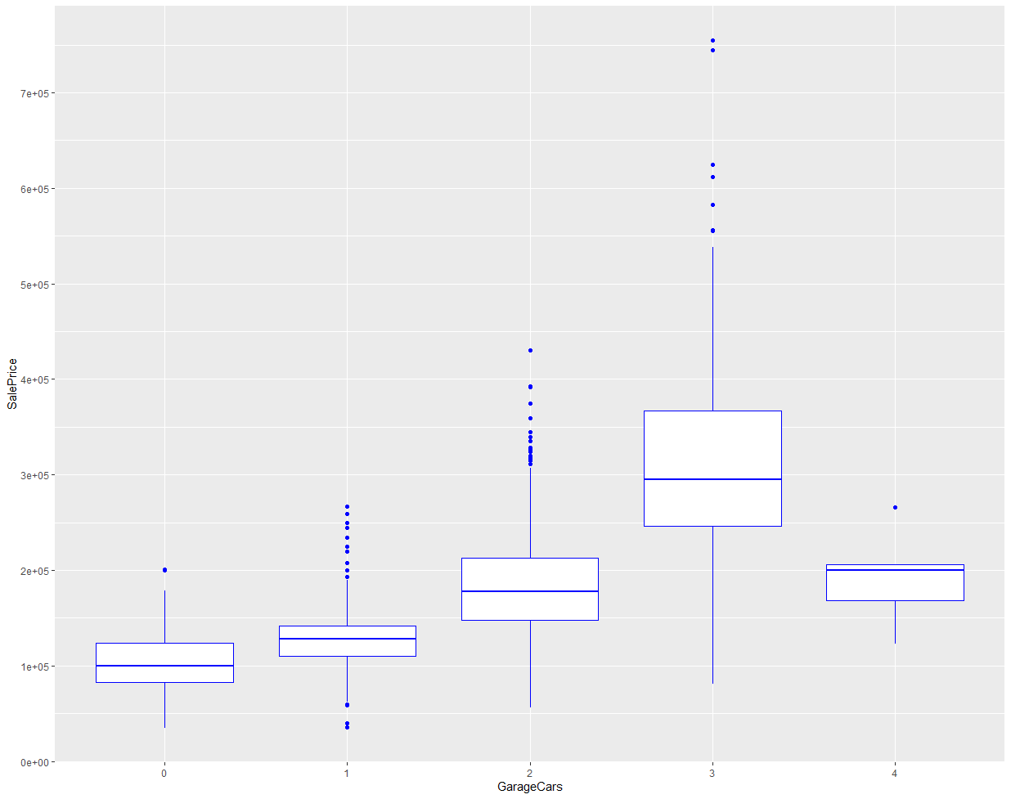
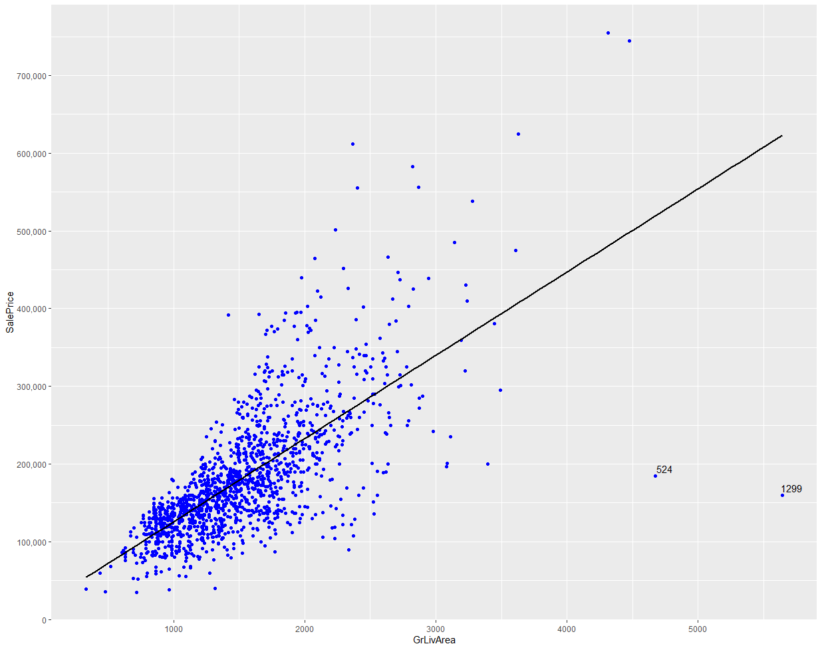
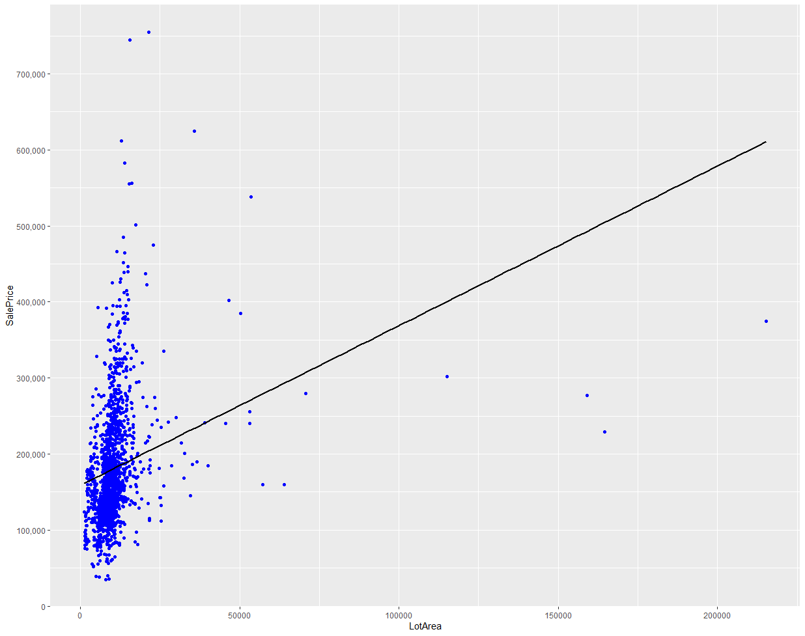
Important Variables

Slide 6
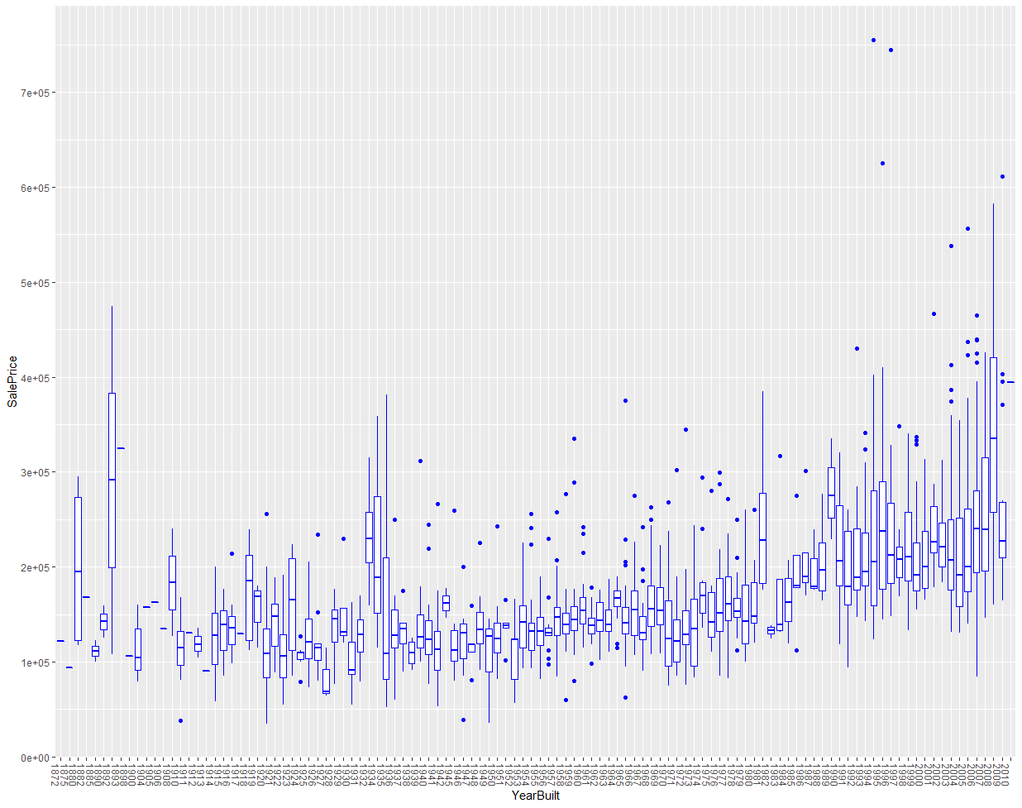
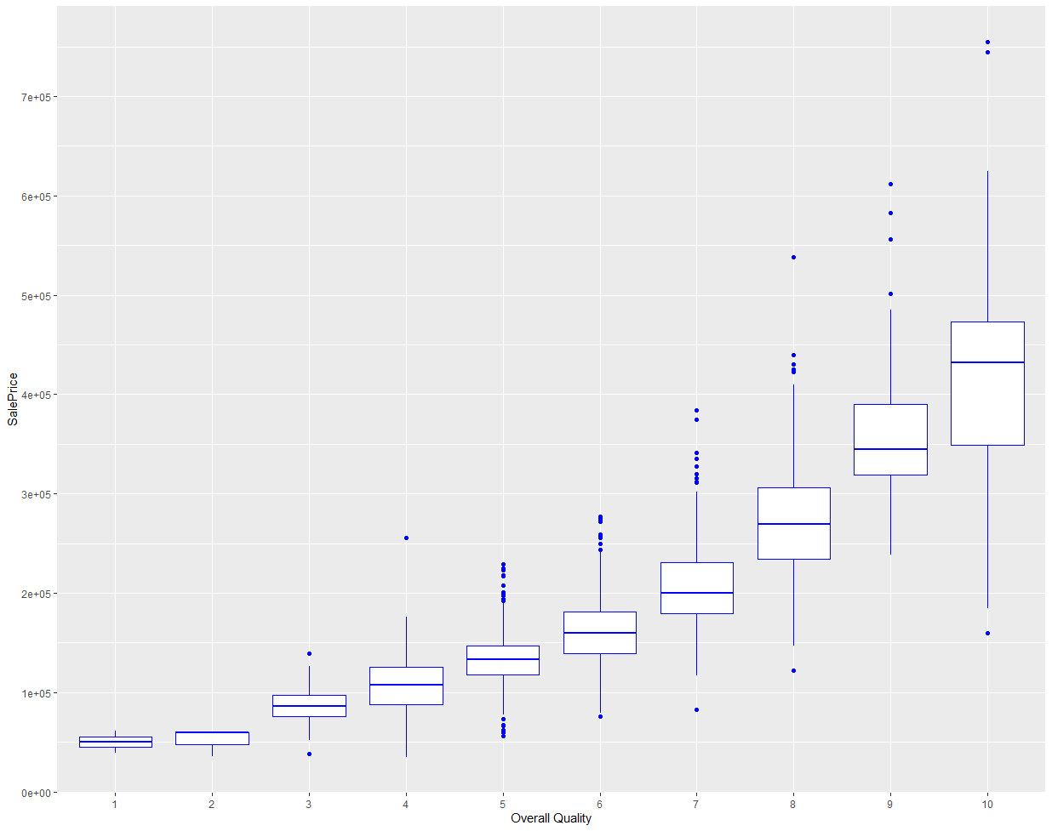
Important Variables pt.2

Slide 7
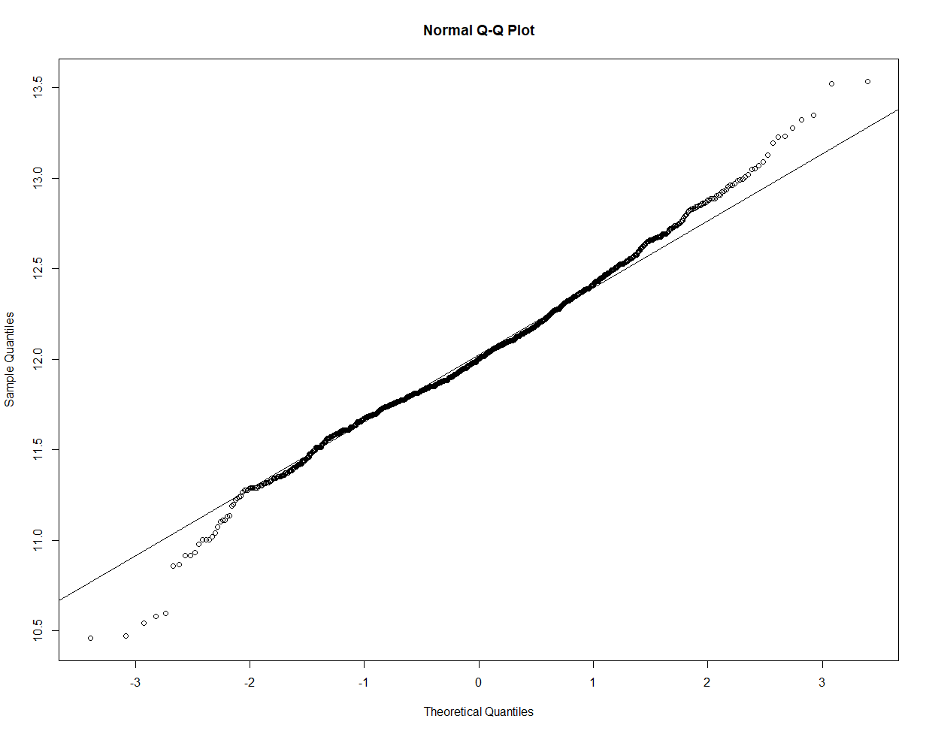
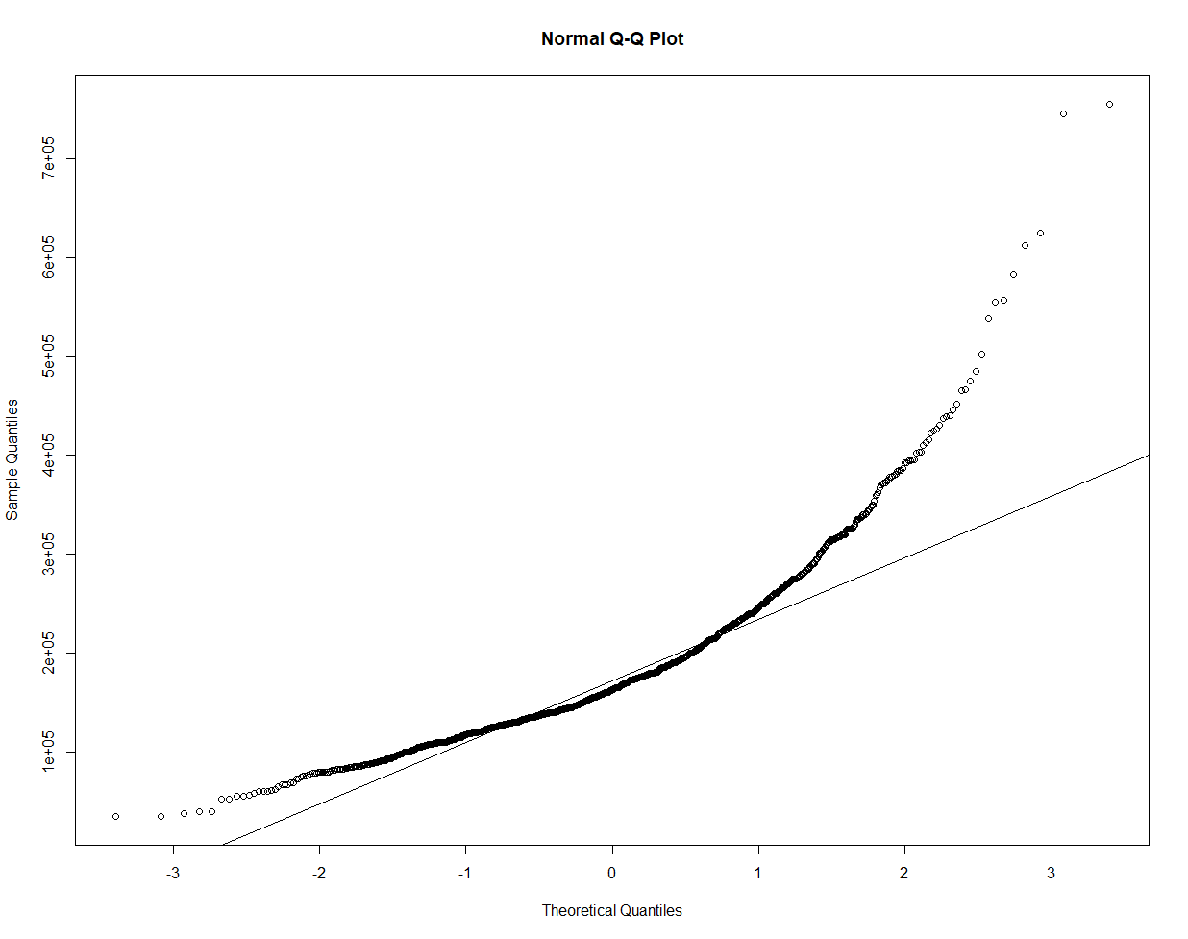
Before and After Log
Taking log of SalePrice, our predictor variable, reduced the right skewness

Slide 8

Models Applied
KNN
Forward Stepwise Regression
Lasso
Random Forest
PLS
* All models are tested with 10-fold cross validation*

Slide 9
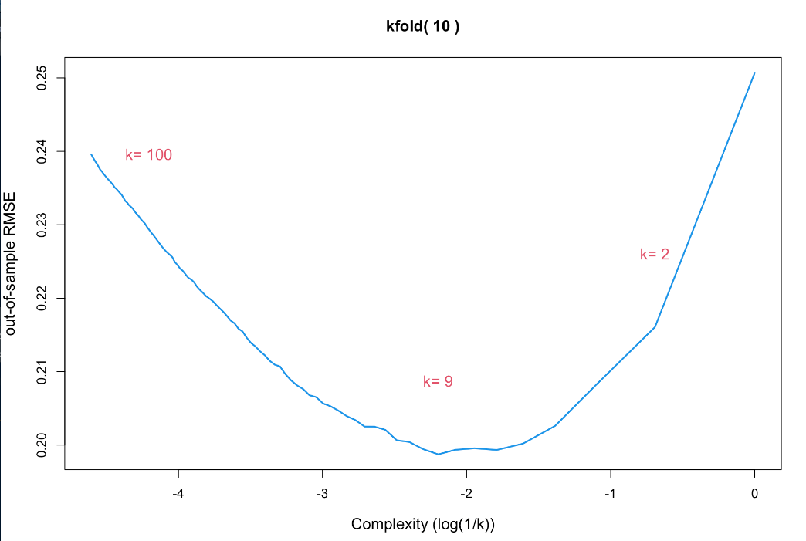
KNN
Number of nearest neighbors tested: [1:100]
Optimal number of KNN: 9
Out-of-sample RMSE: 0.1987424

Slide 10
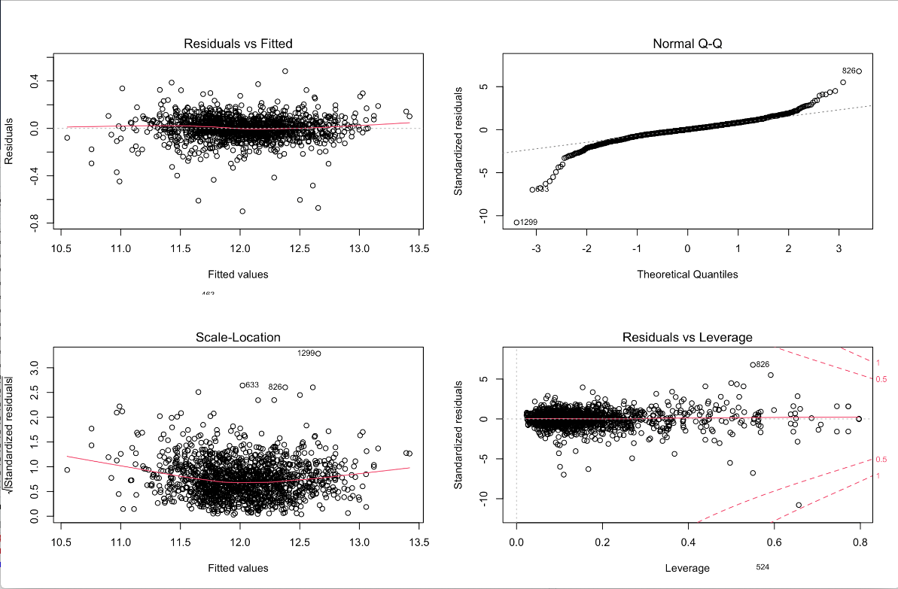
Forward Stepwise Regression
Running stepAIC() returns model that contains all coefficients.
AIC = -6325.657
Out-of-sample RMSE: 0.097

Slide 11
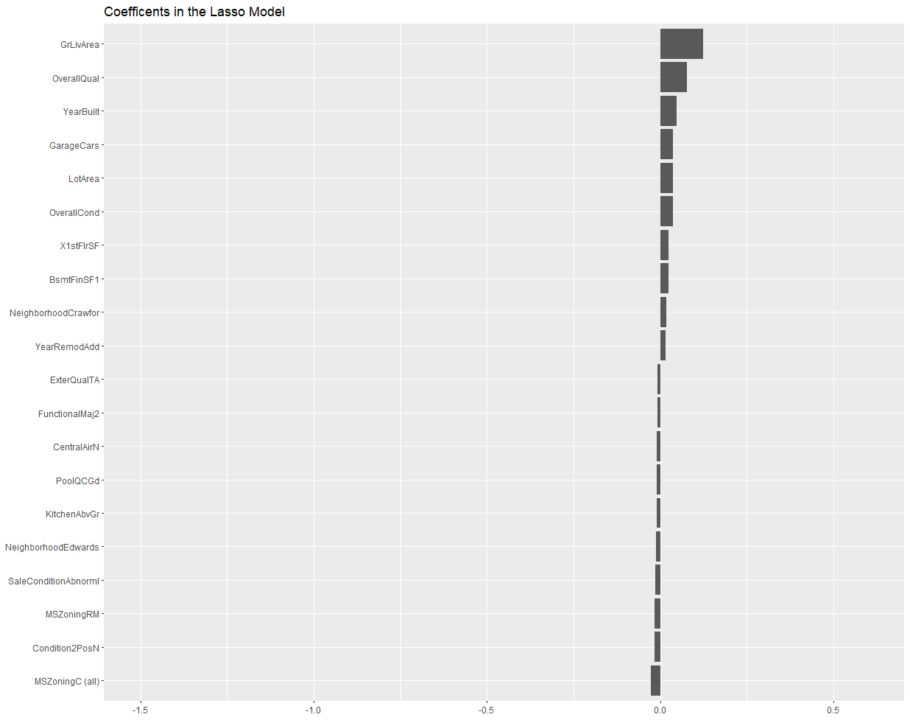
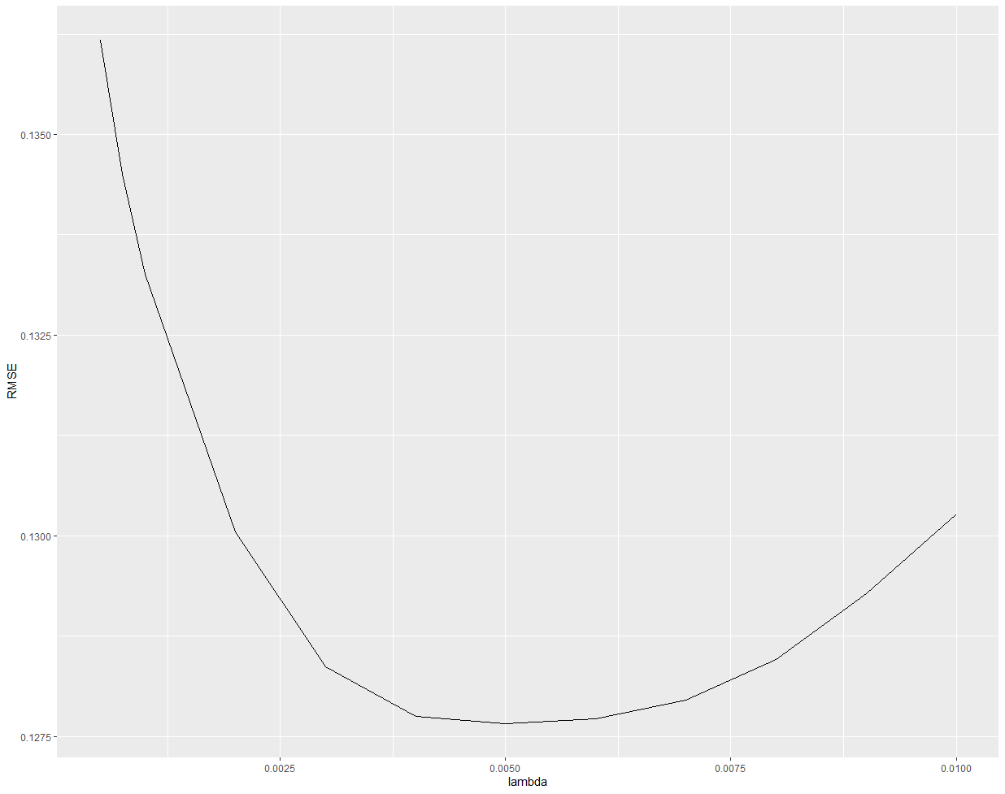
LASSO
Out-of-sample RMSE: 0.1276

Slide 12
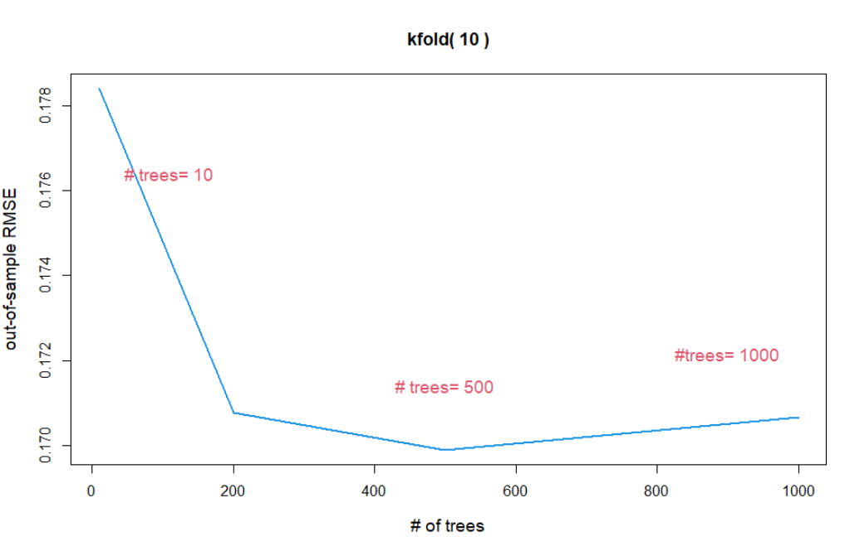
Random Forest
Number of trees tested: 10, 200, 500, 1000
Maximum number of nodes in each tree: 15
Optimal number of trees: 500
Out-of-sample RMSE: 0.02886456

Slide 13
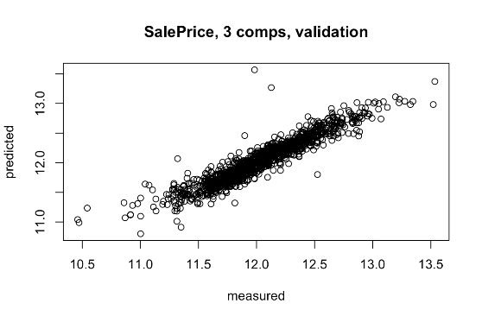
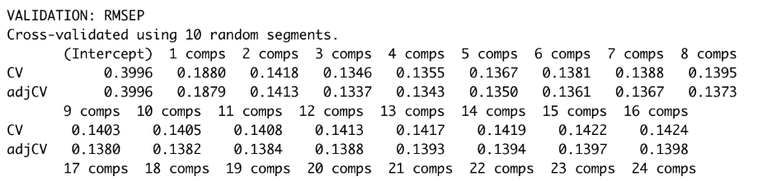
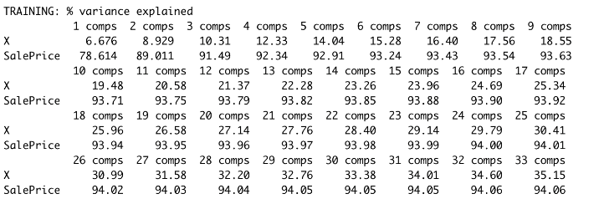
Partial Least Squares (PLS)
Use 10-fold cross validation so this is just an example of how PLS model’s prediction looks like comparing to the splitted-testing data.
The optimal ncomp for training set is 3, but for test set is 4.
Out-of-sample RMSE: 0.018

Slide 14
Model Comparison
Model | Out-of-sample RMSE | Test RMSE
KNN | 0.1987 | 0.2061
Forward Stepwise Regression | 0.0970 | 0.1474
Lasso | 0.1276 | 0.1278
Random Forest | 0.0288 | 0.1741
PLS | 0.0188 | 0.1358
From cross-validation,
In log form
RMSE on test data,
Provided by Kaggle.

Slide 15
Limitations
Large number of multicollinear variables, might be subject to overfitting
Outliers reducing accuracy of models
Kaggle holds true data set, which caused us to split train dataset into a test and train

Slide 16
Conclusion
Our Results—PLS is the best predictive model
RMSE = 0.0188
Kaggle’s Results—Lasso is the best predictive model
RMSE = 0.1278
Kaggle Competition—1333/5089
About the 26th percentile
Important Variables
GrLivArea
OverallQual
YearBuilt
GarageCars
LotArea

