Slide 1
U.S Census - Classification
By: Rehan Daya
Notes:
Hello everyone. Thank you for being here.

Slide 2
Preface - Limitations
Spent 2 day on this project while balancing full-time work
Focus on substantive analysis over visual aesthetics
Limited compute resources required dimension reduction
Presentation designed for both technical and non-technical audience members
Code available for deeper discussion if time permits
Notes:
Before diving into the analysis, I want to be transparent about my approach. I allocated 2 days to this project while balancing my full-time job and in that time I prioritized analysis over visual aesthetics. To do this, that means that most of my time was spent on looking over the documentation provided and developing the code. My experience at Ernst and Young and other firms tells me that in real-world settings, we often work within established templates or platforms like Dataiku that standardize presentation formats. That said, I can certainly create polished presentations when needed - I've developed investor pitch decks for my startup, Roommate AI. Today, I've designed this presentation to provide value for both technical and non-technical team members, but if there's interest in exploring the code detail, it is available in my GitHub repository. I feel that the code is very busy though and so I decided to make this presentation to make it easier to convey my points.
I also wanted to note that while my computer is pretty nice, the pipeline I created is quite extensive and so it limited how much fine tunning I could perform within the given time frame. This means that model's effectiveness is quite poor, as I didn’t spend enough time on iterating

Slide 3
Overview
Build a model predicting whether individuals earn above/below $50K annually
Binary classification with real implications for policy, program design, and resource allocation
Example: Government educational subsidies targeting communities with lower income prospects
Example: Financial products tailored to different income segments
Example: Non-profit service distribution optimization
Dataset: ~300,000 anonymized Census records
Complete dataset (no missing values)
Notes:
Let's begin with an overview of the problem and the data.
Our objective is to predict whether individuals earn above or below $50,000 annually - a classic binary classification problem that has real-world implications for policy, program design, and resource allocation. For example, government agencies could use these predictions to target educational subsidies to communities with lower income prospects, businesses might develop financial products tailored to different income segments, and non-profits could optimize the distribution of their services based on regional income patterns.
We're working with anonymized census data covering approximately 300,000 individuals, provided by the Federal Statistical System. Fortunately, the dataset is complete without missing values, which simplified our initial preparation. I've analyzed the metadata to understand the available features, but in a real-world scenario, I would collaborate with domain experts to gain deeper insights into the data's context. This collaborative approach typically leads to more meaningful feature engineering and helps identify which variables are truly relevant to the business question at hand.

Slide 4
Data Science Pipeline
Step 1
Step 2
Step 3
EDA
Target Variable Distribution
Numerical Features Analysis
Categorical Features Analysis
Data Preparation
Data Cleaning
Feature Engineering
Encode Categorical Features
Split Data
Imputation
Handle Outliers
Handle Skewness
Scale
Dimension Reduction – PCA (optional)
Remove Multicollinearity
Modeling
Model Training and Evaluation
Hyperparameter tuning for Top models
Build Ensemble Model
Final Model Evaluation
Feature Importance Analyses
Notes:
I followed a standard data science pipeline that I've refined through practical experience. In fact, at my current role, I've developed functions that automate many of these steps, improving efficiency and consistency across projects.
First, we start with Exploratory Data Analysis or EDA - this is where we get to know our data through visualizations and statistics. It's like meeting someone new and learning about their background and personality before working closely with them.
Next comes Data Preparation, where we transform raw data into a format that models can effectively utilize. Think of this as translating between languages so our models can understand what the data is saying.
Finally, we reach the Modeling stage, where we build, refine, and evaluate predictive models. This is where the insights emerge that can drive business decisions.
Each of these stages is crucial - skipping steps would be like trying to build a house without proper blueprints or foundation. Let's explore what we discovered in our EDA.

Slide 5
EDA (Exploratory Data Analysis)
Purpose of EDA:
Is to validate patterns and find anomalies
May uncover improper ETL process
Show potential features to engineer
Provide a means to tie models coefficients to business insights
Find outliers
Results:
Imbalanced dataset
93.65% under $50K
6.35% over $50K
Reflects real-world income distribution
Presents modeling challenge requiring special handling
33 categorical features, 7 numerical features
Label encoding vs. One-hot encoding approaches
Notes:
To keep things simple, I combined my train and test dataset for the EDA portion. My initial exploration revealed an important characteristic of this dataset: it's significantly imbalanced, with only 6.35% of individuals earning over $50,000. This imbalance reflects real-world income distribution but presents a modeling challenge we'll need to address. The dataset contains 33 categorical features - things like occupation, education level, and marital status - and 7 numerical features like age and work hours. This mix of categorical and numerical data requires careful handling to extract meaningful patterns.
For categorical features, I needed to convert them into a format our models can process. I used two approaches: Label Encoding for features with a natural order (like education levels) and One-Hot Encoding for features without hierarchy (like types of occupations). This conversion preserves the information while making it accessible to our models - similar to how we might translate concepts from different languages while maintaining their original meaning.

Slide 6
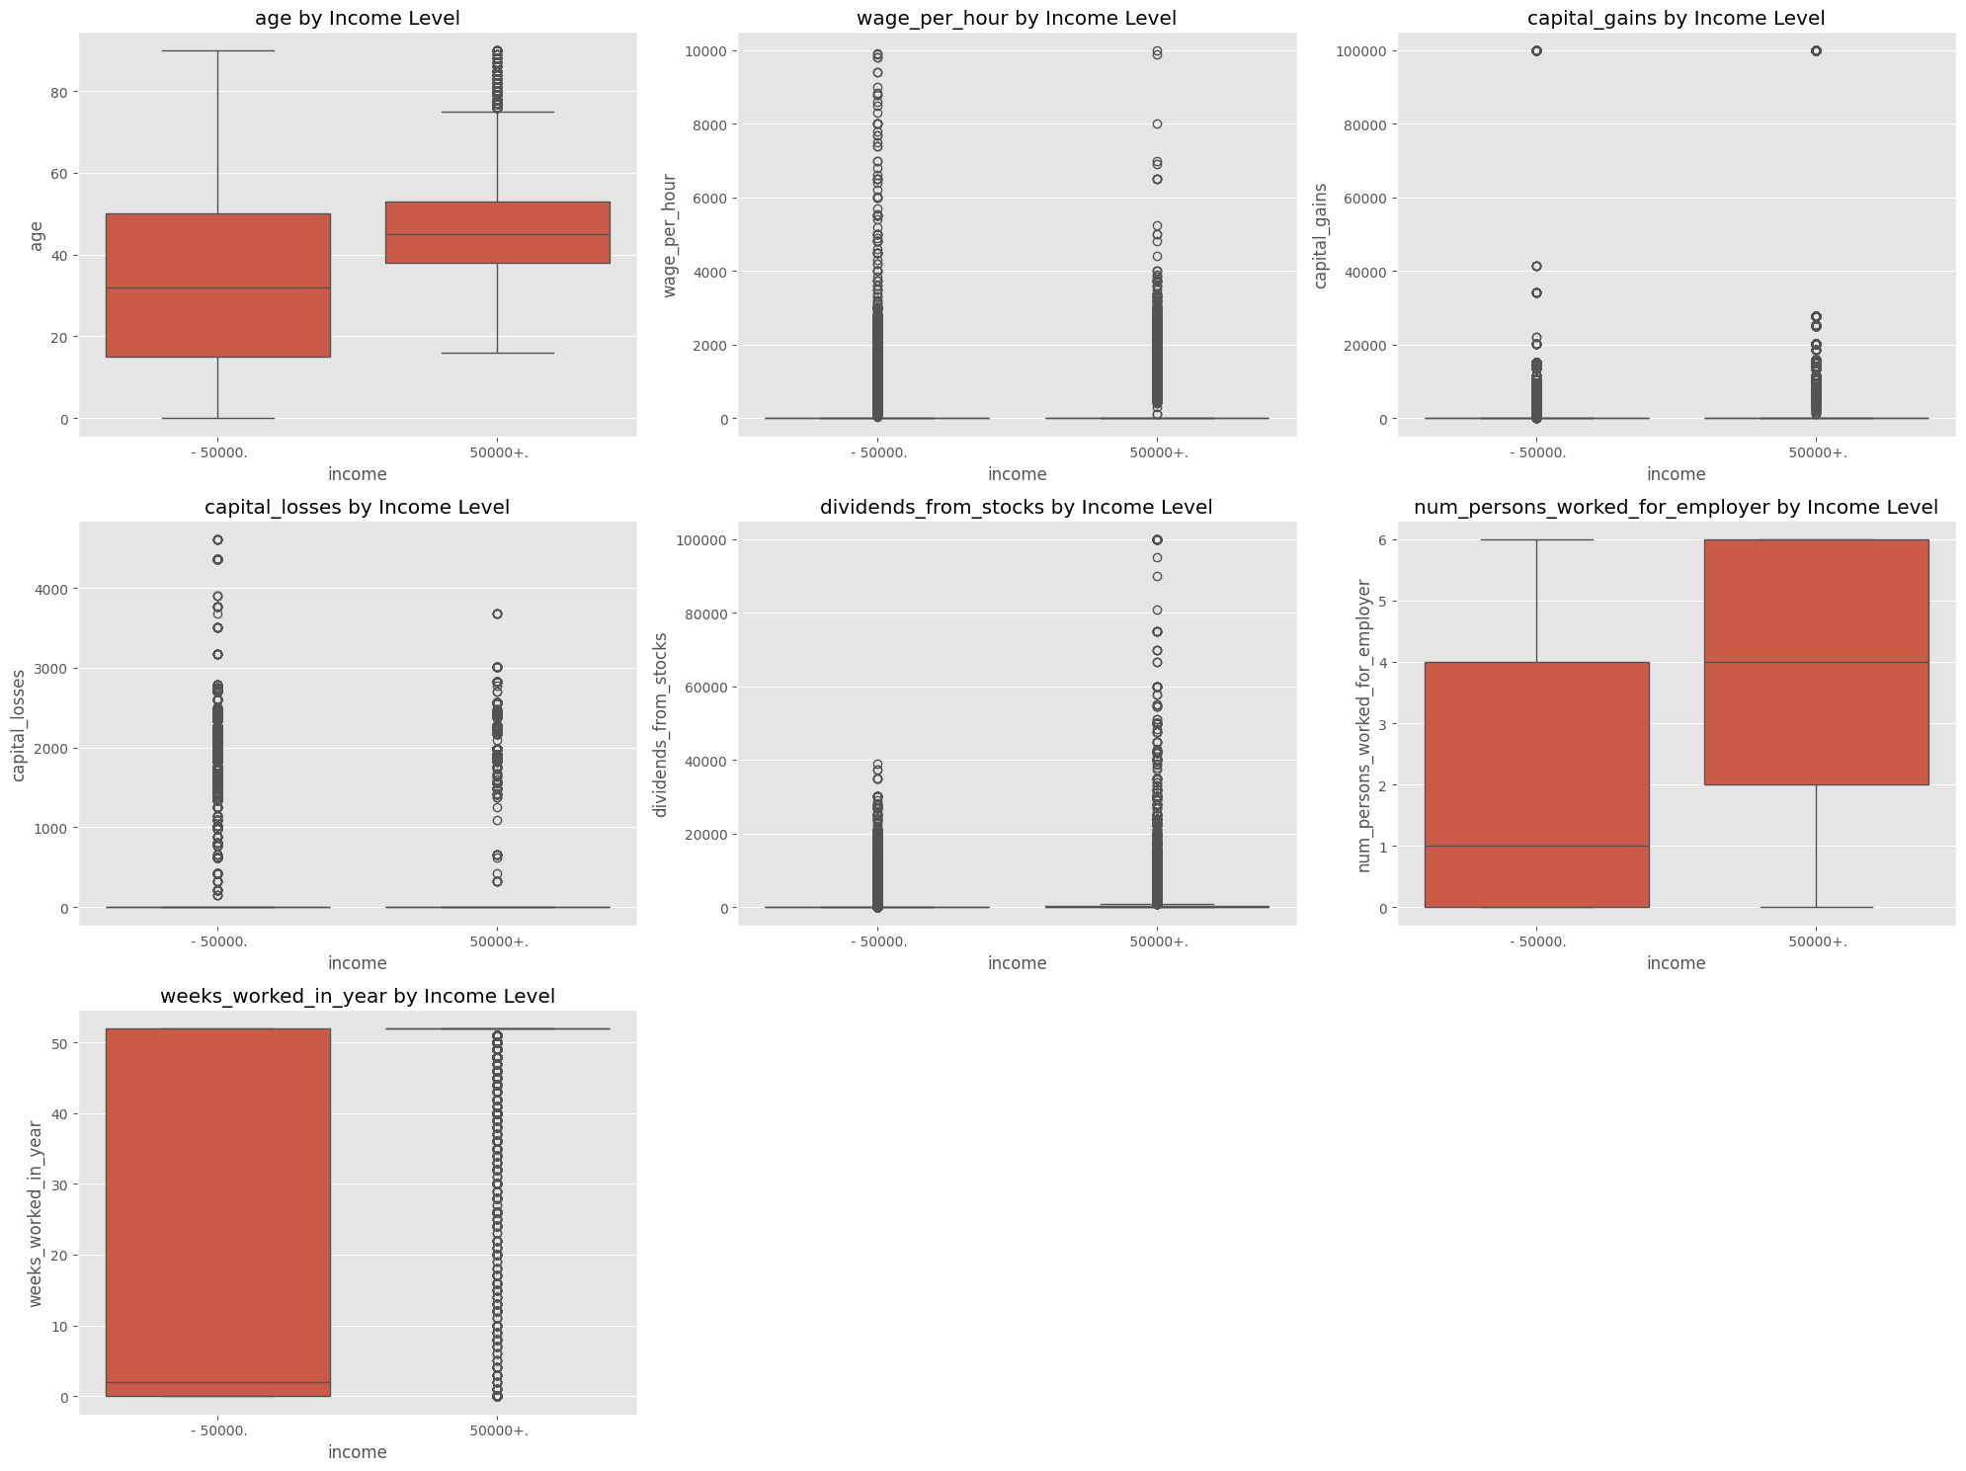
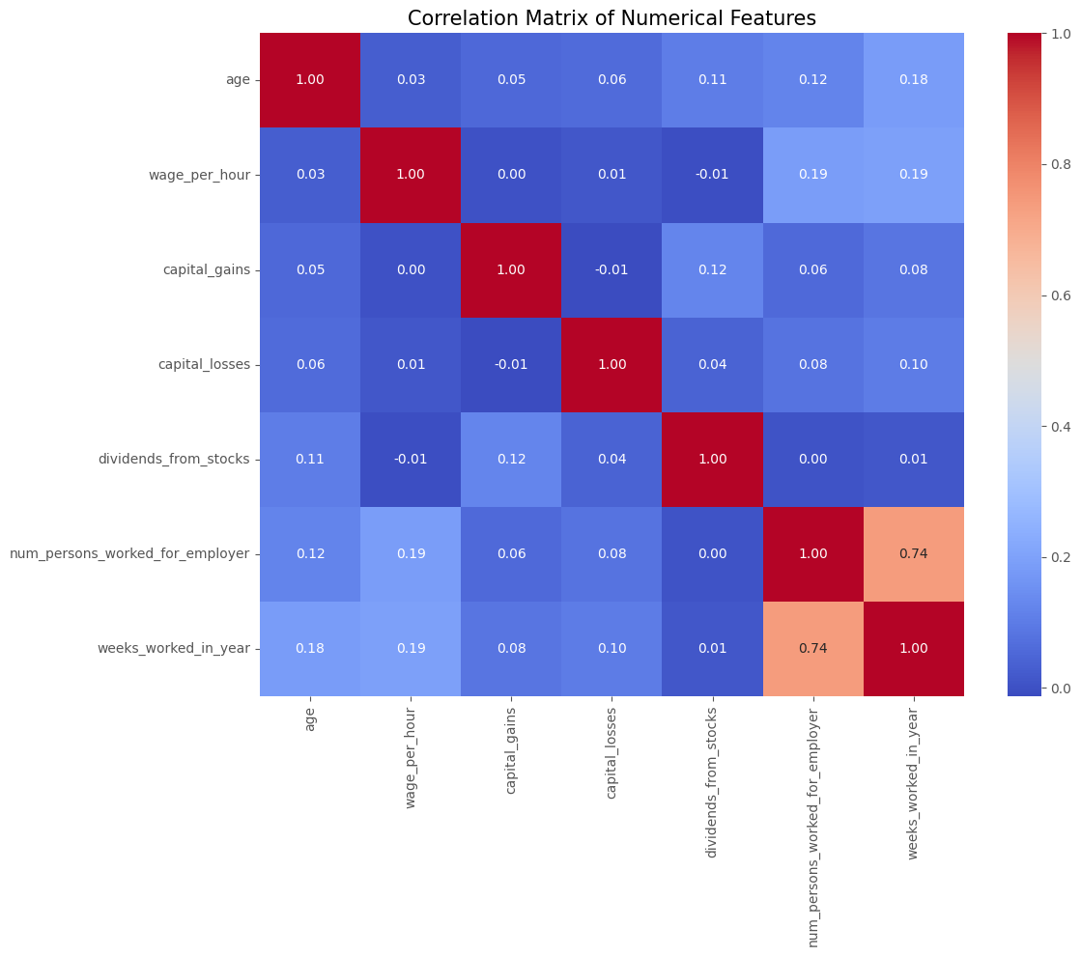
EDA Numeric
Highlight extreme outliers (e.g., $10,000/hour wages)
Note key correlations between features
Notes:
Looking at the numerical features, I was searching for two key insights: outliers that might distort our analysis and relationships between variables.
The visualizations reveal some extreme outliers - notice the wage per hour feature, where some values exceed $10,000 per hour. Unless we're analyzing compensation for Fortune 500 CEOs or star athletes, these are likely data entry errors that could mislead our models.
I also examined correlations between numerical features. The strongest relationship appears between weeks worked per year and the number of employees at a person's workplace - suggesting that larger companies might provide more consistent employment throughout the year.
These observations inform our data preparation strategy - we'll need to handle outliers carefully to ensure they don't disproportionately influence our models, while preserving legitimate patterns in the data.

Slide 7
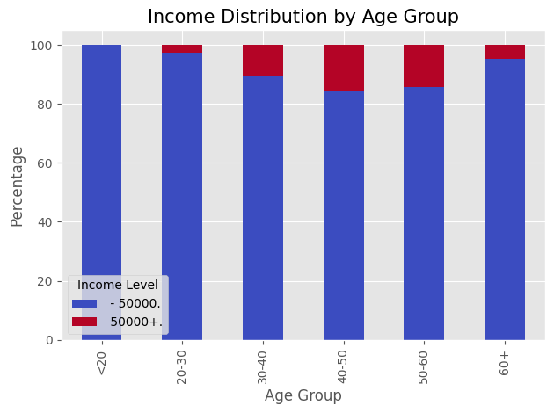
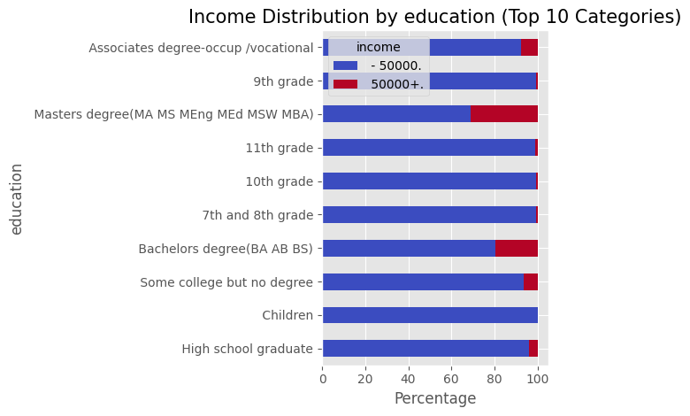
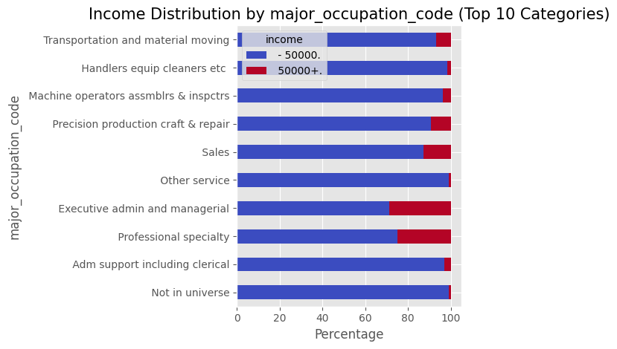
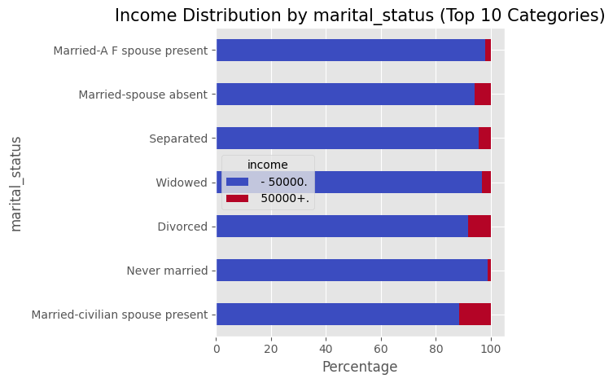
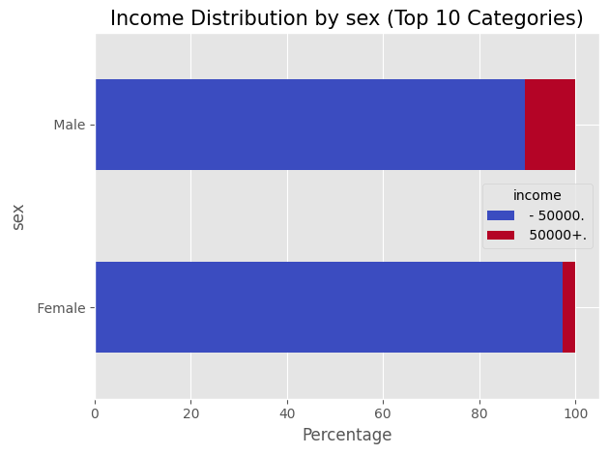
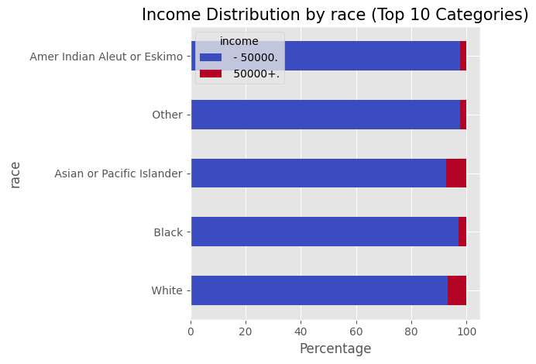
EDA Categorical
Income peaks in 40-50 age range
Higher education levels strongly correlate with >$50K income
Notes:
Looking at the categorical features, these visualizations reveal patterns that align with what we might intuitively expect about income distribution in society. The data shows that higher education levels strongly correlate with incomes above $50,000, and earnings tend to peak in the 40-50 age range.
There are also clear differences in income distribution across occupations, with professional and managerial roles showing higher proportions of individuals earning above $50,000.
The gender and racial distributions reflect historical socioeconomic patterns - males and certain racial groups show higher proportions of high earners. As an Asian-American, I recognize the cultural emphasis often placed on pursuing high-paying professions like medicine, law, or engineering.
These insights aren't just academically interesting - they help us identify which features might be most predictive in our models and could inform targeted interventions to address income disparities. In a business context, understanding these patterns could help organizations design more effective services for different demographic segments. As I alluded to earlier though, I’d still recommend working with the teams that are close with this data to better understand their meaning.

Slide 8
Data Preparation
Use metadata file to map column headers to data, since they are missing in CSV
Convert target to binary with the correct values
There’s some padding in its value, tricky
{' - 50000.': 0, ' 50000+.': 1}
There are duplicate rows in train and test, causing data leakage, drop those
Data leakage occurs when information from outside the training dataset is used to create the model.
Each preprocessing step involves tradeoffs between information preservation and model performance
Notes:
Moving to data preparation, my first challenge was addressing the missing column headers in the CSV files. I mapped the data to appropriate column names using the metadata file, which isn't ideal. I usually don’t see this happening in real world scenarios either as you’d simply pull data from a warehouse which maintains the column names. In this case though, if the data were to be scrapped online, then it might make sense for them to be separated as it won’t be as clean.
I converted the target variable into binary format (0 for under $50K, 1 for over $50K), carefully handling the padding in the original values that could have caused errors. What I mean by padding, is the spacing before and after the value, which can interfere with the coding process.
Interestingly, I discovered duplicate rows appearing in both training and test datasets - a potential source of data leakage that could artificially inflate model performance metrics. In practical terms, this could lead us to overestimate how well our model would perform on truly unseen data. I removed these duplicates to ensure a fair evaluation of our models' capabilities.

Slide 9
Data Preparation (Feature Engineer/Encode)
Feature Engineer
Reach out to experienced management to better derive features
Created some simple ones:
Work experience = age minus 18, assuming people start working at 18
Encode Categorical Features
Label encode features with hierarchy
'sex': {' Female': 0, ' Male': 1},
One hot encode features without hierarchy
citizenship: 5 unique values
Unique values: [' Native- Born in the United States'
' Foreign born- Not a citizen of U S '
' Foreign born- U S citizen by naturalization'
' Native- Born abroad of American Parent(s)'
' Native- Born in Puerto Rico or U S Outlying']
Notes:
Feature engineering is where domain knowledge becomes particularly valuable. I could have also read through the 300 page supplemental documentation on this dataset, but I decided to skim over it to glean some basic insights. So, with limited time, I created some derived features, such as estimating work experience by subtracting 18 from age - assuming most people begin working around that age.
For categorical features, I used label encoding for features with a natural hierarchy - like assigning 0 to 'Female' and 1 to 'Male' for the sex feature. For features without inherent order, like citizenship status, I used one-hot encoding to create separate binary columns for each category.
An important observation during this process was finding categorical values in the training dataset that didn't appear in the test dataset after one hot encoding. This kind of inconsistency can cause models to fail when deployed, as they encounter values they weren't trained on - similar to asking someone to recognize a fruit they've never seen before. In a production environment, we would need a strategy for handling such novel values. I made a script that checks the overlap between test and train dataset to identify this issue and resolve it.

Slide 10
Data Preparation (Imputation and Outliers)
Split data into train and validation
Done before preprocessing to avoid data leakage
Preprocessing can change interpretation of features, but some models need this
Used stratified split
Imputation for missing values
For each numerical column, uses median value
For each categorical column, uses most frequent value
Remove outliers
Using IQR (visualized by a boxplot)
Typically Lower bound: Q1 - 1.5 * IQR and Upper bound: Q3 + 1.5 * IQR
I used 5 * IQR due to the process being too harsh
Notes:
Data splitting is crucial for honest model evaluation. While we already had separate training and test sets, I initially followed an approach where I created an additional stratified validation set early in the process. My original plan was to use this dedicated validation set for model tuning.
However, as I began modeling and reconsidered the imbalanced nature of our dataset, I pivoted toward using stratified cross-validation to maximize the training data available and ensure each fold maintained the class distribution. This created a redundancy, as I was now using both approaches simultaneously—the early validation split and cross-validation during model training.
This premature validation split reduced our training data by about 20%, potentially limiting the models' ability to learn patterns from the full dataset, especially concerning the minority class where only 6.35% of individuals earned over $50K. The more optimal approach would have been to pick one strategy from the beginning: either use the entire training set with cross-validation or stick with the dedicated validation set approach.
In production settings, we would be more methodical about our validation strategy, carefully considering data volume, class distribution, and computational constraints before deciding on the most appropriate approach.
Regarding imputation for missing values, I found that this dataset actually had no missing values, which was fortunate. However, I still included imputation steps in my pipeline as a best practice, since most real-world datasets have missing data.
My approach used median imputation for numerical features and most frequent value imputation for categorical features. These are simple but effective methods that maintain the overall distribution without introducing extreme values. In a production environment, more sophisticated techniques might be appropriate, such as KNN imputation or model-based approaches that consider relationships between features.
I generally prefer not to impute when possible, as it introduces assumptions about the missing data. When feasible, I'd rather drop rows with missing values, especially if they represent a small percentage of the data. However, this isn't always an option if missing values are prevalent or follow specific patterns that would create bias if removed. Imputation is essentially a guessing game, but it's often necessary to preserve sample size and information.
For outlier removal, standard statistical methods proved too aggressive for this dataset - they would have eliminated too many observations. Instead, I used a more lenient approach (5 times the IQR rather than the standard 1.5), which removed extreme outliers like those $10,000 per hour wages while preserving the legitimate variability in the data.
These preprocessing decisions involve trade-offs between data purity and information preservation. Too aggressive, and we lose valuable patterns; too lenient, and outliers might distort our models. Finding the right balance requires both technical knowledge and judgment informed by the business context.

Slide 11
Data Preparation (Scale/Skew/Collinearity)
Handle Skewness
Applies log transformation (works with positive and negative values) to bring distribution of features closer to Gaussian distribution (normal distribution). Some models benefit from this.
Scale
Applies robust scaling (X - Median) / IQR. This makes it robust to outliers
Important for models like KNN, where difference in scales influence disproportionately.
Dimension Reduction
PCA used to reduce features to speed up model, but lose interpretability
Reduces correlation and noise, by capturing variance between features
Remove multicollinearity
Remove features with absolute correlation above .75
Notes:
These final preparation steps further refine our data for modeling. To handle skewness, I applied transformations that make the data distributions more symmetric - similar to adjusting the lighting in a photograph to reveal details in both shadows and highlights.
Scaling is particularly important for models that use distance calculations, like K-Nearest Neighbors. Without scaling, features measured in large units (like dollars) would dominate over features measured in small units (like hours), distorting the model's perception of similarity between observations. It's like ensuring we're comparing apples to apples.
I also applied Principal Component Analysis (PCA) to reduce dimensionality. This technique identifies patterns across multiple features and combines them into new composite features that capture most of the variation in the data. Think of it as distilling the essence of our data while reducing noise and redundancy.
If we hadn't used PCA, we would still need to address multicollinearity - where features are highly correlated with each other. I would have removed features with absolute correlation above 0.75, as highly correlated features can cause instability in some models and make interpretation difficult. A more sophisticated approach would be using Variance Inflation Factor (VIF), but the correlation threshold method provides a simpler and effective alternative.
Each of these transformations preserves the meaningful patterns in our data while making it more suitable for modeling, though they do affect interpretability. This trade-off between model performance and interpretability is something we need to consider based on business requirements.

Slide 12
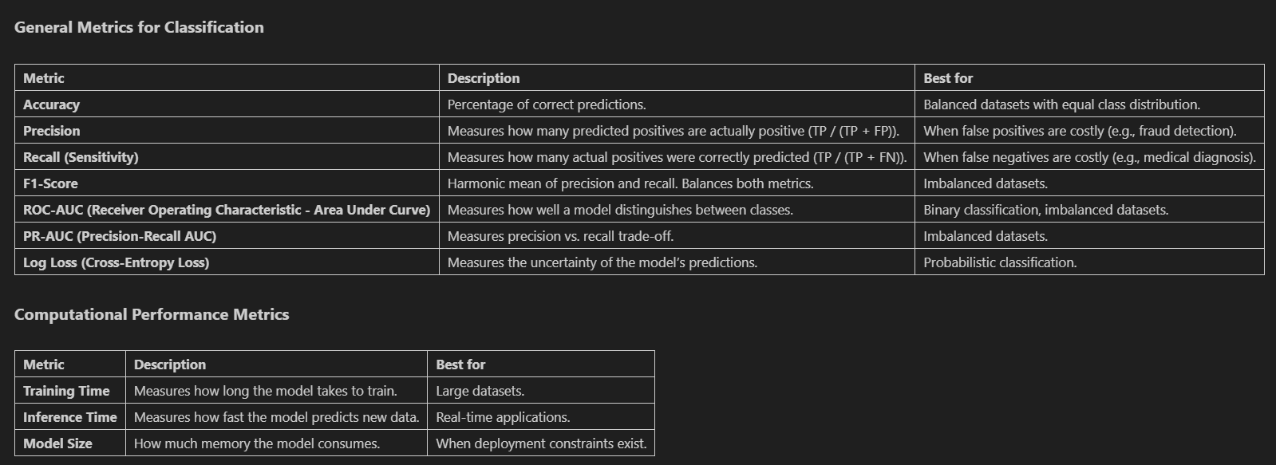
Modeling Evaluation Method
Train variety of models using default parameters first and evaluate them based on the following, with F1 score being the primary determinant.
Notes:
When evaluating classification models, we need metrics that align with our business objectives. For this imbalanced dataset, where only 6.35% of individuals earn over $50,000, accuracy alone would be misleading - a model could achieve 93.65% accuracy simply by predicting everyone earns under $50K!
Instead, we focus on the F1 score, which balances precision and recall. In business terms, precision answers: 'When we predict someone earns over $50K, how often are we right?' High precision means fewer false alarms. Recall answers: 'Out of everyone who actually earns over $50K, how many did we correctly identify?' High recall means we're not missing potential high earners.
The F1 score combines these metrics into a single number and tells you how successful your overall strategy is.
We also look at ROC-AUC, which stands for 'Area Under the Receiver Operating Characteristic Curve.' This metric tells us how well our model can distinguish between classes across different threshold settings. Imagine our model assigns a probability score to each person. By adjusting the threshold for classifying someone as earning over $50K, we can trade off between catching more high earners (higher recall) versus making fewer false predictions (higher precision). The ROC curve plots these trade-offs, and the area under this curve gives us a single number between 0 and 1. A perfect model scores 1.0, while random guessing gives 0.5. This is particularly valuable for imbalanced datasets like ours.
PR-AUC or 'Precision-Recall Area Under the Curve' is similar but focuses specifically on the trade-off between precision and recall, making it especially useful for imbalanced classes. While ROC curves can sometimes look overly optimistic with imbalanced data, PR curves provide a more honest assessment of performance when we care more about the minority class.
Finally, Log Loss (or Cross-Entropy Loss) measures the uncertainty in our model's predictions. Rather than just considering whether predictions are right or wrong, it penalizes confident wrong predictions more heavily than uncertain ones. Lower values are better. This is like rewarding a weather forecaster who correctly expresses uncertainty rather than one who is confidently wrong.
Together, these metrics give us a comprehensive view of model performance beyond simple accuracy, allowing us to select models that align with specific business objectives.

Slide 13
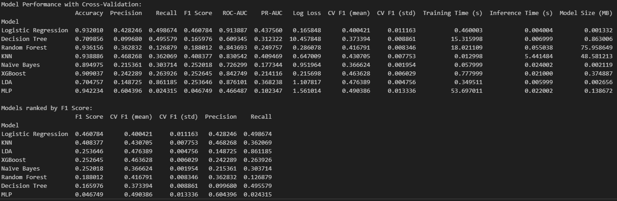
Modeling Training (Using Default Param)
Used the following models:
Logistic regression
Decision Tree
Random Forest
SVM (Support Vector Machine)
KNN (K-Nearest Neighbors
Naïve Bayes
XGBoost (Extreme Gradient Boosting)
LDA (Linear Discriminant Analysis)
MLP (Multi-layer Perceptron)
Used Stratified Cross Validation for imbalanced dataset
Selects top 3 models based on F1 score
Notes:
I tested a diverse set of models, each with different strengths. Logistic Regression offers simplicity and interpretability. Random Forest and XGBoost handle complex relationships but may overfit. KNN works well when similar individuals have similar incomes. I will note I left SVM out because it takes forever to run and I know it won’t perform as well as some other models here based off running a smaller dataset size.
It's interesting to note the trade-offs between different metrics. The KNN model achieved higher accuracy than Logistic Regression but a lower F1 score. This illustrates why choosing the right evaluation metric is so important - depending on our business objective, we might prefer different models.
The Multi-Layer Perceptron took significantly longer to train, which matters in production environments where time and computational resources have real costs. Sometimes a simpler model that delivers results quickly is more valuable than a marginally better but resource-intensive one.
Based on F1 scores, our top three models were Logistic Regression, KNN, and LDA. These became candidates for further refinement and possible ensemble methods.

Slide 14
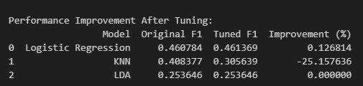
Hypertuning Top 3 models
Uses GridSearchCV to search through wide variety of parameter ranges for our top 3 models. Chooses the best one to evaluation on validation dataset.
Sometimes, tuning can degrade performance, be mindful
Notes:
Hyperparameter tuning is like fine-tuning a car's engine for optimal performance. I tested numerous configurations of our top three models to find the best settings for each.
Interestingly, tuning improved our Logistic Regression model only slightly, while it actually degraded KNN's performance. This highlights an important lesson: more complex isn't always better. Sometimes the default parameters are already well-optimized for certain datasets.
The degradation in KNN's performance suggests that the initial parameters were coincidentally well-suited to our specific data and that I should have spent more time on the parameter ranges I was testing on. These tuned models form the foundation for our ensemble approach, where we'll combine their strengths to potentially achieve better overall performance.

Slide 15
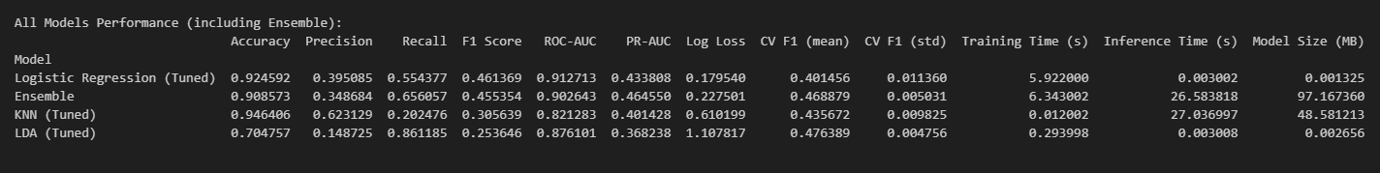
Ensemble Model
Uses top 3 models to produce ensemble model called VotingClassifier. Soft voting is used, which averages the predicted probabilities of each model.
Then trained and evaluated on validation data.
Compares the ensemble model to the top 3 models it’s derived from.
Sometimes ensemble doesn’t perform as well
Notes:
Ensemble models combine multiple individual models to make predictions, similar to how a company might gather input from different departments before making a major decision. Our ensemble uses 'soft voting,' which averages the probability estimates from our three best models.
The intuition is that different models capture different aspects of the data - where one model might be weak, another might be strong. Together, they potentially provide a more robust prediction than any single model alone.
When evaluated on our validation set, the ensemble achieved an F1 score of 0.455, slightly below the tuned Logistic Regression's 0.461. This suggests that the weaker models (KNN and LDA) may be diluting the ensemble's performance rather than enhancing it.
In a business context, we'd need to weigh whether the slight performance decrease is worth the additional complexity of maintaining multiple models. Sometimes simplicity and interpretability outweigh marginal performance gains.

Slide 16
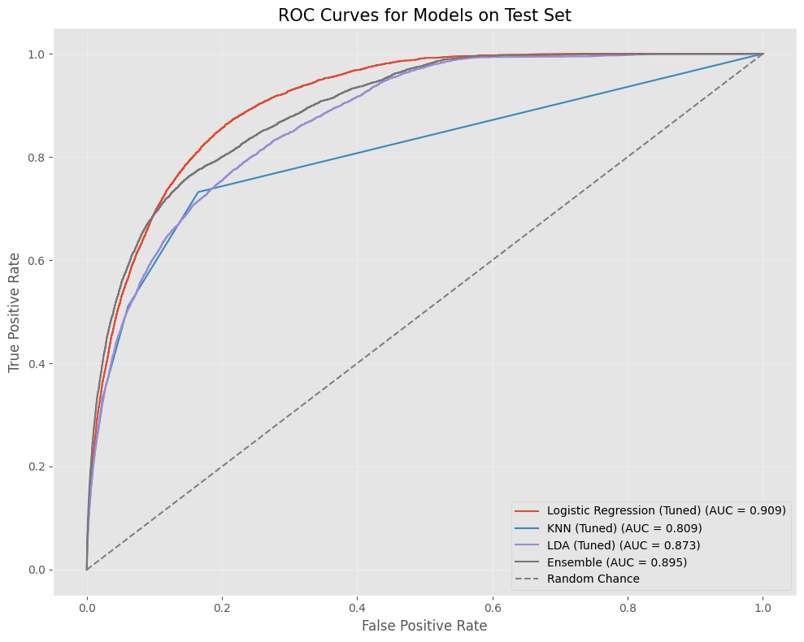
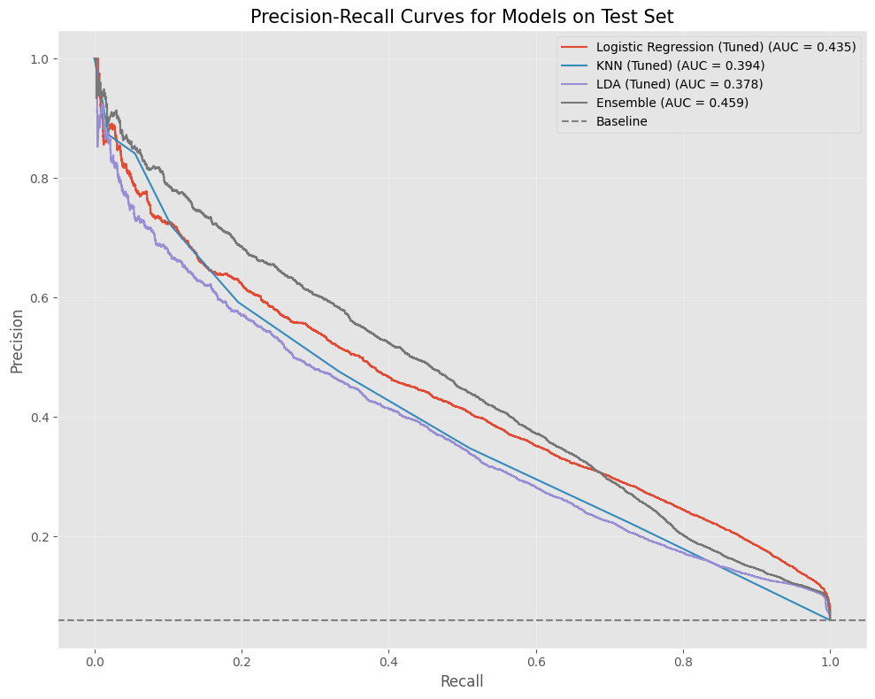
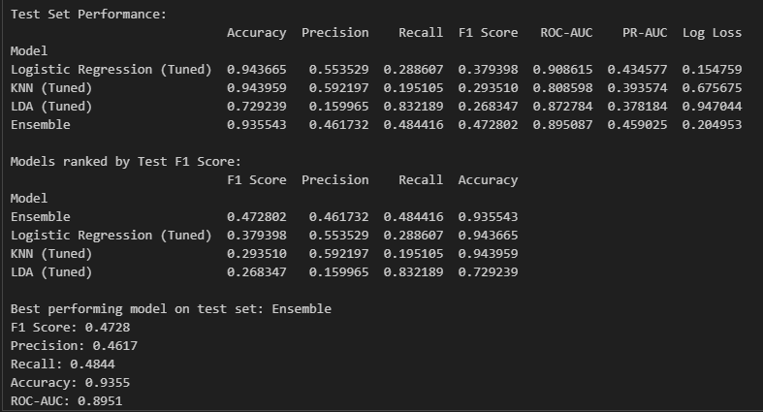
Final Evaluation
Results show significant room for improvement (F1 < 0.5)
Performance limitations stem from:
Highly imbalanced dataset (6.35% positive class)
Combined EDA prevented identifying test/train differences
Limited hyperparameter tuning
Notes:
When evaluated on the unseen test data, our ensemble model outperformed the individual models, achieving an F1 score of 0.473 compared to Logistic Regression's 0.379. However, let's be clear - these results are still quite poor overall. An F1 score below 0.5 indicates significant room for improvement.
This underwhelming performance stems from several factors. Most obviously, the imbalanced nature of our dataset presents a fundamental challenge - with only 6.35% of individuals earning over $50K, our models struggle to identify patterns for the minority class.
I also need to acknowledge I performed EDA on the combined test and training datasets, which prevented me from identifying potential distribution differences between them. This is problematic because if the test data has a different distribution than the training data, our models would be unprepared for those differences. The surprisingly better performance of the ensemble on the test set might indicate that the test data differs significantly from the training data, and the ensemble's ability to average multiple perspectives happened to work better in this case - not necessarily because it's inherently superior.
The hyperparameter tuning process was also limited by time constraints and could have been more comprehensive. As we saw earlier, tuning actually degraded KNN's performance, suggesting our tuning strategy wasn't optimal.
Looking at the ROC curves, all models do perform better than random guessing (the diagonal line), but the AUC values aren't as high as we'd want for a reliable predictive model. The Precision-Recall curves similarly show mediocre performance, with precision dropping rapidly as recall increases.

Slide 17
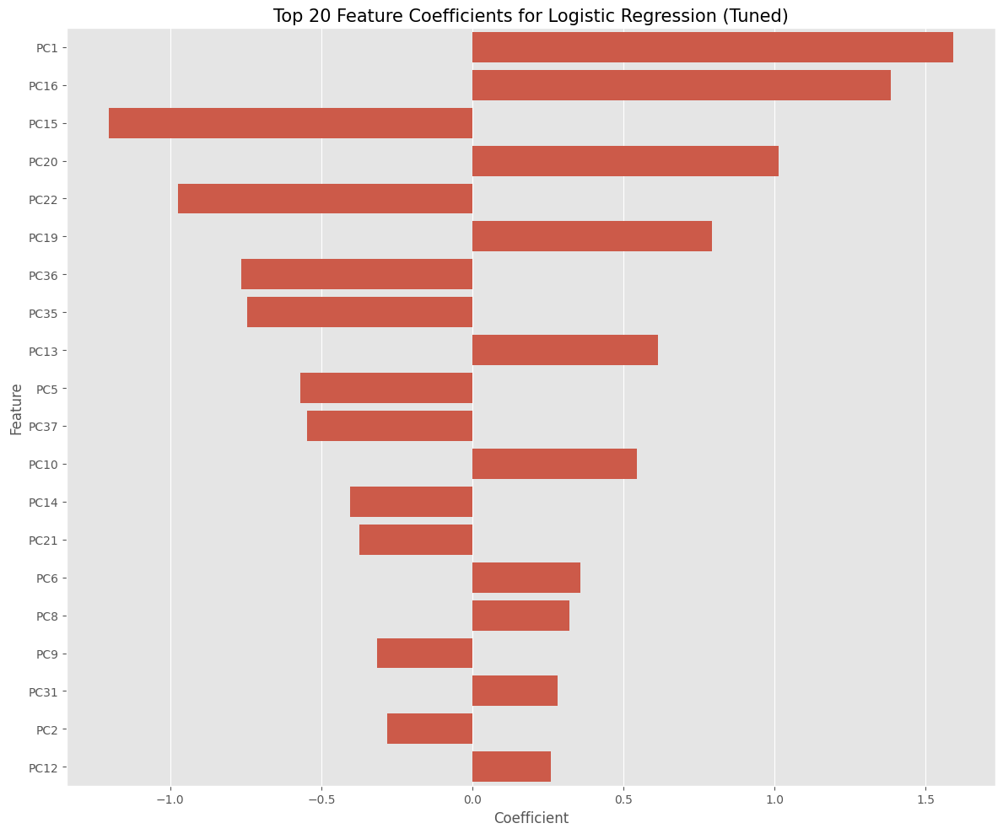
Feature Importance (PCA)
PCA was used, and time wasn’t spent understanding those features
PCA components can be mapped back to original features through component loadings
Positive coefficients indicate features that increase likelihood of >$50K income
Notes:
Understanding which features drive our predictions is crucial for both technical validation and business insights. Due to our use of PCA for dimensionality reduction, the feature importance shown here represents the principal components rather than the original features.
The balanced distribution of positive and negative coefficients suggests our model is capturing complex patterns rather than being dominated by just a few factors. Some components strongly indicate higher income probability (positive coefficients), while others suggest lower income probability (negative coefficients).
It is possible to map these principal components back to the original features by examining the component loadings – essentially how much each original feature contributes to each principal component. For example, if PC1 has high loadings from education level and occupation type, and PC1 has a strong positive coefficient in our model, we could deduce that these original features are important positive predictors of higher income. This mapping would allow us to translate our technical findings into actionable business insights, such as identifying which demographic or employment factors most strongly influence income levels.

Slide 18
Future Improvements
Enhanced Feature Engineering
Utilize OpenFE package for automated feature creation
Collaborate with domain experts to identify business-relevant features
Improved Preprocessing & Model Selection
Implement systematic testing of preprocessing combinations
Experiment with various outlier removal techniques (Z-score, IQR, LOF)
Test different skewness handling methods (Yeo-Johnson, Box-Cox)
Better Model Interpretability
Map PCA features back to original variables for clearer insights
Add confusion matrices to visualize specific model errors
Include example individuals with characteristics to demonstrate predictions
More Robust Validation Approach
Properly separate test/train data throughout the analysis
Allow ensemble to choose from both tuned and non-tuned models
Presentation Enhancements
Add educational visuals explaining model mechanics
Improve visualization legend and formatting
Include examples showing real-world applications of predictions
Notes:
While this analysis provides valuable insights, there are several areas where we could enhance both the technical approach and business value with additional time and resources.
I would leverage automated feature engineering tools like OpenFE to discover more predictive features, potentially revealing patterns we haven't considered. Working cross-functionally with domain experts would help focus on the most business-relevant features rather than treating all variables equally.
For model optimization, I would implement a systematic approach to testing preprocessing steps - similar to a function I've developed professionally that automatically evaluates which combination of techniques produces the best results for a given dataset.
On the presentation side, adding educational visualizations to explain model mechanics would make complex concepts more accessible to stakeholders across the organization. This improves not just the analysis itself, but also its adoption and impact within the business.
Adding a confusion matrix would provide a clearer picture of exactly where our model succeeds and fails - showing the specific numbers of correct and incorrect predictions for each income category. I would also include examples of 2-3 real individuals with their characteristics and how the model classifies them, which would help stakeholders understand the practical implications of our model's predictions. For instance, showing a 45-year-old manager with a bachelor's degree whom our model correctly predicts earns over $50K, alongside a 35-year-old service worker whom our model misclassifies, would make the model's strengths and limitations tangible.
These improvements would strengthen both the technical rigor and the business applicability of our findings, enabling more effective decision-making based on our predictions.
That concludes my presentation, is anyone still awake, and are there any questions?

