Slide 1
U.S Census - Classification
By: Rehan Daya
Notes:
Hello everyone. Thank you for being here.

Slide 2
Preface - Limitations
Spent 1 day working on this
Focus is on data science and explanation over graphics
Limited compute resources
Had to use dimension reduction techniques to compete
Notes:
In preparing this analysis, I made a decision to spend 1 day on this, allowing me to maintain a healthy work-life balance, as I am currently working a full-time job outside of this. My focus was on delivering a concise and insightful solution, rather than focusing on a pretty PowerPoint, and I believe the following presentation reflects that. The reason for this was that in my prior consulting experience, I’d be provided with a power point template to work within with some guidelines on how things should be made. I imagine DataIku’s platform would also take care of this aspect, so I think the core amount of my time would be better spent on the actual content. However, I don’t want this to reflect my ability to make a pretty power point, at the same time, so if it’s any help, I have made pitch decks that I have given to investors for a company I founded a few years ago called Roommate AI.
As I have been briefed, there are technical and non-technical people here so I will try to aim for something in the middle that everyone can take something valuable away from. While I could have just opened up my code and presented that, I feel it’s a very busy file to look at, so we will proceed from here. But if there’s time left, we can open up the code and look through it to explain things further.

Slide 3
Overview
The core task is to build a model that predicts whether an individual earns more or less than $50,000 per year.
This is a binary classification problem.
The data comes from the US Census archive and includes anonymized information for approximately 300,000 individuals.
Provided metadata and other supporting documentation to assist in understanding the dataset.
Notes:
Let's begin with an overview of the problem and the data.
The goal of this project is to predict whether an individual earns more or less than $50,000 per year. This is a binary classification problem, which means we're predicting one of two categories.
The dataset contains anonymized information for approximately 300,000 individuals.
In my initial data exploration, I observed that there were no missing values, which simplified the initial data cleaning process.
I also reviewed the metadata to gain a better understanding of the dataset's features.
If I had more time, I would delve deeper into understanding the data's source and meaning by collaborating with relevant teams. This would inform feature engineering and help identify potentially irrelevant features.

Slide 4
Data Science Pipeline
Step 1
Step 2
Step 3
EDA
Target Variable Distribution
Numerical Features Analysis
Categorical Features Analysis
Data Preparation
Data Cleaning
Feature Engineering
Encode Categorical Features
Split Data
Imputation
Handle Outliers
Handle Skewness
Scale
Dimension Reduction – PCA (optional)
Remove Multicollinearity
Modeling
Model Training and Evaluation
Hyperparameter tuning for Top models
Build Ensemble Model
Final Model Evaluation
Feature Importance Analyses
Notes:
The data science pipeline I followed to address the problem is what I’d consider to be pretty standard. I’ve actually made a large function that performs a good portion of this at my job, in a much cleaner way then I did for this project. It helps to automate things a bit better.
1. EDA (Exploratory Data Analysis):
We start with EDA to understand the data's characteristics.
In short, EDA helps us understand the data and identify potential issues or opportunities.
This involves analyzing the target variable, numerical features, and categorical features in the form of bar charts, scatter plots, or box plots
2. Data Preparation:
Next, we prepare the data for modeling.
Essentially, this step gets the data into a clean, usable format for our models.
This includes cleaning, feature engineering, encoding categorical variables, splitting the data, handling missing values (if any), addressing outliers and skewness, scaling, optional dimension reduction with PCA, and removing multicollinearity.
3. Modeling:
Finally, we build and evaluate our models.
In this stage, we build, refine, and assess our predictive models.
This involves training and evaluating models, tuning hyperparameters, potentially building an ensemble model, performing final model evaluation, and analyzing feature importance.
Moving on to explain in detail my modeling, well start with EDA

Slide 5
EDA (Exploratory Data Analysis)
Purpose of EDA:
Is to validate patterns and find anomalies
May uncover improper ETL process
Show potential features to engineer
Provide a means to tie models coefficients to business insights
Find outliers
Results:
Imbalanced dataset
Percentage - 50000.: 93.65%
Percentage 50000+.: 6.35%
33 categorical features, 7 numerical features
Notes:
I found that the dataset was imbalanced, with 93% of the individuals earning less than $50K. This tells me that in future steps, ill need to consider stratifying my models during their cross-validation process, to ensure I am training my models on data that represents the distribution seen here.
I also noted that there were 33 categorical features and 7 numerical features. This let me know that I’d need to spend a bit of time working on encoding those categorical features using methods like Label Encoding and One Hot Encoding.
Label Encoding:
Assigns a unique numerical value to each category in a categorical feature.
Used for ordinal features (where categories have a meaningful order).
Example: "Low," "Medium," "High" might be encoded as 0, 1, 2.
One-Hot Encoding:
Creates new binary columns for each category in a categorical feature.
Each observation gets a "1" in the column corresponding to its category and "0" in the others.
Used for nominal features (where categories have no inherent order).
Example: "Red," "Blue," "Green" would become three columns: "Red" (1/0), "Blue" (1/0), "Green" (1/0).

Slide 6
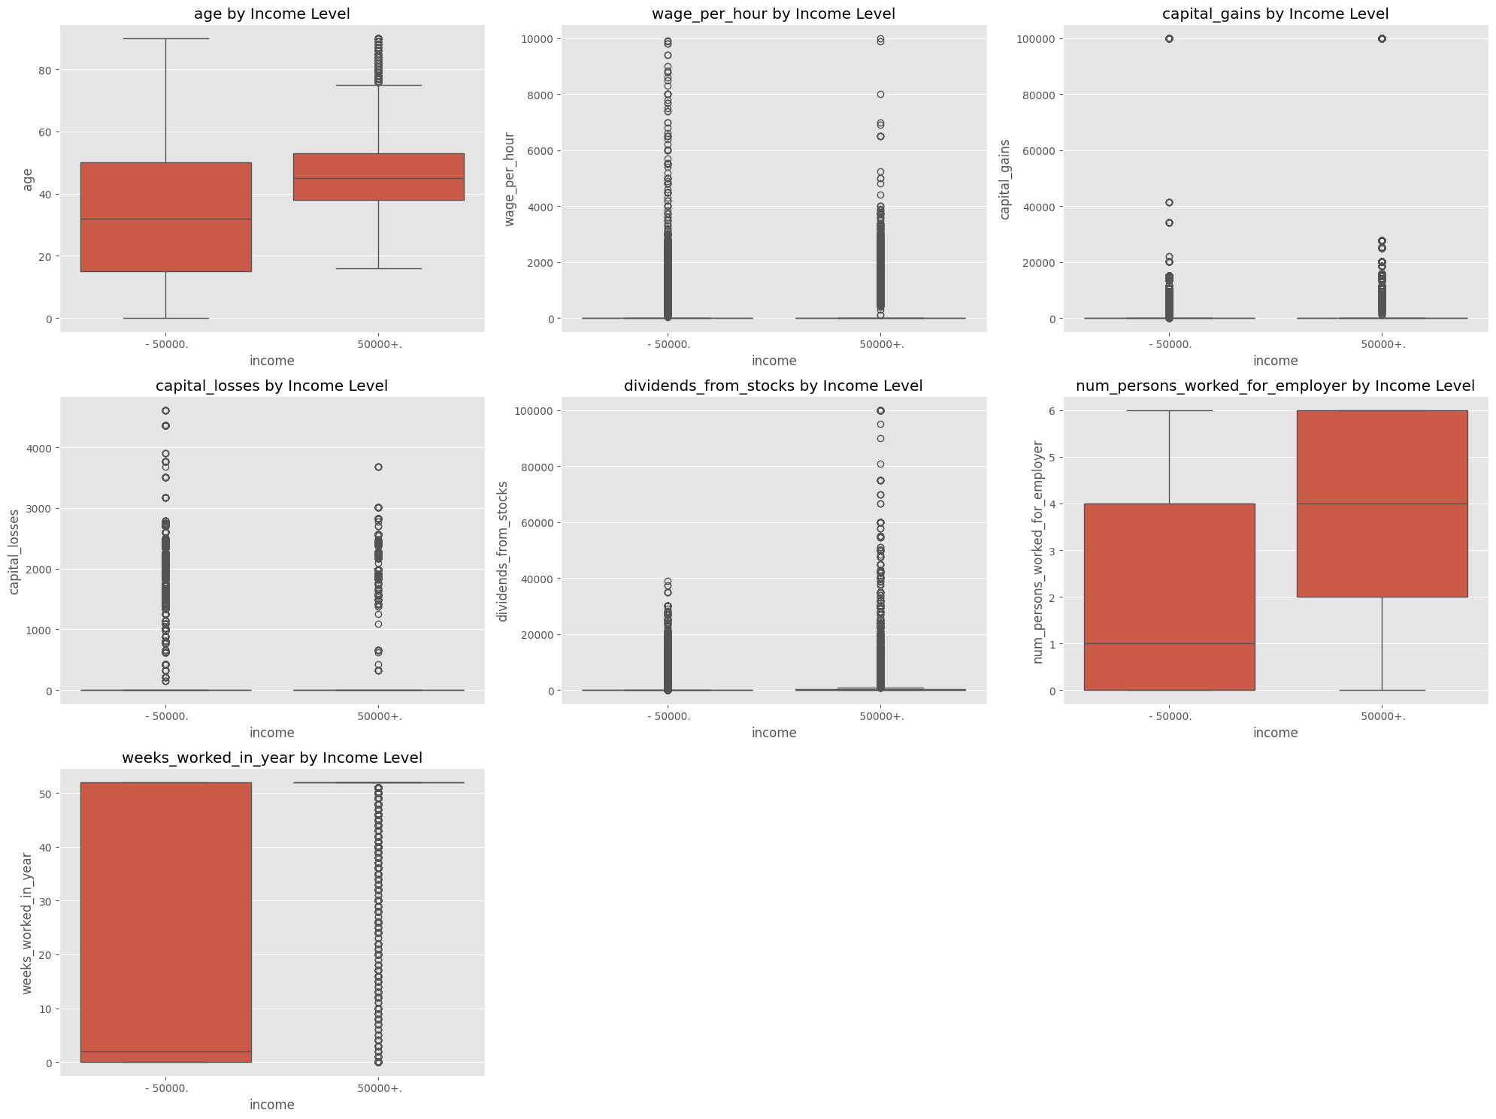
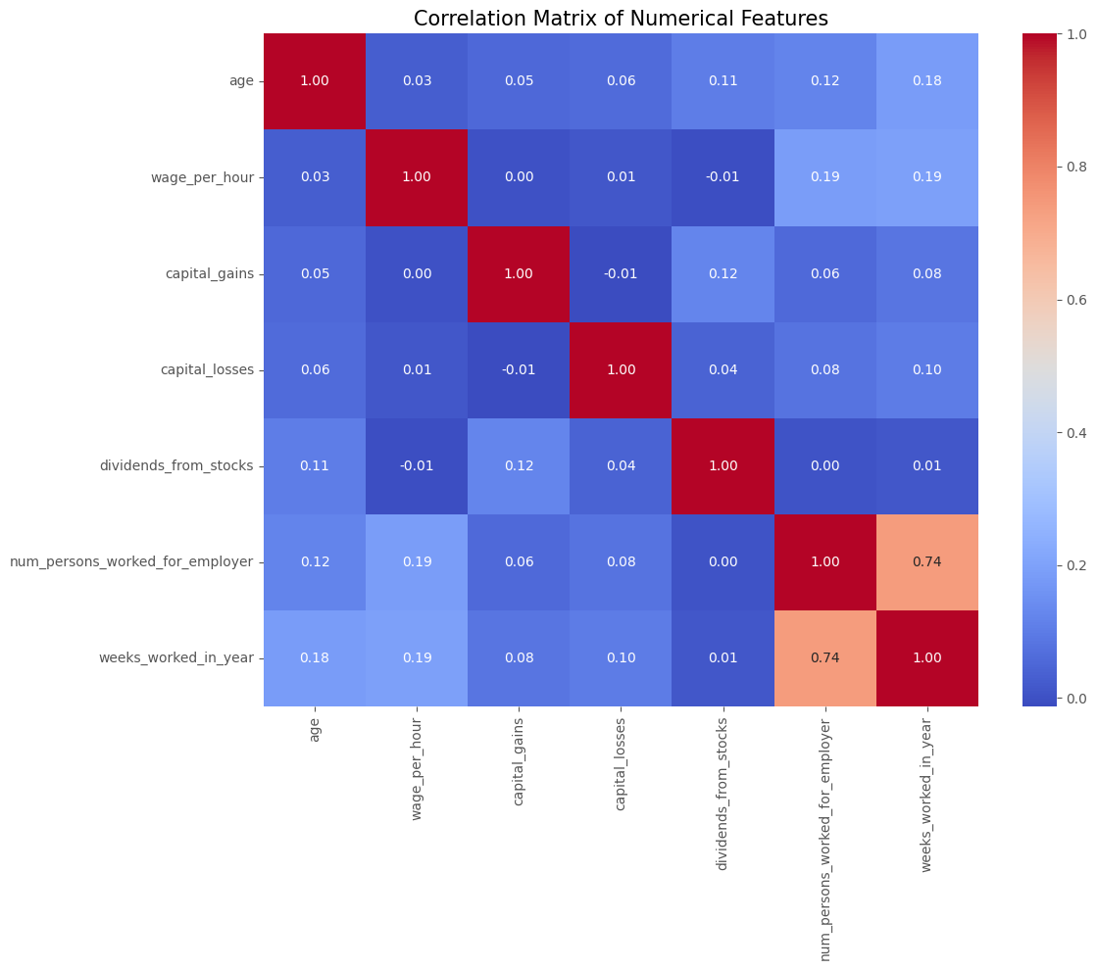
EDA Numeric
Notes:
I only visually checked for outliers and correlations for numerical features, since I still needed to encode my categorical features. Not to worry though, I do check for outliers and correlations in my categorical features later, I do it for all features, except our target feature of course.
But based on the visualizations here alone, we can see that there was only relationship that was highly positively correlated and it was that an individual worked more weeks in a year as their company size grew.
We can also see that there are very large amounts of outliers in some of these features. Taking a look at wage per hour, it’s clear some of these values are not correct and need to be removed, because who here is earning $10,000 an hour? If you are, I'm not sure why you’re here

Slide 7
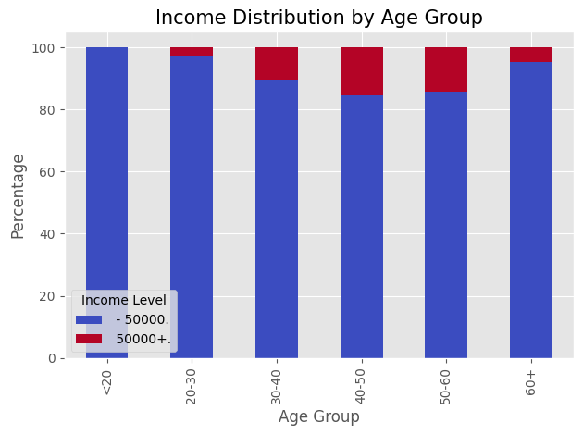
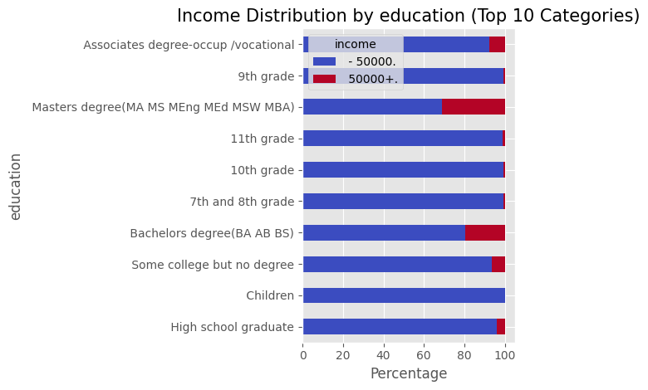
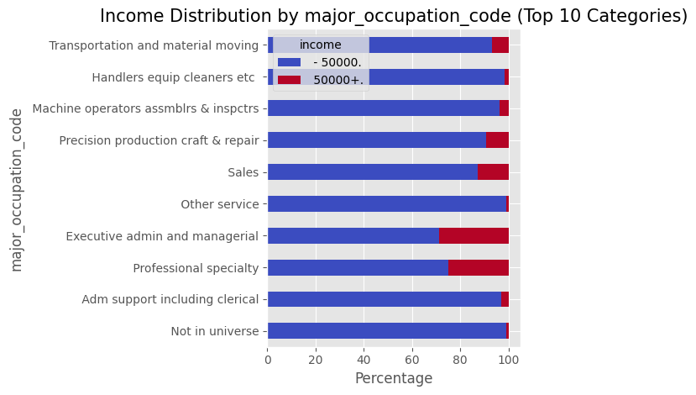
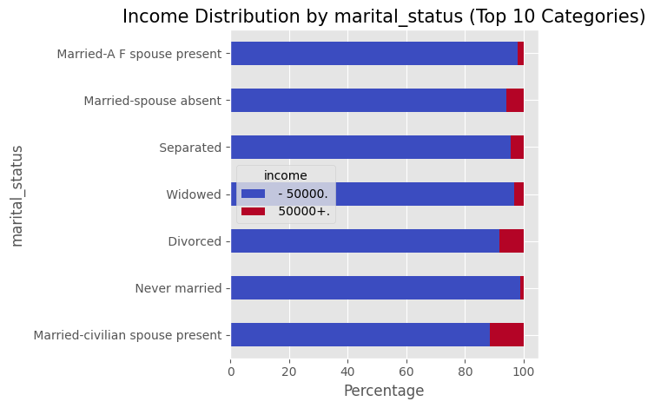
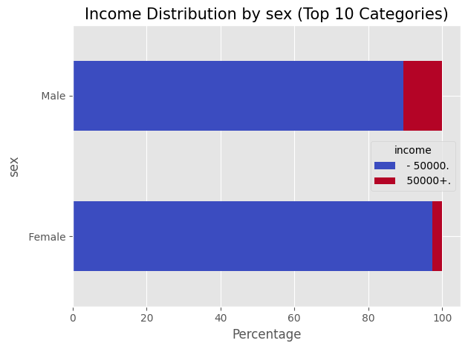
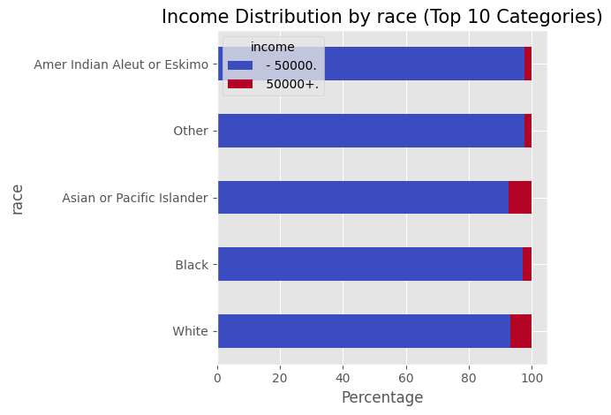
EDA Categorical
Notes:
So, there’s a lot of visualizations I made considering there were 33 categorical features, but I don’t want to spend the whole day going over them, especially since I mentioned earlier that I didn’t spend too much time on this since I’d usually work with other teams to narrow down what features are significant instead of relying purely on visuals and statistics to guide me.
But what we can see here is a group of stacked bar charts covering some of the typical variables you’d expect to see from a dataset like this. The overall trend I saw here, was that older working-class men with higher educations tend to make more than $50,000. They work in fields that are in higher demand and thus get higher pay. There’s a cultural aspect at play too here, where we can see white and Asian people pursuing higher paying jobs. That’s not a surprise to me, because growing up as an Asian guy, it was pushed to be a doctor, lawyer, or engineer.

Slide 8
Data Preparation
Use metadata file to map column headers to data, since they are missing in CSV
Convert target to binary with the correct values
There’s some padding in its value, tricky
{' - 50000.': 0, ' 50000+.': 1}
There are duplicate rows in train and test, causing data leakage, drop those
Notes:
Moving on from EDA, let’s get into preparing the data for modeling purposes.
To start, I used the metdata file to figure out the values respective column names. Probably a complaint I’d make to the data engineer who gave me the dataset, because it’s Definity not common to have the columns not be apart of the dataset.
I converted the target variable into a binary output of 0 and 1 for our model to understand.
And I removed duplicate rows, where I noticed there was some data leakage. There were rows that were duplicated in the test and train dataset, very odd I think.

Slide 9
Data Preparation cont.
Feature Engineer
Reach out to experienced management to better derive features
Created some simple ones:
Work experience = age minus 18, assuming people start working at 18
Encode Categorical Features
Label encode features with hierarchy
'sex': {' Female': 0, ' Male': 1},
One hot encode features without hierarchy
citizenship: 5 unique values
Unique values: [' Native- Born in the United States'
' Foreign born- Not a citizen of U S '
' Foreign born- U S citizen by naturalization'
' Native- Born abroad of American Parent(s)'
' Native- Born in Puerto Rico or U S Outlying']
Notes:
Next, I worked on engineering some new features. As I mentioned earlier, I didn’t spend too much time here, because I could have used a python package to automate this, or reached out to other folks to glean some wisdom on this. I could have also read through the 300 page documentation on this dataset, but as a wise person once said, ain’t nobody got time for that.
So I stuck with some features that seemed interesting, like subtracting 18 years from a person age, to determine their work experience. I know some people start working earlier then that, and I could have tuned it better.
I also encoded my categorical features, like their sex and one hot encoded features like their citizenship status.
I did notice that there was a value in the train dataset that wasn’t in the test dataset afterwards by comparing their overlapping columns, it’s something to keep in mind as it’ll bite you in the butt later on.

Slide 10
Data Preparation cont.
Split data into train and validation
Done before preprocessing to avoid data leakage
Scaling using test and train, will cause values to be based on test data as well
Preprocessing can change interpretation of features, but some models need this
Used stratified split
Imputation for missing values
For each numerical column, uses median value
For each categorical column, uses most frequent value
Remove outliers
Using IQR (visualized by a boxplot)
Typically Lower bound: Q1 - 1.5 * IQR and Upper bound: Q3 + 1.5 * IQR
I used 5 * IQR due to the process being too harsh
Notes:
Once the basic data cleaning is done, you’d want to split the dataset into test and train, but that’s already been done for us. You're going to want to do this early on to prevent data leakage. This means that changes you make like scaling your data, will take into account information from the test set and training set. Something I want to note here, is that I made the mistake of creating a hold out validation set, which is redundant, so I’d go back and fix that. But I essentially split the train into a hold out validation and train dataset, then created an additional validation set s from the train set later on. It’s not entirely harmful sine it reduced the train dataset size by about 20%, but it’s not helpful either. This is usually not going to be done unless you’re going to train an LLM I imagine, where the test set might be huge and so you want to be extra sure that your models are good to go before training them.
Moving on, hen we impute missing values. There are various methods you can use for this, including complex ones that utilize probability, but I stuck to a simple solution like using the median value for numeric columns and frequency for categorical.
I mentioned earlier that there were no missing values though, so I didn’t really need this step. I personally don’t believe in imputation because it’s entirely a guessing game and not a great one, so I usually prefer to just drop rows entirely. But sometimes you can’t afford to do that.
Then we remove outliers. Remember that box plot where people were earning $10,000 an hour. We can kiss those people goodbye with this step. The problem was, that the standard IQR method was too harsh, so I had to make it a bit more lenient. I was getting some issues where it was dropping all the rows, can’t have that now can we.

Slide 11
Data Preparation cont.
Handle Skewness
Applies log transformation (works with positive and negative values) to bring distribution of features closer to Gaussian distribution (normal distribution). Some modals benefit from this.
Scale
Applies robust scaling (X - Median) / IQR. This makes it robust to outliers
Important for models like KNN, where difference in scales influence disproportionately.
Dimension Reduction
PCA used to reduce features to speed up model, but lose interpretability
Reduces correlation and noise, by capturing variance between features
Places a vector or line that maximizes this variance, and then turns that line into a feature.
Remove multicollinearity
Remove features with absolute correlation above .75
Notes:
Last steps for the data preparation, are adjusting skewness. This just means we want to try to make features reach a certain level of similarity to a normal distribution or bell curve because some models work well with that. Keep in mind, all these cleaning steps we’re doing here change the inherent make up of the data just enough to the point that you can and will lose interpretability of the data. So you do have to be mindful of the steps you apply, you don’t have to apply all the steps I do. This is more of an example of showing what can be done. Overengineered some might say.
Anyways, the next step was scaling. Imagine you got a feature that uses dollars and another that uses hours. The goal is to place them on the same scale, because models like K nearest neighbors use distance between points to function and so scale can really mess things up.
Then there is an optional step of applying dimension reducing techniques, a popular one is PCA. Imagine you have a scatter plot and place a line on it like a linear regression. The goal of that line is to capture the largest variance between that line and each point. Then that line will represent those features in a singular feature.
Lastly, if you didn’t use PCA, you have to remove multicollinearity after all the features that were made and altered at this point. You can use something called Variance inflation Factor too, but I stuck with a simpler approach.

Slide 12
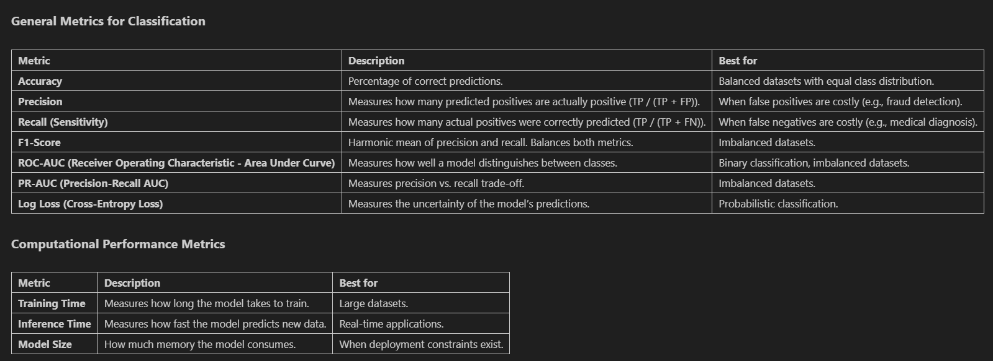
Modeling Evaluation
Train variety of models using default parameters first and evaluate them based on the following, with F1 score being the primary determinant.
Notes:
So that sums up all the data cleaning and we’re ready for the fun part now.
There are a lot of ways to evaluate models, and I’ve narrowed them down to the following ones you see here in the tables. I felt like adding some cool ones like training time, inference time and model size in case someone wanted to think about computational resources.
The feature we’re going to focus on is F1 score, because we are working with an imbalanced dataset.
F1 Interpretation 1
"The F1 score helps us measure a model's performance, especially when dealing with imbalanced data. It's like a balanced average of precision and recall. A high F1 score means the model is good at both: correctly identifying positive cases (recall) and avoiding false positives (precision)."
F1 Interpretation 2
"Imagine you're trying to find all the apples in a basket (positive cases). The F1 score tells you how successful you are at that. It considers:
How many of the items you picked were actually apples (precision).
How many of the total apples you managed to find (recall).
The F1 score combines these two measures to give you a single number that shows how useful your search is.

Slide 13
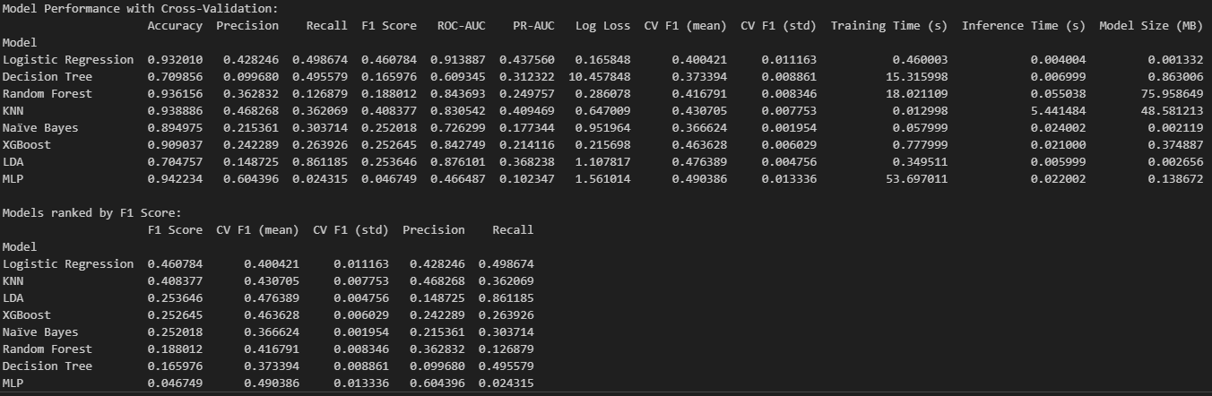
Modeling Training (Using Default Param)
Used the following models:
Logistic regression
Decision Tree
Random Forest
SVM (Support Vector Machine)
KNN (K-Nearest Neighbors
Naïve Bayes
XGBoost (Extreme Gradient Boosting)
LDA (Linear Discriminant Analysis)
MLP (Multi-layer Perceptron)
Used Stratified Cross Validation for imbalanced dataset
Selects top 3 models based on F1 score
Notes:
Well, be applying all those metrics we looked at earlier, to each of these models. I will note I left SVM out because it takes forever to run and I know it won’t perform as well as some other models here based off running a smaller dataset size.
You might remember I mentioned earlier that I accidentally made a validation before this step we’re on. But like I said, it doesn’t really hurt much other then reducing our training data a tad bit.
So once the models are done being evaluated, we pick the top 3 models based on their f1 score.
Depending on what your goal is, you’ll notice that some models perform better in certain metrics than others. Like for KNN, it has a higher Accuracy then Logistic, but a lower F1 score then Logistic.
I’d also note that the Multi Layer Perceptron took the longest to train here, which isn’t a surprise considering it’s delving into neural networks.

Slide 14
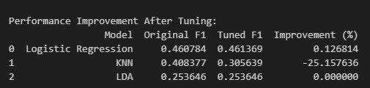
Hypertuning Top 3 models
Uses GridSearchCV to search through wide variety of parameter ranges for our top 3 models. Chooses the best one to evaluation on validation dataset.
Sometimes, tuning can degrade performance, be mindful
Notes:
We tune those 3 models by running dozens of version of them with slightly altered parameters, like for a random forest, how many branches deep do we want it to go.
Then we select the best performing iteration of these 3 models to make our ensemble model.
It’s possible that tuning might hurt your model, like it did with KNN. This is because the default parameters I used in the initial model selection in the last slide, were more optimal than the options I gave it in the grid search. This is an area you can easily tinker around a bit in and get massive improvements in performance of the model.

Slide 15
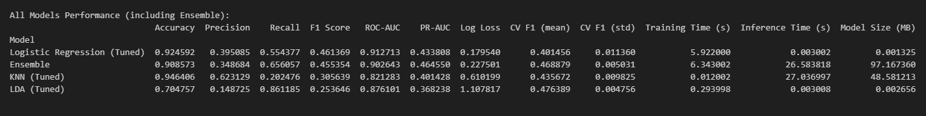
Ensemble Model
Uses top 3 models to produce ensemble model called VotingClassifier. Soft voting is used, which averages the predicted probabilities of each model.
Then trained and evaluated on validation data.
Compares the ensemble model to the top 3 models it’s derived from.
Sometimes ensemble doesn’t perform as well
Notes:
Each of the top 3 models has their own outputs with their respective probabilities based on various thresholds. So, the ensemble basically uses the averages of those probabilities to get an output.
We then train and evaluate this ensemble model on the validation set
I then compare how it performs versus the other 3 top performing models it was derived from on the validation set. This is because sometimes, one of those models might drag the performance of the ensemble down. This step is redundant as I mentioned earlier due to how I produced the validation sets early on in the code.
Either way though, we can see that it’s performing slightly worse then the logistic regression model in it’s f1 score, no doubt, due to the KNN and LDA it’s partially based on. Still not bad all things considered.

Slide 16
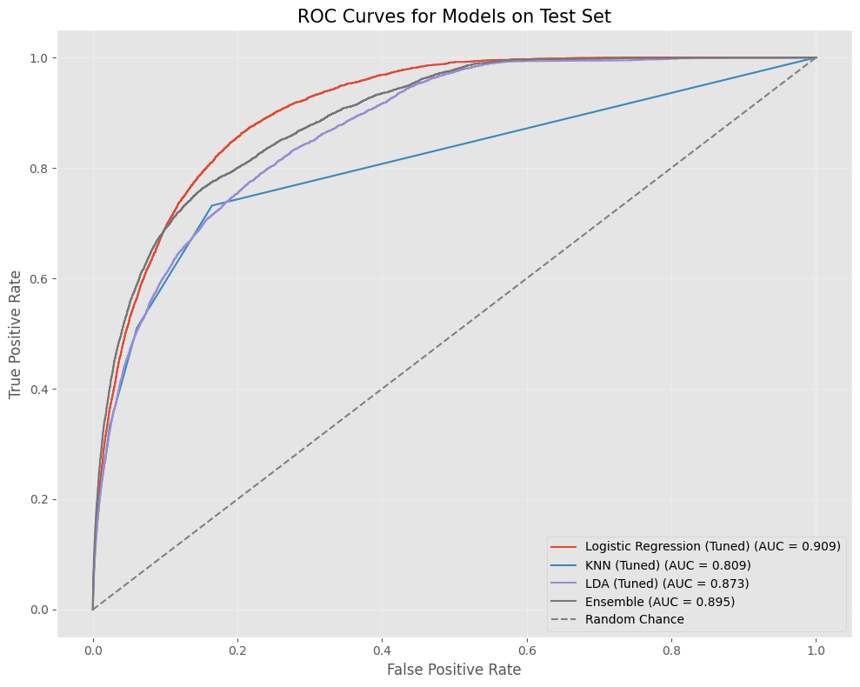
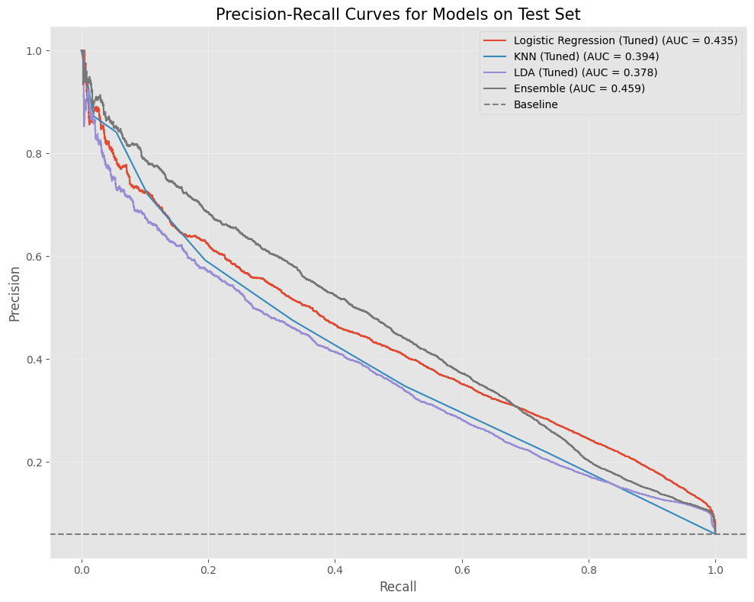
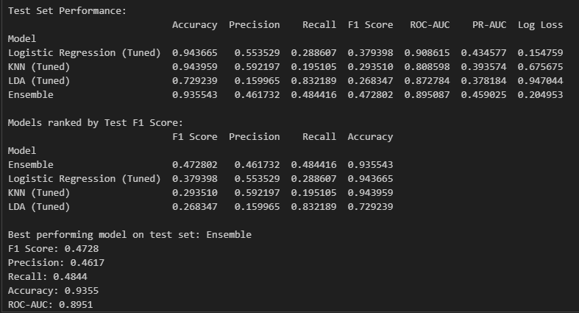
Final Evaluation
Using top 3 models end ensemble model, runs them on test dataset for final evaluation.
Visualize the test results by plotting ROC curves and Precision Recall curves for each model to easily compare
Notes:
Once the best model is chosen, we do the same thing here except we apply the models to the test dataset. I found that my ensemble method performed the best surprisingly. It’s surprising because as I mentioned, I’ve been validating models through an extra step by using the hold out validation dataset I made early on, so that’s supposed to prevent having major Suprises on the train dataset. But what I realized at this point, was that it was based on the train dataset, and I never did a separate EDA on the train and test and instead combined both datasets to do my EDA. This means that the reason for the ensemble doing better in this is potentially because it’s averaging of probabilities is making it less susceptible to data changes, or that the test dataset is different in it’s distribution of it’s features compared to the train. I’d have to go back and check.
The graph in the middle is the ROC Curve and a random guess will get you a 50/50 chance to get something right essentially as depicted by the diagonal line. So, the goal is to have your model get to the upper left of the graph, which means the model has good discriminatory power. It guesses things correctly more rather then incorrectly. The Precision-Recall Curve shows the trade off between a model making fewer false alarms (which is it’s precision) and how many individuals did the model correctly identify. So the goal is to have the lines be up and to the right.
Precision: When the model predicts someone makes over $50,000, how often is it right? High precision means fewer false alarms
Recall: Out of all the people who actually make over $50,000, how many did the model correctly identify? High recall means the model doesn't miss many high earners
So overall, the results suck. We can chalk it up to some finer tuning needed and especially due to the imbalanced nature of the data, where 6% of individuals earned more than $50K. There are methods you can use to create observations to address this imbalance, but they’re not reliable enough as it’s just a guessing game again at that point, rather than going off of hard data. For instance, random oversampling, where you can duplicate examples for those who made over $50K because they’re the minority. But that’s just introducing noise in my opinion and experience.
The other down side is that my ensemble wasn’t able to produce feature importance for some reason. But I had a workaround where since the logistic regression performed the best, I used it’s features. To be clear, I used logistic because it’s part of the ensemble.

Slide 17
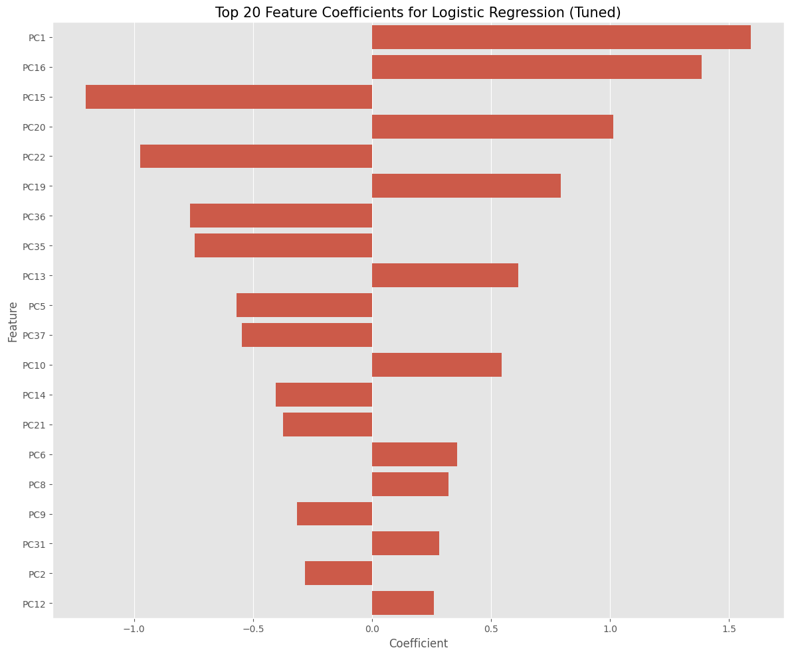
Feature Importance
PCA was used, and time wasn’t spent understanding those features
Notes:
So like I mentioned earlier in the data preprocessing steps, I didn’t spend much time trying to understand the PCA features I made. And the reason for using PCA other then flexing my knowledge on the available tools, was compute limitations. I would have had over 300 features otherwise to work with and I’d rather not have my computer running these models for hours on end, cause it heats up my room like crazy.
But what we can see from this graph, is that there is a good balance of important and less important features, both positive and negative influences on our target feature. That’s a good sign that we have a balanced feature set at least, so we know our preprocessing wasn’t that bad in that regard at least.

Slide 18
Future Improvements
Experiment with various univariate outlier removal techniques (e.g., Z-score, IQR, MAD, LOF, Isolation Forest, One-Class SVM) and their parameter settings.
Explore different skewness handling methods (e.g., Yeo-Johnson, square root, cube root, Box-Cox, log transformations) to potentially improve model performance.
Test different feature scaling techniques (e.g., Z-score, MinMax, Robust, MaxAbs, Quantile, Power) to suit various models.
Spend more time on feature engineering and work cross functionally with different teams to better understand industry
Refine hyperparameter selection by utilizing more logical ranges and deepening understanding of each model's parameters through documentation.
Have ensemble choose from tuned and non-tuned models, since tuned can perform worse
Enhance the visual appeal of the plots, particularly by improving the legend.
Spend more time understanding the PCA features and which features they are replacing
Use python package OpenFE to automate feature engineering with 21 transformations
Make the power point prettier and add educational slides on how models work
Notes:
My favorite slide is this, and it’s Obviously, I like to tinker around quite a bit. There’s a lot of things I would improve here, and I think what matters here again, is the time limit, so knowing what I would change in the future is key if I didn’t have that. Obviously I’d make a much nicer looking power point too, I’ve given pitches to investors for a company I founded, so yeah, this is pretty bare bones, but that’s not always a bad thing, really depends on the audience and topic.
The most notable things Id change are using a python package to automate feature engineering and working with management to filter down features that matter.
I’d also implement the function I made at work, which automatically tests out the various preprocessing steps on a model like a random forest, to see which combination produces the best results.
Lastly, I’d want to spend more time on the presentation itself, by adding more images that help explain complex things like how the models work.
And that’s the end of my presentation, are there any questions?

