Slide 1
Timer

Slide 2
Registers
Timer register
Compare register
Prescaler / Control Register

Slide 3
Timer Register
It is basically a counter register which is provided the clk generated by prescaler. if prescaler is enabled with some value otherwise direct PCLK is connected to it.
Compare register
It contains the value which will be compared with timer register if both are equal then an interrupt will be generated.

Slide 4
Prescaler / Control register
It is a register which contains some prescaler bits as well as an enable bit. It simply enable / disable the timer based on the value of zeroth bit. ctrl_reg[0] = 0 or ctrl_reg[0] = 1. 0 = disable , 1 = enable.
In this timer the prescaler_value = ctrl_reg[5:3].
This value is used to divide the clk frequency.
For this timer if prescaler is 1 and enable bit is also 1 so the clk provided to timer register will be 10 times slower than the PCLK.

Slide 5
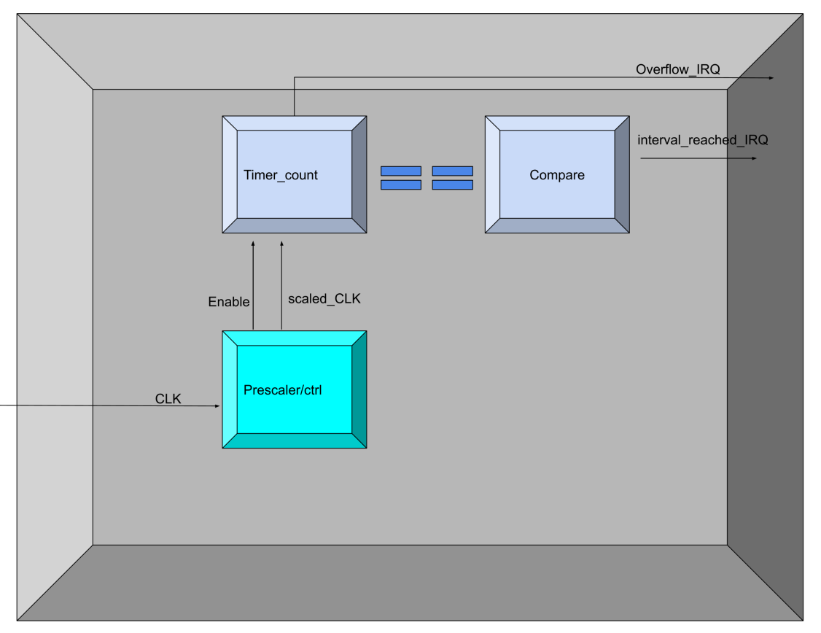
BLOCK DIAGRAM

Slide 6
Address and prescaler format
REG_TIMER 0
REG_TIMER_CTRL /Prsecaler 1
REG_CMP 2
format of :PADDR = {7'd0,index[2:0],2’d0}
addr => ctrl = 12'd4
addr => cmp = 12'd8
addr => timer = 12’d0
PRESCALER_STARTBIT 3 of reg_timer_ctrl
PRESCALER_STOPBIT 5 of reg_timer_ctrl
prescaler format: WDATA = {26'd0,presc_bit[5:3],3’d0}

Slide 7
Prescaler Values
ctrl = 32'd0 disabled timer no prescaler
ctrl = 32'd1 enabled timer no prescaler
ctrl = 32'd8 disabled timer prescaler 1 i.e 10 times larger delay
ctrl = 32'd9 enabled timer prescaler 1 i.e 10 times lager delay
ctrl = 32'd16 disabled timer prescaler 2 i.e 20 times greater delay
ctrl = 32'd17 enabled timer prescaler 2 i.e 20 times greater delay
ctrl = 32'd24 disabled timer prescaler 3 i.e 30 times greater delay
ctrl = 32'd25 enabled timer prescaler 3 i.e 30 times greater delay
ctrl = 32'd32 disabled timer prescaler 4 i.e 40 times greater delay
ctrl = 32'd33 enabled timer prescaler 4 i.e 40 times greater delay
ctrl = 32'd40 disabled timer prescaler 5 i.e 50 times greater delay
ctrl = 32'd41 enabled timer prescaler 5 i.e 50 times greater delay
ctrl = 32'd48 disabled timer prescaler 6 i.e 60 times greater delay
ctrl = 32'd49 enabled timer prescaler 6 i.e 60 times greater delay
ctrl = 32'd56 disabled timer prescaler 7 i.e 70 times greater delay
ctrl = 32'd57 enabled timer prescaler 7 i.e 70 times greater delay

Slide 8
Specs
to set prescaler we have to write on REG_TIMER_CTRL
to set timer we have to write on REG_CMP
irq_o[0] == overflow interrupt when REG_Timer == 32’hFFFF_FFFF
irq_o[1] == time reached interrupt
zeroth bit of reg timer ctrl is ENABLE BIT
if you set value 1 in cmp register then you will receive interrupt after every clock cycle
if you set value 1 in cmp register and 1 value in prescaler bits then you will receive interrupt after every 10 clock cycles
Conclusion prescaler value 1 will slow down the clock ten times and normal number of cycle-based delay will be given by value of compare register you set.

Slide 9
Delay time calculation
max value through cmp register = 4294967295 clks
delay_time = time_of_one_clk*(cmp value * prescaler_value)
Max delay_time = time_of_one_clk*(4294967295*70)
= time_of_one_clk*(300647710650)

Slide 10
Ports
input HCLK 1 bit
input HRESETn 1 bit
input PADDR 12 bits
input PWDATA 32 bits
input PWRITE 1 bit
input PSEL 1 bit
input PENABLE 1 bit
output PRDATA 32 bits
output PREADY 1 bit
output PSLVERR 1 bit
output irq_o 2 bits

Slide 11
Thank you

