Slide 1
Object-Oriented Programming (OOP)
Lecture No. 1
Engr.Asma Khan
Assistant Professor
Software Engineering Dept
NED University Karachi

Slide 2
Course Objective
Objective of this course is to make students familiar with the concepts of object-oriented programming
Concepts will be reinforced by their implementation in C++

Slide 3
Course Contents
Object-Orientation
Objects and Classes
Overloading
Inheritance
Polymorphism
Generic Programming
Exception Handling
Introduction to Design Patterns

Slide 4
Books
C++ How to Program
  By Deitel & Deitel
The C++ Programming Language
  By Bjarne Stroustrup
Object-Oriented Software Engineering
  By Jacobson, Christerson, Jonsson, Overgaard

Slide 5
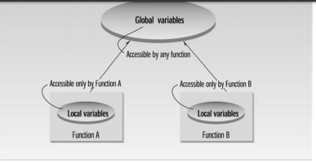
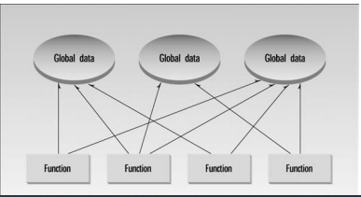

Procedural Programming Paradigm

Slide 6
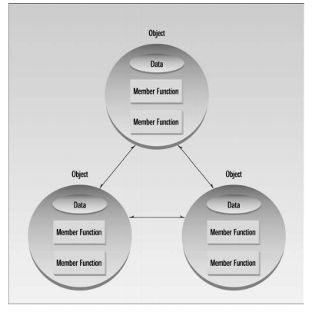
Object Oriented Paradigm

Slide 7
Object-Orientation (OO)

Slide 8
What is Object-Orientation?
A technique for system modeling
OO model consists of several interacting objects

Slide 9
What is a Model?
A model is an abstraction of something
Purpose is to understand the product before developing it

Slide 10
Examples – Model
Highway maps
Architectural models
Mechanical models

Slide 11



Example – OO Model

Slide 12
…Example – OO Model
lives-in
Objects
  Ali
  House
  Car
  Tree
Interactions
  Ali lives in the house
  Ali drives the car
Ali
House
drives
Car
Tree

Slide 13
Object-Orientation - Advantages
People think in terms of objects
OO models map to reality
Therefore, OO models are
  easy to develop
  easy to understand

Slide 14
What is an Object?
An object is
Something tangible (Ali, Car)
Something that can be apprehended intellectually (Time, Date)

Slide 15
… What is an Object?
An object has
State (attributes)
Well-defined behaviour (operations)
Unique identity

Slide 16
Example – Ali is a Tangible Object
State (attributes)
  Name
  Age
behaviour (operations)
  Walks
  Eats
Identity
  His name

Slide 17
Example – Car is a Tangible Object
State (attributes)
  - Color
  - Model
behaviour (operations)
  - Accelerate - Start Car
  - Change Gear
Identity
  - Its registration number

Slide 18
Example – Time is an Object Apprehended Intellectually
State (attributes)
  - Hours - Seconds
  - Minutes
behaviour (operations)
  - Set Hours - Set Seconds
  - Set Minutes
Identity
  - Would have a unique ID in the model

Slide 19
Example – Date is an Object Apprehended Intellectually
State (attributes)
  Year - Day
  Month
behaviour (operations)
  - Set Year - Set Day
  - Set Month
Identity
  - Would have a unique ID in the model

