Slide 1
Object-Oriented Programming (OOP)
Lecture No. 2
By: Engr Asma Khan
Software Engineering Dept
NED University Karachi

Slide 2


Objects:

Slide 3
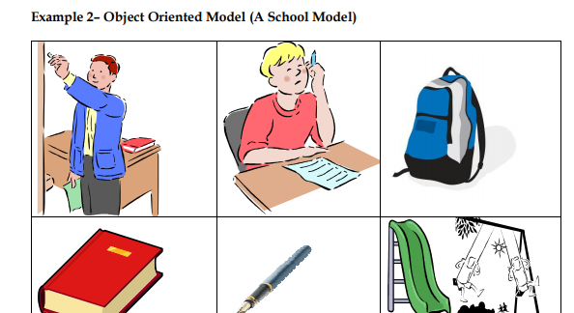
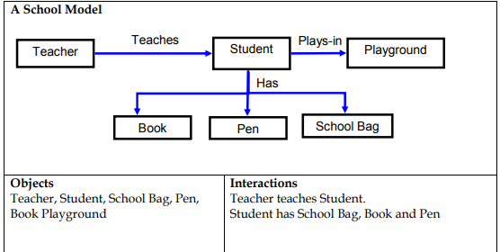

Slide 4
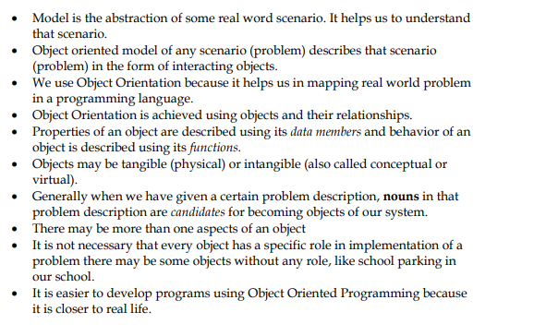
Summary of Lecture 1

Slide 5
Information Hiding
Information is stored within the object
It is hidden from the outside world
It can only be manipulated by the object itself

Slide 6
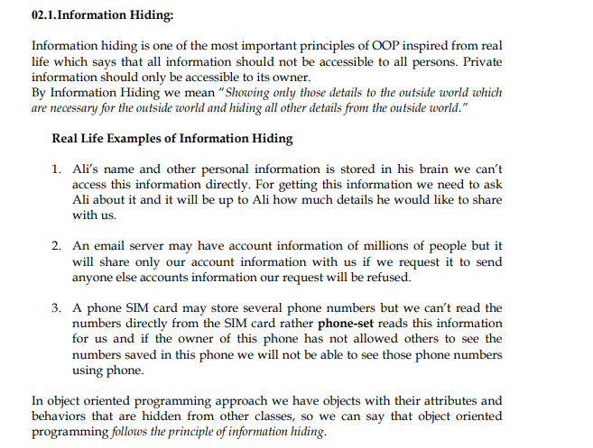

Slide 7
Example – Information Hiding
Hiding the object details(state and Behavior) from the user or outside world
Ali’s name is stored within his brain
We can’t access his name directly
Rather we can ask him to tell his name

Slide 8
Example – Information Hiding
A phone stores several phone numbers
We can’t read the numbers directly from the SIM card
Rather phone-set reads this information for us

Slide 9
Information Hiding
Advantages
Simplifies the model by hiding implementation details
It is a barrier against change propagation

Slide 10
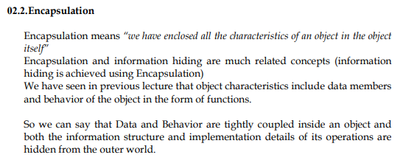
Encapsulation
Data and behavior are tightly coupled inside an object
Both the information structure and implementation details of its operations are hidden from the outer world

Slide 11
Example – Encapsulation
Ali stores his personal information and knows how to translate it to the desired language
We don’t know
  How the data is stored
  How Ali translates this information

Slide 12
Example – Encapsulation
A Phone stores phone numbers in digital format and knows how to convert it into human-readable characters
We don’t know
  How the data is stored
  How it is converted to human-readable characters

Slide 13
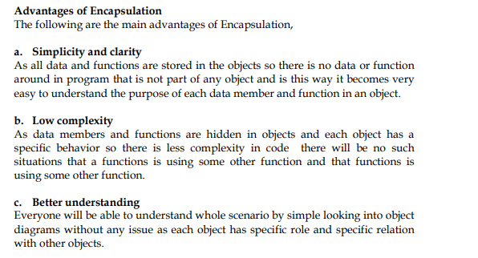
Encapsulation – Advantages

Slide 14
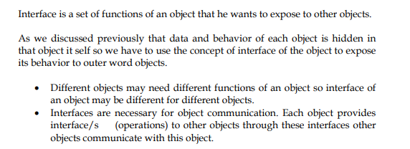
Object has an Interface
An object encapsulates data and behavior
So how objects interact with each other?
Each object provides an interface (operations)
Other objects communicate through this interface

Slide 15
Example – Interface of a Car
Steer Wheels
Accelerate
Change Gear
Apply Brakes
Turn Lights On/Off

Slide 16
Example – Interface of a Phone
Input Number
Place Call
Disconnect Call
Add number to address book
Remove number
Update number

Slide 17
Implementation
Provides services offered by the object interface
This includes
  Data structures to hold object state
  Functionality that provides required services

Slide 18
Example – Implementation of Gear Box
Data Structure
  Mechanical structure of gear box
Functionality
  Mechanism to change gear

Slide 19
Example – Implementation of Address Book in a Phone
Data Structure
  SIM card
Functionality
  Read/write circuitry

Slide 20
Separation of Interface & Implementation
Means change in implementation does not effect object interface
This is achieved via principles of information hiding and encapsulation

Slide 21
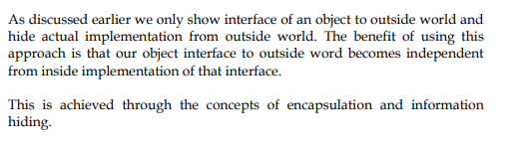
Example – Separation of Interface & Implementation
A driver can drive a car independent of engine type (petrol, diesel)
Because interface does not change with the implementation

Slide 22
Example – Separation of Interface & Implementation
A driver can apply brakes independent of brakes type (simple, disk)
Again, reason is the same interface

Slide 23
Advantages of Separation
Users need not to worry about a change until the interface is same
Low Complexity
Direct access to information structure of an object can produce errors

Slide 24
Messages
Objects communicate through messages
They send messages (stimuli) by invoking appropriate operations on the target object
The number and kind of messages that can be sent to an object depends upon its interface

Slide 25
Examples – Messages
A Person sends message (stimulus) “stop” to a Car by applying brakes
A Person sends message “place call” to a Phone by pressing appropriate button

