Slide 1

Design a processor with minimum number of instructions so that it can do the basic Arithmetic and Logic Operation
Presented by
Ruhadina Musfikin(2017-1-60-002)
Rehana Akter(2018-1-60-202)
A A Anannya Das(2016-2-60-135)

Slide 2
OVERVIEW: Objective processor knowledge design implementation improvement result conclusion

Slide 3

OBJECTIVES: TO ANALYSE THE ARCHITECTURE OF THE PROCESSOR TO PROPOSE A IMPROVED DESIGN OF A PROCESSOR

Slide 4

PROCESSOR KNOWLEDGE :
THE MOST IMPORTANT COMPONENT
OF A COMPUTER IS THE CENTRAL
PROCESSING UNIT WHICH IS ALSO
CALLED THE PROCESSOR.
THE PROCESSOR ACTS A S
THE COMPUTER’S BRAIN RUNNING.
THE TASK OF PROCESSOR IS
TO PROCESS DATA AND EXECUTE
INSTRUCTIONS.

Slide 5
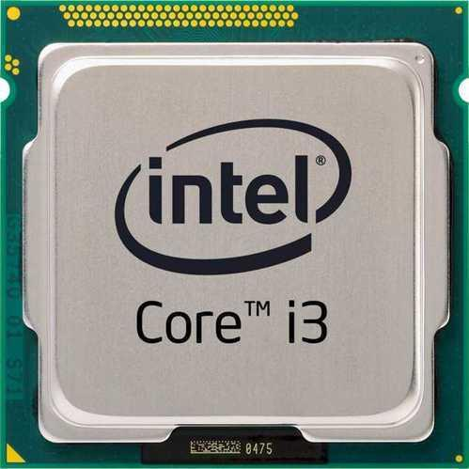
DESIGN OF PROCESSOR:
FOR DESIGNING A PROCESSOR WE HAVE
CHOSEN INTEL CORE I3.
OUR PROJECT’S AIM IS TO ANALYZE
THIS PROCESSOR.

Slide 6
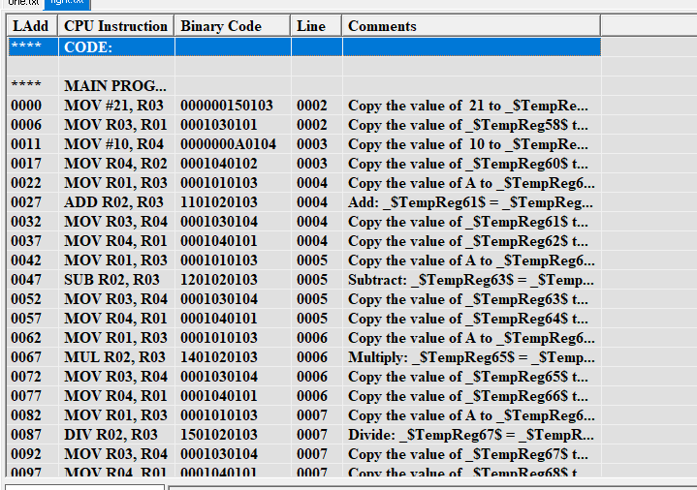
ASSEMBLY CODE:

Slide 7
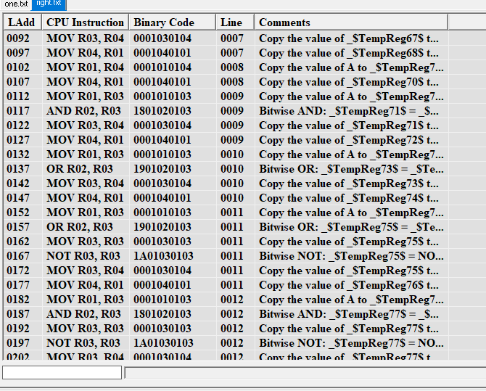

Slide 8
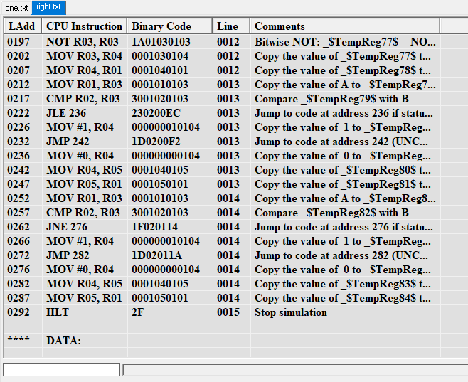

Slide 9
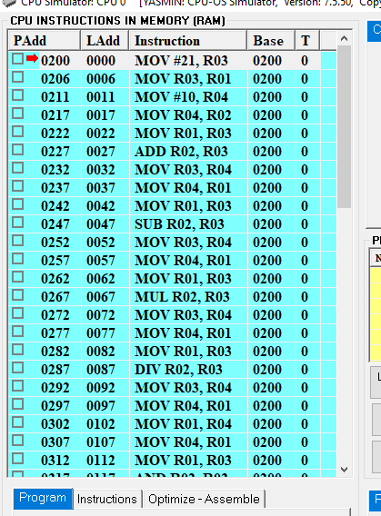
CPU INSTRUCTION

Slide 10
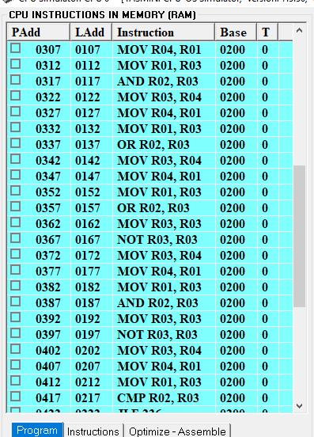

Slide 11
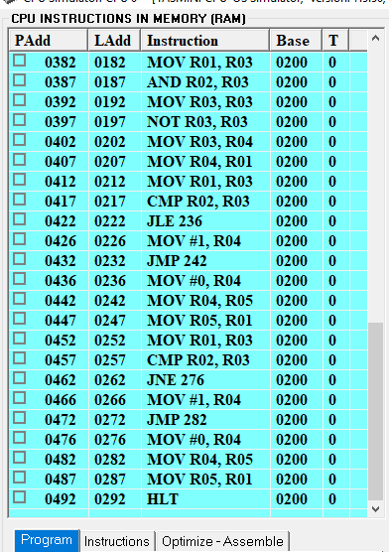

Slide 12
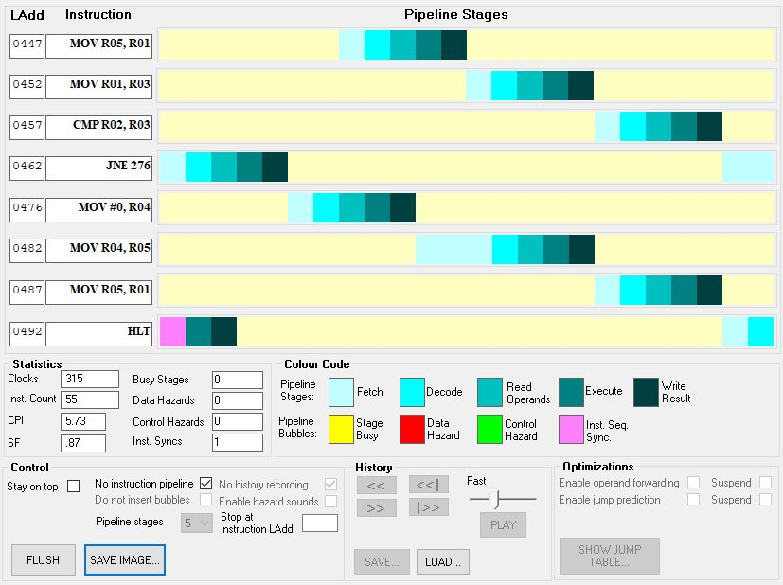
PIPELINE STAGES

Slide 13
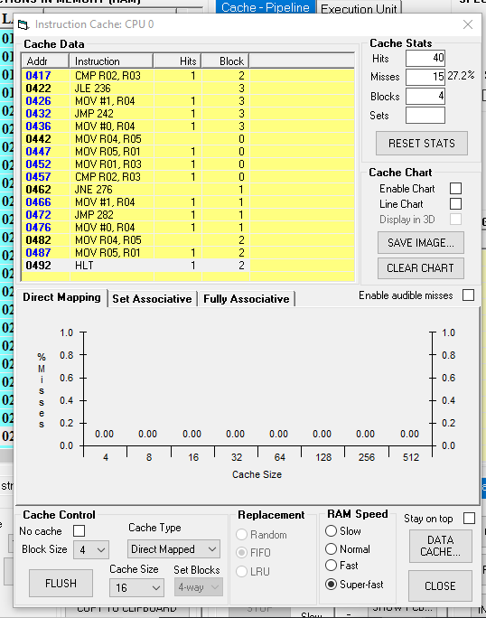
IMPLEMENTATION OF CACHE
DIRECT MAPPED

Slide 14
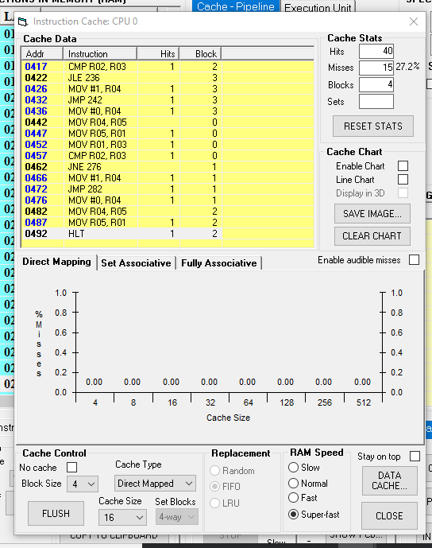
SET ASSOCIATIVE

Slide 15
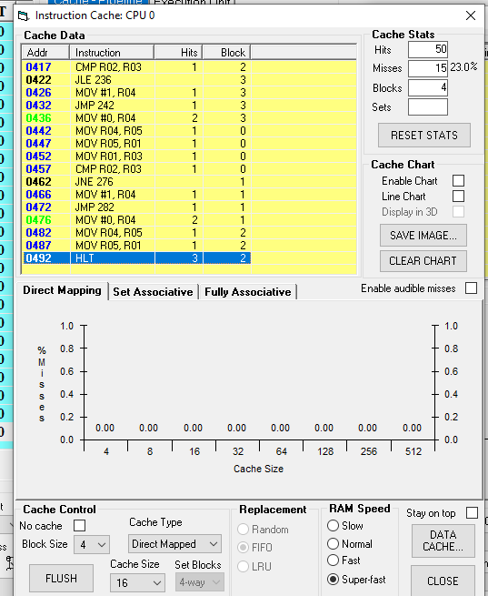
FULLY ASSOCIATIVE

Slide 16
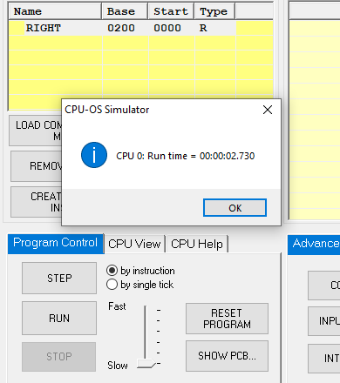
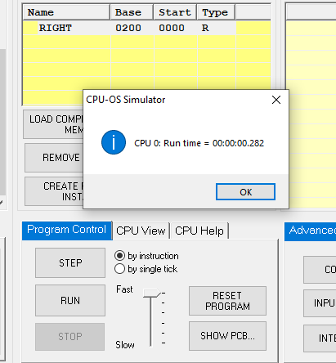
CPU SPEED
WHEN SPEED OF CPU IS SLOW
WHEN SPEED OF CPU IS HIGH

Slide 17
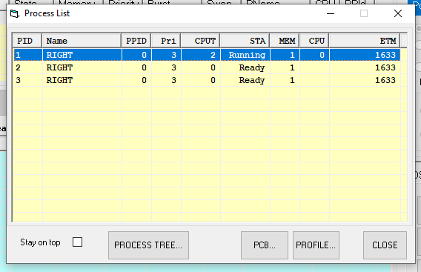
CPU IMPROVEMENT FOR IMPROVING THE PROCESSOR WE HAVE APPLIED 3 PROCESSES: 1.RIGHT 2.RIGHT 3.RIGHT

Slide 18
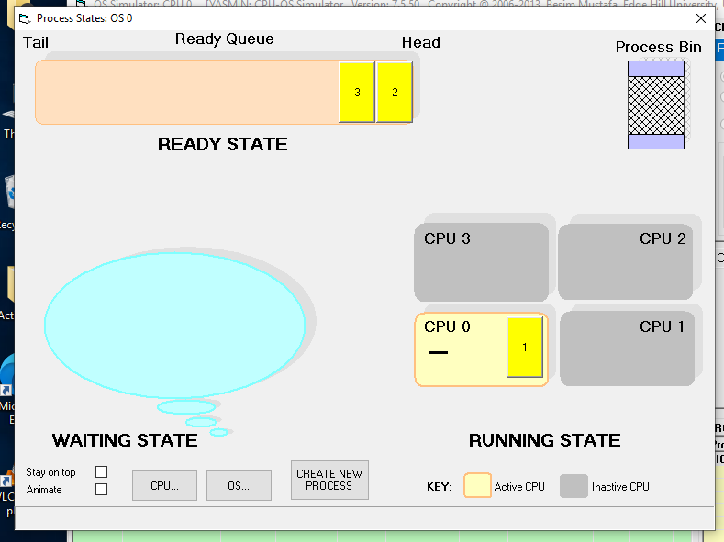
IMPROVEMENT PROCESSES ARE WORKING IN 3 STATES: READY STATE WAITING STATE RUNNING STATE

Slide 19
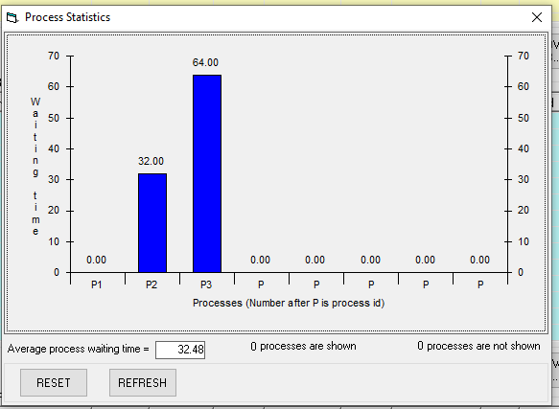
PROCESSOR STATISTIC

Slide 20
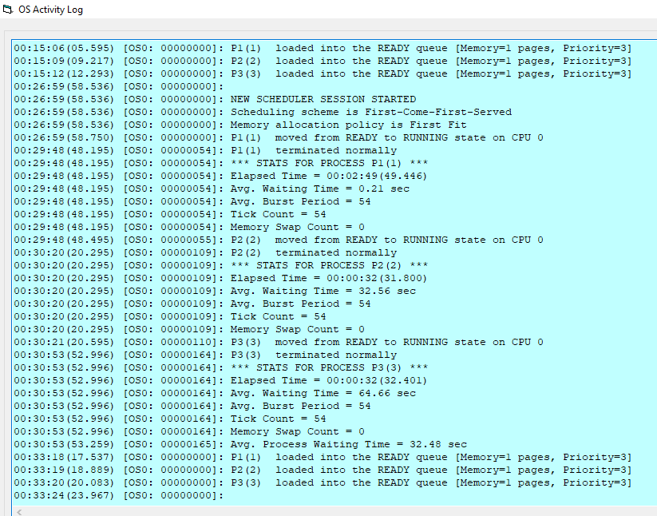
ACTIVITY LOG

Slide 21
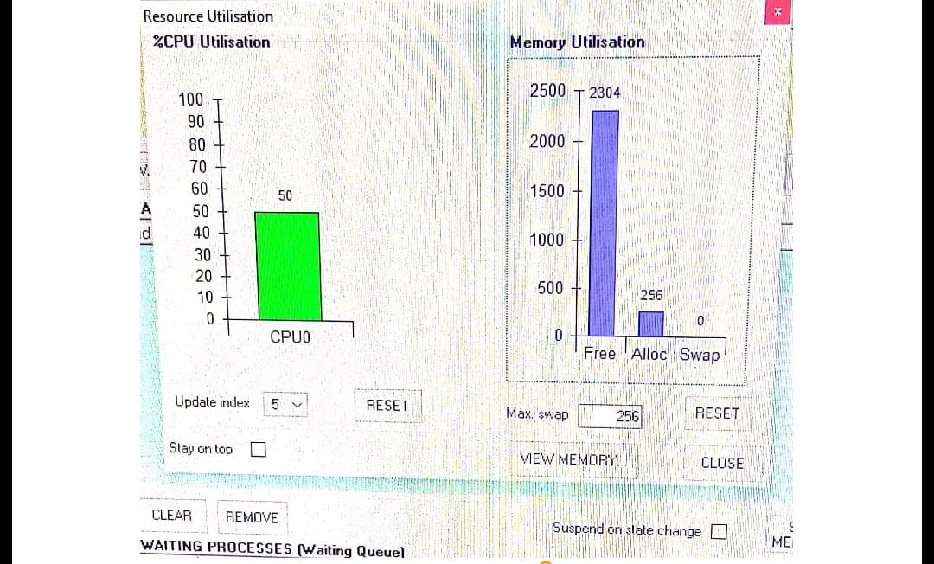
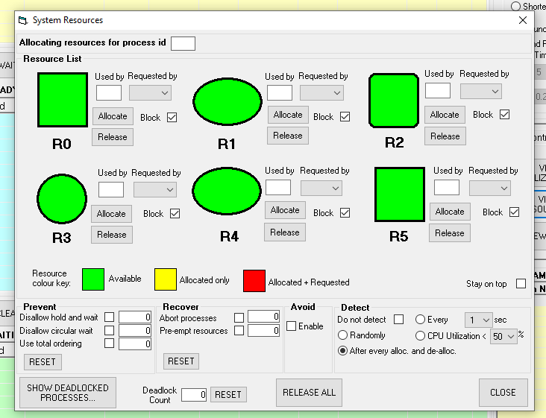
RESOURCE UTILIZATION

Slide 22

RESULT: CREATING OF PROCESSOR HELPS TO INCREASE THE CAPACITY OF CPU PERFOMANCE. INCREASING OF BLOCK NUMBER OF CACHE DECREASES THE CHANCE OF CACHE MISSES. FULLY ASSOCIATIVE CACHE HAS GIVEN BETTER PERFOMANCE IN CACHE.

Slide 23
CONCLUSION: PROCESSOR DESIGN NEEDS TO BE AWARE OF PERFOMANCE, CACHE SIZE ETC. THE IMPROVEMENT OF PROCESSOR GIVES US THE HIGHER SPEED OF ANY TASK AND REDUCES OUR TIME.

Slide 24
THANK YOU

