Slide 1
HTML (HyperText Markup Language) - By Ginni Aggarwal

Slide 2
HTML
HTML stands for HyperText Markup Language.
HTML is the building block for web pages.
HTML enables you to structure and organize text, graphics, pictures, sound, video, and other media content for processing and display by browsers.
HTML supports headings, paragraphs, lists, tables, links, images, forms, frames, and so on.

Slide 3
HTML
To create HTML files you may use any standard text editor such as Notepad, MS Word. You may use Adobe Dreamweaver and Visual Web Developer 2010 Express IDE also to create HTML File.
Here we will use Notepad text editor to write the HTML code.
You will Save the text editor file with “.htm” or “.html” extension
Open the file with any web browser(Like Chrome, Firefox, Safari or Internet Explorer ) to see the HTML page output.
HTML uses bracketed commands called ‘HTML tags’ that are integrated into a text document

Slide 4
HTML
HTML is a markup language that provides tags for you to organize information for the Web.
By inserting HTML tags into a page of text and other content, you mark which part of the page is what to provide structure to the document.
Following the structure, client browsers can perform on-screen rendering or other processing.
Thus, browsers process and present HTML documents based on the marked-up structure.
A Web page in HTML contains two parts: markup tags and content.
HTML tags are always enclosed in angle brackets (< >).

Slide 5
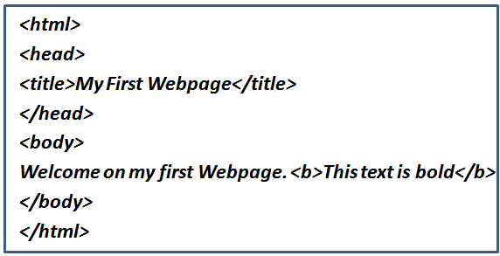
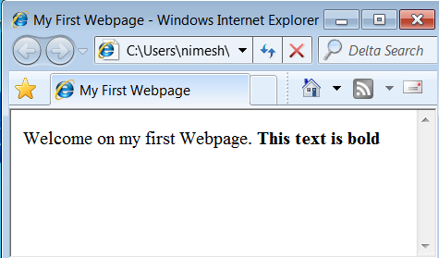
HTML: Example
Open your text editor (i.e. Notepad here) and type the following text:
HTML Code
Save the file with htm or .html extension.
Open the file with any web browser (Like Chrome, Firefox, Safari or Internet Explorer ) to see the HTML page output
HTML Output

Slide 6
HTML : Example Explanation
HTML tag : The first tag in your html document is <html> tag that tells your browser that this is the start of an html document. The last tag in your document is </html>. This tag tells your browser that this is the end of the html document.
Head tag: The text between the <head> tag and the </head> tag is header information. Header information is not displayed in the browser window.
Title tag: The text between the <title> tags is the title of your document. The <title> tag is used to uniquely identify each document and is also displayed in the title bar of the browser window.
Body tag: The text between the <body> tags is the text that will be displayed in your browser.
The text between the <b> and </b> tags will be displayed in a bold font.

Slide 7
HTML Elements
HTML provides over 90 different elements.
Generally, they can be divided into following categories:
Top-level elements
Head elements
Block-level elements
Inline elements

Slide 8
HTML Elements - Top-level elements
html
head
body

Slide 9
HTML Elements - Head elements
Head elements are placed inside head elements.
title (page title),
style (rendering style),
link (related documents),
meta (data about the document),
script (client-side scripting).

Slide 10
HTML Elements - Block-level elements
H1- H6 (headings),
P (paragraph),
pre (pre-formatted text),
div (designated block),
ul, ol, dl (lists),
Table (tabulation),
form (user input forms).
When displayed, a block-level (or simply block) element always starts a new line and any element immediately after the block element will also begin on a new line.

Slide 11
HTML Elements - Inline elements
Inline elements behave like words, characters, or phrases within a block,
a (anchor or hyperlink),
br (line break),
img (picture or graphics),
sub (subscript),
sup (superscript),
Span (designated inline scope).

Slide 12
HTML Attributes
An attribute is used to define the characteristics of an element and is placed inside the element's opening tag.
All attributes are made up of two parts: name and value
The name: It is the property you want to set.
The value: It is what you want the value of the property to be.

Slide 13
HTML Attribute: Example
HTML links are defined with the <a> tag. The link address is specified in the href attribute:
<a href=“http://www.w3schools.com”>This is a link</a>
Name
Value

Slide 14
Some commonly used HTML Attribute
Attribute | Options | Function
align | right, left, center | Horizontally aligns tags
valign | top, middle, bottom | Vertically aligns tags within an HTML element.
bgcolor | numeric, hexidecimal, RGB values | Places a background color behind an element
background | URL | Places an background image behind an element
id | User Defined | Names an element for use with Cascading Style Sheets.
class | User Defined | Classifies an element for use with Cascading Style Sheets.
width | Numeric Value | Specifies the width of tables, images, or table cells.
height | Numeric Value | Specifies the height of tables, images, or table cells.
title | User Defined | "Pop-up" title for your elements.

Slide 15
HTML
When an element is placed inside another, the containing element is the parent and the contained element is the child.
Comments in an HTML page are given as <!-- a sample comment -->.
Text and HTML elements inside a comment tag are ignored by browsers.
Make sure not to put two consecutive dashes (--) inside a comment.
It is good practice to include comments in HTML pages as notes, reminders, or documentation to make maintenance easier.

Slide 16
HTML
Use Lowercase Tags
Always use lowercase tags even though HTML tags are not case sensitive.
<B> means the same as <b>.
Reason: The World Wide Web Consortium (W3C), the group responsible for developing web standards, recommends lowercase tags in their HTML 4 recommendation, and XHTML (the next generation HTML) requires lowercase tags.

Slide 17
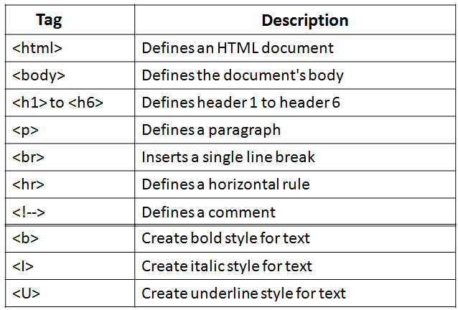
Basic HTML Tags

Slide 18
Basic HTML Tags
Headings : Headings are defined with the <h1> to <h6> tags. <h1> defines the largest heading while <h6> defines the smallest.
Paragraphs : Paragraphs are defined with the <p> tag. Think of a paragraph as a block of text. You can use the align attribute with a paragraph tag as well.
Line Breaks : The <br> tag is used when you want to start a new line, but don't want to start a new paragraph. The <br> tag forces a line break wherever you place it. It is similar to single spacing in a document. The <br> tag has no closing tag.
Horizontal Rule : The <hr> element is used for horizontal rules that act as dividers between sections, like this:

Slide 19
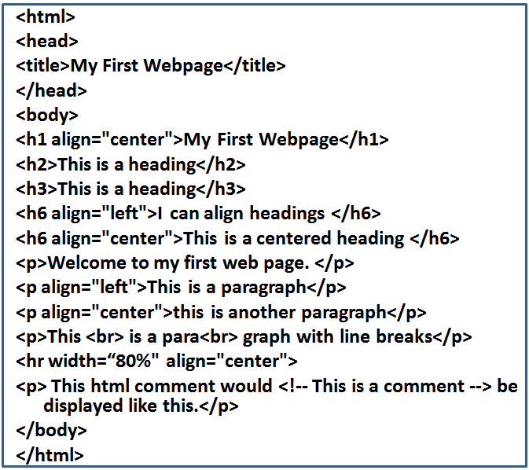
Basic HTML Tags : Example

Slide 20
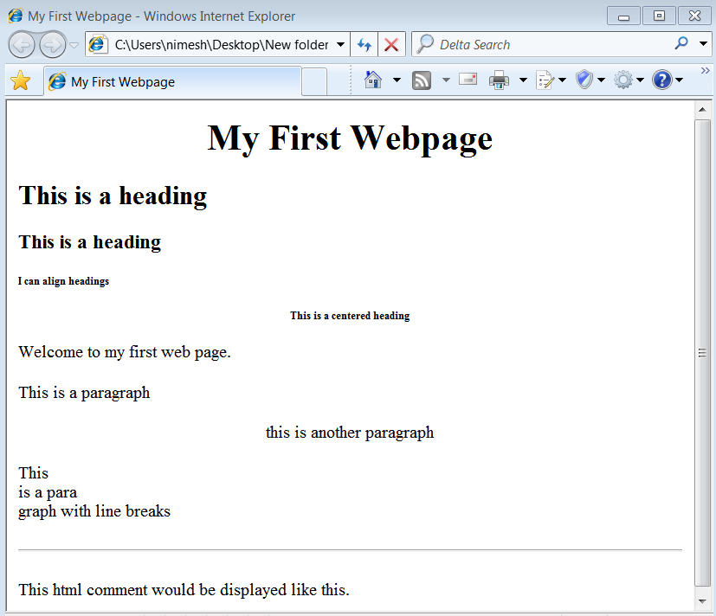
Basic HTML Tags : Output

Slide 21
HTML Character Entities
Some characters have a special meaning in HTML, like the less than sign (<) that defines the start of an HTML tag.
If we want the browser to actually display these characters we must insert character entities in place of the actual characters themselves.

Slide 22
HTML Character Entities
A character entity has three parts:
An ampersand (&): & means we are beginning a special character
An entity name
An entity number
A semicolon (;) is also used with character entity to specify the ending a special character and the letters in between are sort of an abbreviation for what it's for.
To display a less than sign in an HTML document we must write: &lt; or &#60;

Slide 23
HTML Character Entities
Entities are case sensitive.
The advantage of using a name instead of a number is that a name is easier to remember.
The disadvantage is that not all browsers support the newest entity names, while the support for entity numbers is very good in almost all browsers.

Slide 24
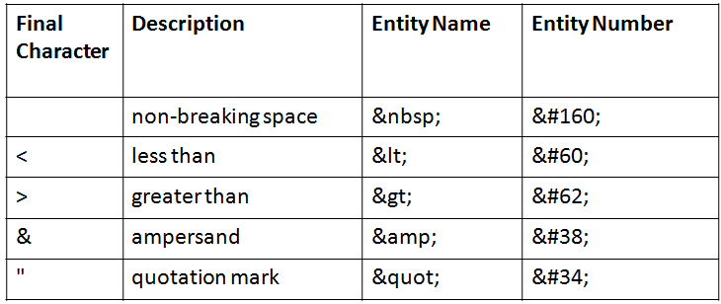
HTML Character Entities
Some commonly used Character Entities:

Slide 25
HTML Character Entities
Non-breaking Space(&nbsp):
The most common character entity in HTML is the non-breaking space &nbsp;
Normally HTML will truncate spaces in your text. If you add 10 spaces in your text, HTML will remove 9 of them.
To add spaces to your text, use the &nbsp; character entity.

Slide 26
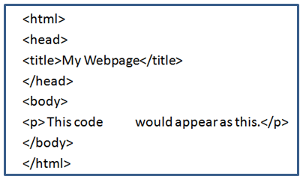
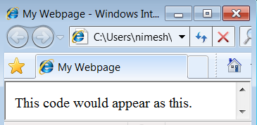
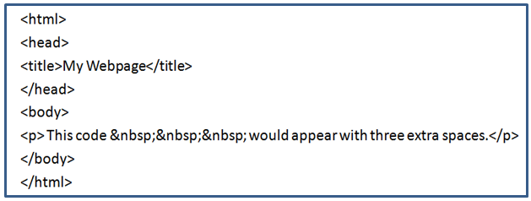
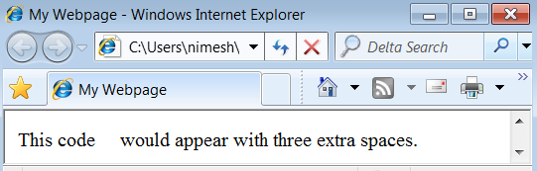
Non-breaking Space(&nbsp): Example
Output
Output

Slide 27
HTML Backgrounds
The <body> tag has two attributes where you can specify backgrounds. These are:
bgcolor : to apply background-color for an HTML page
Background : to apply a background-image for an HTML page

Slide 28
HTML Backgrounds: Bgcolor
The bgcolor attribute specifies a background-color for an HTML page.
The value of this attribute can be a hexadecimal number, an RGB value, or a color name
The lines below all set the background-color to black.
<body bgcolor="#000000">
<body bgcolor="rgb(0,0,0)">
<body bgcolor="black">

Slide 29
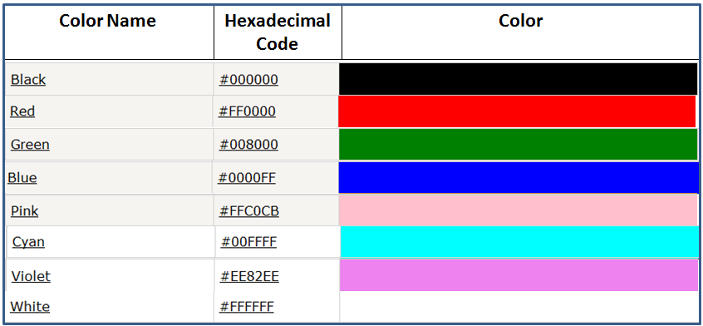
HTML Backgrounds: Bgcolor
Some HTML Color with Hexadecimal code

Slide 30
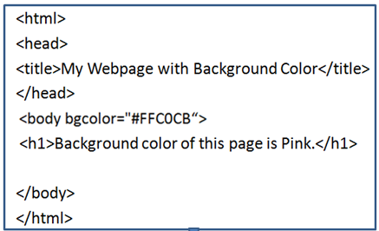
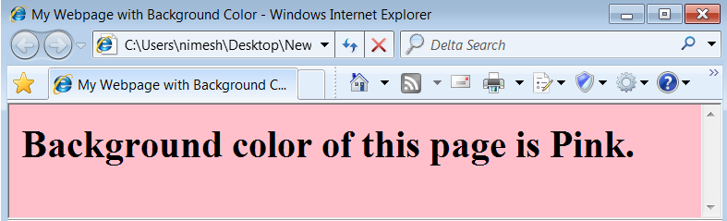
HTML Backgrounds(Bgcolor) : Example

Slide 31
HTML Backgrounds: Background
The background attribute can also specify a background-image for an HTML page.
<body background=“./Nature_Image.gif“>
In this example we have a image file named Nature_Image.gif in the same directory of the html file, so we use the path as ./ Nature_Image.gif
The value of this attribute is the URL of the image you want to use.
If the image is smaller than the browser window, the image will repeat itself until it fills the entire browser window.

Slide 32
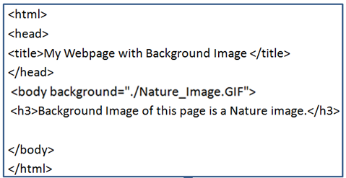
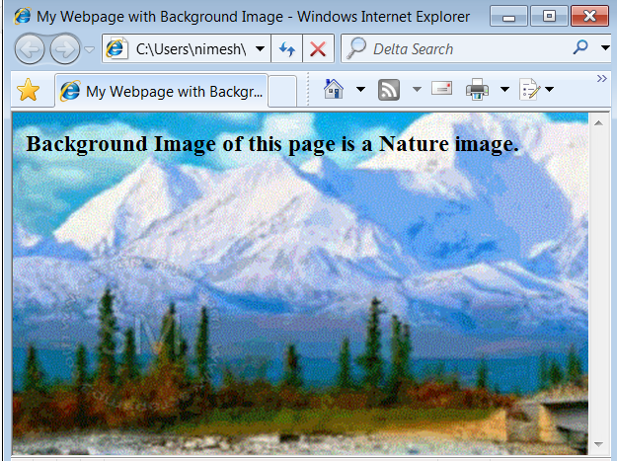
HTML Backgrounds(Background): Example

Slide 33
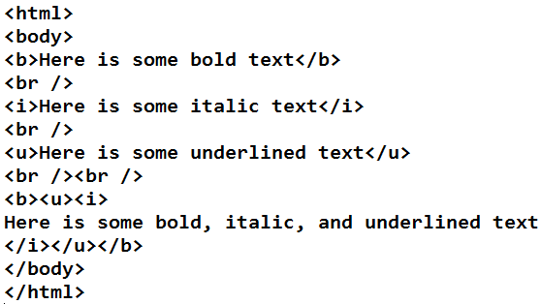
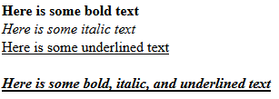
Working with HTML Text

Slide 34
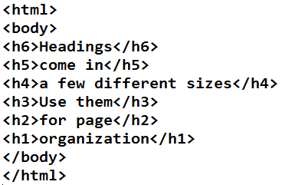
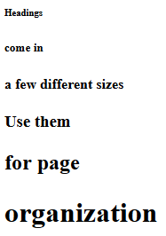
Displaying text in different sizes using headings

Slide 35
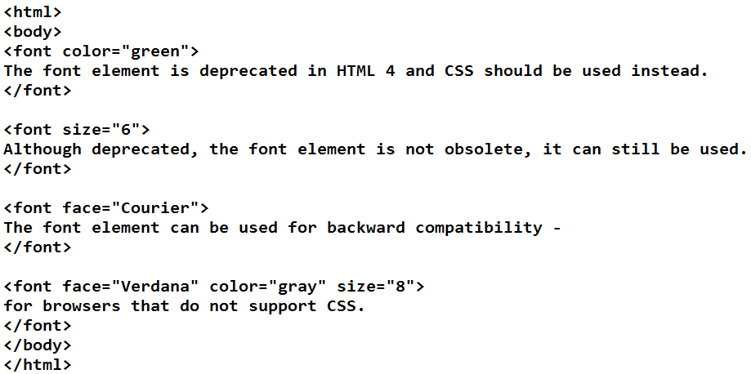
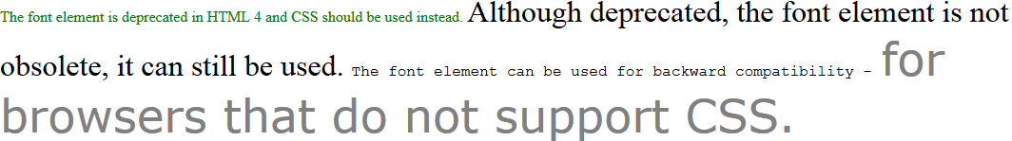
Displaying text in different fonts, sizes, and colors

Slide 36
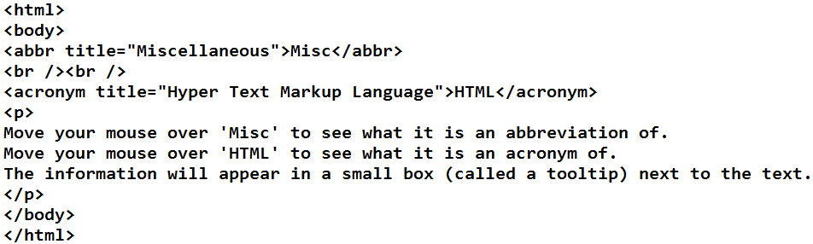
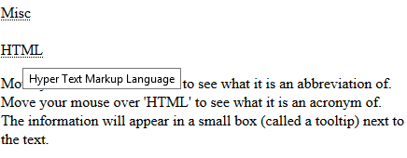
HTML text formatting - Abbreviations and acronyms

Slide 37
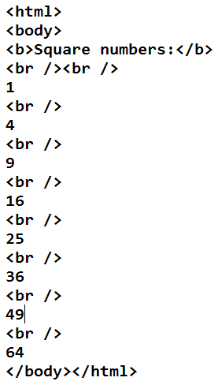
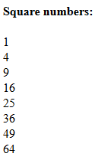
Skipping lines in a webpage

Slide 38
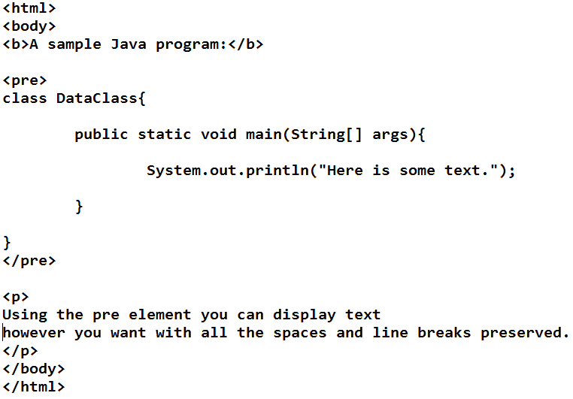
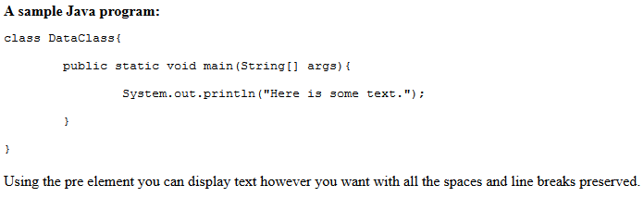
Displaying preformatted text

Slide 39
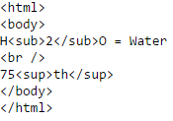

Setting text to a subscript or superscript

Slide 40

HTML Links
HTML uses the <a> anchor tag to create a link to another document or web page.
The Anchor Tag and the href Attribute :
href stands for Hypertext REFerence.
The <a> tag is used to create an anchor to link from, the href attribute is used to tell the address of the document or page we are linking to and the words between the open and close of the anchor tag will be displayed as a hyperlink.
Syntax of creating an anchor:

Slide 41
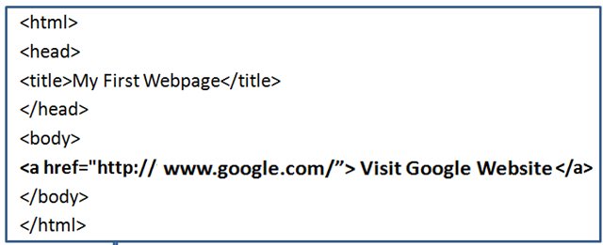
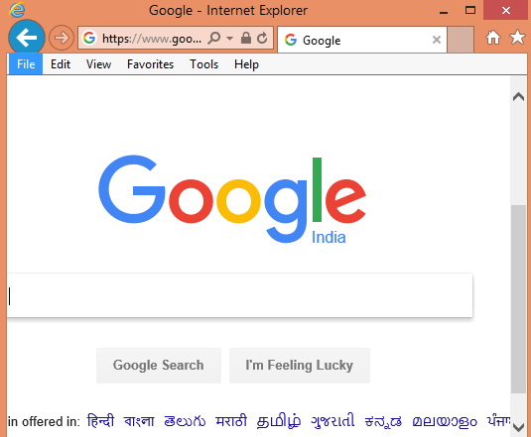
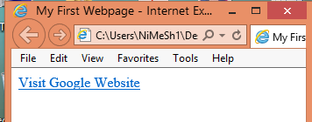
HTML Links : Example
Click on this Hyperlink

Slide 42
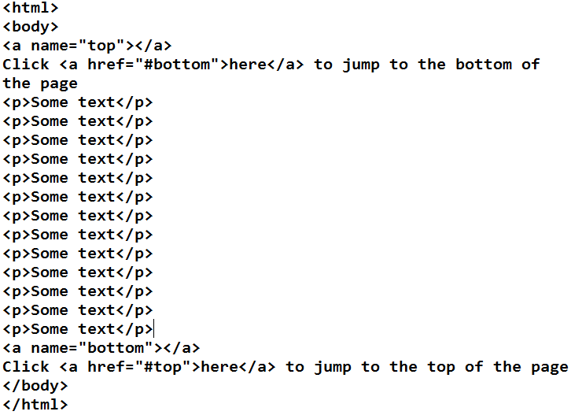
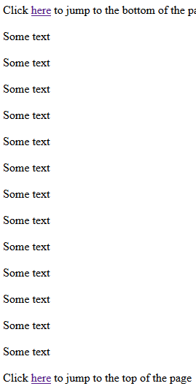
Linking within the same page

Slide 43
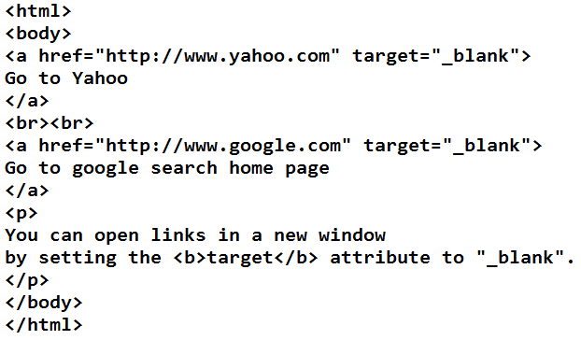
Opening links in a new window

Slide 44
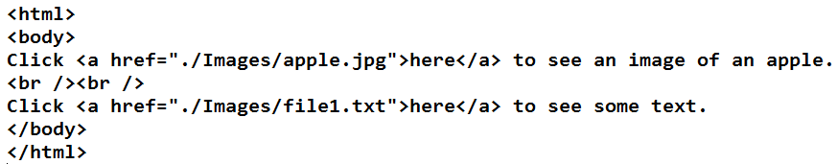

Linking to resources other than webpages

Slide 45
HTML Images
it is the ability of the Web to provide images, graphics, or sometimes icons, that has made it so popular.
Use the <img > tag to place an image on your webpage.
<img /> tag does not require a formal ending tag. Instead, all we need to do to close this tag out with a slash (/) placed just inside the ending bracket (/>).
In order to place an image onto a website, one needs to know where the image file is located.

Slide 46

HTML Images
To display an image on a page, you need to use the src attribute. Src stands for "source".
An image source is a URL value and should point to the directory location of an image file.
Syntax of defining an image:

Slide 47
Image Formats for the Web
.gif - Graphics Interchange Format.
.png - Portable Network Graphic.
.jpeg or .jpg - Joint Photographic Experts Group,
.bmp - bitmap

Slide 48
HTML Images
Explanation of Local URLs:
Local src | Location Description
src=“Baby.jpg" | picture file resides in same directory as .html file
src=“Images/Baby.jpg" | picture file resides in the Images directory
src="../Baby.jpg" | picture resides one folder "up" from the .html file
src="../Images/Baby.jpg" | picture file resides in the Images directory, one folder "up" from the .html file.

Slide 49
HTML Images : The Alt Attribute
The alt attribute is used to define an alternate text for an image.
The value of the alt attribute is author-defined text:
<img src=“Images/Baby.jpg" alt="Smiling Happy Baby ">
It is a good practice to include the alt attribute for each image on a page, to improve the display and usefulness of your document for people who have text-only browsers or use screen readers.

Slide 50
Html Image Dimensions : Height & Width
Image dimension can be defined by using two attributes ,Height & Width.
Height: it represents the height of the image in pixels.
Width: it represents width of the image in pixels.
If no height or width attribute is specified inside the <img> tag, the browser will use the actual dimensions of the image file to render the image.
Format for placing an image:

Slide 51
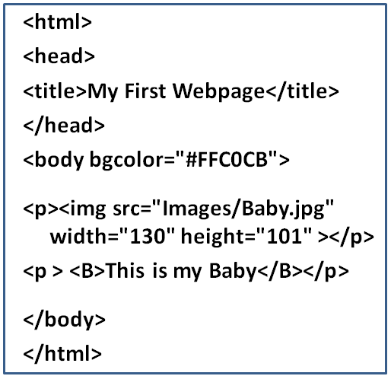
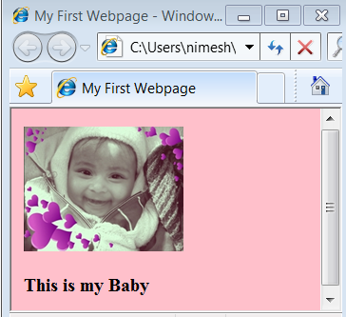
HTML Images : Example

Slide 52
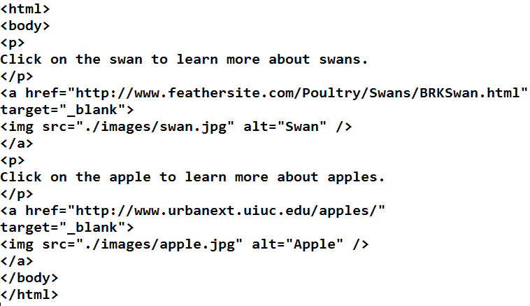
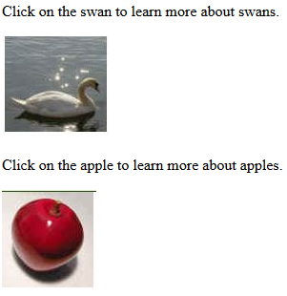
Setting an image as a link

Slide 53
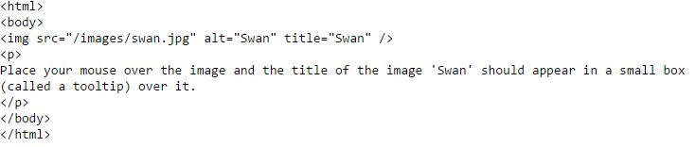
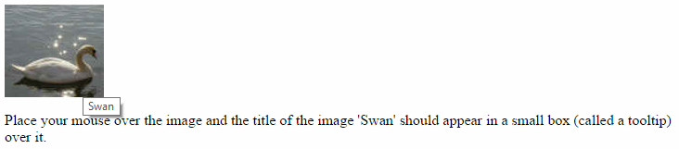
Setting a title for an image

Slide 54
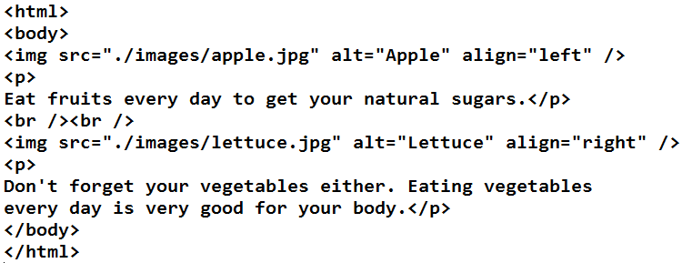
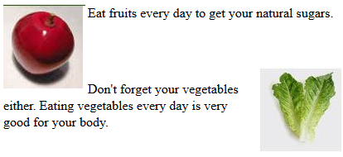
Aligning an image with a paragraph

Slide 55
HTML Tables
An HTML table is an element comprised of table rows and columns.
Tables are just like spreadsheets
Tables are defined with the <table> tag.
Inside <table> element the table is written out row by row.
A table is divided into rows and each row is divided into data cells.
A row is contained inside a <tr> tag, which stands for table row.
Each cell is then written inside the row element using a <td> tag which stands for table data.
A data cell can contain text, images, lists, paragraphs, forms, horizontal rules, tables, etc.

Slide 56
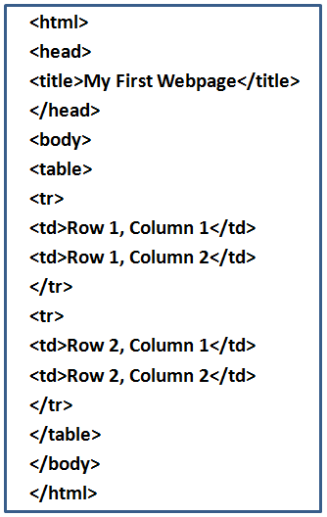
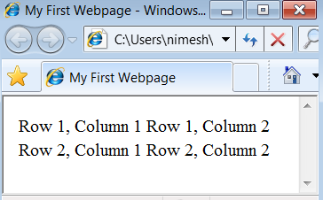
HTML Tables

Slide 57
HTML Tables: Border Attribute
To display a table with borders, you will use the border attribute with <table> tag.
<table border=“value of border size">

Slide 58
HTML Tables: Headings in a Table
Headings in a table are defined with the <th> tag.
<th> Heading Text </th>

Slide 59
HTML Tables: Cell Spacing
Cellspacing is the pixel width between the individual data cells in the table.
The default is zero.
If the border is set at 0, the cellspacing lines will be invisible.
<table border=“Value" cellspacing=“Value">

Slide 60
HTML Tables: Cell Padding
Cellpadding is the pixel space between the cell contents and the cell border.
The default for this property is also zero.
This feature is not used often, but sometimes comes in handy when you have your borders turned on and you want the contents to be away from the border a bit for easy viewing.
Cellpadding is invisible, even with the border property turned on.
Cellpadding can be handled in a style sheet.
<table border=“Value" cellpadding=“Value">

Slide 61
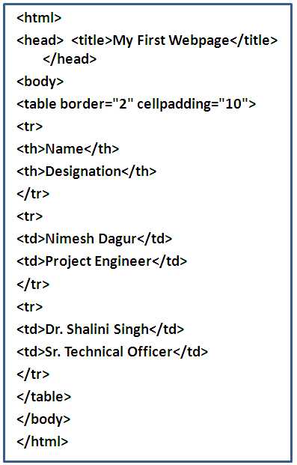
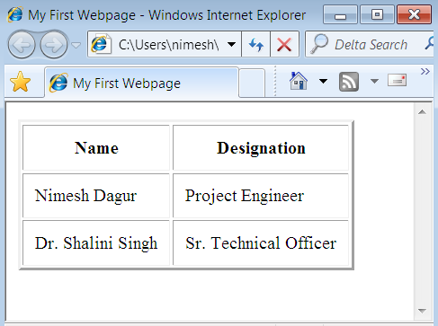
HTML Tables: Example

Slide 62
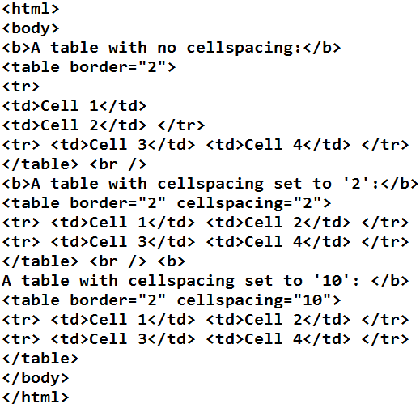
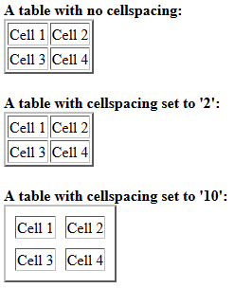
Table Cellspacing

Slide 63
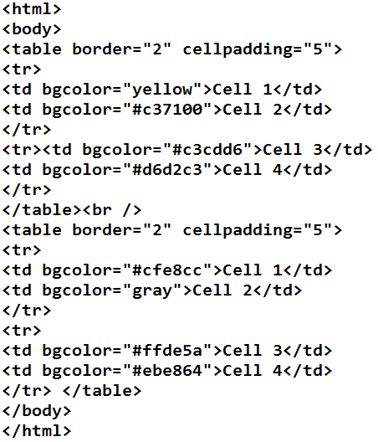

Table cell background color

Slide 64


Table row span and column span

Slide 65
HTML Lists
HTML offers authors several mechanisms for specifying lists of information.
All lists must contain one or more list elements.
There are three different types of HTML lists:
Unordered List
Ordered List
Definition List

Slide 66
HTML Lists: Unordered List
An unordered list is a list of items marked with bullets (By default list type).
An unordered list starts with the <ul> tag.
Each list item starts with the <li> tag.
Type attribute can also be used with <ul> tag to specify different kinds of bulleted lists.
There are following bullet options:
disc
circle
square

Slide 67

HTML Lists: Unordered List
HTML Unordered List Type Code:

Slide 68


HTML Unordered List : Example

Slide 69

HTML Lists: Ordered Lists
An ordered list is defined using the <ol> tag, and list items placed inside of an ordered list are preceded with numbers instead of bullets.
Each list item starts with the <li> tag.
The numbering of an HTML list can be changed to letters or Roman Numerals by using the type attribute with <ol> tag.

Slide 70


HTML Ordered List : Example

Slide 71
HTML Lists: Definition Lists (dl)
HTML definition lists (<dl>) are list elements that have a unique array of tags and elements;
The resulting listings are similar to those you'd see in a dictionary and glossary.
Definition lists consist of two parts:
Definition term (dt)
Definition description (dd).

Slide 72


HTML Definition List : Example

