Slide 1
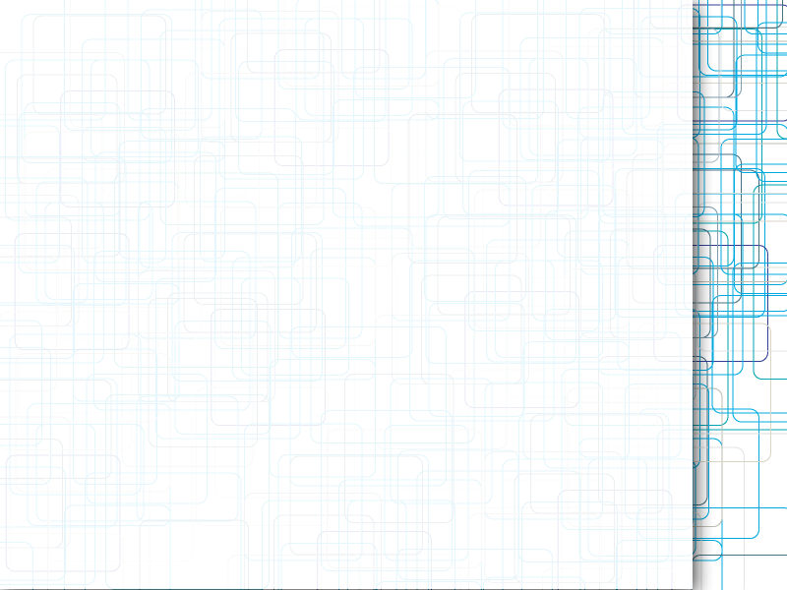
King County Housing Data EDA
neuefische hh-ds-24-9

Slide 2
Introduction
Summarize the main plans
Explain the long-term course to follow

Slide 3
Client
Nicole Johnson
Buyer
Lively, central neighborhood
Middle price range
Right timing (within a year)

Slide 4
Nicole Johnson - Buyer
Middle price range
  Assess prices and find a good value
Lively, central neighborhood
  Find locations around the center of Seattle
Right timing (within a year)
  Wants to move in quickly
  Find high condition and grade

Slide 5
Assumptions and Hypotheses
Properties within a city will be smaller and cost more than houses away from the center.
Houses that have been renovated will sell at a higher price.
House size will have increasing returns on its price.

Slide 6
Process
Prepare Data
  Filter by distance and price
  Filter by condition and grade
  Sort and rank the pool of houses
List 5 houses for your assessment

Slide 7
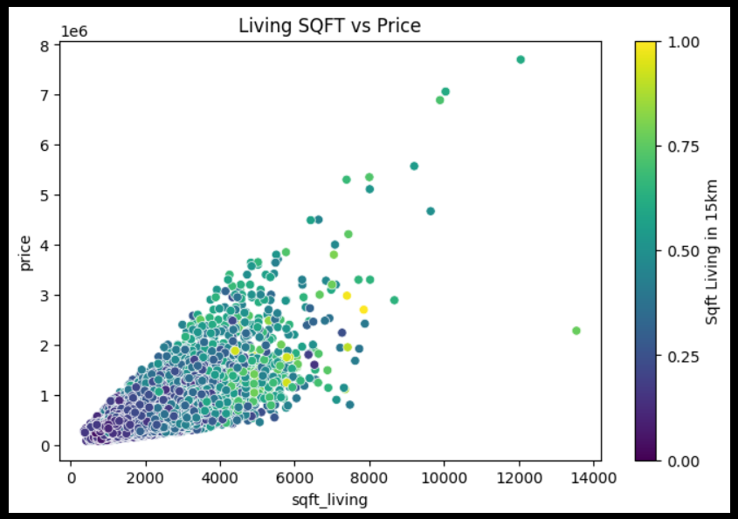
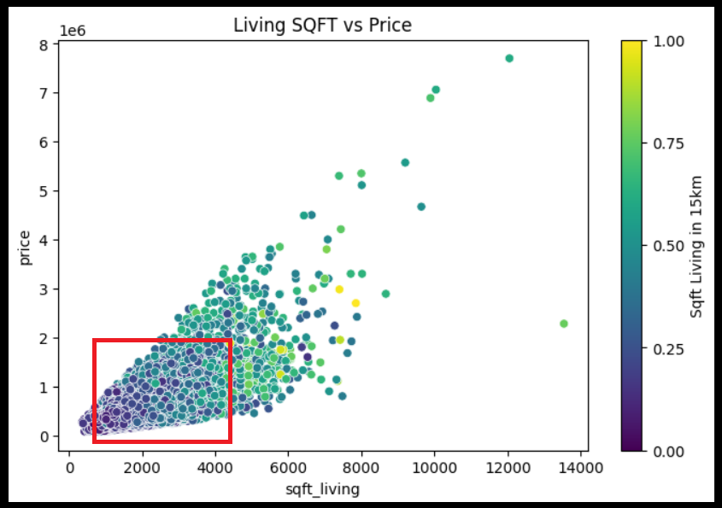
Price focus
How much SQFT can we get for our price point? Let's get good value out of our dollar.

Slide 8
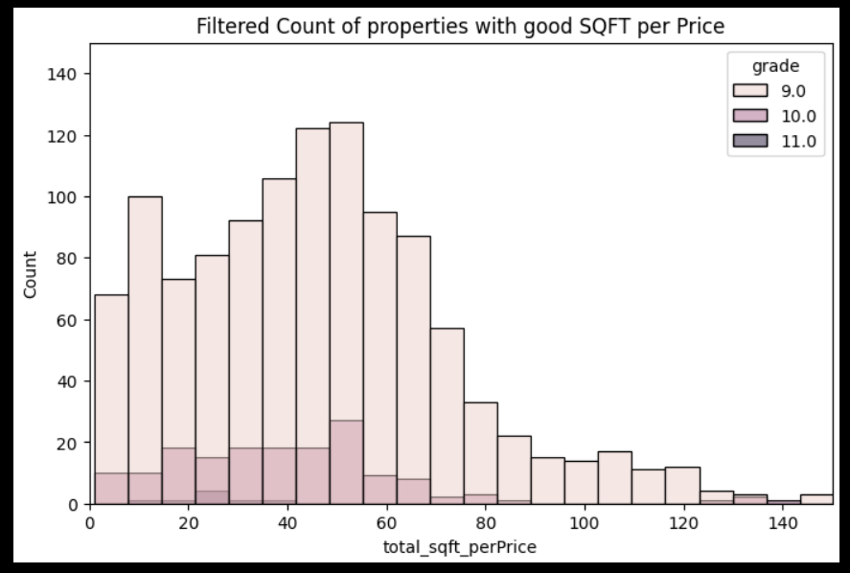
Price focus
Now we will filter:
  High grade/condition
  Middle price range

Slide 9
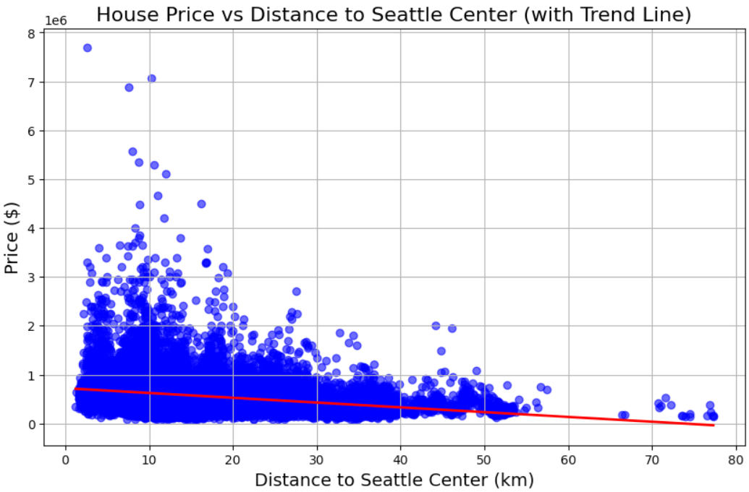
Distance focus
Looking for houses closest to the center of Seattle
House prices do get cheaper further out

Slide 10
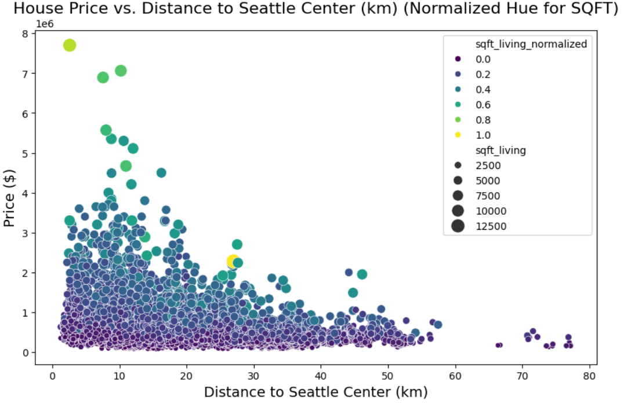
Distance focus
Applying a hue to show living space normalized (ranked
Size marker is total living space

Slide 11
Correlations:
Correlation between Price and Distance:
-0.2864763687636491
The negative correlation indicates that as the distance from the city center increases, the price of properties tends to decrease.
Correlation between SQFT Living Space and distance:
0.07577580001819821
In city centers, space is at a premium, and properties are typically smaller due to higher population density and limited land availability. Suburban and rural areas farther from the center often have more land, allowing for the construction of larger homes.

Slide 12
Bringing it all together:
To assess the best houses from the list, I created an algorithm to rank the houses based price, quality and distance that are assigned weights.
These weights will give us a ranking of the houses and allow us to examine the top 5 (or even top 100).

Slide 13
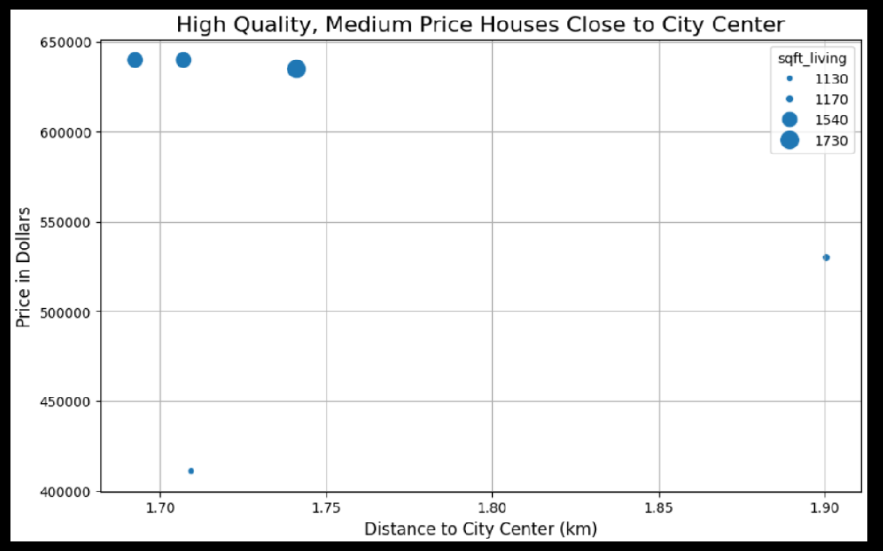
Distance from city focus
We now have smaller list of properties with good condition and price. I applied an algorithm to sort them by weighted score. Here's the top 5.

Slide 14
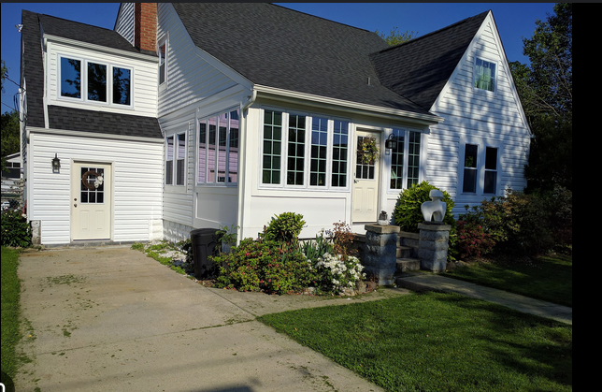
Recommendations
Location: Central District and Capitol Hil
1. ID 6003500743
  2 bed, 2 bath
  1540 SQFT Living
  $640,000
2. ID 6003500749
  2 bed, 2 bath
  1540 SQFT Living
  $640,000
3. ID 7600136
  2 bed, 2 bath
  1130 SQFT Living
  $411,000

Slide 15
Recommendations
Location: Eastlake and Capitol Hill
4. ID 6848200221
  3 bed, 3 bath
  1730 SQFT Living
  $635,000
5. ID 6003001999
  2 bed, 1 bathroom
  1170 SQFT Living
  $530,000

Slide 16
Thank you!

