Slide 1
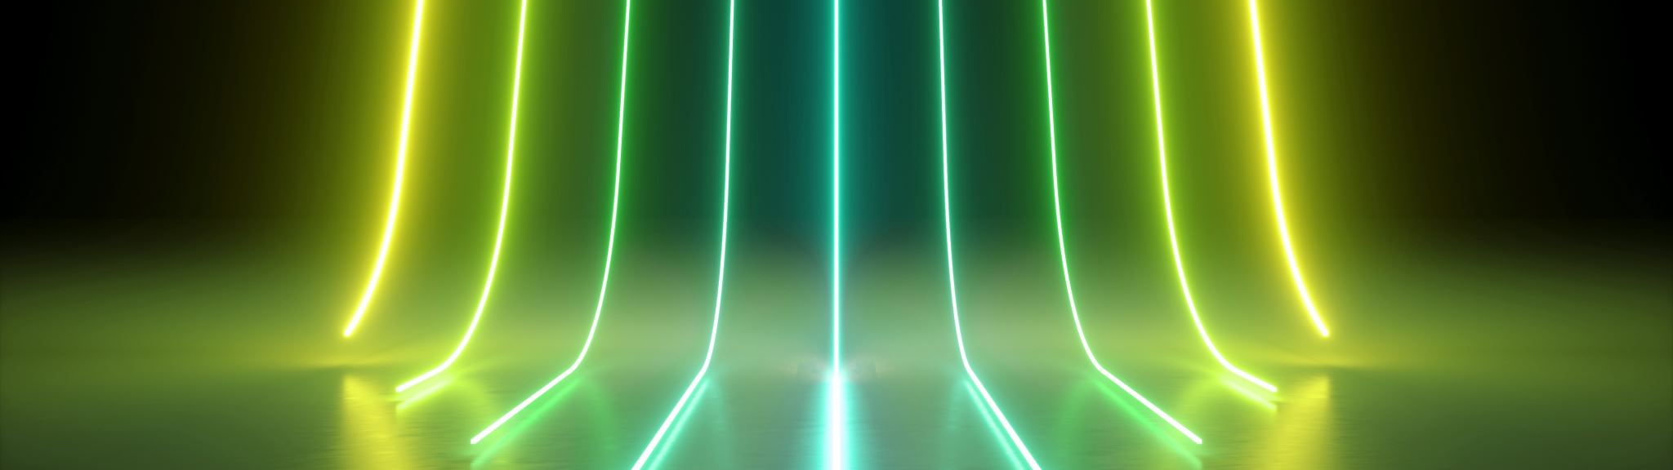
Fake News Detection Using Support Vector Machine (SVM)
AI201L
Nohail Faraz 2024519
Abdul Rehman 2024026
Haseeb Syed 2024220

Slide 2


Introduction
Misinformation spreads rapidly online.
Automatic detection is essential to maintain reliability.
Machine learning can help identify fake news efficiently.

Slide 3
Problem Statement
Manual verification of news is impossible due to data volume.
Automated system needed to classify news as Fake or Real.
61.9% of online news may be false.

Slide 4
Objectives
Preprocess news data: cleaning, tokenization.
01
Extract features using TF-IDF vectorization.
02
Implement SVM classifier for binary classification.
03
Evaluate model using accuracy, precision, recall, and F1-score.
04

Slide 5
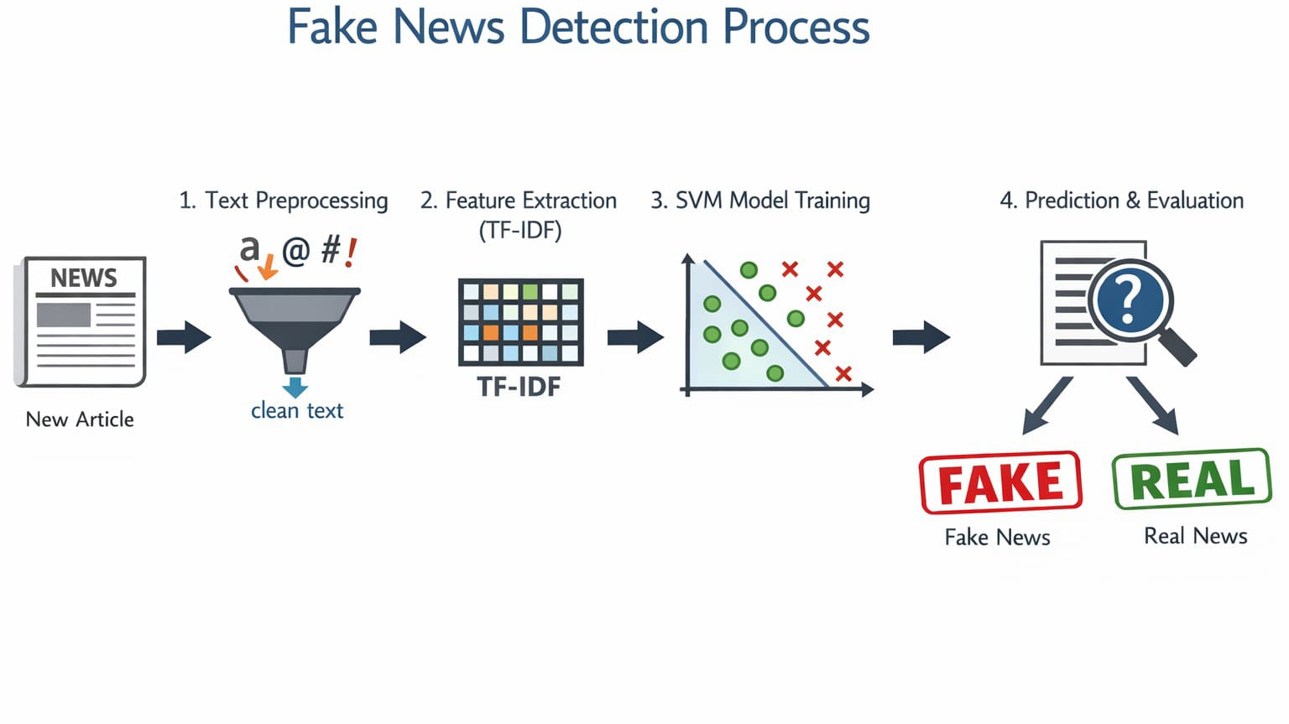

Slide 6
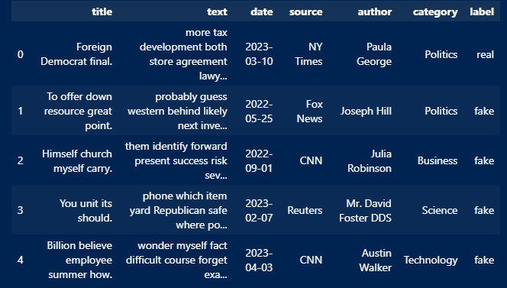
Dataset
Source: Kaggle Fake News Dataset
Columns: “Title”, ”Text”, “Date”, “Source”, “Author”, “Category”, “Label’
Number of samples: ~20,000

Slide 7

Data Preprocessing
Remove missing values
Lowercase text, remove punctuation & stopwords
Tokenization

Slide 8
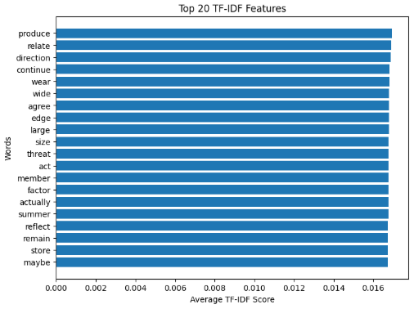
Feature Extraction (TF-IDF)
Convert text → numerical vectors
Term Frequency-Inverse Document Frequency (TF-IDF)
Implemented from scratch

Slide 9
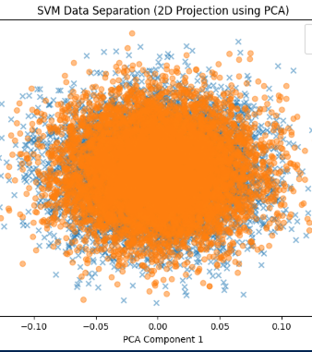
Model Selection
Support Vector Machine (SVM) for binary classification
Handles high-dimensional data well (text data)
Finds optimal boundary between Fake and Real news

Slide 10

Model Training
Split dataset: 80% training, 20% testing
Train SVM on TF-IDF features
Predict on test set

Slide 11

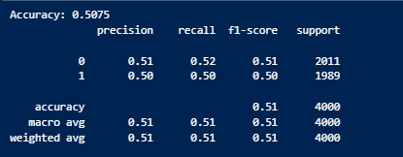



Model Evaluation
Metrics: Accuracy, Precision, Recall, F1-score, Support

Slide 12
Challenges
High dimensionality of text data
Ambiguous or misleading news content
Accuracy Score Not Ideal

Slide 13
Solution
PyTorch enables deep learning models (LSTM, CNN, BERT) that capture context and semantic meaning in news text better than TF-IDF.
Neural networks automatically learn complex language patterns, leading to improved accuracy and recall in fake news detection.
GPU acceleration and modern embeddings in PyTorch allow faster training and more robust models for large text datasets.

Slide 14
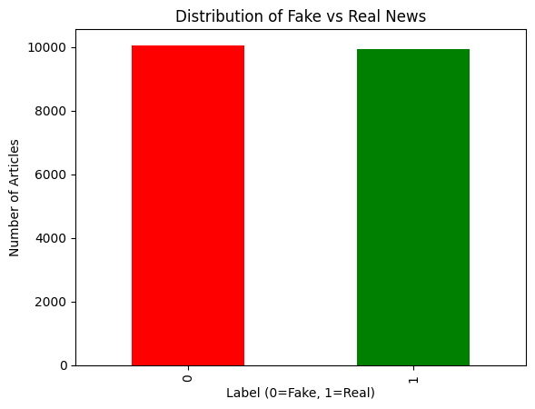
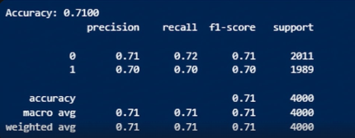
Visualization:

