Slide 1
ASGARD 2017
Microbial Community Analysis
Size-Fractionated Prokaryotic & Eukaryotic Communities across Processing Stations
16S & 18S Amplicon Sequencing | SILVA v132 Taxonomy | 78 Samples

Slide 2
Study Overview
ASGARD 2017 Cruise — Processing Stations
78
Samples analyzed (>5,000 reads per sample)
Methodology
Size fractionation: 0.2, 3, and 20 µm filters separating free-living from particle-associated communities
16S & 18S rRNA gene amplicon sequencing with ASV resolution (SILVA v132)
Fourth-root transformation applied to compress high-abundance dominance
Hierarchical clustering (Bray-Curtis distance, Ward.D linkage)
Distance-based RDA constrained by temperature, salinity, DO, NO₃, fluorescence
PCoA ordination across Bray-Curtis, Jaccard, and Euclidean distances
221
16S ASVs retained after abundance filtering
49
Particle-associated ASVs (absent in 0.2 µm fraction)
4
Distinct community clusters (Bray-Curtis / Ward linkage)

Slide 3
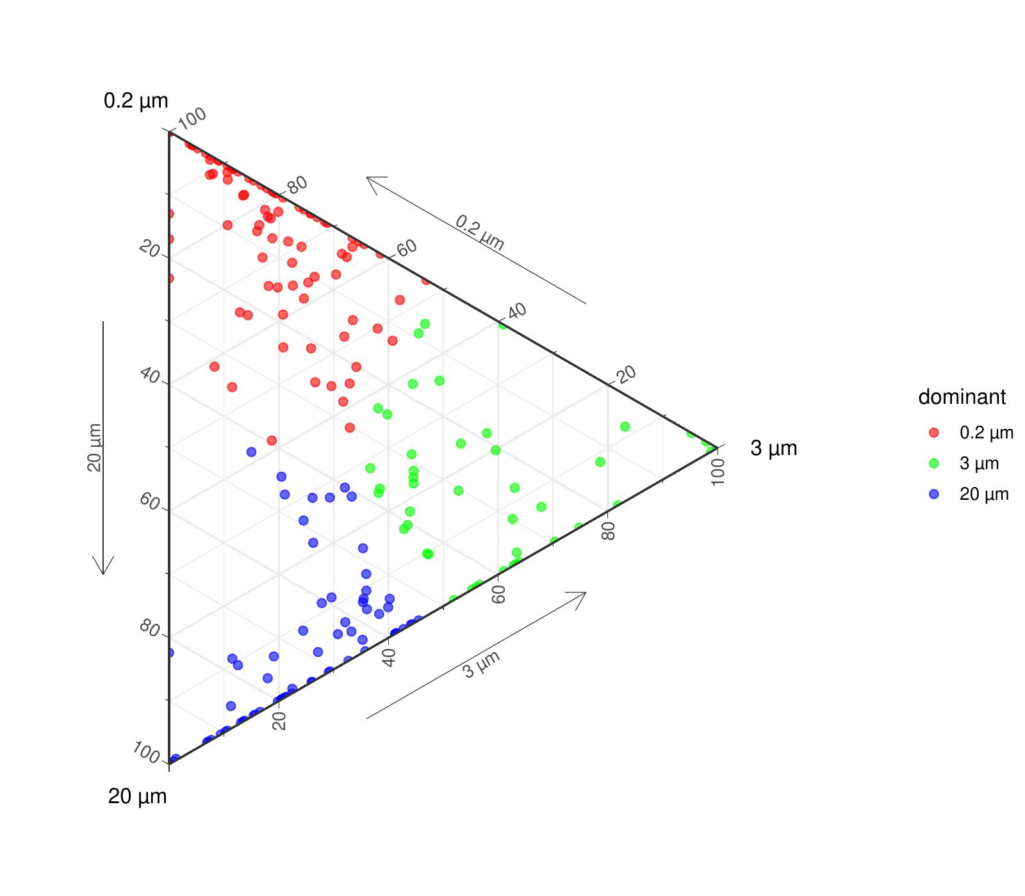
Size Fractionation Patterns
Distribution of ASVs across filter sizes (0.2, 3, 20 µm)
Key Findings
72 ASVs dominant in free-living fraction (0.2 µm ≥70%)
9 ASVs dominant in 3 µm fraction (≥70%)
36 ASVs dominant in particle-associated fraction (20 µm ≥70%)
49 ASVs completely absent in the 0.2 µm fraction — exclusively particle-associated taxa
Ternary plots colored by RGB proportions across three size fractions

Slide 4
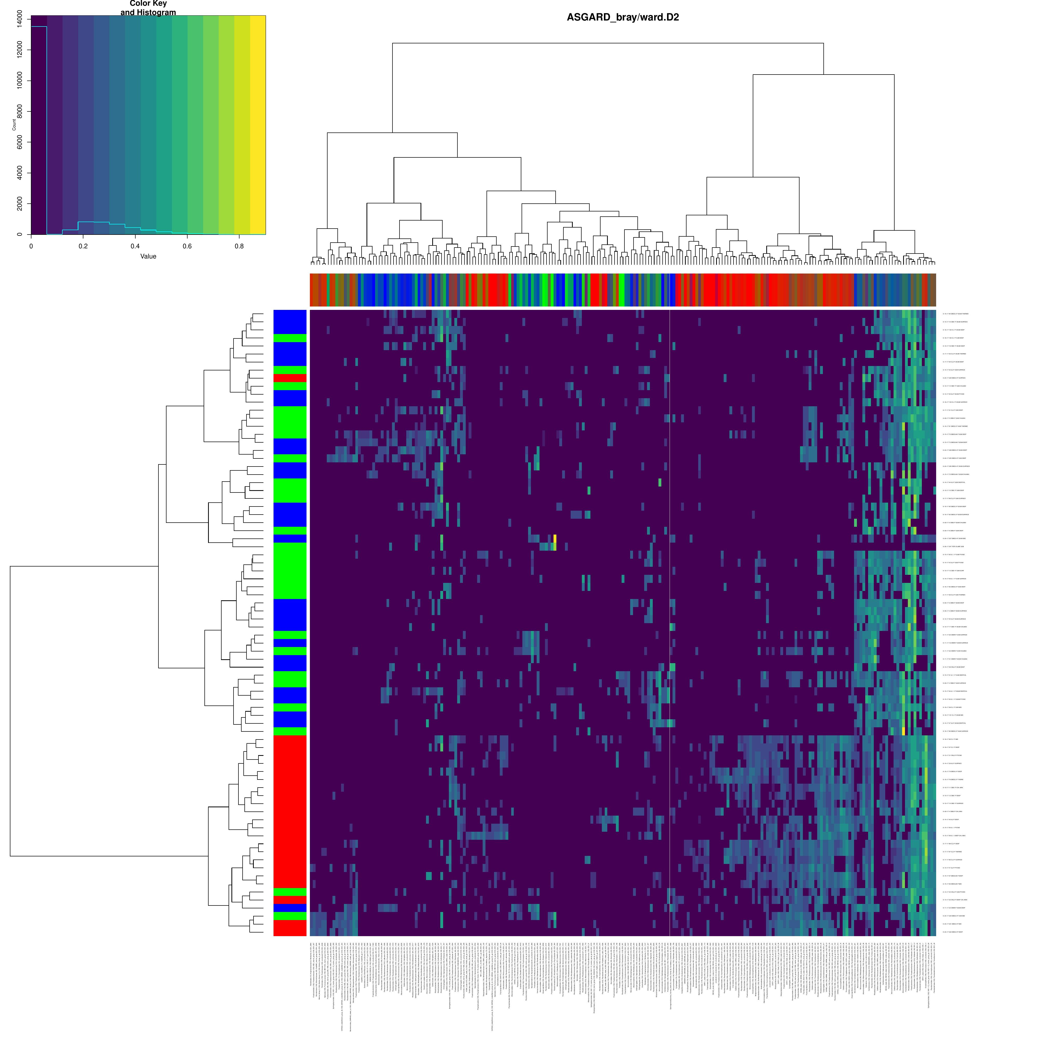
16S Community Structure
Hierarchical clustering of 78 samples × 221 ASVs
Cluster Analysis
Bray-Curtis dissimilarity with Ward.D linkage identifies 4 distinct clusters
Samples color-coded by filter size (0.2, 3, 20 µm) and cluster assignment
Fourth-root transformation (^0.25) compresses dominance of abundant ASVs
Dendrogram ordering preserved across all downstream heatmaps for consistency
Particle-associated ASVs (zero_cols) highlighted in focused sub-heatmap

Slide 5
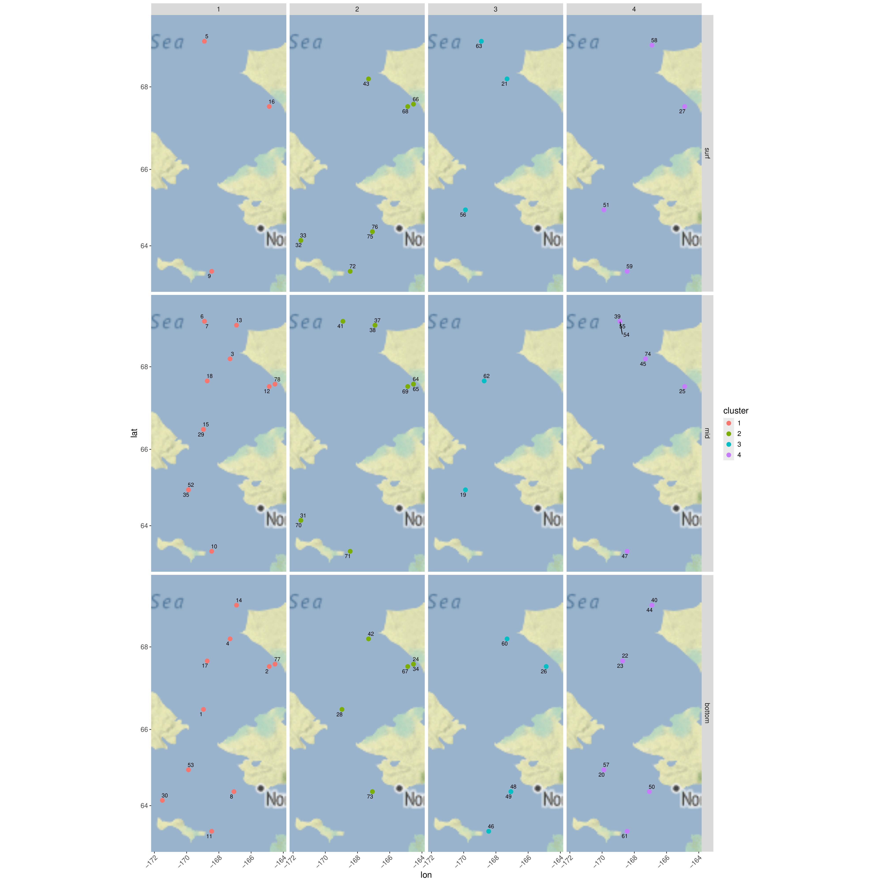
Geographic Distribution
Processing station clusters across sampling sites
Spatial Patterns
77 processing stations mapped by cluster assignment and water depth
Faceted by depth category: surface, mid-water, and bottom
Clusters show non-random geographic distribution
Per-ASV presence/absence maps generated for all 49 particle-associated taxa
Particle-associated ASVs display spatially heterogeneous distributions

Slide 6
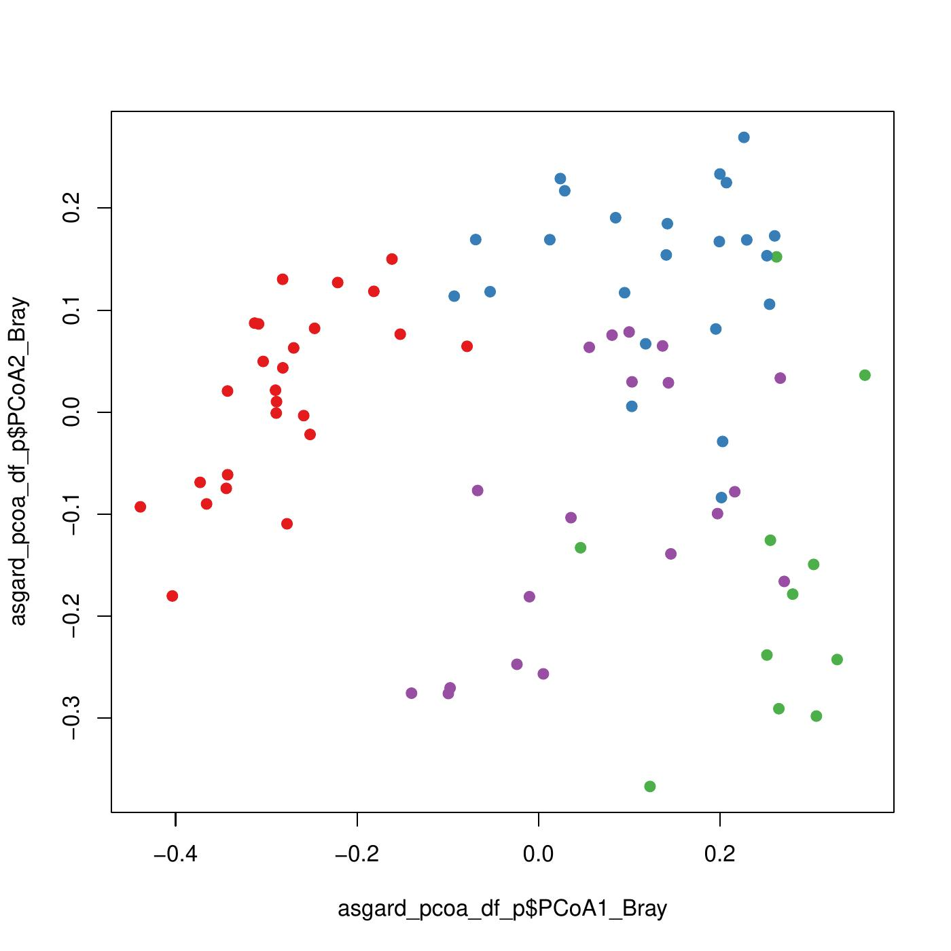
Beta Diversity Analysis
Principal Coordinates Analysis across distance metrics
Ordination Results
Three complementary distance metrics: Bray-Curtis (composition), Jaccard (presence/absence), Euclidean
PCoA reveals clear separation of the 4 clusters in ordination space
Boxplots of 52 metadata + PCoA variables by cluster assignment
Temperature, salinity, dissolved oxygen, and nutrient concentrations vary significantly across clusters
Cluster membership reflects underlying environmental gradients

Slide 7
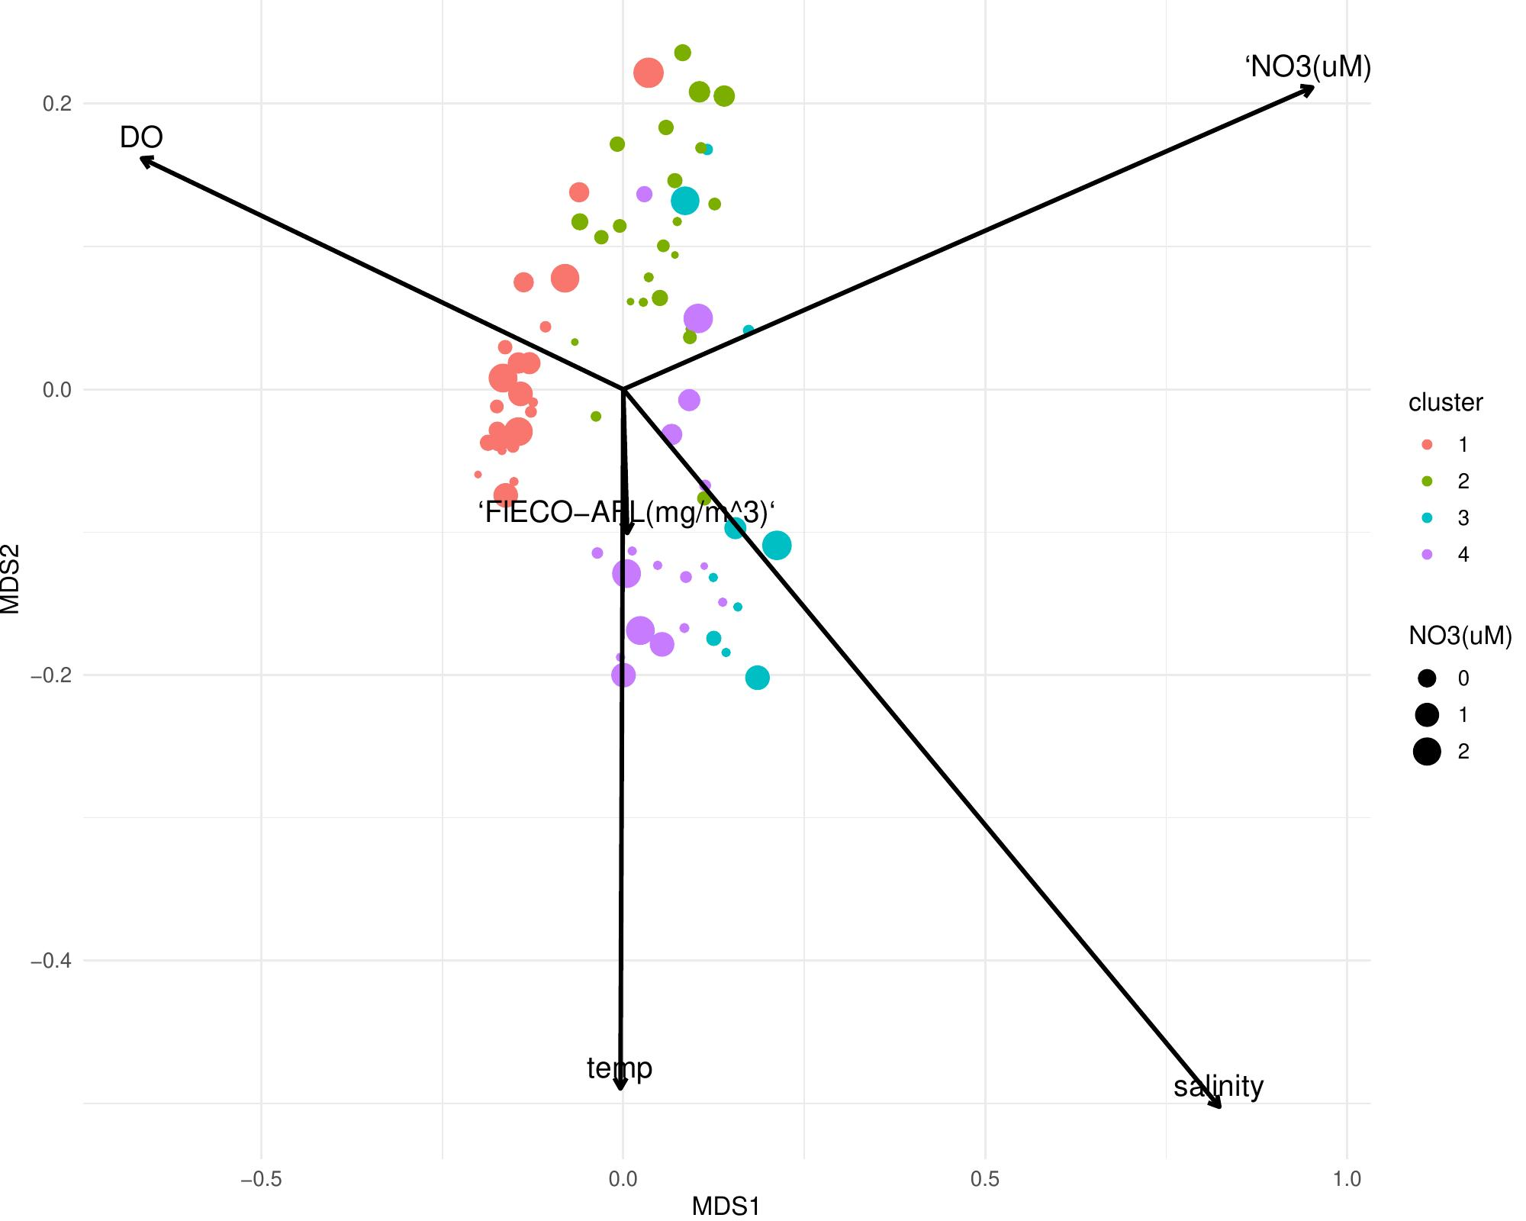
Environmental Drivers
Distance-based Redundancy Analysis (db-RDA)
Constrained Ordination
Model constrained by 5 environmental variables: temperature, salinity, dissolved oxygen, nitrate, fluorescence
75 samples with complete environmental data (3 removed for missing values)
Overall model significant (p < 0.001, ANOVA permutation test, 999 iterations)
Biplot arrows indicate direction and magnitude of environmental gradients
Salinity vs. temperature and salinity vs. NO₃ plots reveal cluster positioning along water mass gradients

Slide 8
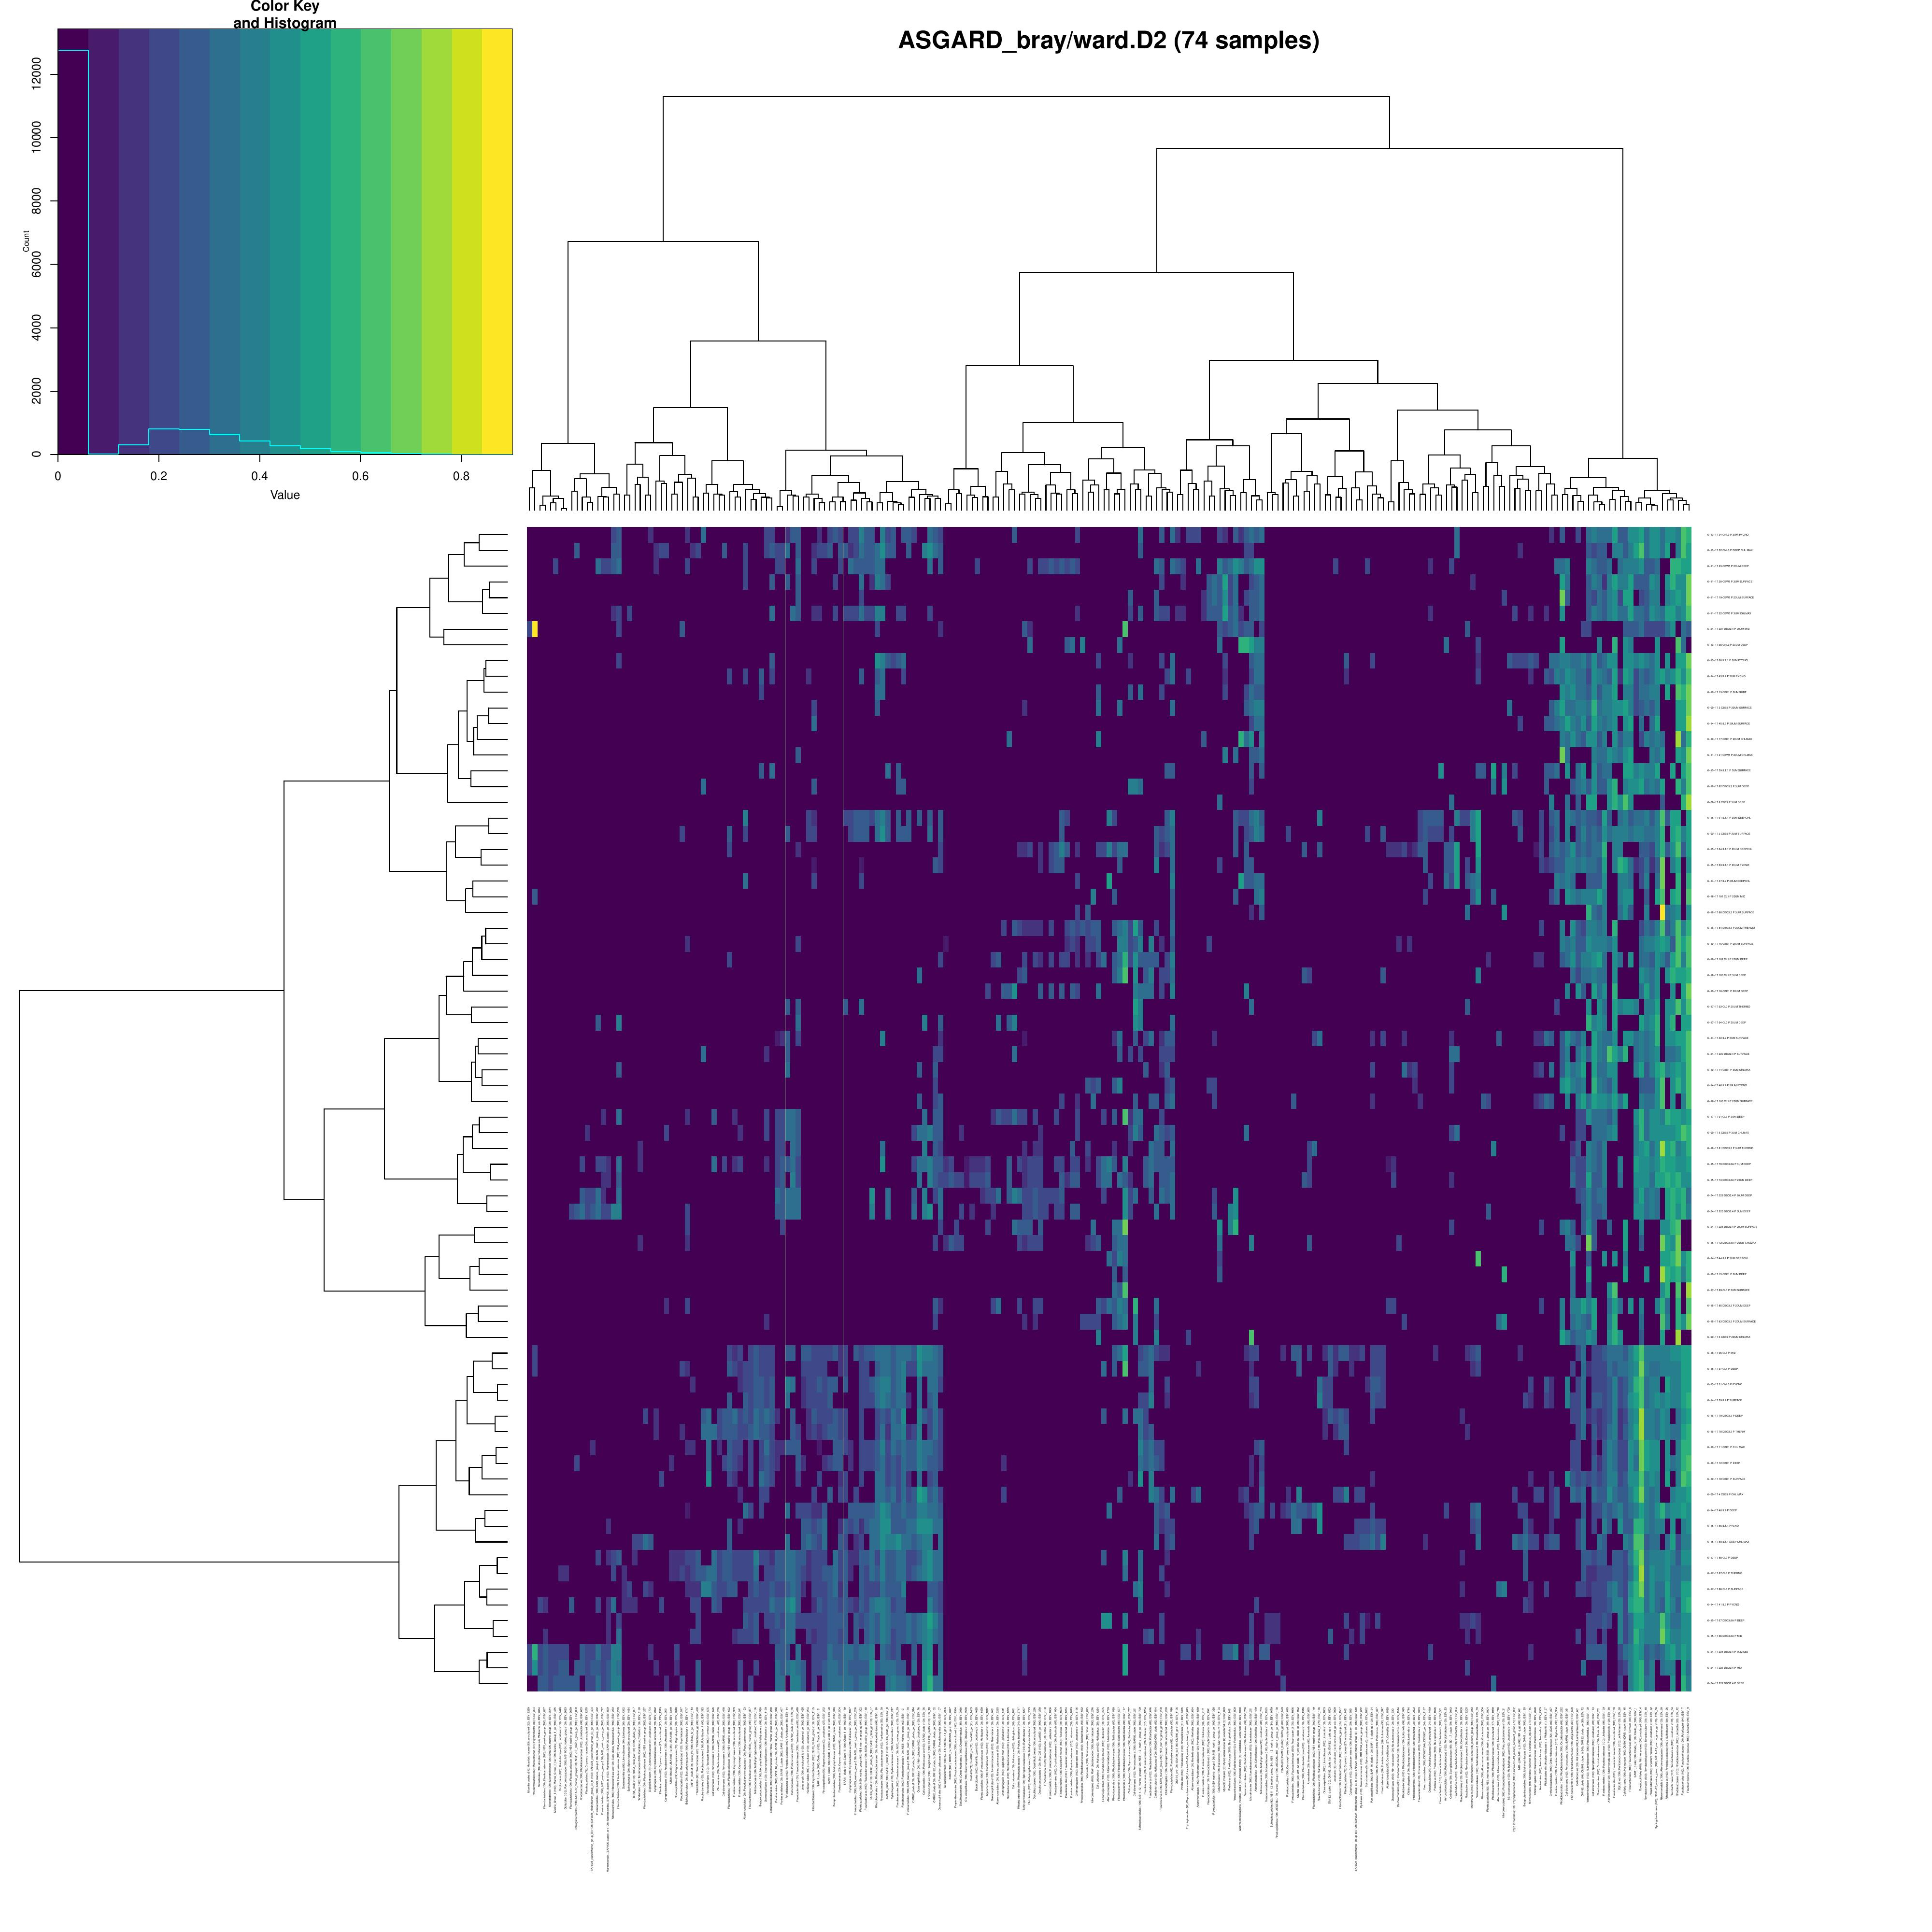
Eukaryotic Community Structure
18S rRNA — Class-level heatmap of 74 samples × 66 classes
Eukaryotic Patterns
74 samples analyzed (4 excluded due to missing 18S data)
66 eukaryotic classes and 57 phyla identified
Heatmap aligned to 16S dendrogram for consistent sample ordering
Eukaryotic community composition co-varies with prokaryotic clusters
ESV-level resolution reveals fine-scale within-ASV diversity patterns

Slide 9
Summary & Conclusions
Community Structure
Particle Association
Hierarchical clustering reveals 4 distinct microbial community types across 78 processing stations, driven by both size fractionation and environmental gradients.
49 ASVs are exclusively particle-associated (absent in 0.2 µm fraction), showing spatially heterogeneous geographic distributions across the study area.
Environmental Controls
Prokaryote-Eukaryote Co-structure
Temperature, salinity, dissolved oxygen, nitrate, and fluorescence significantly constrain community composition (db-RDA, p < 0.001). Clusters map onto distinct water mass characteristics.
18S eukaryotic communities co-vary with 16S prokaryotic cluster assignments, suggesting shared environmental responses across domains of life.

Slide 10
Analysis Pipeline
8-script R pipeline with session-state data flow
Script 00: Setup
Script 01: Data Prep
Script 02: Ternary
Script 03: Heatmaps
Load raw data 2193 × 18535
→
Filter to 78 samples 221 ASVs
→
Size fraction ratios
→
4 clusters identified
↓
↓
↓
↓
Script 04: Maps
Script 05: PCoA
Script 06: db-RDA
Script 07-08: 18S
Geographic patterns
→
Beta diversity ordination
→
Environmental drivers
→
Eukaryotic communities

