Slide 1





Computer Parts Picker

Slide 2
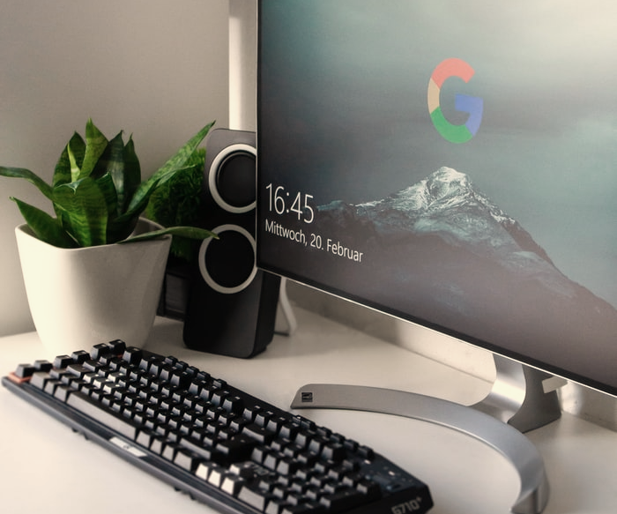
Hello!
We are here to talk about our OOP Project, where we are hoping to make a PC Parts Picker Application.

Slide 3
We’re looking to make a user-friendly application as picking parts for computer making could feel daunting to people.

Slide 4



1.
Description and Objectives
Let’s start with how we define our application and objectives.

Slide 5
The app itself
We’re making an app that is user-friendly
Have a good selection of PC Parts
Easily pick out parts for your PC

Slide 6








Objectives
Our main objective is to simplify picking out parts for a personal computer.

Slide 7
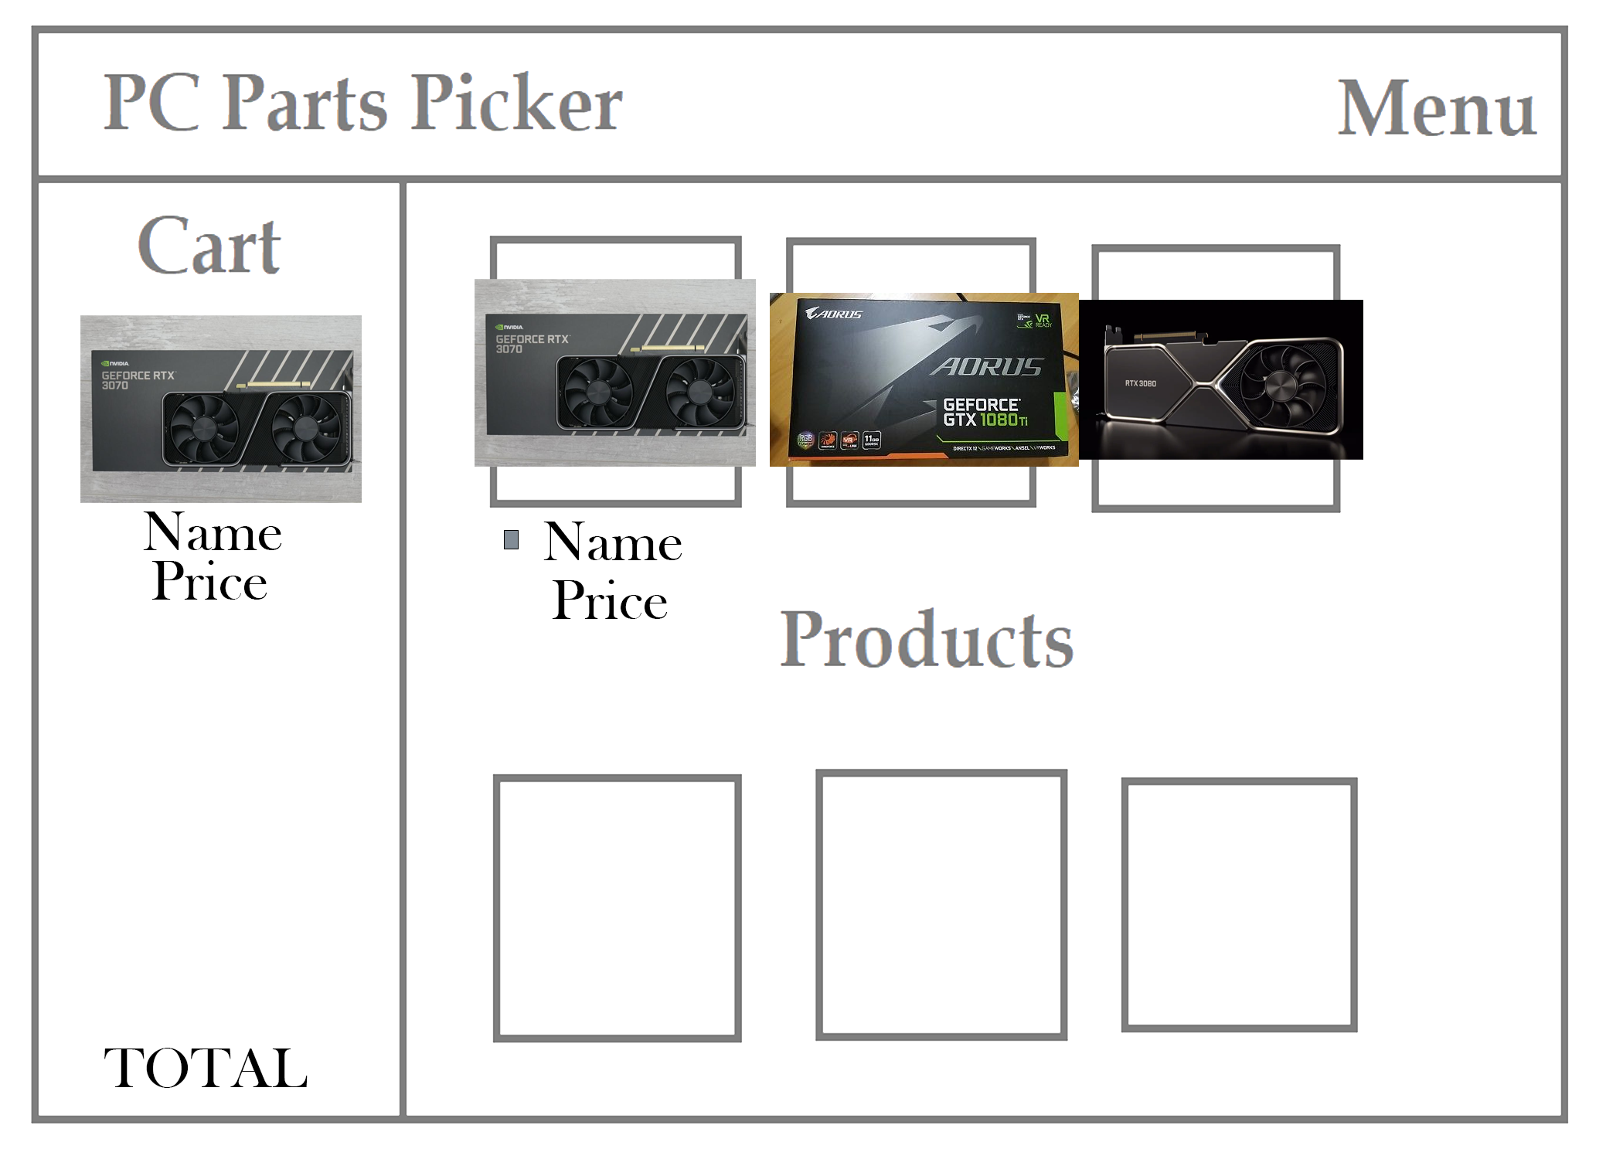
Draft
This is roughly the design of our app, we’re looking to improve it but generally this is what it would look like.

Slide 8

Thanks for listening!

