Slide 1
Collectible Merchandise Price Prediction
A machine-learning case study: predicting the resale price of trading cards, figures, comics, LEGO sets and memorabilia
UE24CS352A Machine Learning | Team 30 | Problem 50
Reia S (PES2UG24CS921) and Ritesh Babu Reddy (PES2UG24CS403)
Notes:
Introduce the team and problem 50. We generalise the Funko-only CS229 reference report to six collectible categories and to dollar-price regression.

Slide 2
Problem: what should this item sell for?
Collectible prices span $10 to $30,000+ and depend on rarity, condition, age and demand
Task: predict the dollar resale price of a listing from its attributes
Useful when comparable transactions are scarce (new or unusual items)
Challenges: right-skewed prices, mixed feature types, rare 'grail' outliers
Reference: Lu (CS229, 2021) classified Funko Pop price bins; we generalise to six categories and regression

Slide 3
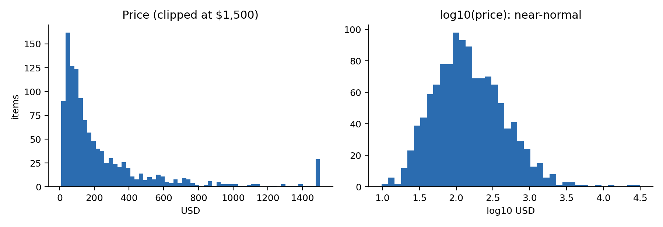
Dataset (synthetic, 1,200 listings)
Why synthetic?
No licensed real-market data was available. Prices come from a latent log-linear model with a condition x rarity interaction, a vintage premium and heavy-tailed noise.
Linear models are favoured by construction, so results describe the methods, not the real market.
9 features: product type, franchise, condition, rarity, age, edition size, search volume, graded, original packaging
Notes:
Be upfront that the data is synthetic. Code accepts a real CSV with the same columns.

Slide 4
Approach
Preprocess
Target
Models
Evaluate
One-hot, ordinal and log transforms inside each CV pipeline (no leakage)
Predict log(price), map back with exp(): fits skewed prices
Baseline, linear, ridge, kNN, SVR, tree, bagging, forest, boosting
5-fold CV x3; RMSE, R2, MAE, MedAPE, within-25% hit rate

Slide 5
Models compared
Family | Models | Why include it
Baseline | Median | Floor to beat
Linear | Linear, Ridge | Interpretable; natural for log prices
Kernel / instance | RBF-SVR, kNN | Non-linear, similarity-based
Trees | Decision tree, Bagging, Random Forest | Handle interactions; bagging cuts variance
Boosting | Gradient Boosting | Usually strongest on tabular data

Slide 6
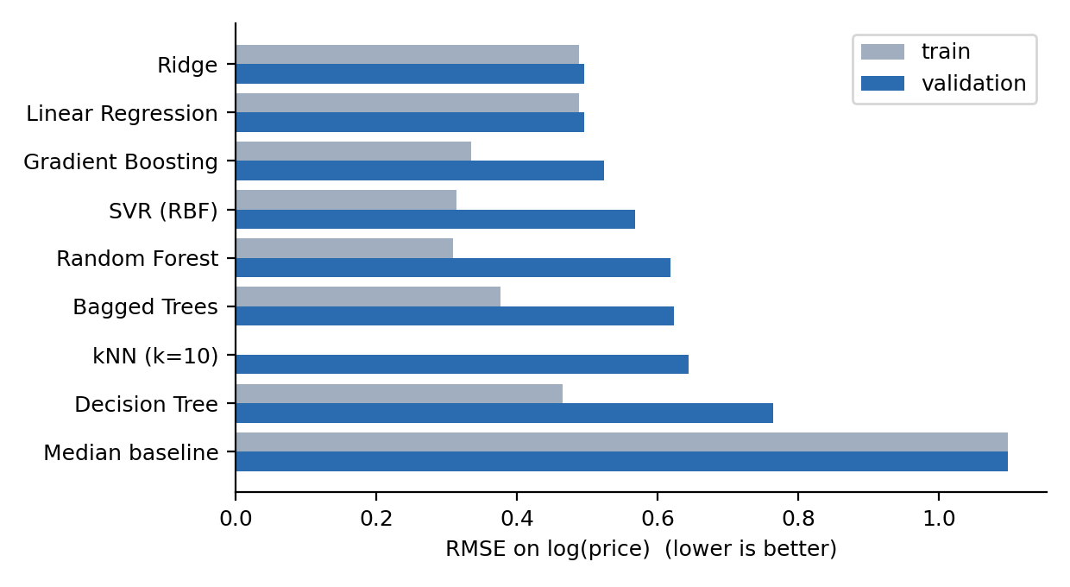
Results: validation error by model
Ridge best: RMSE 0.495, R2 0.79
44% of predictions within 25% of true price
Gradient boosting close behind (0.524)
Median baseline: 1.10
Notes:
Linear models win partly because the synthetic generator is log-linear. Say so if asked.

Slide 7
Trees: variance reduction helps
Single decision tree: RMSE 0.76
Bagged trees: 0.62
Random forest: 0.62
Trees still trail smooth log-linear models on this data
kNN memorises: train RMSE 0.00 vs validation 0.64

Slide 8
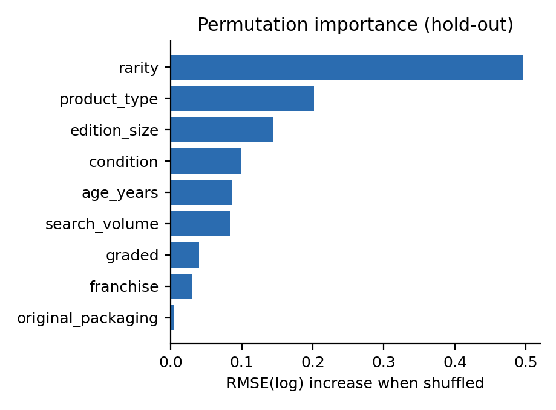
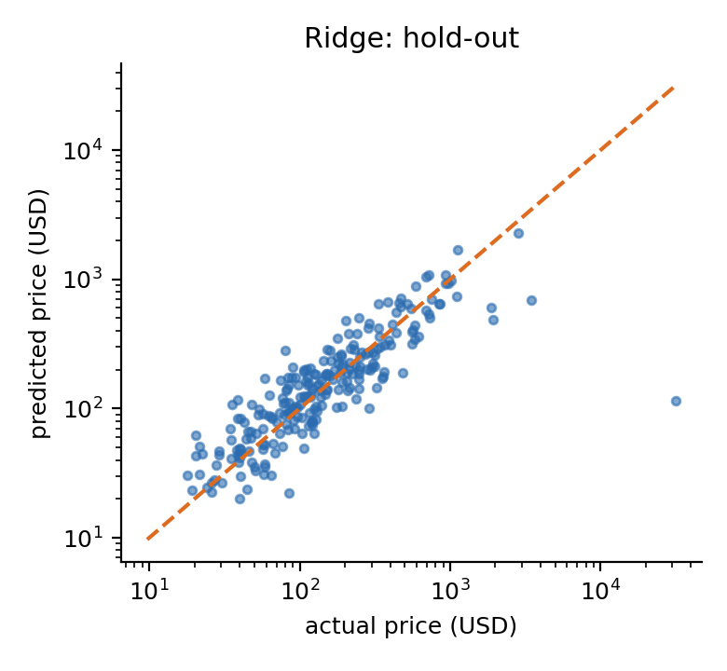
What drives price, and where the model fails
Rarity, product type and edition size matter most. Top-10% items are under-predicted by about 42%: treat top-tier estimates as a floor.

Slide 9
Conclusions and future work
All models beat the median baseline; Ridge best with about 30% median error
Bagging and forests tame tree overfitting but trail log-linear models here
Predictions for rare, expensive items are biased low: heavy-tailed outliers
Next: real marketplace data, quantile regression for price ranges, listing-title text features, tuned boosting

Slide 10
Live demo and repository
python src/demo.py --rarity ultra_rare --condition mint \
--graded 1 --age_years 25 --edition_size 5000 --search_volume 2000
Prints price estimates from Ridge, Gradient Boosting and Random Forest
python src/run_experiments.py regenerates all metrics and figures
Private GitHub repo with README, shared with faculty and TAs

