Slide 1
Application of Machine Learning Methods to Evaluate Collectibles
Real curated Funko Pop! collectible metadata • Five-tier price classification
UE24CS352A • Team 30 • Project ID 50
REIA S - PES2UG24CS921
RITESH BABU REDDY - PES2UG24CS403
TEAM 30 • MACHINE LEARNING MINI-PROJECT • 01

Slide 2
Problem & Motivation
The Problem
Collectible merchandise prices vary widely depending on product characteristics and market demand.
Factors such as category, material, special editions, release date, and search popularity may influence market prices.
Identifying the relative value of a collectible using product metadata alone is a challenging prediction task.
Project Objective
Apply machine learning classification algorithms to real-world collectible sales data.
Categorise products into five relative price tiers, from lower-priced to higher-priced collectibles.
Compare multiple models to determine which performs best on unseen data.
Why This Matters
Helps explore patterns in collectible merchandise pricing.
Demonstrates how product metadata can support data-driven price analysis.
Provides a comparative evaluation of machine learning models for a real-world dataset.
TEAM 30 • MACHINE LEARNING MINI-PROJECT • 02

Slide 3
Dataset
Source: original author's CS229 repository and data_curated.csv.
359 unique products in our local cleaned run.
Anime 198 • Marvel 69 • Ad Icons 44 • Disney 37 • Game of Thrones 11.
Target field: average_sale_price; tiers derived from training-set quantiles.
https://raw.githubusercontent.com/timothyxlu/CS229/master/project/src/data_sourcing/data_curated.csv
TEAM 30 • MACHINE LEARNING MINI-PROJECT • 03

Slide 4
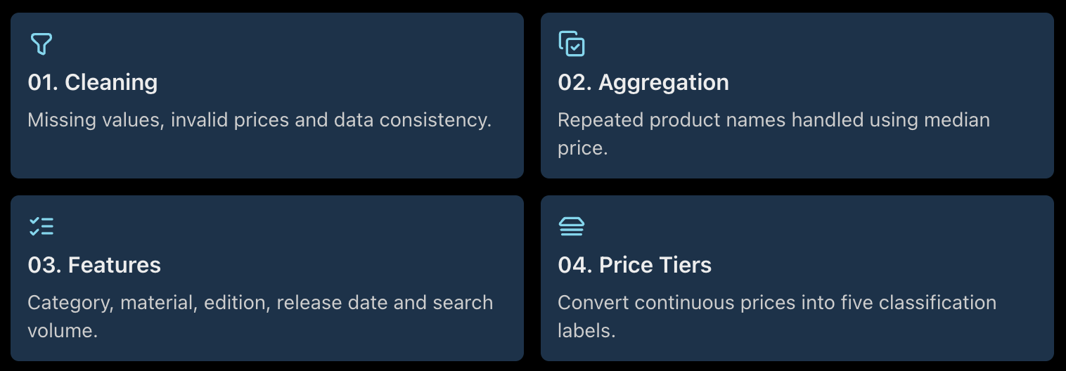
Data Preparation & Features
TEAM 30 • MACHINE LEARNING MINI-PROJECT • 04

Slide 5
Models Compared
Majority-class baseline:
  Linear SVM
  RBF SVM
  Decision Tree
  Bagged Trees
  Random Forest
Evaluation: held-out test set of 90 products; accuracy, balanced accuracy, macro-F1 and weighted-F1.
TEAM 30 • MACHINE LEARNING MINI-PROJECT • 05

Slide 6
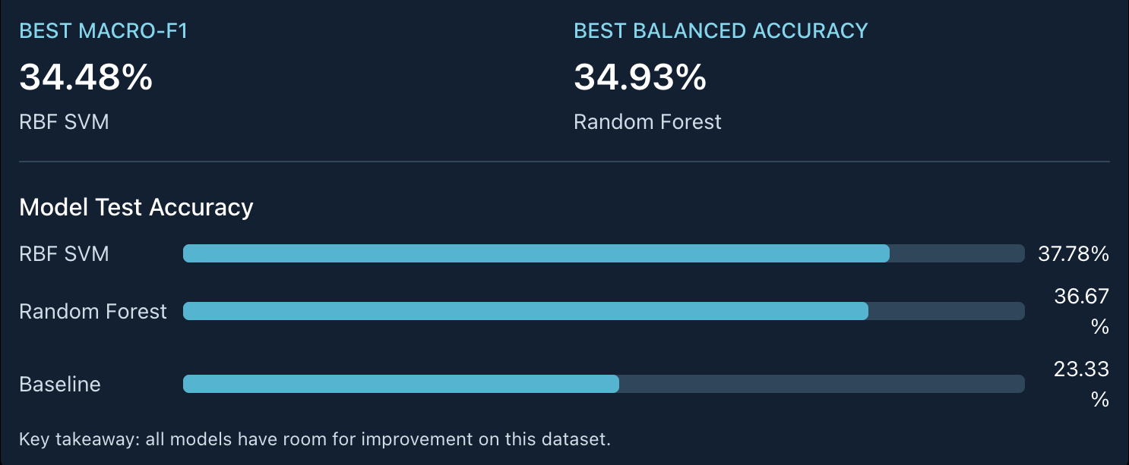
Results
TEAM 30 • MACHINE LEARNING MINI-PROJECT • 06

Slide 7
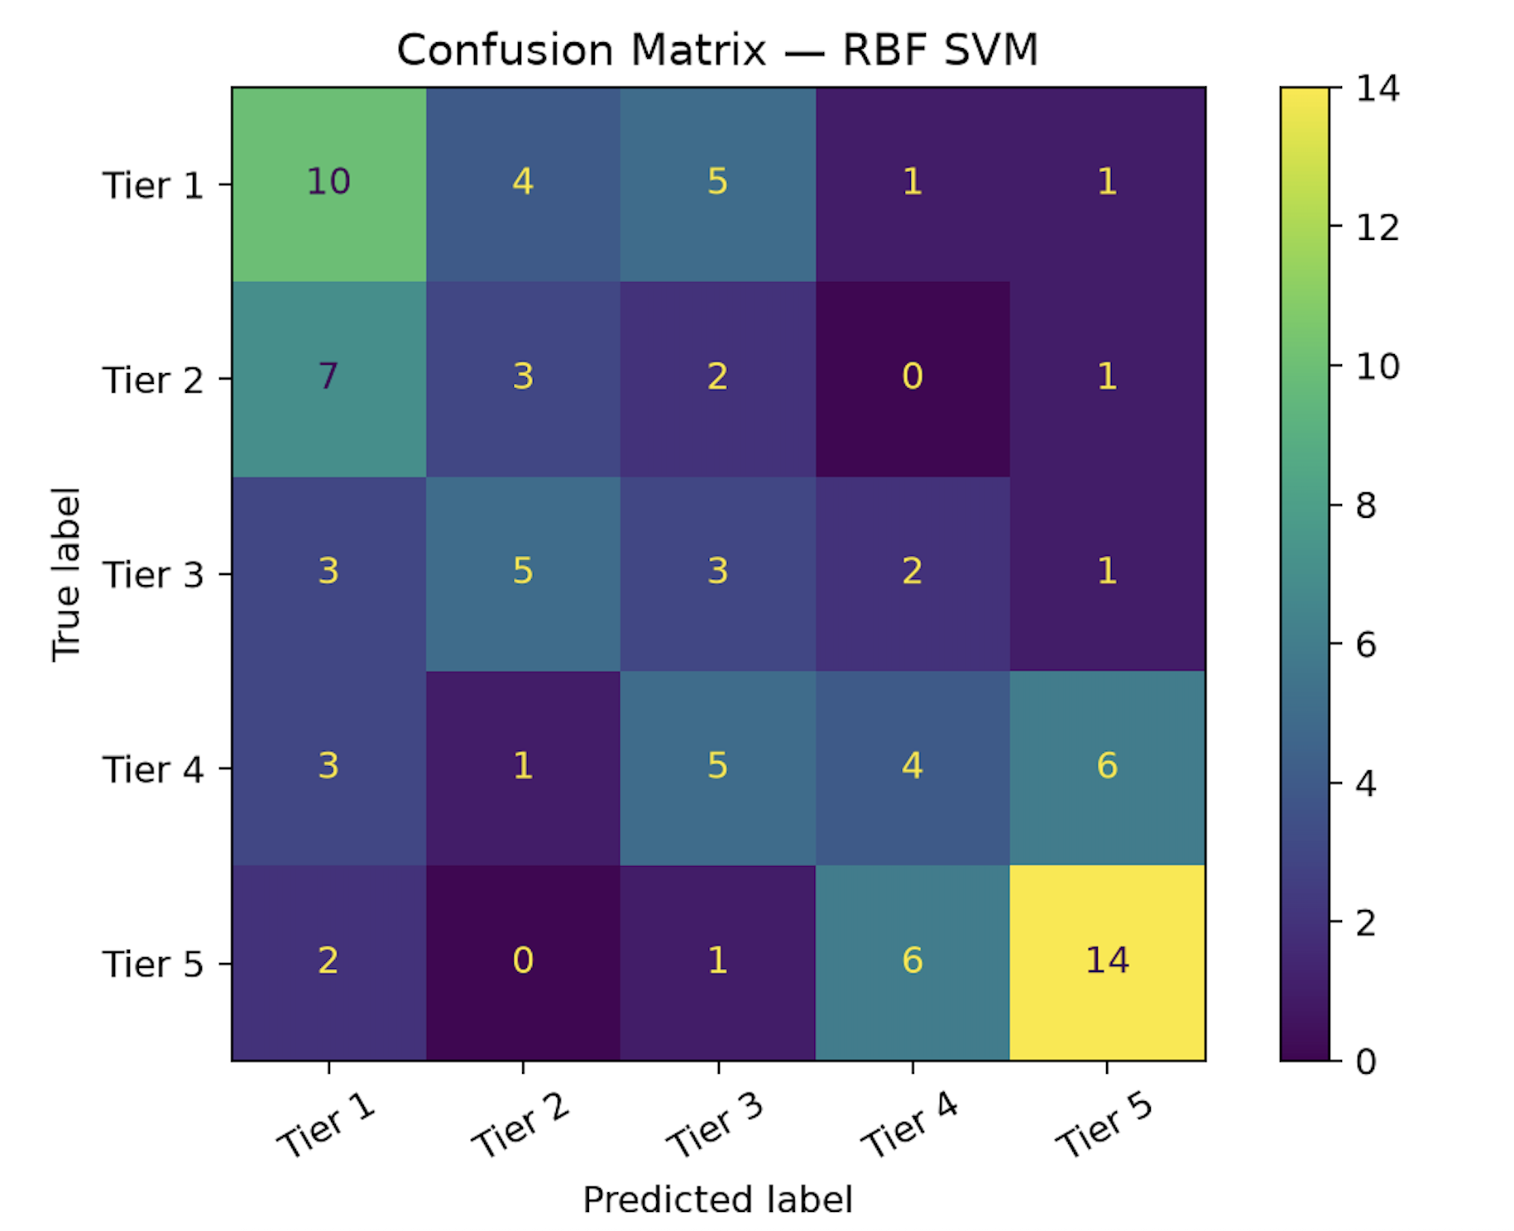
Error Analysis
RBF SVM correctly classified 34/90 test products.
Tier 5 recall: 60.9%
Tier 1 recall: 47.6%.
Tier 3 recall: 21.4%.
Tier 4 recall: 21.1%.
Middle tiers are harder to separate; performance is modest.
TEAM 30 • MACHINE LEARNING MINI-PROJECT • 07

Slide 8
Demo
Run:
python -m src.predict --name "Funko Pop Animation Dragon Ball Z Beerus Metallic SDCC Figure 120" --category Anime --material Metallic --special-version "San Diego Comic Con”
Observed output: predicted relative price tier 5/5.
TEAM 30 • MACHINE LEARNING MINI-PROJECT • 08

Slide 9
THANK YOU!
TEAM 30 • MACHINE LEARNING MINI-PROJECT • 08

