Slide 1
Identifying Site-Based Risk in Clinical Trials Using Multivariate Outlier Detection Techniques
Oisín Mangan: 95484701
Declan Ryan: 96322586
Academic Supervisor: Dr. Miguel Nicolau, UCD Industry Supervisor: Michael Phillips, ICON

Slide 2
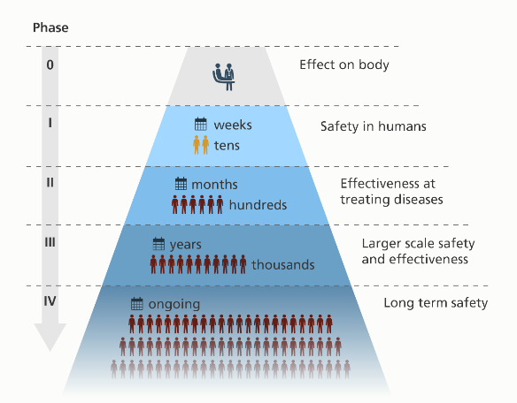
What is a Clinical Trial?
Clinical trials are used to determine the safety and efficacy of new drugs or treatments
Usually conducted in 4 or 5 Phases
http://www.yourgenome.org/facts/what-is-a-clinical-trial

Slide 3
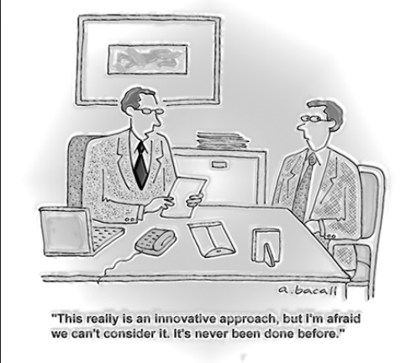
Business Problem - Motivation
ICON
Centralised Monitoring
Irish Company
Global provider of outsourced development services to pharmaceutical industry
http://www.georgeclinical.com/resources/corporate-news/george-clinical-arcs-presentation
Cost – Monitoring is expensive

Slide 4
Key Concepts
Key Risk Indicators (KRIs)
Types of Data Errors
Examples:
Adverse Event Reporting
Hear Rate Variability
Examples:
Miscalibrated equipment
Sloppiness
Tampering
Fraud
Clinical Data Analysts (CDAs):
At ICON CDAs are responsible for monitoring KRIs

Slide 5
Data Preparation
Key Risk Indicator (KRI)
Raw Data
KRIs Table

Slide 6
KRIs Table
Site ID
K1 | K2 | K3 | K4 | K5 | : : : | K18 | K19 | K20
1
2
3
:
:
:
1259
1260
1261
0.16
0.21
0.09
:
:
:
0.19
0.32
0.41
0.67
0.61
0.74
:
:
:
0.66
0.71
0.56
0.82
0.17
0.76
:
:
:
0.45
0.42
0.61
0.22
0.26
0.35
0.24
:
:
0.29
:0.5
:0.27
0.81
0.77
0.71
0.9
:
:
0.9
0.8
0.86
: : :
: : :
: : :
: : :
: : :
: : :
: : :
: : :
: : :
0.54
0.59
0.36
:
:
:
0.42
0.88
0.39
0.33
0.25
0.29
:
:
:
0.61
0.52
0.52
0.51
0.48
0.16
:
:
:
0.47
0.69
0.09

Slide 7
Outlier Detection
local Outlier Factor (LOF)
Baysout

Slide 8
KRIs Table
Site ID
K1 | K2 | K3 | K4 | K5 | : : : | K18 | K19 | K20
1
2
3
:
:
:
1259
1260
1261
0.16
0.21
0.09
:
:
:
0.19
0.32
0.41
0.67
0.61
0.74
:
:
:
0.66
0.71
0.56
0.82
0.17
0.76
:
:
:
0.45
0.42
0.61
0.22
0.26
0.35
:
:
:
0.29
:0.5
:0.27
0.81
0.77
0.71
:
:
:
0.9
0.8
0.86
: : :
: : :
: : :
: : :
: : :
: : :
: : :
: : :
: : :
0.54
0.59
0.36
:
:
:
0.42
0.88
0.39
0.33
0.25
0.29
:
:
:
0.61
0.52
0.52
0.51
0.48
0.16
:
:
:
0.47
0.69
0.09

Slide 9
KRIs Table
Site ID
K1 | K2 | K3 | K4 | K5 | : : : | K18 | K19 | K20
1
2
3
:
:
:
1259
1260
1261
0.16
0.21
0.09
:
:
:
0.19
0.32
0.41
0.67
0.61
0.74
:
:
:
0.66
0.71
0.56
0.82
0.17
0.76
:
:
:
0.45
0.42
0.61
0.22
0.26
0.35
:
:
:
0.29
:0.5
:0.27
0.81
0.77
0.71
:
:
:
0.9
0.8
0.86
: : :
: : :
: : :
: : :
: : :
: : :
: : :
: : :
: : :
0.54
0.59
0.36
:
:
:
0.42
0.88
0.39
0.33
0.25
0.29
:
:
:
0.61
0.52
0.52
0.51
0.48
0.16
:
:
:
0.47
0.69
0.09

Slide 10
3-Set of K1, K2 and K5
Site ID
K1 | K2 | K5
1
2
3
:
:
:
1259
1260
1261
0.16
0.21
0.09
:
:
:
0.19
0.32
0.41
0.67
0.61
0.74
:
:
:
0.66
0.71
0.56
0.81
0.77
0.71
:
:
:
0.9
0.8
0.86

Slide 11
LOF Output
All Sites 1-1261
Ordered by LOF
Outliers
Site ID
LOF
Site ID
LOF
Site ID
LOF
1
2
3
4
5
6
7
8
9
10
1.2
1.0
1.07
1.06
0.99
1.0
1.03
1.02
1.02
1.09
668
1033
1256
1176
865
693
1050
11
106
343
2.54
2.31
2.26
2.13
2.11
2.06
20.3
1.96
1.89
1.84
668
10.33
1256
1176
865
693
1050
2.54
2.31
2.26
2.13
2.11
2.06
2.03

Slide 12
Outlier Detection
local Outlier Factor (LOF)
Baysout
Total LOF

Slide 13
Total LOF
Site ID: 221
Outlier in: List 4, List 12, List 32 . . . . . . . . List 21,656, List 21,696
Total LOF = LOF + LOF + LOF + . . . . . . + LOF + LOF
= 1,813.84

Slide 14
Total LOF Results
Site ID | Total LOF
1 | 992.8134774
2 | 807.6242674
3 | 10930.67914
4 | 9535.427867
5 | 4302.545448
6 | 602.1024094
7 | 106.7700625
8 | 9.315091292
9 | 1155.894531
10 | 6169.113677
11 | 73.98027211
12 | 1816.967318
13 | 468.5262905
14 | 145.7669638
15 | 1062.14438
: | :
: | :
1131 | 63.9053705
1132 | 84.279015
1133 | 5929.193206
1134 | 4569.896283
1135 | 15914.72185
1136 | 631.2836202
1137 | 4443.472893
Site ID | Total LOF
829 | 47690.59014
945 | 39801.29964
948 | 35462.99779
687 | 34023.82477
342 | 30812.66648
91 | 25301.91447
484 | 25246.04491
865 | 23643.52105
916 | 21845.15229
579 | 21487.33292
Notes:
1

Slide 15
Outlier Detection
local Outlier Factor (LOF)
Baysout
Total LOF
Frequency
25 Outliers

Slide 16
Frequency of Occurrence as an Outlier
Site ID: 221
Outlier in: List 4, List 12, List 32 . . . . . . . . List 21,656, List 21,696
Total LOF = 1 + 1 + 1 + . . . . . . + 1 + 1
= 654

Slide 17
Outlier Detection
local Outlier Factor (LOF)
Baysout
Total LOF
Frequency
LOF 20 KRIs
25 Outliers
41 Outliers

Slide 18
KRIs Table
Site ID
K1 | K2 | K3 | K4 | K5 | : : : | K18 | K19 | K20
1
2
3
:
:
:
1259
1260
1261
0.16
0.21
0.09
:
:
:
0.19
0.32
0.41
0.67
0.61
0.74
:
:
:
0.66
0.71
0.56
0.82
0.17
0.76
:
:
:
0.45
0.42
0.61
0.22
0.26
0.35
0.24
:
:
0.29
:0.5
:0.27
0.81
0.77
0.71
0.9
:
:
0.9
0.8
0.86
: : :
: : :
: : :
: : :
: : :
: : :
: : :
: : :
: : :
0.54
0.59
0.36
:
:
:
0.42
0.88
0.39
0.33
0.25
0.29
:
:
:
0.61
0.52
0.52
0.51
0.48
0.16
:
:
:
0.47
0.69
0.09

Slide 19
Outlier Detection
local Outlier Factor (LOF)
Baysout
Total LOF
Frequency
LOF 20 KRIs
25 Outliers
41 Outliers
45 Outliers
99 Outliers
94 Outliers
26 Outliers

Slide 20
Summary of Results
Our Study
ICON March Report
330 Outliers
113 Unique Site IDs
113 Risky Sites
438 Risky Sites
54 of 113 in ICON List
59 ?

Slide 21
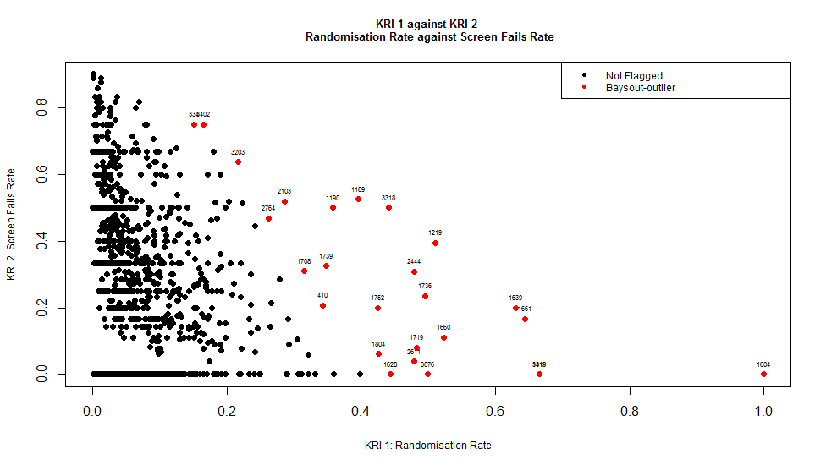
Academic Contribution
Univariate
Versus
Multivariate
Desmet at al. (2014)
Timmermans et al. (2016)
The present study
2764

Slide 22
Problems Encountered
Unlabelled Data
Testing Results
Limits the methodology options
Only CDA data available
Must be supervised

Slide 23
Conclusion and Future Work
Test Results
Previously undetected risky sites
Review of KRIs
59 sites to investigate

Slide 24
References
Desmet, L., Venet, D., Doffagne, E., Timmermans, C., Burzykowski, T., Legrand, C. and Buyse, M. (2014) ‘Linear mixed‐effects models for central statistical monitoring of multicenter clinical trials’, Statistics in medicine, 33(30), pp. 5265-5279.
George Clinical. (2015) George Clinical ARCS Presentation. Available at: http://www.georgeclinical.com/resources/corporate-news/george-clinical-arcs-presentation (Accessed 29 August 2016).
Timmermans, C., Venet, D. and Burzykowski, T. (2016) ‘Data-driven risk identification in phase III clinical trials using central statistical monitoring.’, International journal of clinical oncology, 21(1), pp. 38-45.
Your Genome. (2016) What is a clinical trial? Available at: http://www.yourgenome.org/facts/what-is-a-clinical-trial (Accessed 29 August 2016).

Slide 26
KRI Combinations
54 Risky Sites 21,699 Combinations of KRis
List No. 2384 had 23 out of 54
K2, K3, K8 and K14
Screen Fails Rate
Withdrawals Rate
Lab 2 Missed Rate
Rate of SAE Reporting

Slide 27
Total Number of Combinations
No. of KRIs | Calculation | No. of Combinations
Singles | ²⁰C₁ | 20
Pairs | ²⁰C₂ | 190
3-sets | ²⁰C₃ | 1140
4-sets | ²⁰C₄ | 4845
5-sets | ²⁰C₅ | 15504
Total | ∑_{i=1-5} ²⁰C_{i} | 21699
21,699

