Slide 1

Email ChatBot – AI-Based Email Automation
Using n8n, Telegram & Google Gemini
Shreyas | 3rd Year CSE – A | VNR VJIET

Slide 2

The Problem with Email Communication
Time-Consuming Process
Drafting professional emails takes valuable time away from core tasks, especially when dealing with repetitive communications.
Formatting Challenges
Many struggle with proper structure, tone, and clarity—resulting in unprofessional or unclear messages.
Need for Automation
Repetitive emails like leave requests and status updates require a faster, automated solution.

Slide 3

Our Solution: AI-Powered Email Automation
Telegram Integration
AI-Powered Drafting
Send messages directly through your familiar Telegram interface—no need to switch applications.
Google Gemini transforms casual chat messages into professionally formatted emails instantly.
Gmail API Delivery
Seamlessly send emails directly through your Gmail account with complete security and reliability.

Slide 4

Project Objectives
01
Automate Email Drafting
Eliminate manual composition for routine communications, saving hours weekly.
02
Ensure Professional Quality
Maintain consistent formatting, tone, and structure across all automated emails.
03
Real-Time Conversion
Instantly transform conversational messages into polished email drafts.
04
Boost Productivity
Streamline workflow automation to focus on high-value tasks.

Slide 5

Technology Stack
n8n Workflow
Google Gemini LLM
Telegram Bot API
Open-source automation platform orchestrating the entire process with visual workflow design and powerful integrations.
Advanced language model providing intelligent email composition with context awareness and natural language understanding.
Secure messaging interface enabling seamless user interaction through a familiar, mobile-friendly platform.
Gmail API
LangChain Memory
Official Google API for secure email sending and account integration with OAuth2 authentication.
Conversation memory tools maintaining context across interactions for coherent, personalised responses.

Slide 6





System Architecture
User Input
Sends message via Telegram
Telegram Bot
Receives & forwards message
n8n Automation
Triggers AI workflow
AI Agent
Drafts professional email
Gmail API
Sends email securely
The architecture ensures secure, efficient communication flow from casual chat to professional email delivery.

Slide 7
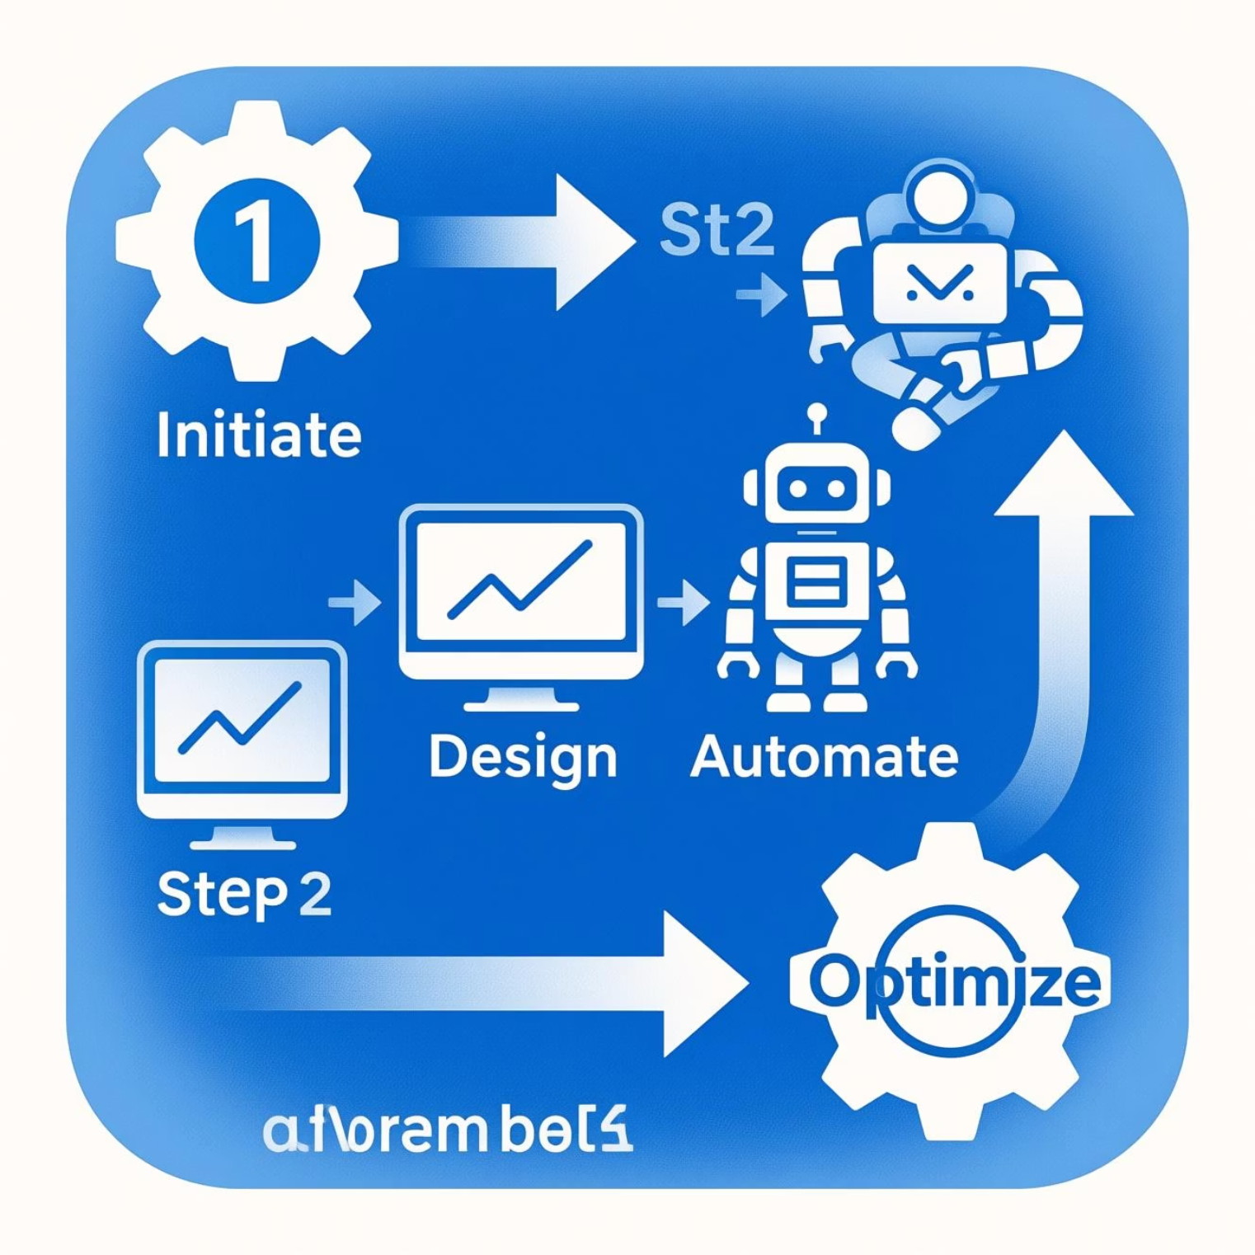
Workflow Process
Message Input
User sends email details through Telegram bot interface.
Trigger Activation
n8n workflow automatically initiates upon message receipt.
AI Drafting
Gemini AI generates professionally formatted email content.
Preview & Review
Draft preview sent back to Telegram for user approval.
Email Delivery
Upon confirmation, Gmail API sends the final email.

Slide 8
Key Features & Capabilities
Auto-Generated Drafts
Automatic Signatures
Context-Aware Writing
AI creates complete email drafts from brief instructions, understanding context and requirements.
Professional signatures appended seamlessly to every email for consistent branding.
LangChain memory maintains conversation history for coherent, personalised communication.
Secure OAuth Access
Preview Before Sending
Gmail integration protected by OAuth2 authentication ensuring account security.
Review and approve drafts within Telegram before final delivery for complete control.

Slide 9

Implementation & Use Cases
Technical Components
Real-World Applications
Telegram Trigger
Webhook-based message reception initiating the automation flow.
AI Agent Node
Gemini + LangChain integration for intelligent email generation.
Memory System
Session-based context retention across conversations.
Gmail Tools
Draft creation and send capabilities through official API.
Leave Applications: Quick submission of absence requests with proper formatting.
Official Communication: Professional correspondence with faculty, administration, or colleagues.
Project Updates: Progress reports and status communications sent efficiently.
Assignment Submissions: Properly formatted submission emails with attachments.

Slide 10
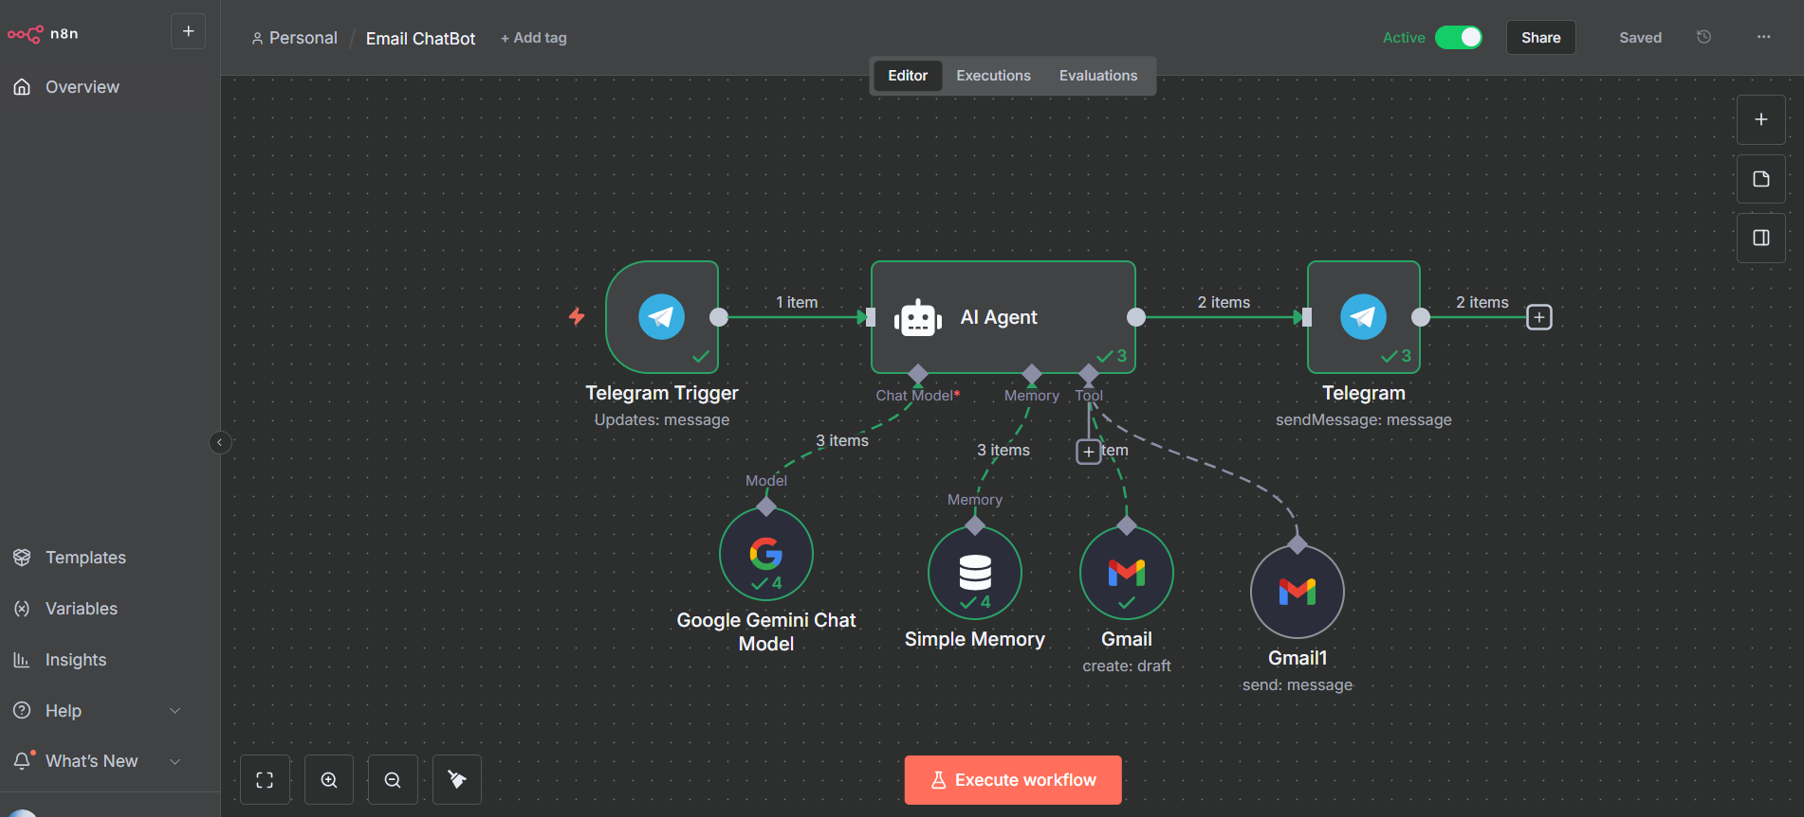
OUTPUTS

Slide 11
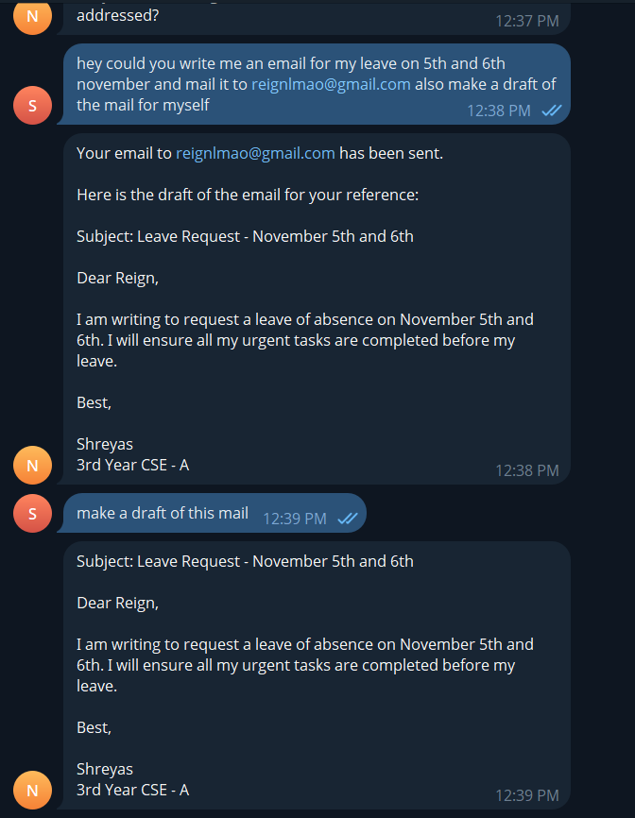
OUTPUTS

Slide 12
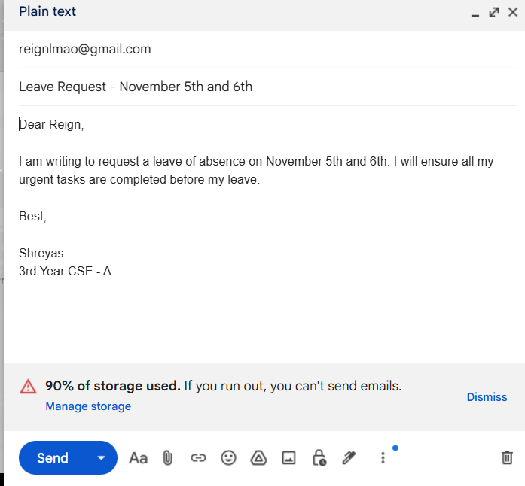
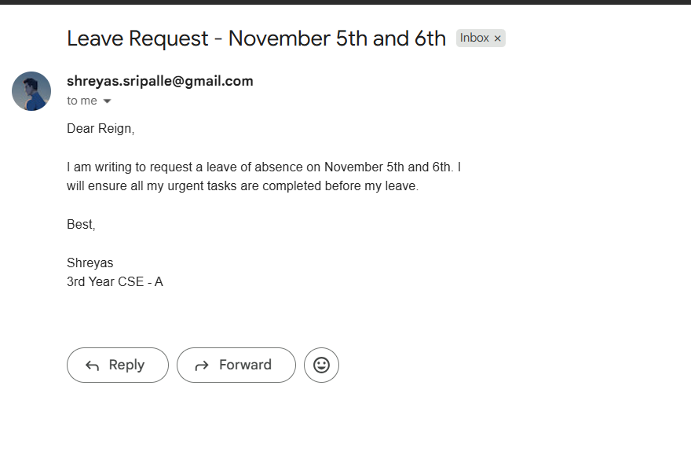
OUTPUTS

