Slide 1

E-Bike Products 2030
Joe Barrett

Slide 2
Introduction
Justification
Previous experience as a bicycle mechanic
First hand exposure to products
Outline
Current market
Potential Advancements
Conclusions

Slide 3
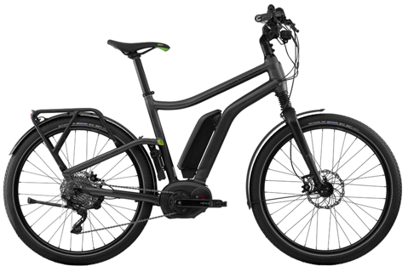
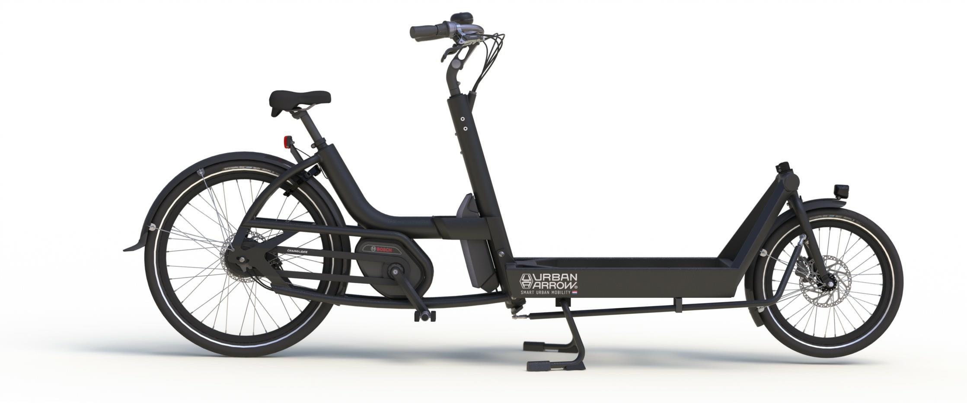
Current Market: Urban
Perfect for commuting/utility
Green transportation
Rapidly increasing market
~70 – 164km range¹
1 Calculated using Range Assistant: https://www.bosch-ebike.com/en/service/range-cockpit/

Slide 4
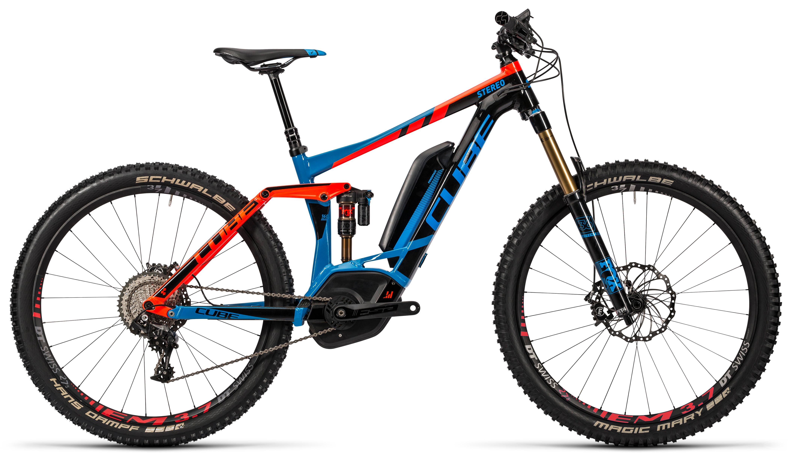
Current Market: Leisure
Smaller market share though increasing
Allows for longer rides
~ 45 – 90km range¹
1 Calculated using Range Assistant: https://www.bosch-ebike.com/en/service/range-cockpit/

Slide 5
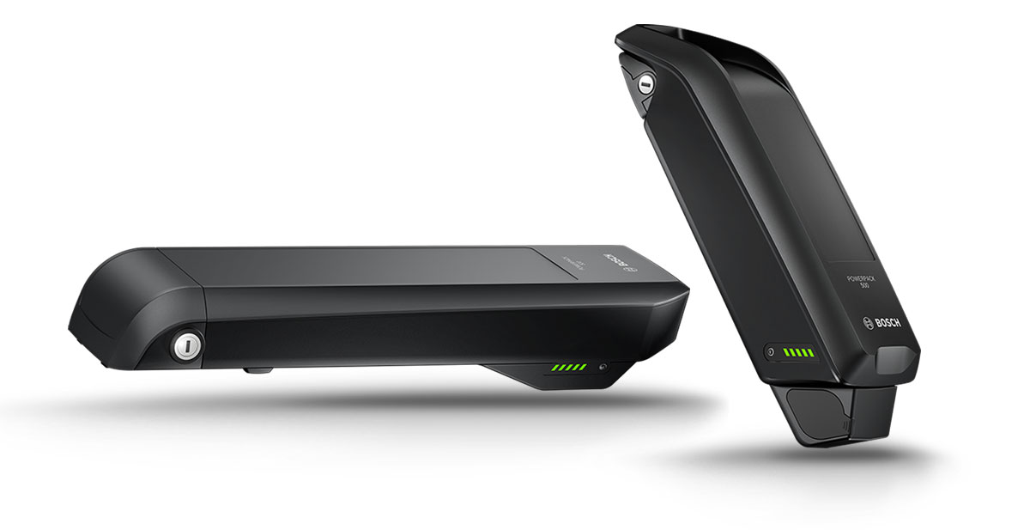
Advancements: Batteries
Increased capacity
Alternative technologies ^{1,2}
Reduced capacity loss
Faster charging
Reduced costs
Improved management ³
1 http://www.bosch.co.uk/en/uk/newsroom_2/news_2/news-detail-page_63360.php
2 http://www.bosch-presse.de/pressportal/en/how-bosch-is-developing-the-battery-of-the-future-43046.html
3 http://www.bosch-presse.de/pressportal/en/facts-about-battery-technology-for-hybrid-and-electric-powertrains-42846.html

Slide 6
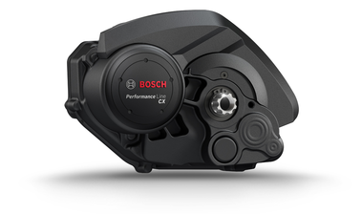
Advancements: Drive Unit
Smaller
Lighter
Smarter
Integrated Gears

Slide 7
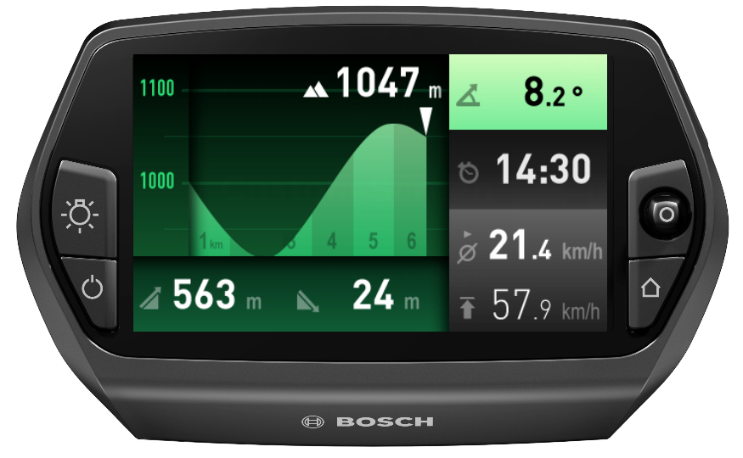
Advancements: Integration
Built in lights
ABS
Automated shifting
Infrastructure

Slide 8
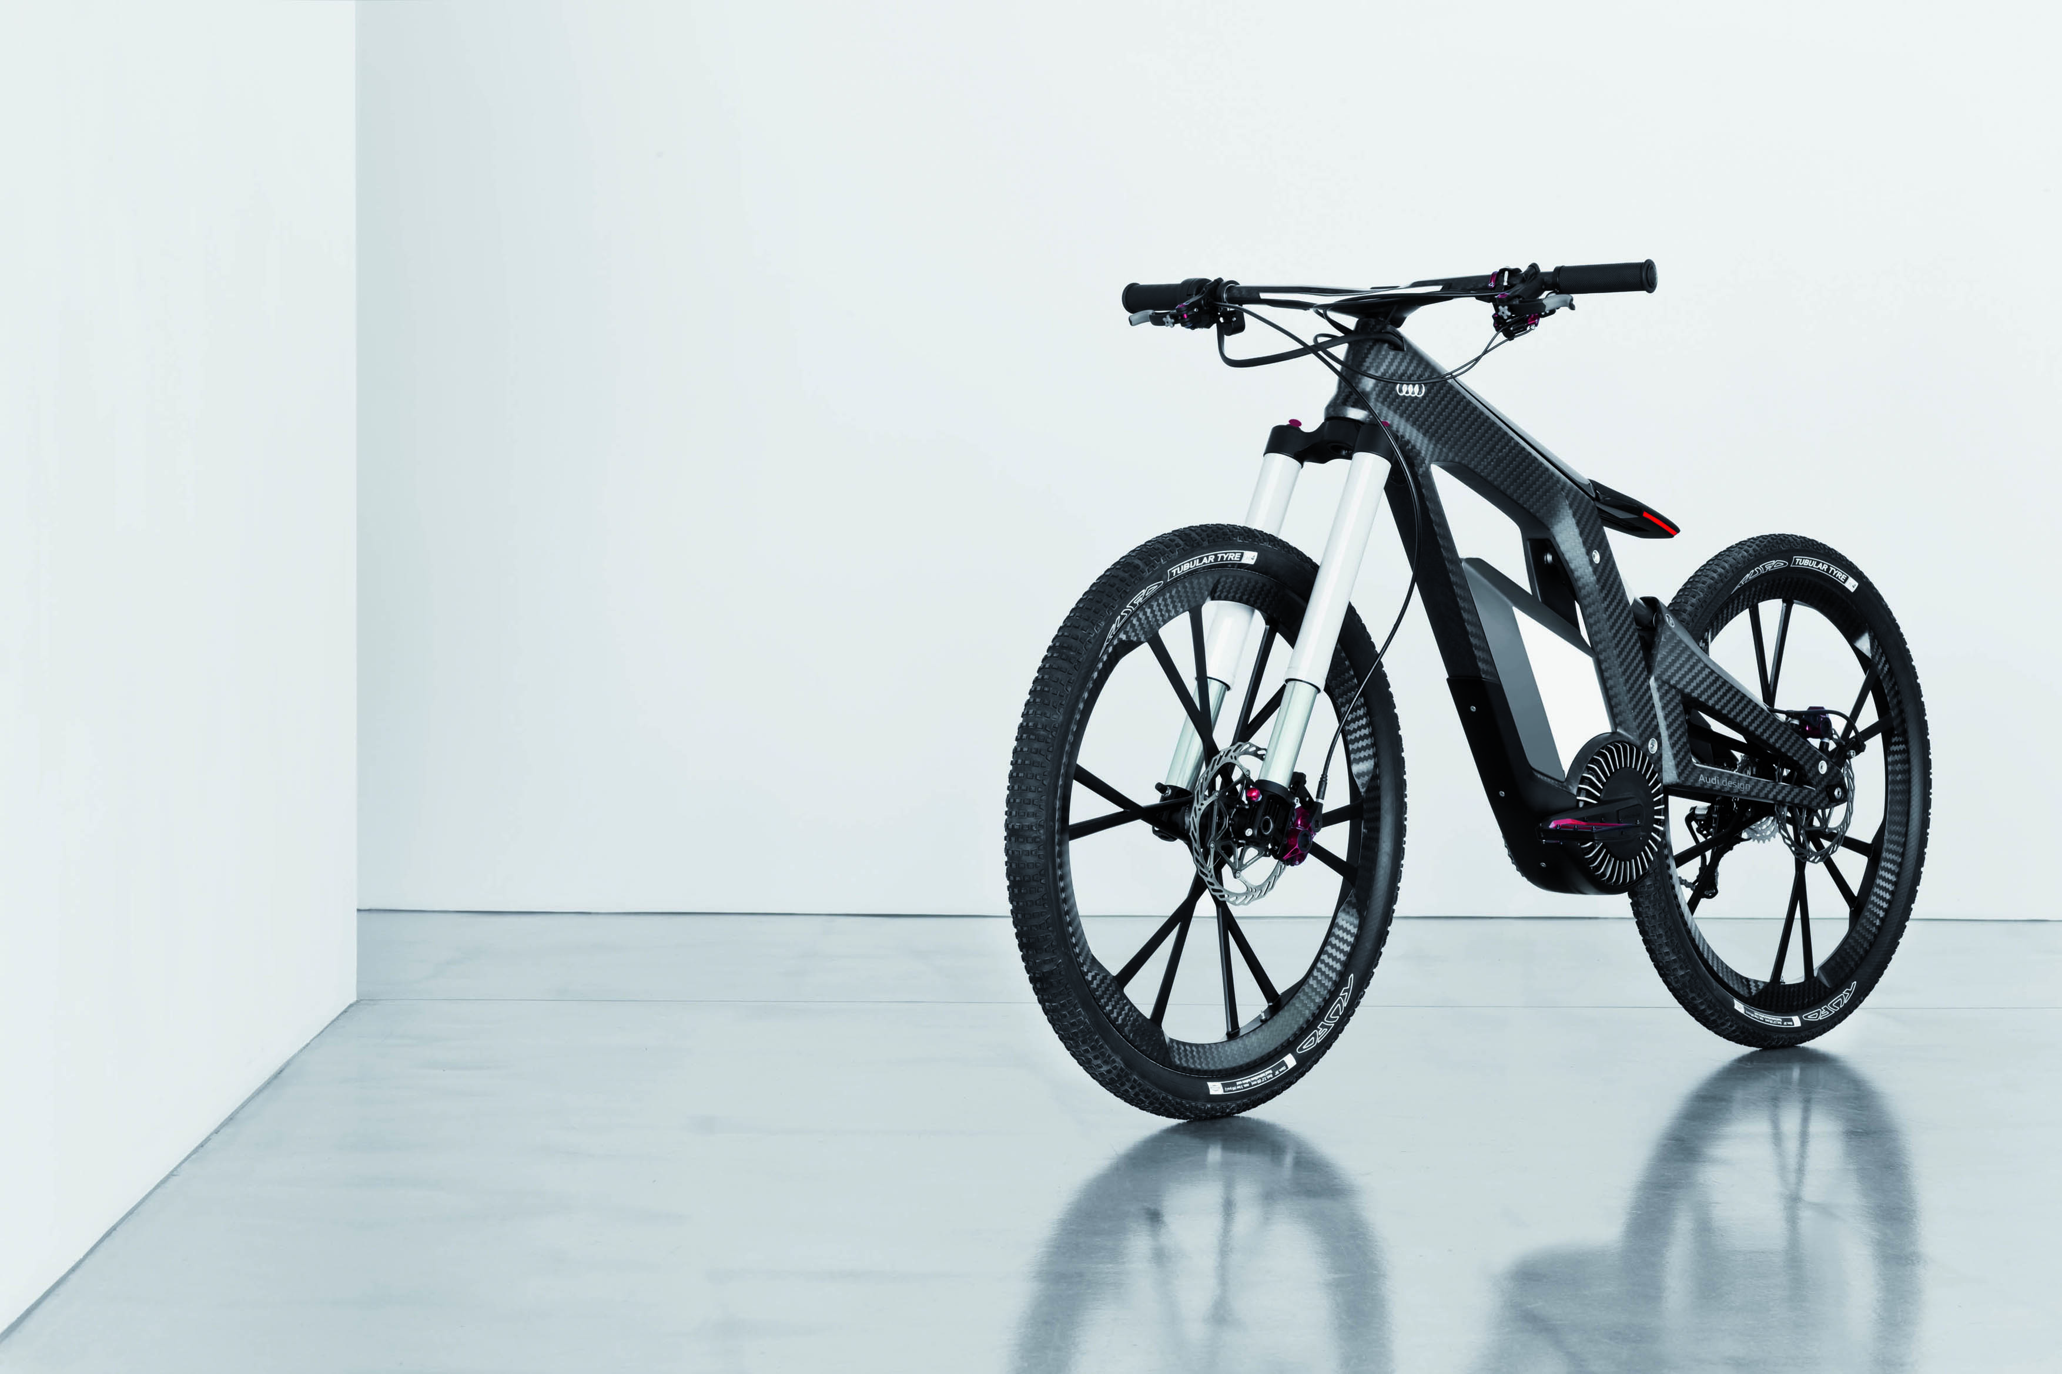
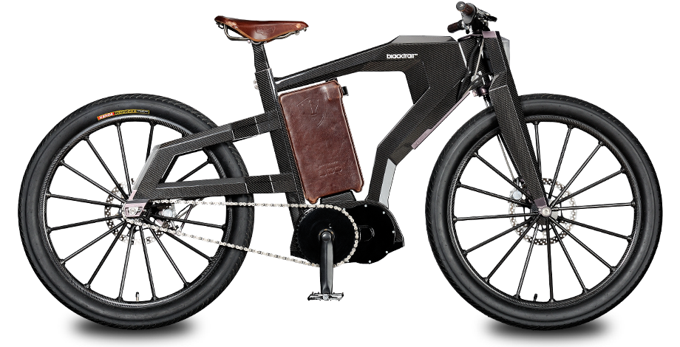
E-Bike 2030

Slide 9
Conclusions
Rapidly growing market
Here to stay
More power
Cheaper

