Slide 1

E-Bike Products 2030
Joe Barrett

Slide 2
Introduction
Previous experience as bicycle mechanic
First hand exposure to products
Outline
Current market
Potential Advancements
Conclusions

Slide 3
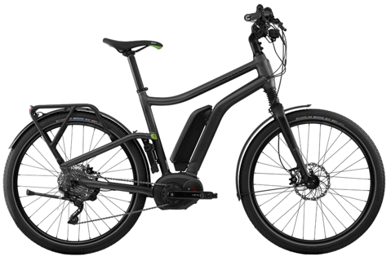
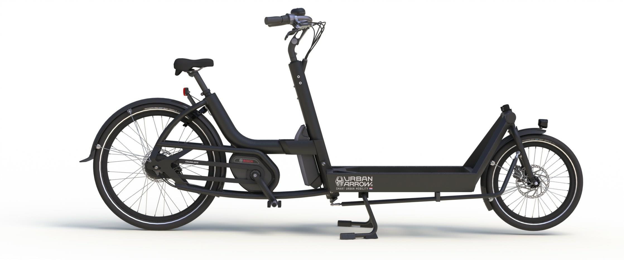
Current Market: Urban
Perfect for commuting/utility
Green transportation

Slide 4
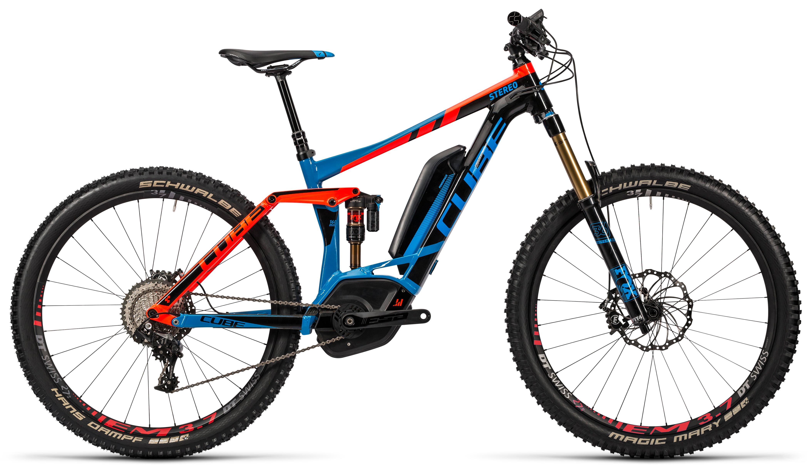
Current Market: Leisure
Slightly controversial

Slide 5
Advancements: Batteries

Slide 6
Advancements: Drive Unit

Slide 7
Advancements: Integration

Slide 8
Conclusions

