Slide 1

E-Bike Products 2030
Joe Barrett

Slide 2
Introduction
Previous experience as bicycle mechanic
First hand exposure to products
Outline
Current market
Potential Advancements
Conclusions

Slide 3
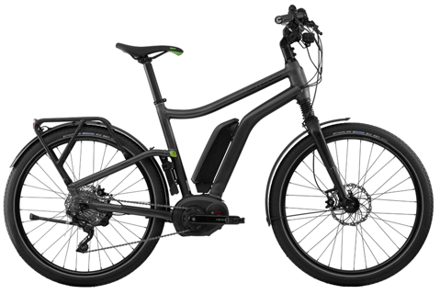
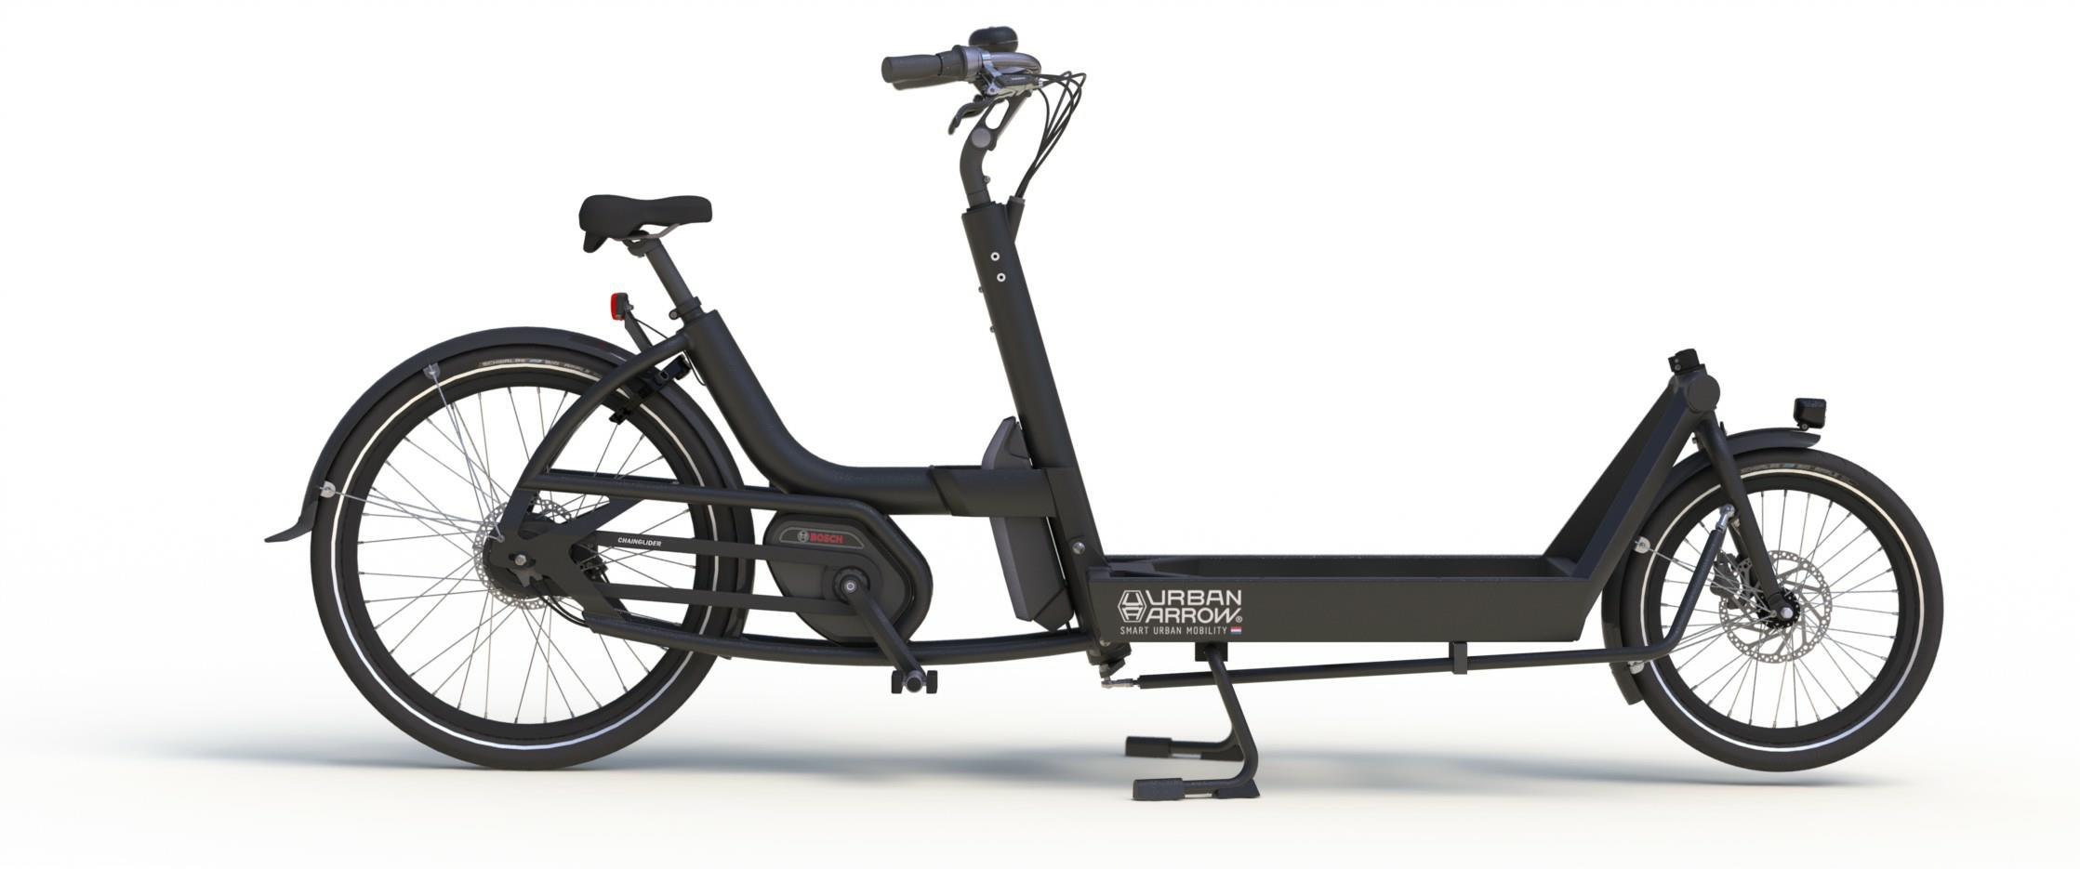
Current Market: Urban
Perfect for commuting/utility
Green transportation

Slide 4
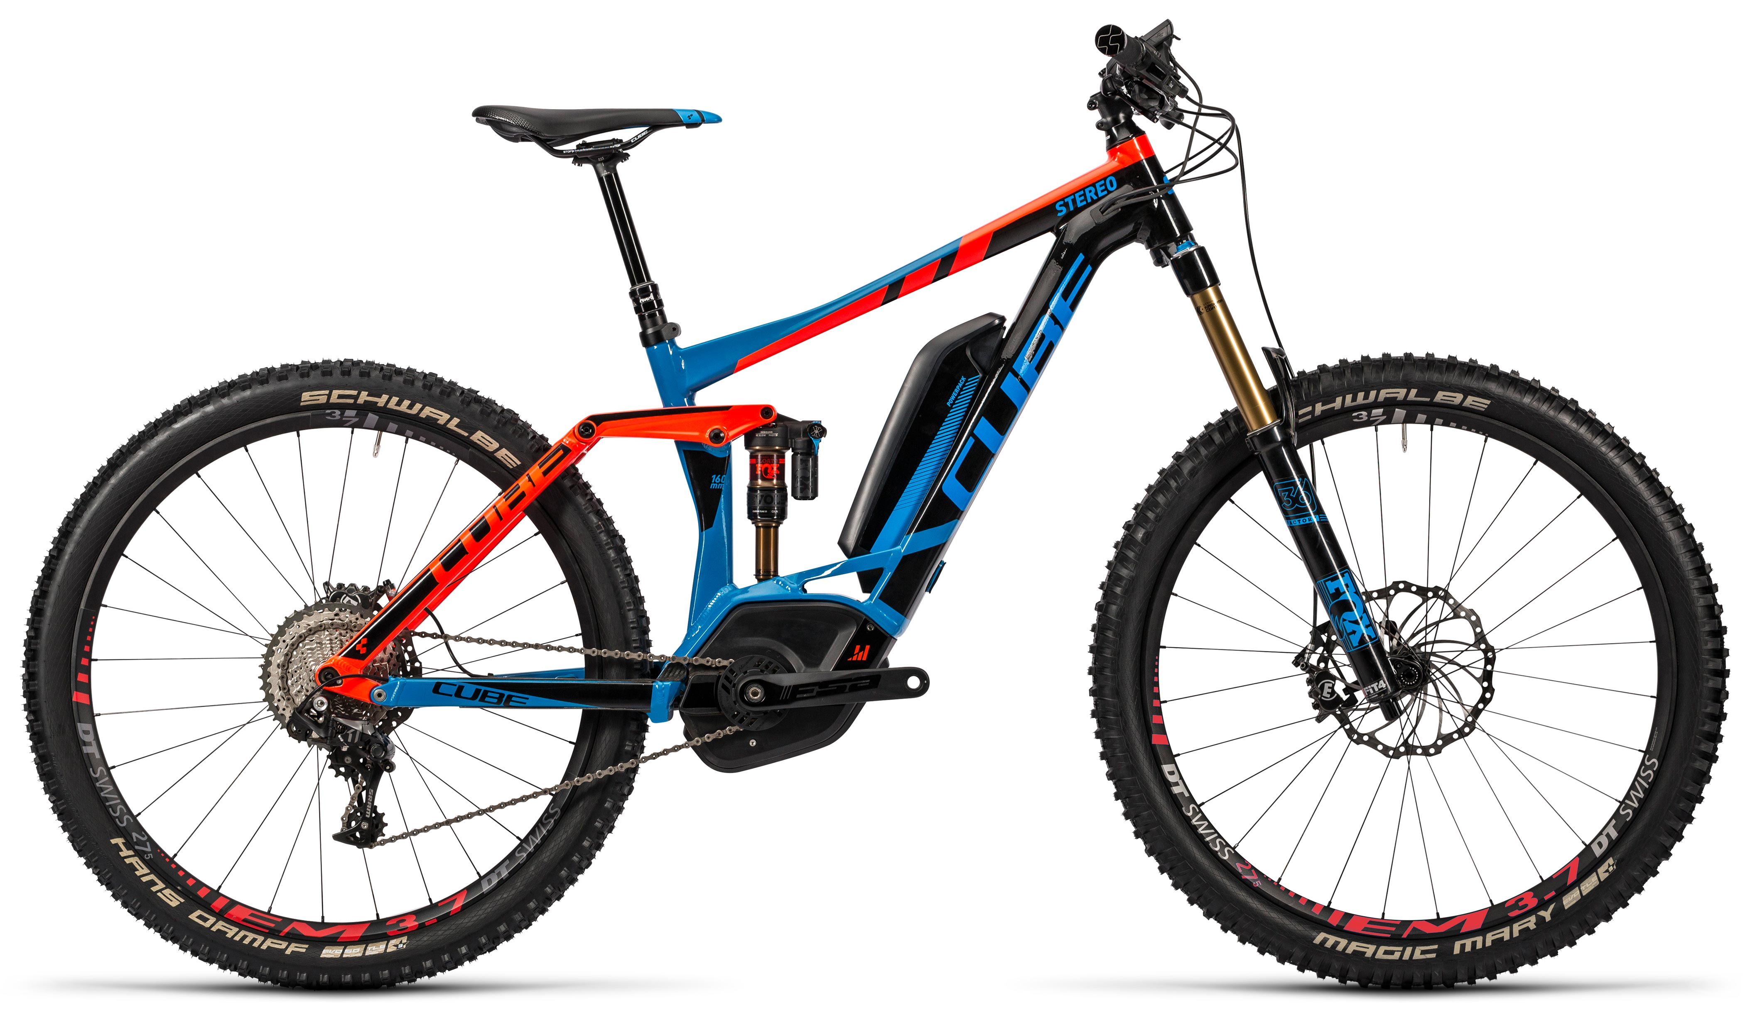
Current Market: Leisure
Slightly controversial

Slide 5
Advancements: Batteries
Extended life
Reduced weight
Faster charging
Wireless charging
Reduced costs

Slide 6
Advancements: Drive Unit
Smaller
Lighter
More power

Slide 7
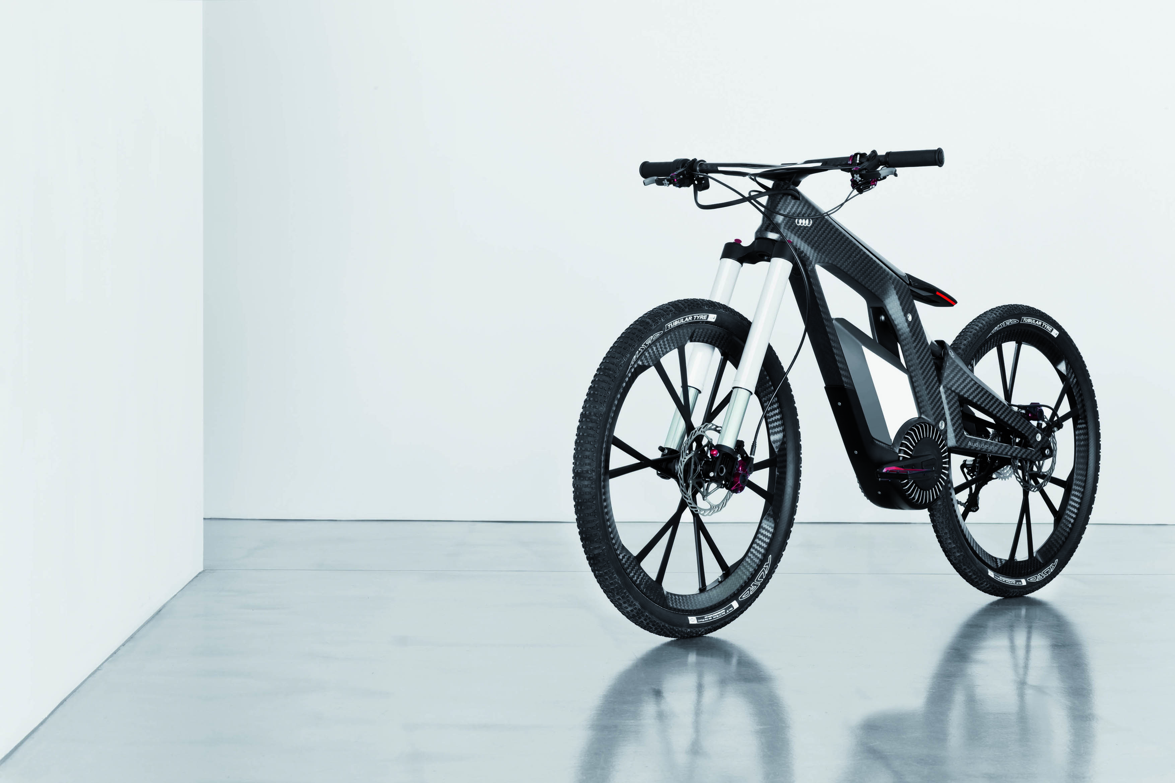
Advancements: Integration
Built in lights
Sensors
ABS
Components in frame
Automated shifting

Slide 8
Conclusions

