Slide 1
Calculation of Mountain Bike Suspension Setup using Image Analysis
Joe Barrett
Honours Project 2016/17

Slide 2
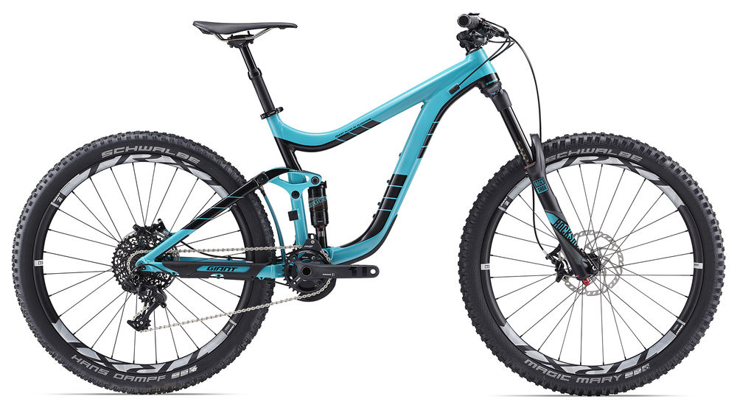
The Problem
Suspension settings must be set for each rider
Wrong setup can cause issues
Knowledge required to calculate settings
Bike shops can’t provide the service required

Slide 3
The Solution
Focus on rear suspension
Use image analysis to calculate sag setting
Intended for mobile devices
Removes need to manually measure bike
Will use various image analysis techniques
Thresholding
BLOB detection
Measurements from image

Slide 4
The Approach
Python proof of concept
OpenCV library
Agile development methods
Requirements analysis
MoSCoW prioritisation
Sprints
Git source control
Provides issue tracking

Slide 5
The Expected Results
Provide one or more images of bike
Provide data about rider
Produces sag setting
Will cover conversion to mobile app

