Slide 1
Goal-Oriented Dialogue Systems – Survey Cognitive Computing & AI
Roopa Prasad
Sarthak Agarwal

Slide 2
Introduction
What are Dialogue Systems?
It is a computer system intended to converse with a human, with a coherent structure. Dialog systems have employed text, speech, graphics, haptics, gestures and other modes for communication on both the input and output channel.
What are Goal-Oriented Dialogue Systems?
When dialogue systems are build to solve a particular problem and are specific to a domain.
E.g.
Restaurant table booking chatbot,
Movie booking chatbot

Slide 3
Papers Reviewed
End-to-End Task-Completion Neural Dialogue Systems [9 Mar 2017]
A User Simulator for Task-Completion Dialogues [5 Jan 2017]
Goal: Movie booking dialogue system
Learning End-To-End Goal-Oriented Dialog [30 Mar 2017]
Goal: Restaurant booking dialogue system

Slide 4
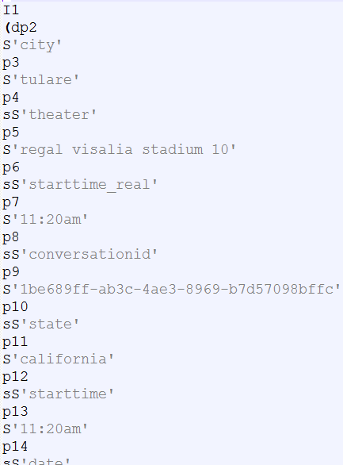
End-to-End Task-Completion Neural Dialogue Systems
Overview:
Presents a task oriented Dialog system to book movie tickets
The system interacts with the database and the users for
helping them access information about a particular task.
Dataset :
The knowledge-base is drawn from the IMDB dataset
The dataset has 11 intents and 29 slots
Intents : request, inform, confirm_question, confirm_answer
Slots : actor,actress, moviename, critic_rating

Slide 5
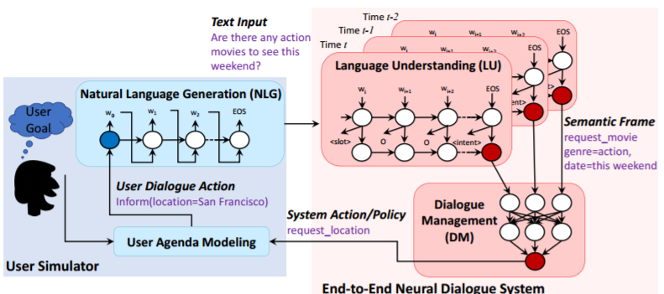
End-to-End Task-Completion Neural Dialogue Systems
Architecture

Slide 6
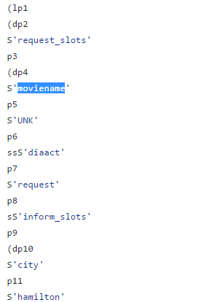
Components
User Simulator:
The main purpose of the user simulator is to generate a user goal
The user goal consists of inform_slots and request_slots
The user simulator takes all the available actions an slots from the
dialog config file
It generates a system action and based on the system action, it
places the values in the respective slots.

Slide 7
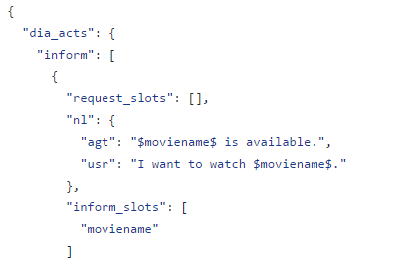
Components :
Natural Language Generator:
With the help of the user dialogue actions, NLG module generates natural language texts.
It uses the lstm decoder to generate template-like sentences with slot placeholders.

Slide 8

Components
Language Understanding:
The NLU model is used for intent prediction and slot filling.
Intent prediction is carried out with the help of LSTM decoder
Using the trained model, the NLU converts the dialog acts into the IOB format

Slide 9
Components
Dialog Manager:
The primary use of the dialog manager is to update the state tracker
The output from the LU module is passed into the dialog manager which interacts with the database
The state tracker will be updated based on the available result and the latest user dialog action.
Based on the state tracker, a policy is generated for the next available system action.
Reinforcement learning is applied to the dialog manager where it is trained using the deep Q network.
The deep Q network takes the input as the state tracker and gives the Q value for all the possible actions available.

Slide 10
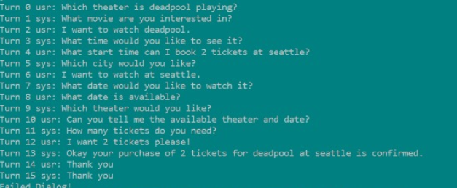
Output

Slide 11
The paper presented involves an end to end framework for task completion neural dialogue systems.
Challenges:
Only Python 2.7 compatible.
There is no framework. It is written in pure Python.
Not trained on large dataset.
It is very specific to the dataset it is trained on.

Slide 12
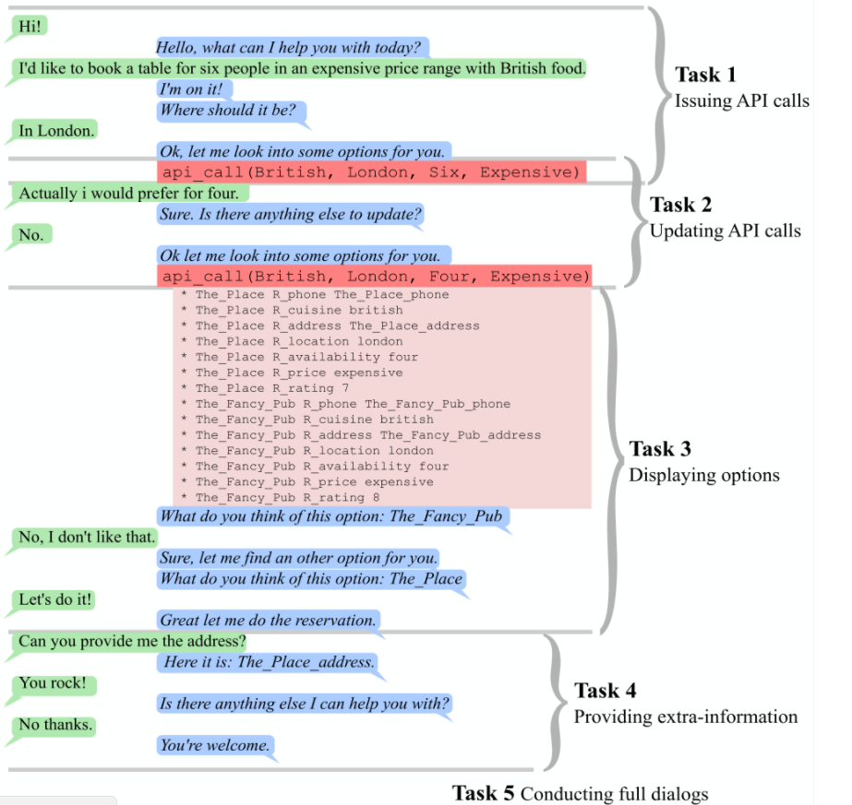
Learning End-To-End Goal-Oriented Dialog

Slide 13
Dataset
(6) dialog bAbI tasks
It is a set of 6 tasks for testing end-to-end dialog systems in the restaurant domain
Each task tests a unique aspect of dialog.
For each task, there are 1000 dialogs for training, 1000 for development and 1000 for testing

Slide 14
Keras RNN on Frames Dataset
Frames dataset is built to improve the research on conversational agents that can support decision making or to accomplish a particular task.

Slide 15
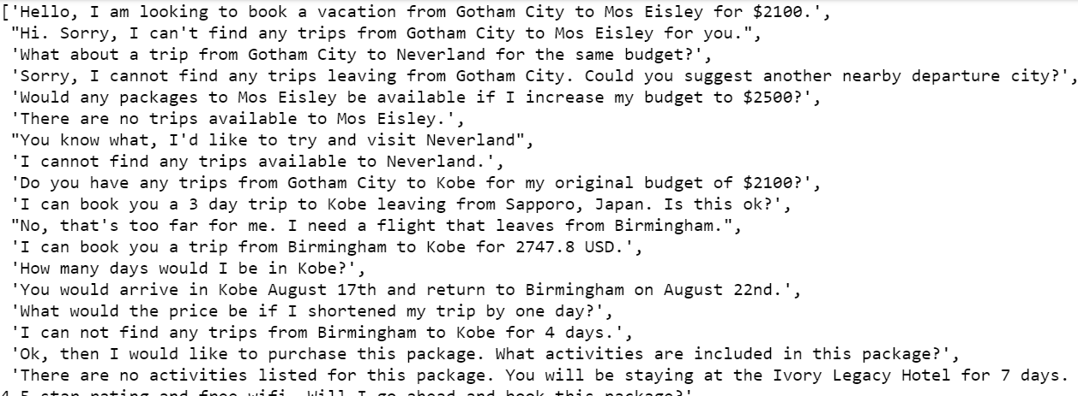
Dataset

Slide 16
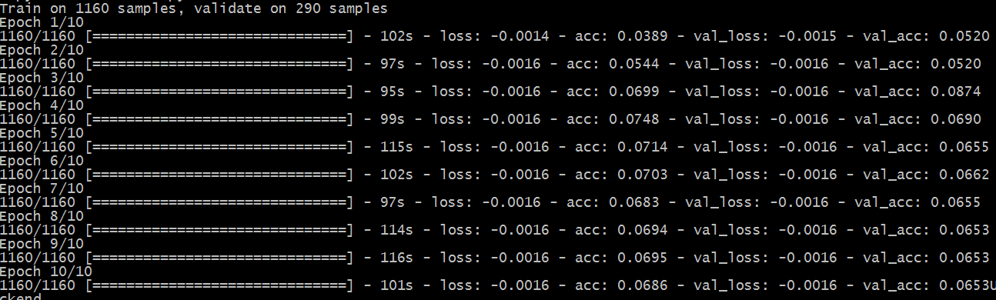
Training

Slide 17
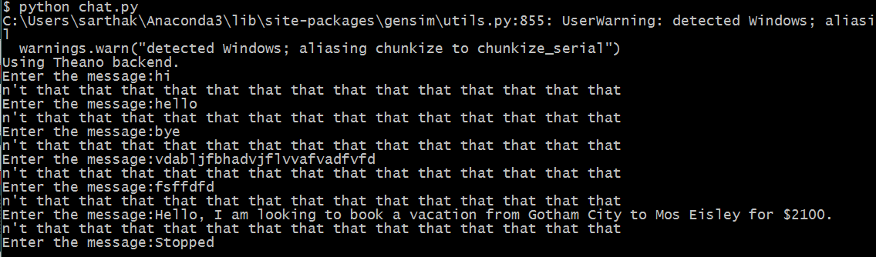
Chat

Slide 18
Thank you!

