Slide 1
Goal-Oriented Dialogue Systems – Survey Cognitive Computing & AI
Roopa Prasad
Sarthak Agarwal

Slide 2
What are Goal-Oriented Dialogue Systems?

Slide 3
Papers Reviewed
End-to-End Task-Completion Neural Dialogue Systems [9 Mar 2017]
A User Simulator for Task-Completion Dialogues [5 Jan 2017]
Learning End-To-End Goal-Oriented Dialog [30 Mar 2017]

Slide 4
End-to-End Task-Completion Neural Dialogue Systems

Slide 5
A User Simulator for Task-Completion Dialogues
(Screenshots of output of user simulator)

Slide 6
Challenges:
Only Python 2.7 compatible.
There is no framework. It is written in pure Python.
Not trained on large dataset.
It is very specific to the dataset it is trained on.

Slide 7
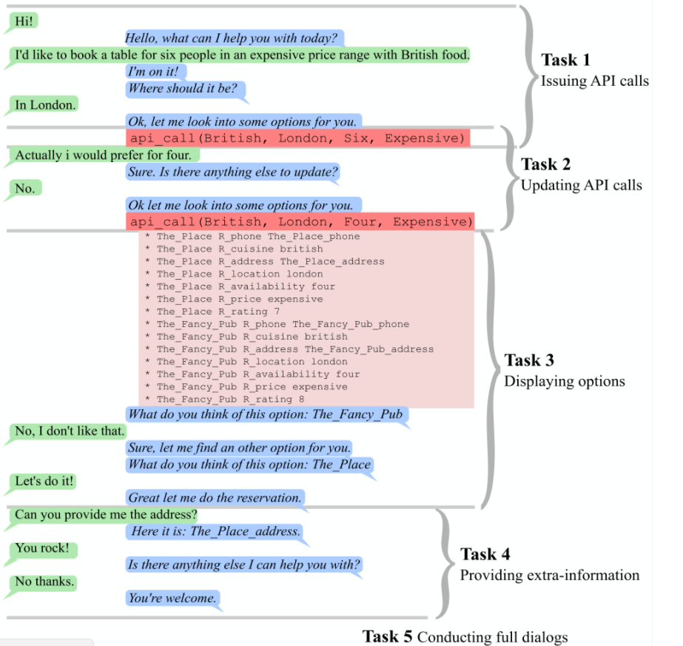
Learning End-To-End Goal-Oriented Dialog

Slide 8
Dataset
(6) dialog bAbI tasks
It is a set of 6 tasks for testing end-to-end dialog systems in the restaurant domain
Each task tests a unique aspect of dialog.
For each task, there are 1000 dialogs for training, 1000 for development and 1000 for testing

