Slide 1
S4 – Distributed Stream Computing Platform
Authors: Leonardo, Bruce, Anish, Anand
From Yahoo!
Priyadarsini
Sri Harsha
Notes:
Hi
Myself Priya and he is Harsha. We are here today to explain what is S4, how it works, its advantages and disadvantages and its future. Let’s start.

Slide 2
Introduction
A distributed stream processing system developed by Yahoo!
Inspired from Hadoop’s Map Reduce paradigm to provide the most relevant ads to the users.
Main intent?
Main priorities: Scalability and availability.
Why not Hadoop?
Batch processing. Not stream processing.
Issues in such model – less Latency and more complex.
Notes:
So, What does S4 stands for? – Simple Scalable Streaming System

Slide 3
Introduction (contd.,)
S4 is a combination of MapReduce and Actors model.
Why Actor’s model? To avoid the use of shared memory across the cluster.
How computation happens at S4? PEs (Processing Elements).
S4 is similar to IBM’s Stream Processing Core (SPC).
SPC is derived from Subscription model.

Slide 4
Design Goals
Simple Programming Interface.
High availability
Low Latency – by using local memory.
Decentralized symmetric architecture that can be customizable.
Assumptions in the following design:
Lossy failure is acceptable.
Nodes can’t be added or deleted.

Slide 5
Design
Events – Keys and attributes will be passed to S4.
Steps :
Consume
Calculate the results
emit the results.

Slide 6
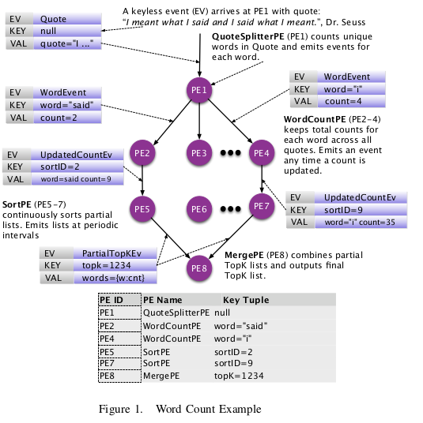
Word Count Example
Source: http://cs.brown.edu/~debrabant/cis570-website/papers/s4.pdf

Slide 7
Processing Element (PE)
A computational unit.
4 key components:
Functionality by PE class and its configuration.
Types of events it consumes.
Keyed attribute.
Value of the Key.
PE deletion

Slide 8
Processing Node (PN)
Listens to events and executes the operations.
S4 routes each event to the PN based on the hash function.
Event listener in the PN will pass these events to PE.
Special PE object which defines the configuration. It can be cloned.

Slide 9
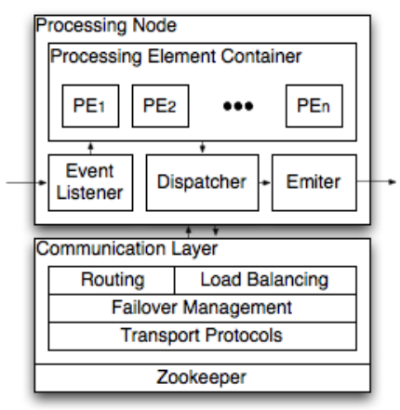
Communication Layer
It is used for cluster management.
It is responsible for moving nodes from failover to stand by.
It also contains the mapping between physical nodes to logical nodes.
Can use any networking protocol in communication layer.
Communication layer in turn uses ZooKeeper to know the statuses of other nodes in the cluster.
Communication Layer API provides bindings in several languages like C++ and Java.
Source: http://cs.brown.edu/~debrabant/cis570-website/papers/s4.pdf
Notes:
Routing of events among PNs in S4 is based on the pre-calculated hash function of the key values.

Slide 10
Programming Model
S4 API has two main event handlers
processEvent()
output()
PEs are assembled in S4 using Spring Framework
Notes:
processEvent() is invoked for every incoming event that it is subscribed to.
The method output() is optional and can be invoked based on time or number of events

Slide 11
Programming Model (contd.)
QueryCounterPE.java
private queryCount = 0;
public void processEvent(Event event) {
queryCount++;
}
public void output() {
String query = (String)this.getKeyValue().get(0);
persister.set(query, queryCount);
}
<bean id="queryCounterPE" class="com.company.s4.processor.QueryCounterPE">
<property name="keys">
<list>
<value>QueryEvent queryString</value>
</list>
</property>
<property name="persister" ref="externalPersister">
<property name="outputFrequencyByTimeBoundary" value="600"/>
</bean>
QueryCounterPE.xml
Source: http://cs.brown.edu/~debrabant/cis570-website/papers/s4.pdf
Notes:
Development is in Java programming language and Spring Framework
processEvent() is invoked for each incoming event of the types the PE has subscribed to.
The output() method is an optional method that can be configured to be invoked in a variety of ways. It can be invoked either at regular time intervals t, or on receiving n input events.
The configuration ties the PE to a data persistence component externalPersister (this could be an abstraction for a data serving system) and instructs the output() method to be invoked every 10 minutes.

Slide 12
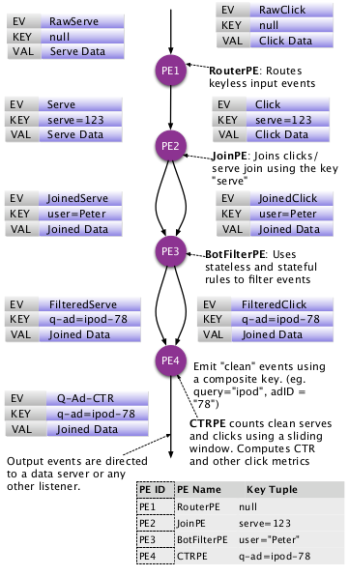
Click Through Rate (CTR)
Source: http://cs.brown.edu/~debrabant/cis570-website/papers/s4.pdf
Notes:
Users will be served with web pages with ads.
Page CTR = (Number of Clicks / Number of Page Views) * 100
Ad CTR = (Number of Clicks / Number of Ad Impressions) * 100
Ad Request CTR = (Number of Clicks / Number of Ad Requests) * 100
Query CTR = (Number of Clicks / Number of Search Queries) * 100

Slide 13
Click Through Rate (CTR) (contd.,)
Online:
16 servers with 2GB memory
250,000 users with 1,000,000 clicks/day
Duration – 14 days
24 hours historical data with 1hour refresh rate
Offline:
8 servers with 16GB memory
3 millions of input events from previous logs
Calculate error rate
Notes:
1 hour refresh rate is to prevent failover because if we have smaller refresh rate say 5 minutes, load will be high and requires more memory

Slide 14
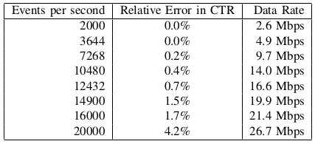
Results
Source: http://cs.brown.edu/~debrabant/cis570-website/papers/s4.pdf
Notes:
There is a performance degrade at nearly 10Mbps data rate. This may be due to the network bandwidth bottleneck or the cluster bottleneck

Slide 15
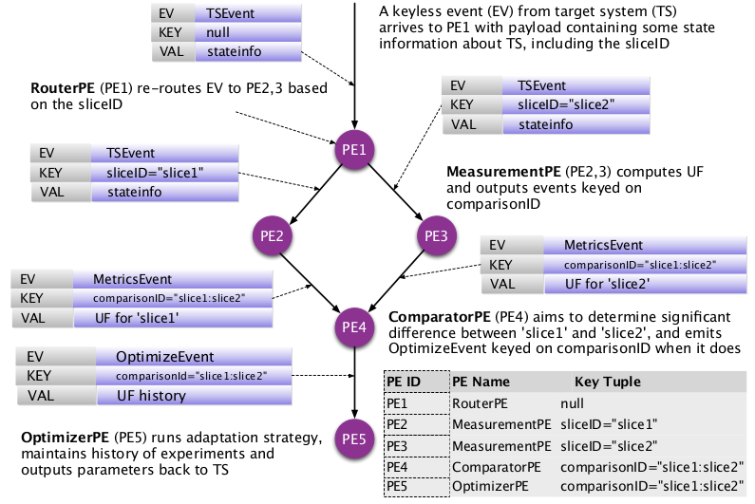
Online Parameter Optimization (OPO)
Source: http://cs.brown.edu/~debrabant/cis570-website/papers/s4.pdf
Notes:
RouterPE - PE1 is splitting the input stream into two slices slice1, slice2.
MeasurementPEs PE2, PE3 calculates their objective function results and passes to ComparatorPE.
The objective function is measured for a specified amount of time or events (called slots).
Comparator PE comapres both the results. If there is no significant change in the results of slice1 and slice2, then comparator declares them as identical.
If there is a change, the PE4 sends the message to OptimizerPE.
OptimizerPE uses historical data and calculates the optimal values for the both the slices and the loop repeats.
Eg: donut eating, money spending(objective is to distribute the money equally)
Here the objective is to improve the revenue and user experience. Each slice has 200,000 users with their searches. And they chose a parameter which affects the search engine performance. The OPO model increased the revenue by 0.4% and click yield by 1.4%

Slide 16
Future Work
Dynamic routing
Improved Failover
Live PE migration
Notes:
The current system has static routing among PEs. So they want to upgrade to dynamic routing between the PEs.
If a PE is failed, it looses its state, and the communication layer restarts the PE from beginning. They wanted to improve the failover by implementing Checkpointing and recovery mechanism for minimizing state loss.
Currently, if they want to update the S4 system by adding or removing PEs, they have to bring down the server, make changes and up the server again.
In future, they wanted to dynamically migrate the PEs without any downtime for the server.
Surprisingly, Yahoo! has migrated from S4 to Storm !!!
The main reasons could be cumbersome S4 configuration (xml) and deciding TTL for PEs.

Slide 17
Thank You
Notes:
S4 vs Storm
Key value pair vs tuples
PN can have unspecified number of PEs (PE prototype instance) vs user defined number of spouts/bolts
Complex xml configuration vs flexible configuration
Automatic load balancing vs No automatic load balancing (available in Heron back pressure)

