Slide 1
Intern project demo
Test suite generation engine
Gao, Ruijing Aug 4 2017

Slide 2
Agenda
Background
Workflow and Interaction
Workflow
UI & input & output
Others Related
Location of this project
Adding new type of calls
Technology in Generator

Slide 3
Background
Section 1

Slide 4
Background
Optional Slide Subtitle
UAT data is unstable. It changes frequently.
Mocking all DB calls and soap calls costs too much time.
Solution:
Test suite generator
Auto-generate mock codes for a given unit test.
More efficient in writing unit test
Unit test cases are more stable.

Slide 5
Workflow and Interaction
Section 2

Slide 6
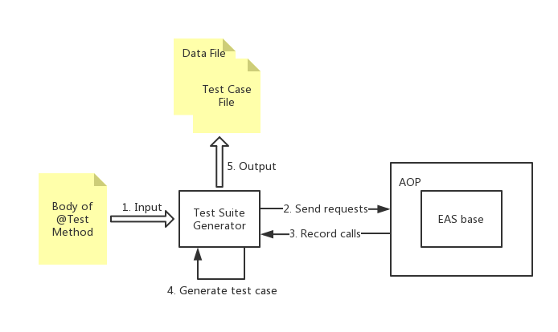
Workflow and Interaction
Workflow

Slide 7
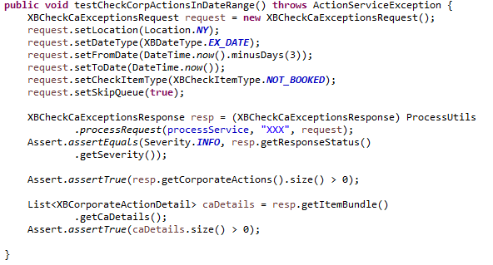
Workflow and Interaction
Interaction: input file
Write down requests that will be sent in the @test method

Slide 8
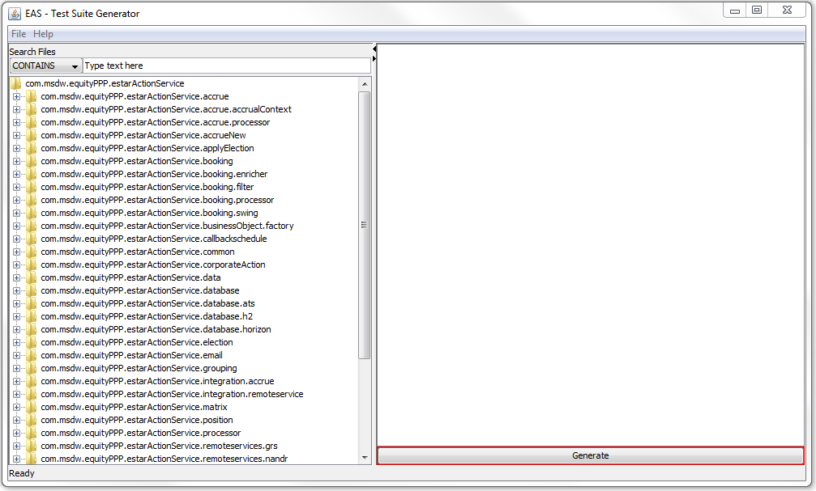
Workflow and Interaction
Interaction: UI (Java Application)
Notes:
Run the java appliaction

Slide 9
Others Related
Section 3

Slide 10
Others Related
Location of this project
Inside EAS base
Need to reuse functions in EAS base
Sending soap requests
Querying database
……
Detect the changes in EAS base
Notes:
Need to reuse functions in EAS, like sending requests and querying database
When codes in EAS are modified, the generator can detect the changes

Slide 11
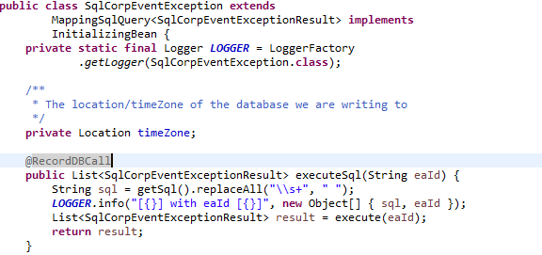
Others Related
Adding new types of calls: DB calls
Add new DB call
Add @RecordDBCall at executeSql(…)

Slide 12
Others Related
Adding new types of calls: Soap calls
Add new soap call
Extract codes about senders’ sending requests and put these codes into a method
Add @RecordSoapCall at this method.
Example: PoseidonSoapClient

Slide 13
Technology in Generator
Section 4

Slide 14
Technology in Generator
AOP
AOP
Aspect-Oriented-Programming
Pros:
Avoid reconstructing the structure of EAS base
Increase modularity of the new codes
An aspect contains two parts:
Advice: addition behavior
Pointcut: specify where to apply this addition behavior
Use AspectJ instead of Spring AOP
Support internal method call
Support private method

Slide 15
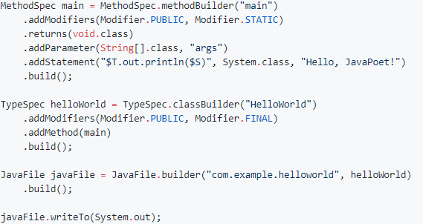
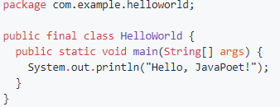
Technology in Generator
Javapoet
Javapoet
Provide classes and methods to generate codes
Pros:
The codes generated are more elegant.
Using Javapoet is more efficient than appending string.
Generate

Slide 16
Thanks

