Slide 1
Test Suite Generation Engine
Gao, Ruijing
Equity Swap Trading Aug 29 2017

Slide 2
Agenda
Background
Workflow
Technology in Implementation

Slide 3
Background
Problems
UAT data is unstable.
Considering to mock all test data when setting up the test case.
Mocking all DB calls and soap calls costs too much time.
Example: testBookingxxxxx:
Test case: 2000 lines
Test method: 20 lines

Slide 4
Background
Brief Introduction
Test suite generation engine
Auto-generate mock codes for a given unit test
Pros:
More efficient in writing unit test
Unit test cases are more stable.

Slide 5
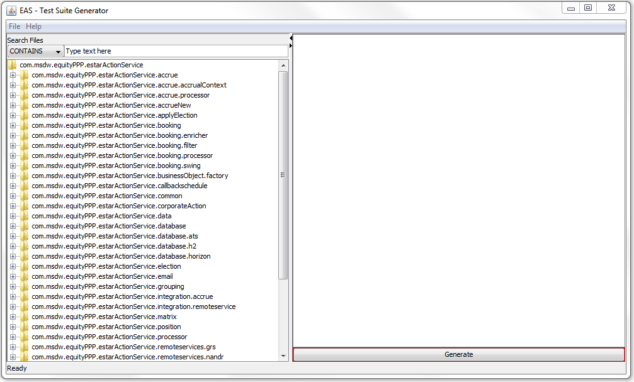
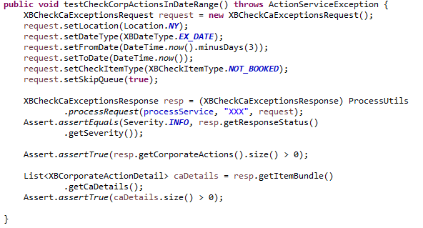
Workflow
Data
File
Same folder
Test Case File
Output
Aspects
Body of @Test Method
EAS base
Input
Test Suite
Generation Engine
Send Requests
Record Calls
Generate Test Case
Notes:
Write down requests that will be sent in the @test method

Slide 6
Workflow
Output: Data files and A Test Case file
Data files:
One Java file: DB data
XML files: Soap response
Test case file
Mock data in the set-up part and unmock in the tear-down part.
Directly return mock values instead of requesting real results.

Slide 7
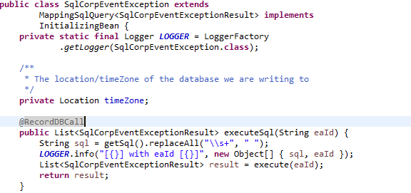
Implementation
AOP (Aspect-Oriented-Programming)
Pros:
Avoid reconstructing the structure of EAS base
Increase modularity of the new codes
Use AspectJ
Define two aspects to record calls
Use two annotations to specify where to invoke aspects: @RecordDBCall, @RecordSoapCall
Notes:
An aspect contains two parts:
Advice: addition behavior
Pointcut: specify where to apply this addition behavior
Add @RecordDBCall at executeSql(…)
Extract codes about senders’ sending requests and put these codes into a method
Add @RecordSoapCall at this method.

Slide 8
Q & A?

