Slide 1

MCC Code School
Introduction to Pair Programming Christian Burk

Slide 2
What is pair programming?
More than solo, less than a swarm
Two programmers working on the same "work product"
Both are looking at the same issue and are contributing to completing it
Notes:
Question for the group:
Has anyone done paired programming before?
Can they explain it?
paired programming fits along a continuum from working solo to swarming
it refers to two (hence, "pair") of programmers working on the same "work product": task, code, configuration, algorithm
the programmers can be right next to each other or remote, but the key is that they are looking at the same issue, usually represented on a screen and are both contributing to completing it

Slide 3
What are the benefits of pair programming?
Learning faster
Increased productivity
Higher quality
Shared understanding
Notes:
If any have ever done this before themselves, ask to for benefits from the group.
learning faster (long-term)
the more you work with others, the faster you learn ("iron sharpens iron")
increased productivity (short-term)
studies vary but most show that newer developers who work together perform as well as a senior developer
higher quality (long-term)
ExtremeProgramming (XP) reports show that pair programmed work is always cleaner than work done individually
shared understanding (long-term)
no longer is the program best understood by the individual programmer but by two, doubling the knowledge among a team, and with the redundancy, eliminating a single-point of failure or bottleneck
Some of these are short-term benefits and some are long-term.
Productivity a short-term benefit but aggregrates to a long-term one. So does learning.
Code quality is the same. It is also a factor in productivity, as you spend less time doing rework or fixing bugs.
Shared understanding is both, too, as a it can mean coming to insights and approaches quicker while doing the work but can also mean benefits when members of a pair aren't always together. One can still work.

Slide 4
What are the drawbacks or pitfalls of pair programming?
Loss of time
Conflict
Boredom
Distraction
Notes:
If any have ever done this before themselves, ask for drawbacks or pitfalls from the group.
Loss of time
programmers can get caught up in discussion ad nauseaum
Conflict
sometimes those discussions spiral into arguments
Boredom
One of the pair can feel bored not coding, especially if they are not engaged
Distraction
One member can get distracted
The communication between the members can be distracting for others

Slide 5
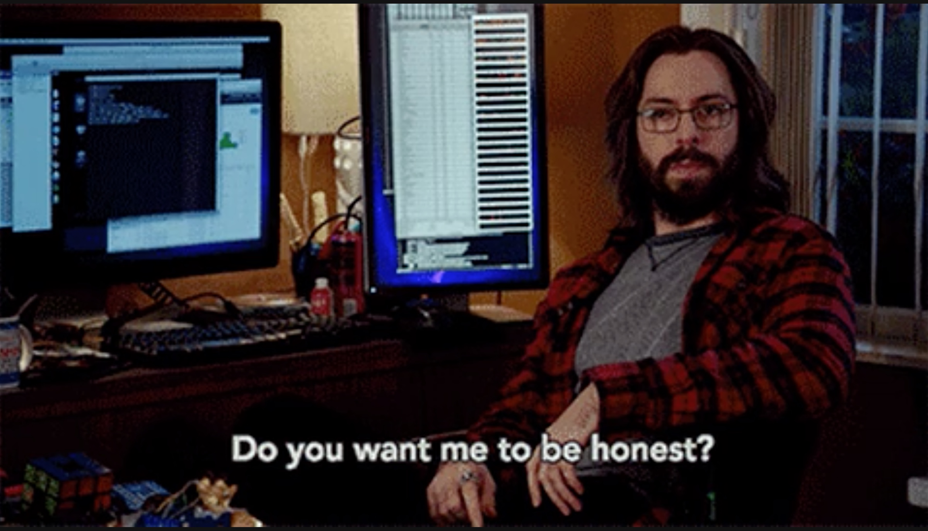
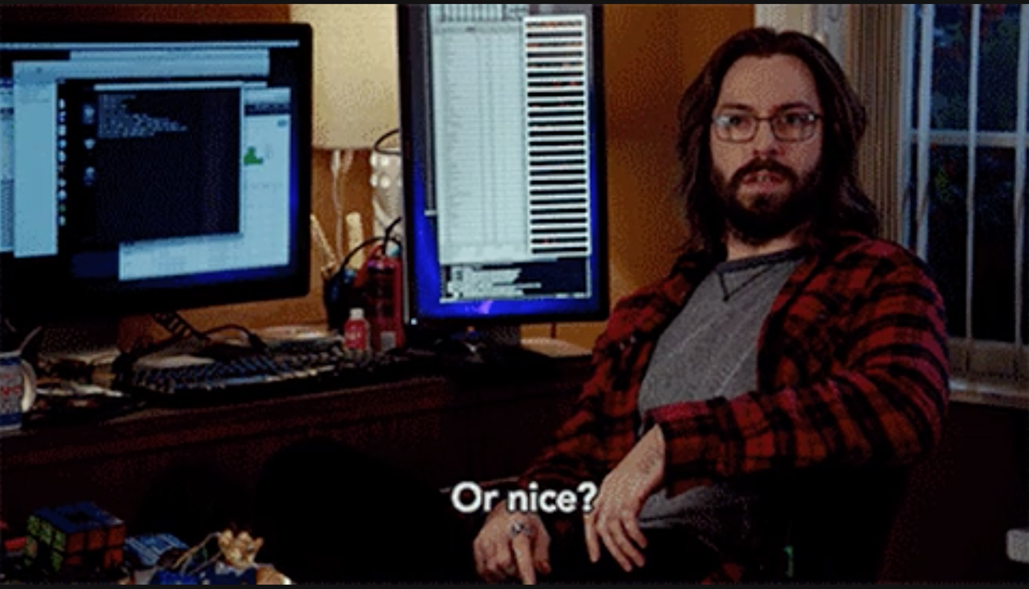
How do you pair program at MCC Code School?
Communicate
To begin work as a cohesive unit, you need to verbalize your thoughts
One person might have their hands on the keyboard or at the whiteboard but both are in constant communication, like the two hemispheres of the brain
Use diagrams, sketches, and metaphors

Slide 6

How do you pair program at MCC Code School?
Many hands make light work
The driver/navigator roles should be switched after 20 minutes or so
Neither should be tasked with the bulk of the work, as this can create resentment
Driver relies on the navigator for direction and “potholes”
Navigator relies on “driver” to transcribe thoughts into code
Notes:
Plus, the work is shared, as is the praise and blame.

Slide 7
How do you pair program at MCC Code School?
Stay focused
Pair programming is not a spectator sport
Each member needs to engage, whether they are coding or reviewing the code being written
Practice active listening

Slide 8
How do you pair program at MCC Code School?
Quality is job one
Two can guarantee higher quality than can one, as there's an instant check on possible errors
Also, they can hold each other to their standards and not let bad habits slip in
It's like exercising with a trainer
Notes:
Both members of the team are encouraged to uphold the highest standards.
Two can influence each other to be better or to be worse. Choose the former.
Good enough is not.

Slide 9

How do you pair program at MCC Code School?
Get along
Conflict is healthy
Anger is not
Kindness is key
You may not agree on everything, but you can disagree and commit
Notes:
Conflict is good for relationships. It means you’re communicating.
People aren’t machines, though. Pure logic is not enough. You have to understand how they feel and how those feeling may be influencing their words or actions.
Disagree and commit (Amazon)

Slide 10
How do you pair program at MCC Code School?
Accentuate the positive
Assume positive intent
The discomfort of the new is real but benefits are real, too, so press on despite your fears
After all, negativity can be toxic in a pair
Notes:
Pairs work better when members have buy-in, both believing the approach and the benefit.
That doesn’t discount the cost, the discomfort, having someone in your personal space.

Slide 11
How do you pair program at MCC Code School?
Not “mine” but “ours”
Practice “ego-less programming”
The work of a pair is teamwork, not your work or my work
Hold with an open hand
Notes:
Don’t white knuckle your own approach to a problem.
Depending on the size of the issue, you may even be able to try more than one approach to see which works better.
If you don’t hold on too tightly, you can let go more easily.
Ultimately, the quality of the work with reflect on the team, not its individual members, so approach the work to put the team in its best light.

Slide 12
How do you pair program at MCC Code School?
Mind the time
Make the time to work together
Time box discussions so you can manage your scarcest resource
Consider Lean coffee as an approach
Look breadth-first, rather than depth-first
Notes:
Agile coffee, where the discussion is timed, and afterward, the members decide if they want to keep talking.
Timer is set and it repeats
It’s easy to dig deep at the outset, but make sure you are accounting for the entirety of the issue or project before going too deep too fast. Otherwise, you’ll find you’ve spent 80% of your time on 20% of the tasks and have to rush through the rest.

Slide 13
How do you pair program at MCC Code School?
Take care of yourselves and each other
Are you hungry, thirsty, needing to go to the restroom, stressed out?
Consider “bio breaks”
Get up, stretch, take a walk and/or talk about something else
Notes:
Honestly, there’s no reason this should not be fun as well as challenging.
Again, we’re not robots. Bio breaks are a way to recharge, eliminate or just stretch your legs. They recognize that we have other needs beyond working as much as we can for as long as we can.
As long as the pair is in sync, taking breaks when you need them will keep the team healthy.
Focused verses diffuse thought: this is a good reason to take a short walk together, especially if there’s a tough problem. Walking around and not thinking about it can help you solve it.
Also, personal and dental hygiene. So deodorant and/or mints are good. Gum? (maybe not because of misophonia)

Slide 14
Resources
Links and such
How to Pair Program 🎦
Summary of “All I Really Need to Know about Pair Programming I Learned in Kindergarten.”
Pair Programming vs. Code Reviews
JSJ 367: Pair Programming 🎧
“The Costs and Benefits of Pair Programming” (PDF)
Lean Coffee
Notes:
And so many others . . .

