Slide 1

MCC Code School
Topic Intro to HCI / UI / UX

Slide 2
Definitions
HCI
Human Computer Interaction
The study and research of human interaction with computer and technology interfaces
You can get a degree in this (different than graphic design)
Focuses on user needs and UX
UI
User Interface
What user sees and interacts with
Typically what Graphic Designers mainly focus on
UX
User Experience
“User-Centered Design"
How a user interacts or interprets how they can interact

Slide 3
History of HCI
Started around 1980 with advent of PC
Combination of fields
Computer science
Human factors engineering
Cognitive science
Focus on how people feel or think about interfaces
Desktop
Literal interpretation of a ‘desktop’

Slide 4
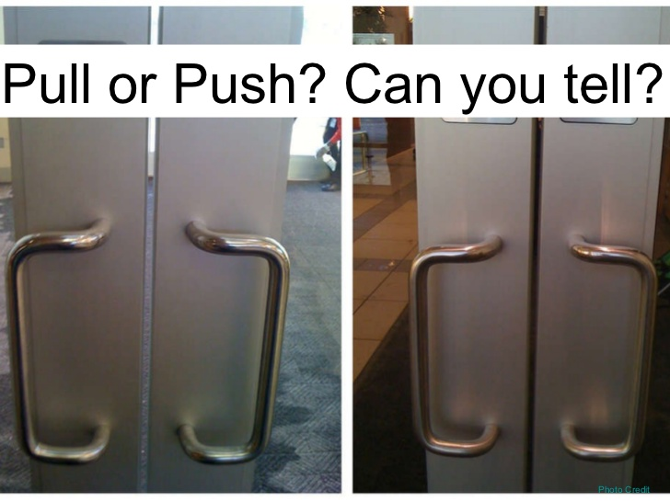
Design of Everyday Things
**http://www.nixdell.com/classes/HCI-and-Design-Spring-2017/The-Design-of-Everyday-Things-Revised-and-Expanded-Edition.pdf

Slide 5
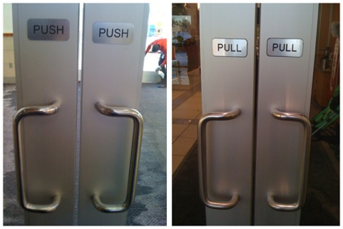
Design of Everyday Things
**http://www.nixdell.com/classes/HCI-and-Design-Spring-2017/The-Design-of-Everyday-Things-Revised-and-Expanded-Edition.pdf

Slide 6
HCI High Level Concepts
Affordance – a perceived clue or signal about what a thing might do or be used for. (door handle example)
Signifier – provides supporting information to an affordance
Mapping – relationship between two or more things interface
Feedback – Communicates the result of an action
Conceptual Model – perceived state and use of the application, based on interface
**http://www.nixdell.com/classes/HCI-and-Design-Spring-2017/The-Design-of-Everyday-Things-Revised-and-Expanded-Edition.pdf

Slide 7
Prototype Fidelity
High
Very detailed
Full color
Exactly or very similar to end product
Maybe even click through function
Digital
Medium
Semi-detailed
Some color
Close to end product
Digital or Paper
Low
Low detail
No color
Sketch or drawing – paper like format typically
Initial design (UI/UX) ideas
Which is best for feedback and why?

