Slide 1
Introduction to Version Control
Various
ICT40120 Certificate IV in Information Technology
Applied Programming in Python
ICTICT449 | Use version control systems in development environments
ICTPRG430 | Introductory object-oriented techniques

Slide 2
Session Contents
Version Control
Git Basics
Exercises

Slide 3
What is Version Control
Introduction to Version Control

Slide 4
What is Version Control?
Records changes to a file or a set of files
Allows you to recall specific versions
Records who did what and where (file/line/character)
Allows multiple people to work on the same project more effectively and safely
Allows you to undo/redo changes beyond an edit session

Slide 5
Activity: Wikipedia as version control
Wikipedia is a prominent example of how version control facilitates mass-scale collaboration with relatively little trust.
Go to: https://en.wikipedia.org/wiki/Python_(programming_language)
Go to History
As group, identify a change and then identify what was changed, why it was changed, and who changed it. Identify whether the change was accepted or reverted and why.

Slide 6
Why it matters in software
The source code of programs is usually the most valuable intellectual property (IP) that the company owns
Many people usually work on one application and its files
A typical application consists of many files and many lines of code
Examples…

Slide 7
Size of software projects
Linux Kernel:
~27 million source lines of code (SLOC)
All the Harry Potter books combined are about 100,000 lines
~70,000 files
~75,000 “edits” a year (commits, but we’ll get to that)
1000’s of contributors (4189 in 2020 alone)
Most projects would have 100’s of files and 10,000’s of lines of code, with a dozen or more contributors (guess)

Slide 8

ALL SOFTWARE DEVELOPMENT PROJECTS USE VERSION CONTROL Many other projects do too

Slide 9
Distinction
In most version control systems there is a clear distinction between:
The files you are editing – sometimes called “working tree” or “working copy”
versus
the revision history, the metadata, and sometimes access control to this information often called “the repository”

Slide 10
Version Control Systems
Local
Centralised
Distributed
Notes:
https://www.geeksforgeeks.org/version-control-systems/
Local Version Control Systems: It is one of the simplest forms and has a database that kept all the changes to files under revision control. RCS is one of the most common VCS tools. It keeps patch sets (differences between files) in a special format on disk. By adding up all the patches it can then re-create what any file looked like at any point in time.
Centralized Version Control Systems: Centralized version control systems contain just one repository and each user gets their own working copy. You need to commit to reflecting your changes in the repository. It is possible for others to see your changes by updating.
Two things are required to make your changes visible to others which are:
You commit
They update
Distributed Version Control Systems: Distributed version control systems contain multiple repositories. Each user has their own repository and working copy. Just committing your changes will not give others access to your changes. This is because commit will reflect those changes in your local repository, and you need to push them in order to make them visible on the central repository. Similarly, When you update, you do not get other’s changes unless you have first pulled those changes into your repository.
To make your changes visible to others, 4 things are required:
You commit
You push
They pull
They update

Slide 11
Version Control Systems
Introduction to Version Control

Slide 12
Version Control Systems
System | Type
Subversion (SVN) | 
Git | 
Mercurial | 
RCS | ●
ClearCase
TFS
Helix Core | $
BitKeeper | *
Icon | Meaning
● | Local
❐ | Centralised
❖ | Distributed
○ | Open Source
$ | Propriety
 | Other
Notes:
BitKeeper
Was used in Linux kernel development (2002 – April 2005) until its license was revoked for breach of contract.
It was open-sourced in 2016 to broaden its appeal again.

Slide 13
What makes distributed distributed
Centralized version control systems generally allow you to work on files locally
Distributed version controls can generally be hosted and shared from a central location. Everyone gets a copy of the repository to keep locally on their computer.
So what is the difference? Discuss.
Notes:
In order to understand the difference between the two architecture students must reach the insight that the difference is not about how you work with files but how you work with a history – is there one and only one history, where you interact with the version control system to get files? or does each person have their own history of a repository?

Slide 14
Version Control Terminology
Introduction to Version Control

Slide 15
Git Terminology
Repository
Working Copy
Commit
Branch
Clone
Remote
Notes:
Interesting article about cloning and forking: https://www.toolsqa.com/git/difference-between-git-clone-and-git-fork/
In short: a clone happens “within git”, while a fork happens “outside git” or even “inside GitHub”.

Slide 16
GIT
Introduction to Version Control

Slide 17
GIT
Manage project source file(s)
Notes:
https://git-scm.com/book/en/v2
The book of git (version 2)
https://www.edureka.co/blog/what-is-git/
Git is primarily used to manage your project, comprising a set of code/text files that may change.
https://techforceservices.com.au/version-control-guide/
https://blog.eduonix.com/software-development/learn-three-types-version-control-systems/
https://www.geeksforgeeks.org/version-control-systems/
https://www.perforce.com/blog/vcs/what-is-version-control

Slide 18
Setting Git Up
Introduction to Version Control

Slide 19
Setting-Up Git [Windows]
Options
Git SCM Installer
Laragon

Slide 20
Setting-Up Git [Windows]
Git SCM installer
Download
https://git-scm.com/download/win
Run installer
Accept Defaults
Laragon
Comes with Git
Detects existing Git installation (terminal)
Notes:
Download from
https://git-scm.com/download/win
Laragon
Has Git as part of its installation
It will also detect if you have Git previously installed via the official installer

Slide 21
Setting-Up Git [MacOS]
Xcode comes with git
Using homebrew:
$ brew install git
Notes:
Just google it. :P

Slide 22
Setting-Up Git [Linux/Ubuntu]
sudo apt install git
Notes:
At least on Ubuntu.

Slide 23
Git Basics
Introduction to Version Control

Slide 24
Git Basics
A practical tutorial
Uses Terminal
Follow each step

Slide 25
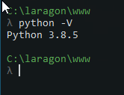
Git Basics
Open Laragon’s Terminal
Default folder will be:
C:\ProgramData\laragon\www (college)
Or
C:\laragon\www (home)

Slide 26

Checking git is installed
To check if git is installed and recognised use:
git --version
You should get something similar to:
git version 2.27.0.windows.1
Notes:
If you have problems with GIT not appearing to be installed then check the “Git Installed but not Working” section at the end of the presentation.

Slide 27
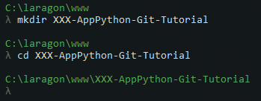
Git Basics
Create a folder:
mkdir XXX-AppPython-Git-Tutorial
Replace XXX with your Initials
Move into the new folder
cd XXX-AppPython-Git-Tutorial

Slide 28

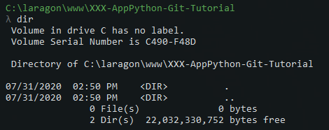
Git Basics
New command prompt will be like:
List current folder content:
dir
or
ls -la

Slide 29

Git Basics: Initialising a Repository
To make the current folder (project) a repo, use:
git init .
Create a repo in a child folder, use:
git init FolderName

Slide 30
Git Basics: Terminal Prompt
When a folder is a repo, Terminal will tell you which “branch” you are on:
This example shows the “master” branch

Slide 31
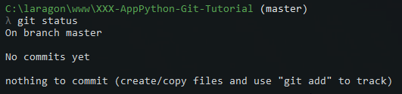
Git Basics: Repo Status
When in a git repo you can check the status of the repo
To check the status of the current folder:
git status
By default no files added to repo

Slide 32
Git Basics: Create a ReadMe.md
Type in the command:
notepad ReadMe.md
Say yes to creating the file, and add the following:
# Applied Python Git Tutorial #1
This tutorial is the start of learning GIT for version control.
## About
This repo is managed by **YOUR NAME HERE**.
Save the File, and close notepad.
Notes:
Type in the command:
notepad ReadMe.md
Say yes to creating the file, and add the following:
# Applied Python Git Tutorial #1
This tutorial is the start of learning GIT for version control.
## About
This repo is managed by **YOUR NAME HERE**.
Save the File, and close notepad.

Slide 33
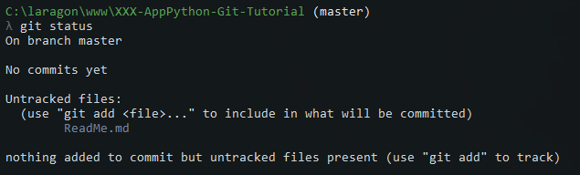

Git Basics: Check the Status
Type in:
git status
You should now see a different message:
The prompt will also be different:

Slide 34

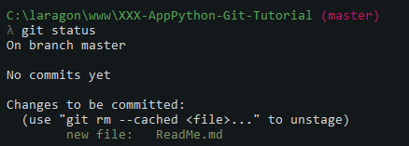
Git Basics: Tracking Files
Tracking ONE file:
git add ReadMe.md
Adding all changed files:
git add .
Check with git status:

Slide 35


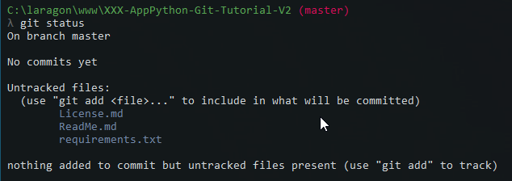
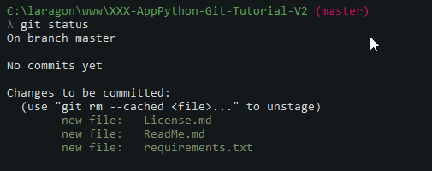
Git Basics: Tracking Files [Multiple]
Example of tracking multiple files:
Creating files and status Add to tracking and status

Slide 36
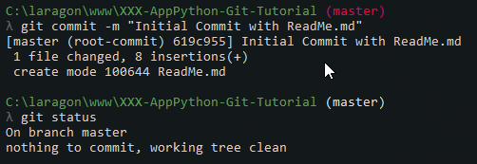
Git Basics: Commit tracked files
When files ready, we commit them using:
git commit –m “MESSAGE”
Use the command:
git commit –m “Initial Commit, with ReadMe.md”

Slide 37
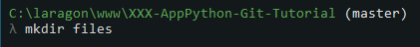
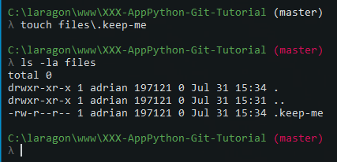
Git Basics: Tracking ‘Empty’ Folders
Easiest way to track empty folders?
Create an empty file in the folder
In Laragon’s terminal use:
touch FOLDER_NAME\.keep-me
Or use:
notepad FOLDER_NAME\.keep-me
And save the new (empty) file
Notes:
Empty folders are not stored in a git repository, they are simply ignored. There are times that you may want to have a folder tracked, even when it may be “empty”.
For example, you want to have the project to contain a “files” folder that will contain files the user creates when they use the application, but by default there is nothing in the folder.

Slide 38
Exercises
Introduction to Version Control

Slide 39
Git Installed but not Working?
Introduction to Version Control
Notes:
We present some checks that you can do to verify git is installed and then fix the problem of it not being found.

Slide 40
Laragon Help (College)
There may be problems with git not appearing
Follow these steps:
Open Laragon
Open the Laragon Terminal (Cmnder)

Slide 41
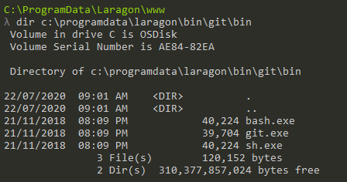
Laragon Help (College)
In the Laragon Terminal (Cmnder)
Type in and press enter:
dir c:\programdata\Laragon\bin\git\
It should show details similar to this:

Slide 42
Laragon Help (College)
Type in and press enter after:
git --version
Hopefully you have fixed your inability to run git.

Slide 43

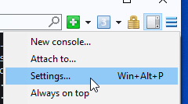
Laragon Help (College)
Follow these to add Git to the search path
Click the Cmder Terminal Hamburger Icon at the top right (the Menu button)
Locate and click on Settings

Slide 44
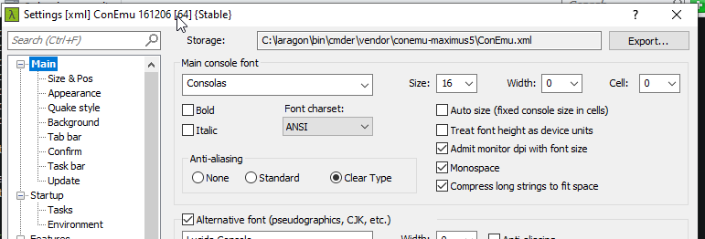

Laragon Help (College)
The Settings Dialog:
Click on the Start-Up / Environment option on the left side of the settings screen

Slide 45
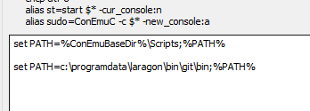
Laragon Help (College)
In the text box on the right go to the end of any existing entries and add:
set PATH=c:\programdata\laragon\bin\git\bin;%PATH%
Click Save Settings
Close and re-open Cmnder

Slide 46
Laragon Help (College)
Once these done, test to see if git is working using:
git --version

