Slide 1
Create a GitHub Account
Session 02
Mohammad Alhabashneh
ICT40120 Certificate IV in Information Technology
Applied Programming in Python

Slide 2
Create a new GitHub Account
Session 02 – Creating a GitHub account

Slide 3
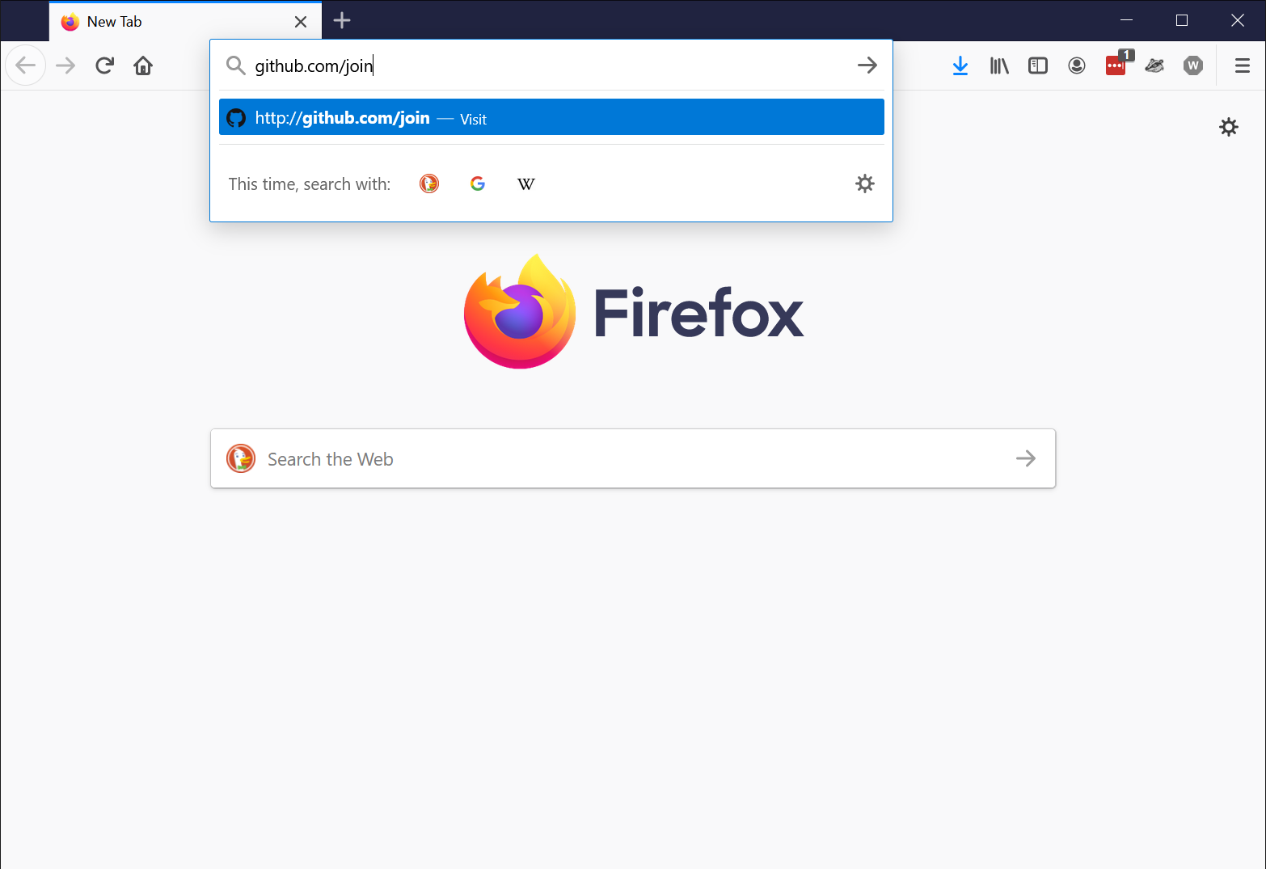
Go to https://github.com/join

Slide 4
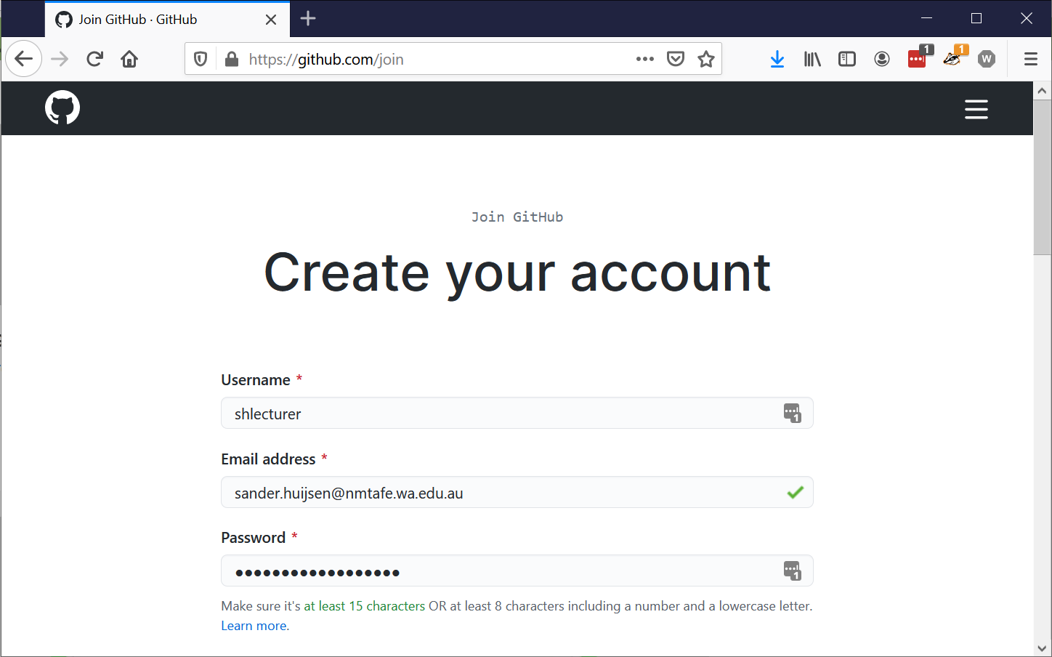
Enter your details
Notes:
The username needs to be unique. You can’t reuse an existing email address either.

Slide 5
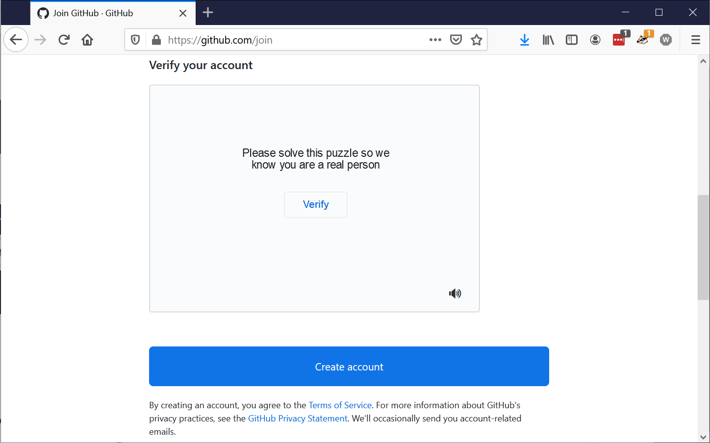
Click verify to solve the puzzle
Notes:
GitHub wants to know you’re not a bot.

Slide 6
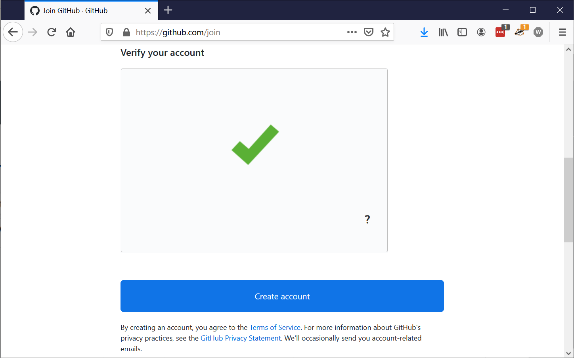
Puzzle solved!
Notes:
You’re not a bot. We already knew that, of course.

Slide 7
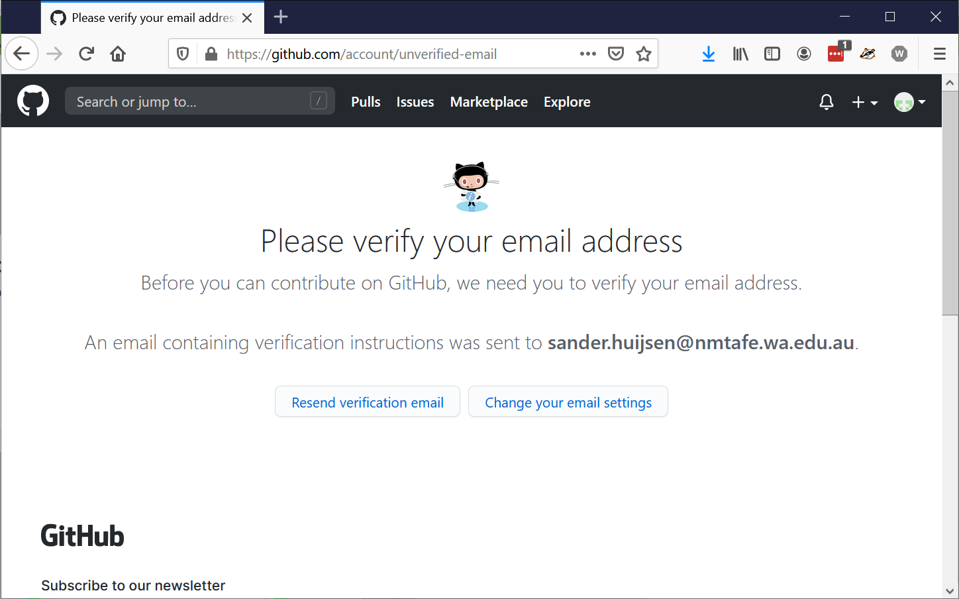
Verify your email address
Notes:
You will receive an email from GitHub with a link. This will verify your email address.

Slide 8
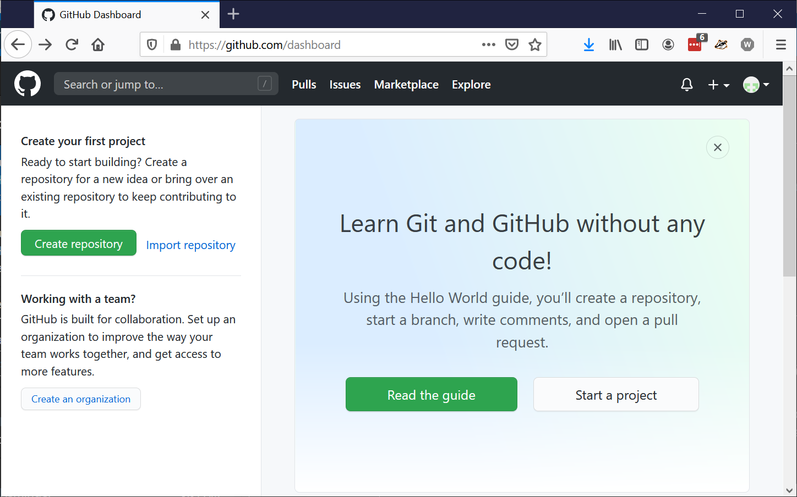
All done!
Notes:
You can now create your very first project in GitHub.

Slide 9
Create a new repository
Session 02 – Creating a GitHub account

Slide 10
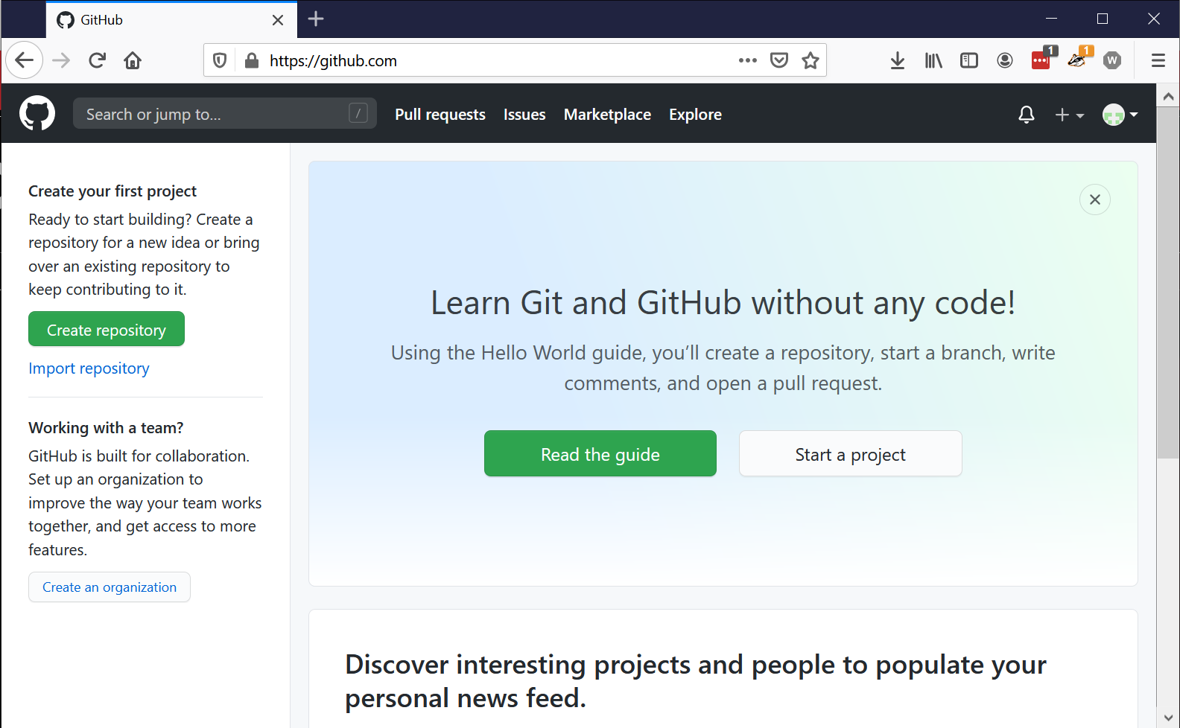
Create repository

Slide 11
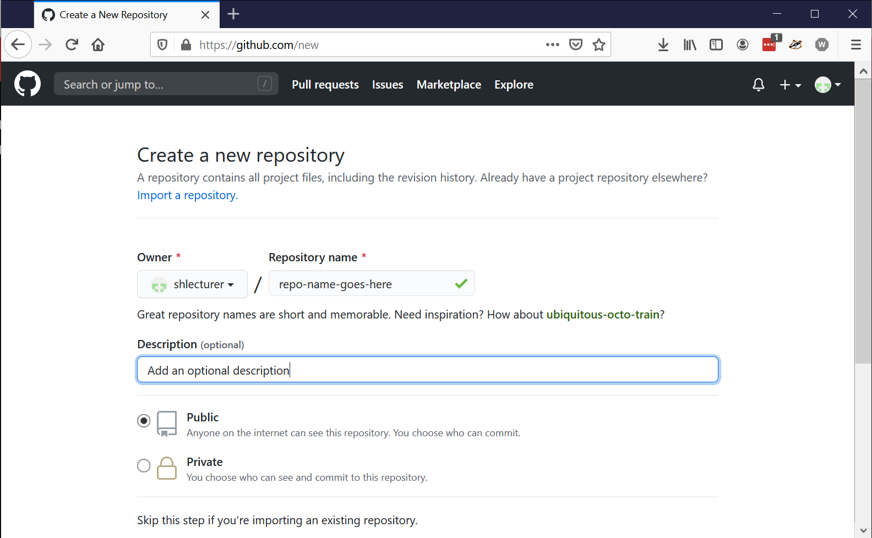
Give it a name and description
Notes:
Create a repository name, which should be unique to your account. The description is optional. Choose whether you want to create a public or a private repository.

Slide 12
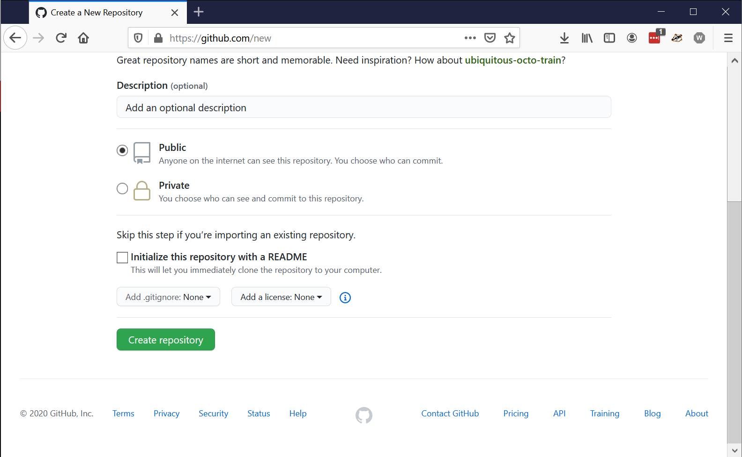
Click create repository
Notes:
You can initialize the repository with a README. This is optional. You can also add a .gitignore file and a license. The default is to do none of the above, though. Click on Create repository create it.

Slide 13
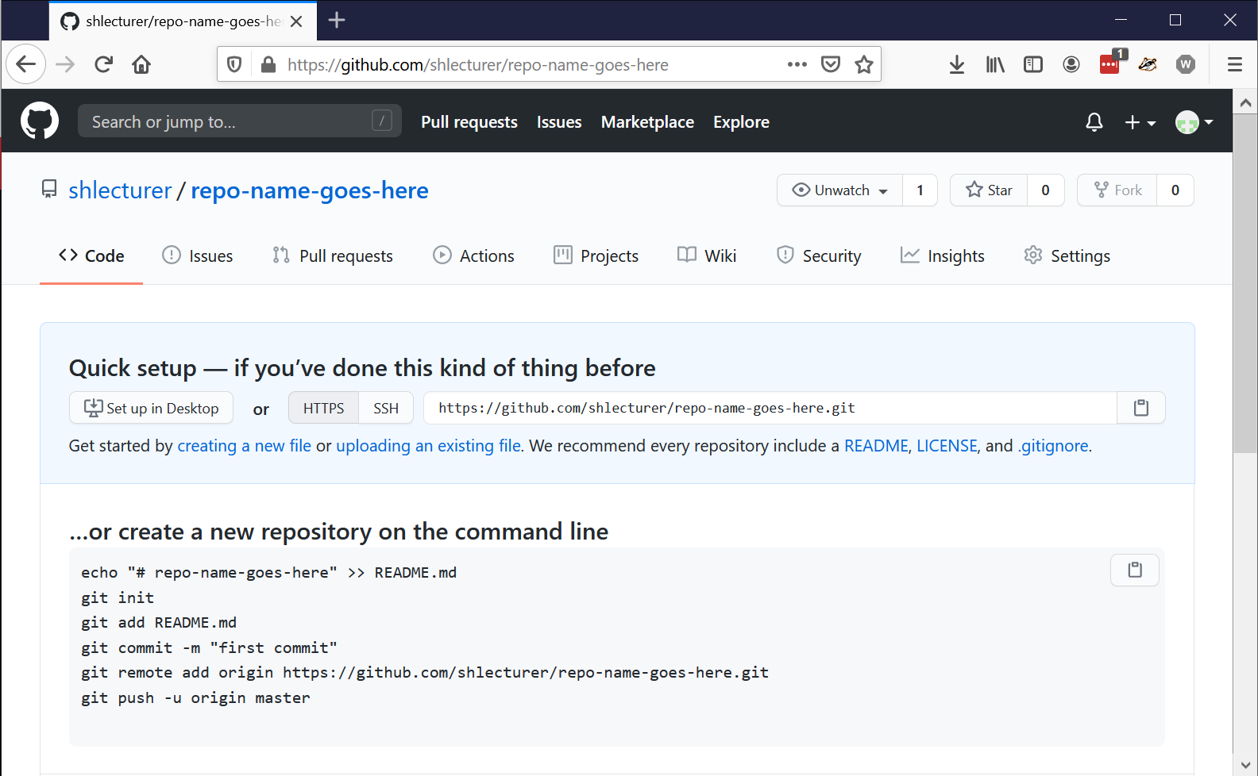
Done!
Notes:
You have created your first repository. You now have various options.
1) You can create a new repository (local) and then push it to your remote one.

Slide 14
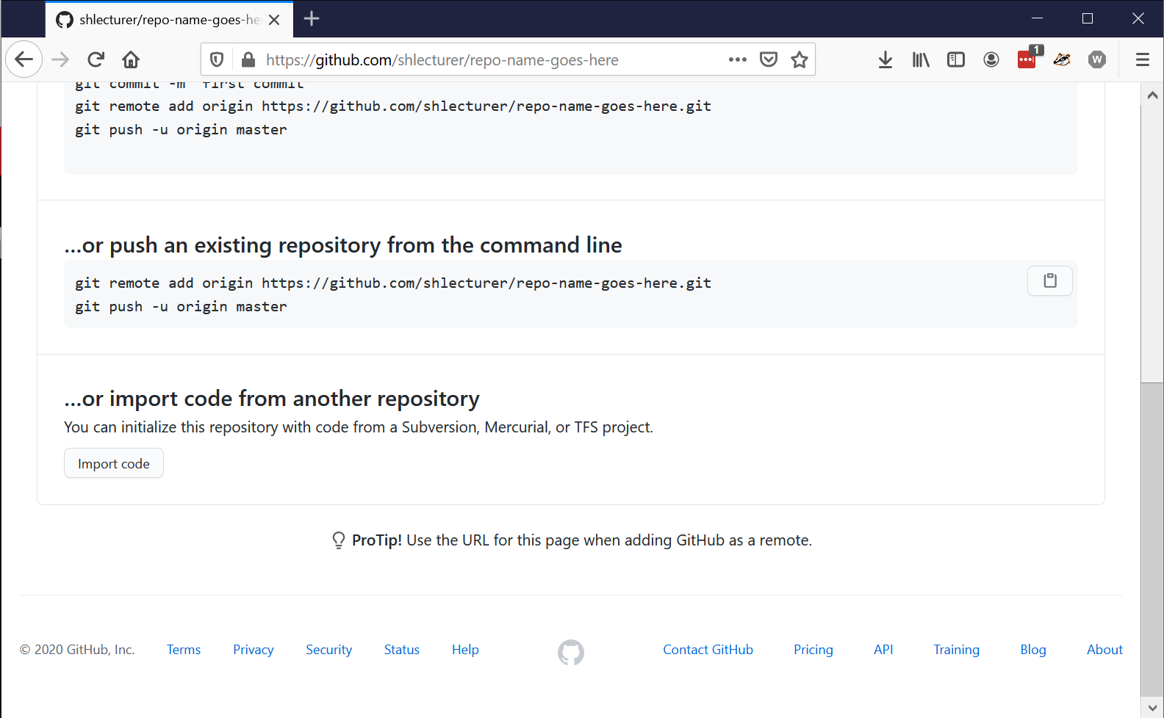
Done!
Notes:
Or 2) you can push an existing repository from the command line.
3) You can even import code from another repository.

Slide 15
Exercise: push your local repository
With the repository you created last week, push it to your remote repository.
Create a new repository on GitHub if you haven’t yet
Follow the appropriate steps to “synchronise” with GitHub
If you’re confident, delete (or rename) your local repository, then clone it from GitHub:
git clone <remote-repo>

Slide 16
End
Session 02 – Creating a GitHub account

