Slide 1

Note: The data and information in this document is reflective of a hypothetical situation and client. This document is to be used for KPMG Virtual Internship purposes only.
Sprocket Central Pty Ltd
Data analytics approach
[The Innovation and Digital Solutions] [Junior Consultant] [Qing Zhao]

Slide 2
Note: The data and information in this document is reflective of a hypothetical situation and client. This document is to be used for KPMG Virtual Internship purposes only.
Agenda
Introduction
Data Exploration
Model Development
Interpretation

Slide 3
Note: The data and information in this document is reflective of a hypothetical situation and client. This document is to be used for KPMG Virtual Internship purposes only.
Introduction
Customer Analysis and High Valued Customers Prediction
We will visualize the data in the following areas:
Age Distributions
Number of Bike Purchases in The Past 3 Years
Population and Age Distribution in Australia
Gender Distributions
Job Industry Category
Wealth Segments
Number of Car Owns in Each States
Postcode distribution
How to predict the high valued customers in new customer list

Slide 4
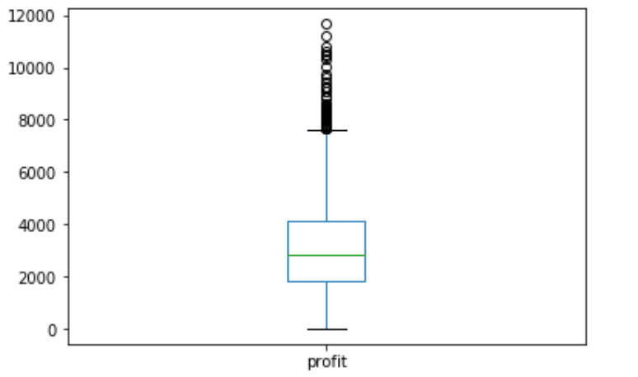
Note: The data and information in this document is reflective of a hypothetical situation and client. This document is to be used for KPMG Virtual Internship purposes only.
Data Exploration
How to define High valued Customer
This is the profit earned from each customer in approved orders, then we set the third quartile (4150) of it as the threshold of high valued customer.
All the data are from transaction records.
max: 11669
Q3: 4150
Q2: 2841
Q1: 1828
min: 15

Slide 5
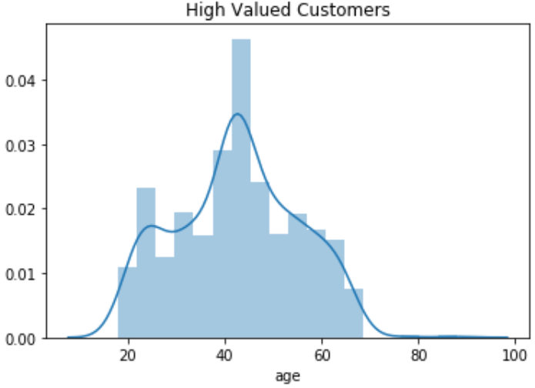
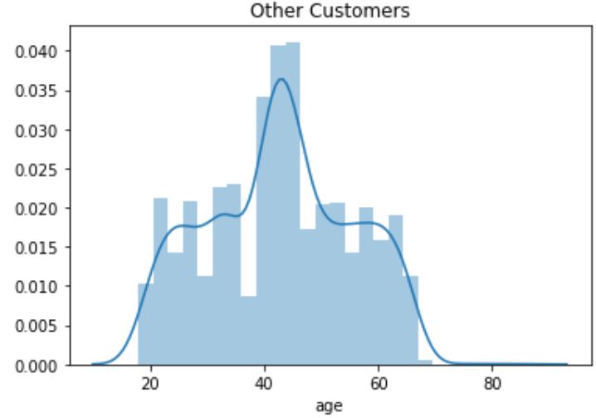
Note: The data and information in this document is reflective of a hypothetical situation and client. This document is to be used for KPMG Virtual Internship purposes only.
Data Exploration
Age Distributions
There are not much differences between the high valued customers and normal customers. So we decided to put them into different age group to target the high valued customer group.

Slide 6
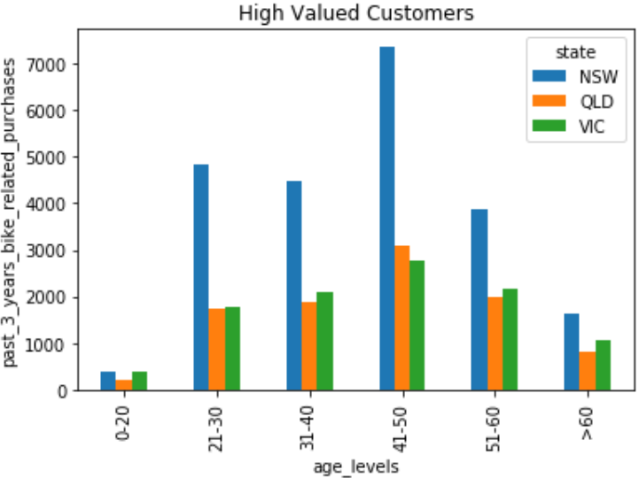
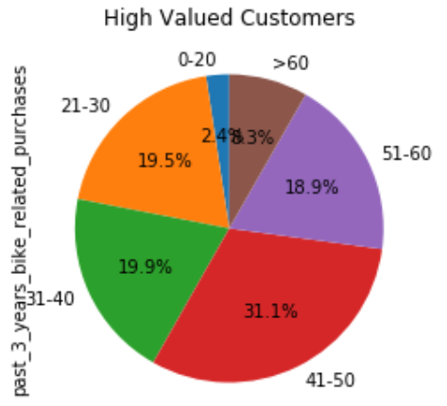
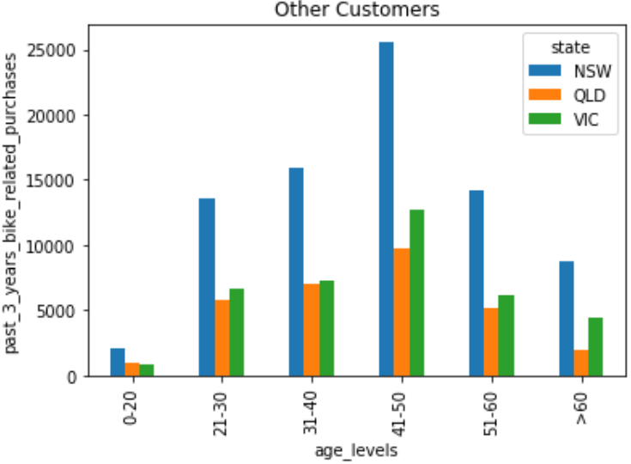
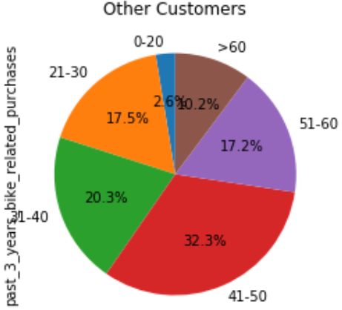
Note: The data and information in this document is reflective of a hypothetical situation and client. This document is to be used for KPMG Virtual Internship purposes only.
Data Exploration
Number of Bike Purchases in The Past 3 Years
Compared to the normal customers, the high valued customers in 41-50 who live in Queensland purchased more bike related products in the past three years.
There are not much difference between two groups, since they all share the same age features and there are more people who are 41-50 years old and live in New South Wales in the customer records.

Slide 7
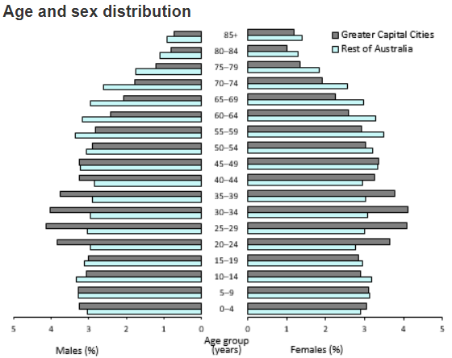
Note: The data and information in this document is reflective of a hypothetical situation and client. This document is to be used for KPMG Virtual Internship purposes only.
Data Exploration
Population and Age Distribution in Australia
Data from Australian Bureau Statistics, 2019
https://www.abs.gov.au/AUSSTATS/abs@.nsf/DetailsPage/3101.0Dec%202019?OpenDocument
https://www.abs.gov.au/AUSSTATS/abs@.nsf/Lookup/3235.0Main+Features12019?OpenDocument

Slide 8
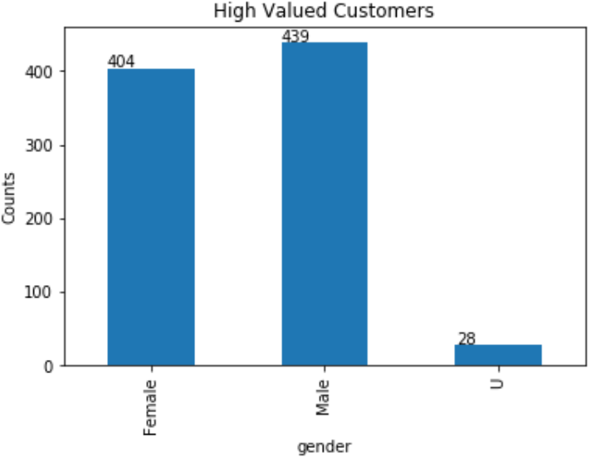
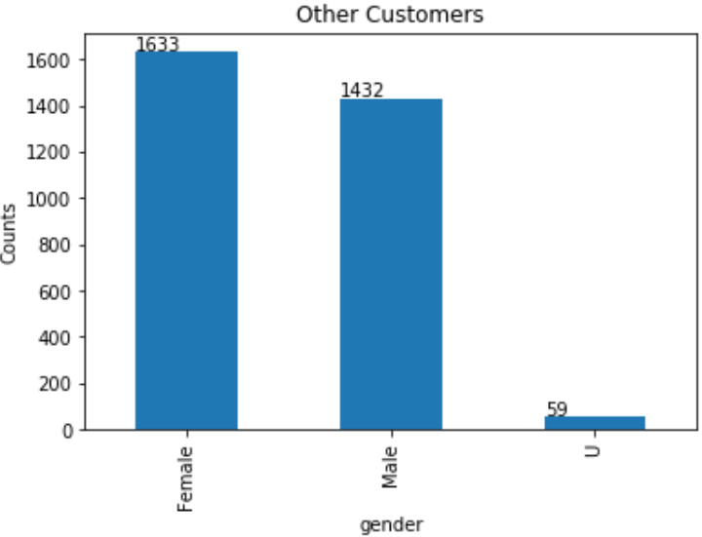
Note: The data and information in this document is reflective of a hypothetical situation and client. This document is to be used for KPMG Virtual Internship purposes only.
Data Exploration
Gender Distributions
The gender ratio between the high valued customers and normal customers are opposite. So we decided to dig out its impact on purchases and other factors.

Slide 9
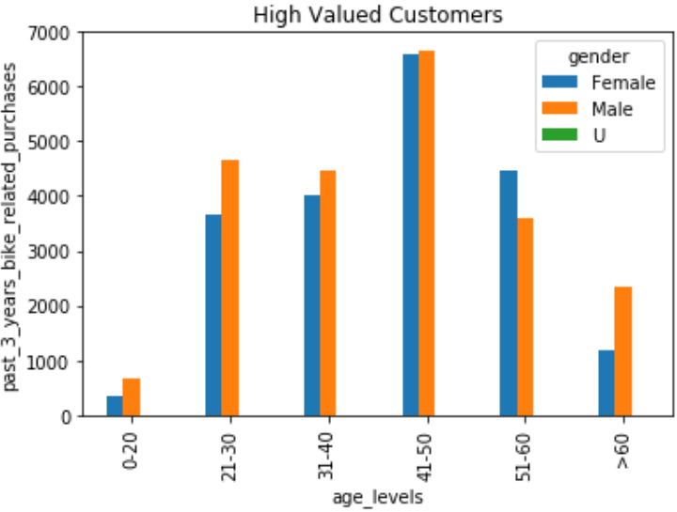
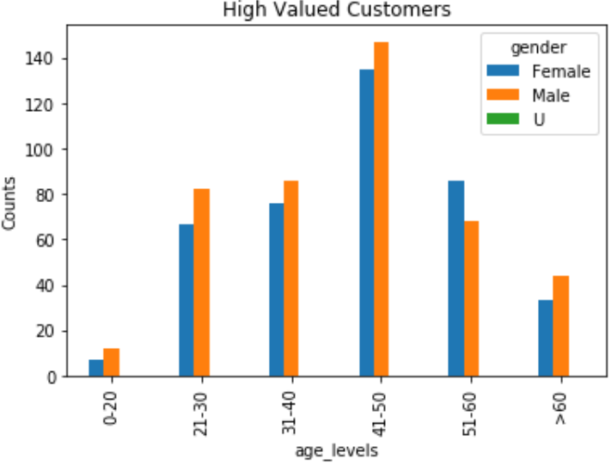
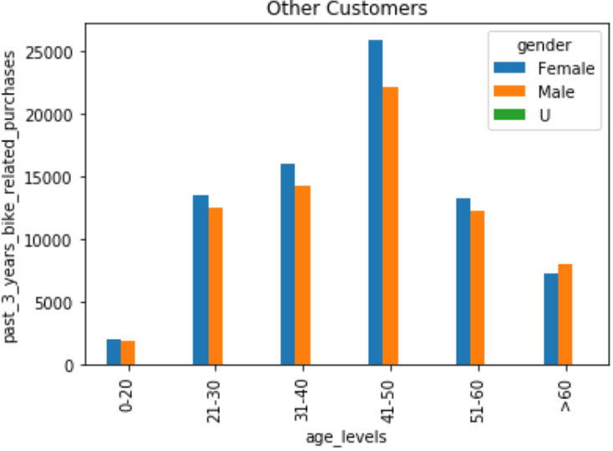
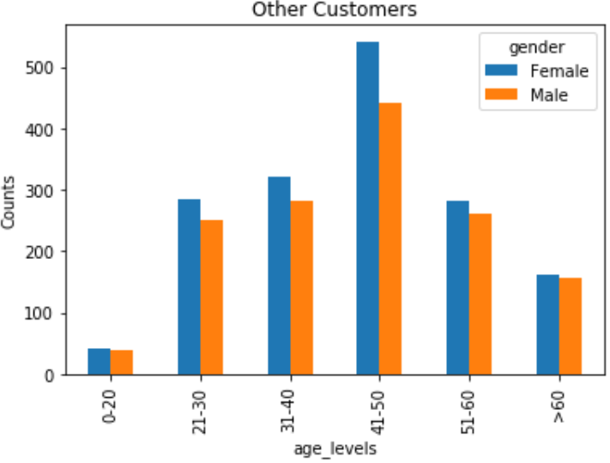
Note: The data and information in this document is reflective of a hypothetical situation and client. This document is to be used for KPMG Virtual Internship purposes only.
Data Exploration
Purchases and Customers condition in each Gender and Age level.
Compared to the normal customers, the high valued customers who are male purchased more bike related products in the past three years, expect for people in 51-60 years old.
There are truly more male high valued customers than female, except for people in 51-60 years old. So those people are likely to become high valued customers.

Slide 10
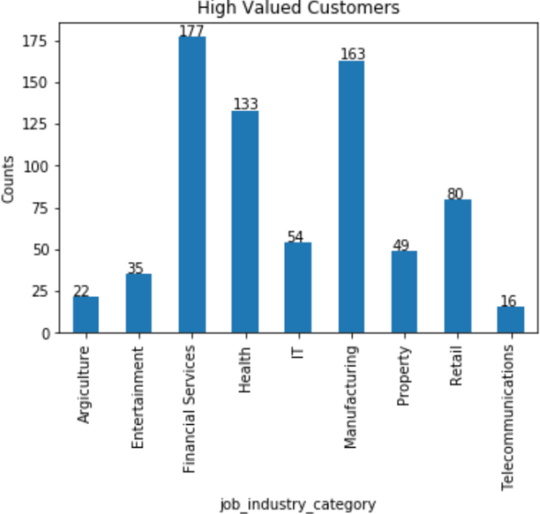
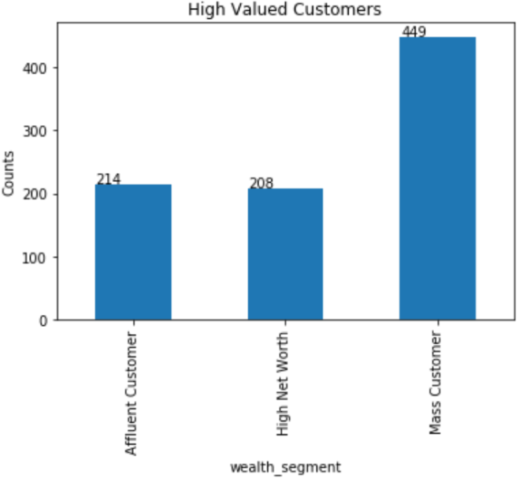
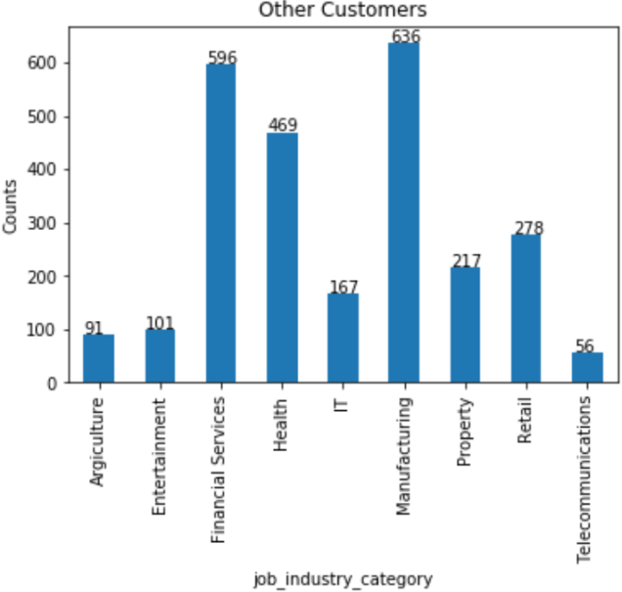
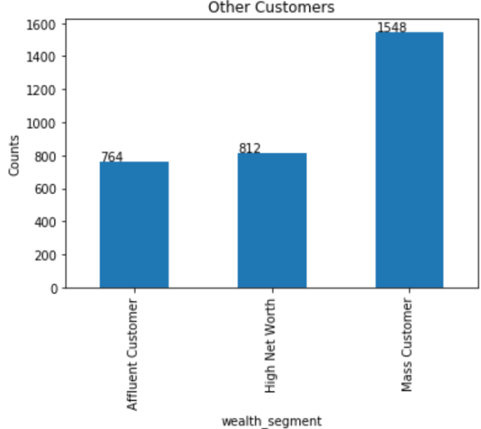
Note: The data and information in this document is reflective of a hypothetical situation and client. This document is to be used for KPMG Virtual Internship purposes only.
Data Exploration
Job Industry Category and Wealth Segments
Both high valued customers and normal customers shared same features in job industry category and wealth segments.
Interpretation

Slide 11
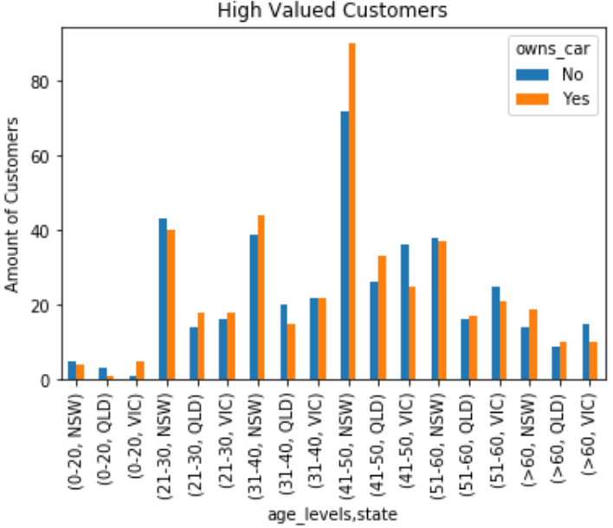
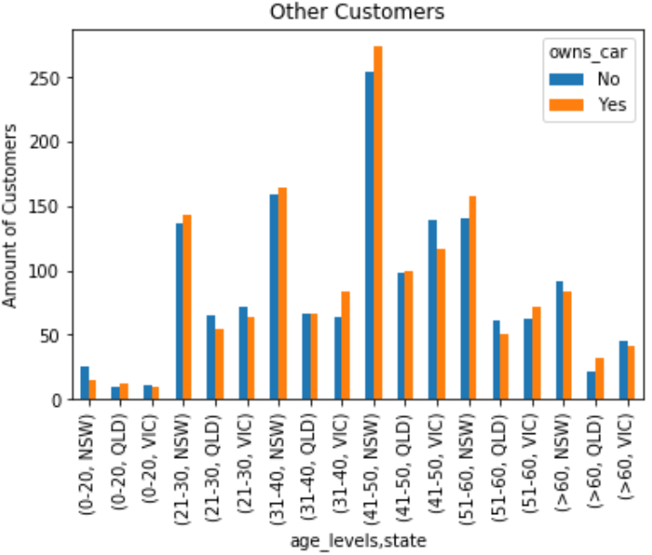
Note: The data and information in this document is reflective of a hypothetical situation and client. This document is to be used for KPMG Virtual Internship purposes only.
Data Exploration
Number of Car Owns in Each States and Age levels
Compared to normal customers, there are not much difference. Except that high valued customers who are 41-50 years old and live in NSW tend to own cars than that of the normal customers.
Interpretation

Slide 12
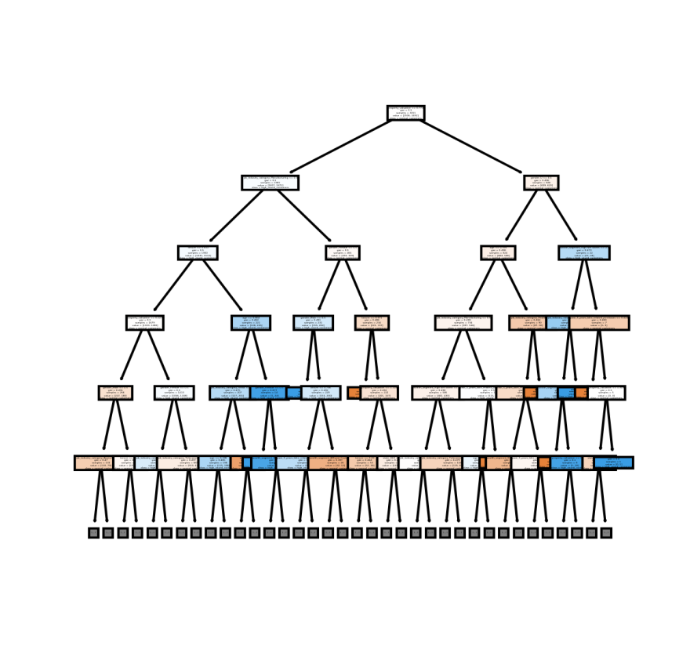
Note: The data and information in this document is reflective of a hypothetical situation and client. This document is to be used for KPMG Virtual Internship purposes only.
Model Development
Predicting High Valued Customers by Machine Learning
Use the customer dataset to train the Random Forest model on how to target high valued customers
Evaluate model performance with 20% of customer dataset(randomly chosen)
Predict the high valued customers in new customer list by well-trained Random Forest model
Accuracy of Random Forest model is 0.93. F-score of Random Forest model is 0.94
Interpretation
One of decision trees in RF model (depth = 5)

