Slide 1
SnowFLOWS: Generative Spatio‑Temporal Modelling of Snow Cover Dynamics Using Satellite Imagery
MDP26-19
Presented by:
Reina Taher (230134)
Carla Youness (232771)
Nour el Saghir (230520)
Ali Mansour (231039)
Hassan Dakhlallah (222814)
Supervised by:
Dr. Laurent Drapeau
Co-Supervised by:
Dr. Youssef El Bakouny
ESIB Multidisciplinary Project
April, 2026
Notes:
Good morning everyone, we are ….[names], we are a team of CCE students and today we present SnowFLOWS, a project focused on modeling and forecasting snow dynamics in Lebanon using satellite data and deep learning techniques.
Snow in Lebanon is not just seasonal — it is a critical component of the country’s water resources. Understanding and predicting its evolution is therefore both an environmental and engineering challenge.

Slide 2




Introduction .Spatio-Temporal Snow Forecasting using Deep Learning and Satellite Data
Project Team & Multidisciplinary Context
Computer & Communications Engineering (CCE) students
Collaboration between data processing, modeling, and system design
Project Context
Snow cover plays a critical role in water resources in Lebanon
Monitoring snow dynamics is essential for environmental and economic planning
Problem Statement
Difficulty in accurately forecasting snow evolution over time
Limited temporal coverage (Sentinel-2) vs limited spatial resolution (MODIS)
High variability of snow behavior in mountainous regions
Engineering Challenge
Design a system capable of modeling complex spatio-temporal snow dynamics
Integrate multi-source satellite data
Capture nonlinear temporal dependencies using machine learning
SnowFLOWS: Spatio-Temporal Snow Forecasting using Satellite Data
2
Notes:
Snow acts as a natural water reservoir in Lebanon. However, its evolution is highly complex due to environmental variability, terrain effects, and data limitations.
Traditional approaches struggle to capture these dynamics, especially when dealing with temporal dependencies and multi-source data.

Slide 3

Project Objectives and Outcomes
Project Objectives
Develop a snow forecasting system using satellite data
Model temporal dynamics of snow cover using LSTM networks
Analyze the impact of sequence length on prediction performance
Project Outcomes
Built a multi-source dataset (Sentinel-2, MODIS, meteorological data)
Achieved improved performance over baseline models
Identified trade-off between numerical accuracy and visual realism
Why ? Because …
Snow behavior is nonlinear and time-dependent
Traditional methods fail to capture complex temporal patterns
Deep learning enables data-driven modeling of environmental systems
Satellite Data
Forecast
Preprocessing
LSTM Model
SnowFLOWS: Spatio-Temporal Snow Forecasting using Satellite Data
Notes:
Our objective was to design a system capable of forecasting weekly snow evolution using time-series modeling.
To achieve this, we:
extracted snow data from satellite imagery,
integrated meteorological variables,
and developed a predictive model capable of learning temporal patterns.

Slide 4

Project Functional Requirements
Data Requirements
Extract satellite data (Sentinel-2, MODIS)
Ensure temporal consistency and alignment
Build structured time-series dataset
Model Requirements
Predict weekly snow cover
Capture temporal dependencies
Support sequence-based input (LSTM)
Feature Requirements
Integrate multi-source variables (snow, temperature, precipitation)
Encode seasonality (cyclical features)
Normalize data for stable training
Evaluation Requirements
Compare with baseline persistence model
Use MAE and RMSE
Analyze different sequence lengths
SnowFLOWS: Spatio-Temporal Snow Forecasting using Satellite Data
Notes:
The system needed to:
process and align multi-source data,
construct temporal sequences for learning,
train a predictive model,
and evaluate performance using quantitative metrics such as MAE and RMSE.

Slide 5



Project Constraints
1. Data Constraints
Cloud coverage affecting Sentinel-2 observations
Limited temporal coverage of high-resolution Sentinel-2 data
2. Technical Constraints
Trade-off:
Processing limitations for large multi-year satellite datasets
3. Model Constraints
Sensitivity to sequence length selection
Risk of overfitting with long sequences
Difficulty capturing extreme snow
peaks accurately
 | Spatial | Temporal
MODIS | Low | High
Sentinel-2 | High | Low
Standards Applied
ESA Copernicus Sentinel-2 data format compliance NASA MODIS data usage standards NDSI-based snow detection (remote sensing standard) Standard ML pipeline: normalization + train/test split
SnowFLOWS: Spatio-Temporal Snow Forecasting using Satellite Data
Notes:
We also had to operate under several constraints.
On the data side, cloud coverage affects Sentinel-2 observations, and there is a trade-off between spatial resolution and temporal availability when combining Sentinel-2 and MODIS.
On the modeling side, performance depends strongly on sequence length selection, and capturing extreme snow peaks remains challenging.
Finally, the project scope was constrained by time, which limited the number of experiments we could explore.

Slide 6


Related Works
Approach | Strengths | Limitations | Suitability for Snow Forecasting
ARIMA | Simple, interpretable | Linear assumptions | Poor for nonlinear snow dynamics
Random Forest | Handles nonlinear data | No temporal memory | ! Limited for time series
LSTM (our choice) | Captures temporal dependencies | Needs tuning | Best suited
Key Insight
Snow forecasting requires modeling nonlinear temporal behavior
LSTM is more suitable for spatio-temporal satellite data
SnowFLOWS: Spatio-Temporal Snow Forecasting using Satellite Data
Notes:
We started by evaluating different modeling approaches for time-series forecasting.
We considered classical models such as ARIMA, machine learning methods like Random Forest, and deep learning approaches such as LSTM.
ARIMA is limited in capturing nonlinear relationships, and Random Forest does not naturally model temporal dependencies.
LSTM was selected because it is specifically designed to learn sequential patterns and long-term dependencies, which are essential for modeling snow evolution over time.

Slide 7
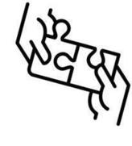
Solution Design Overview
Data Extraction
LSTM Model
Prediction
Preprocessing
Sequence Construction
Evaluation & Visualization
Goal of the system
End-to-end framework to forecast weekly snow cover using satellite data and machine learning.
Data Sources
Sentinel-2 (ESA): high-resolution optical imagery (10m) for detailed snow detection
MODIS (NASA): long-term medium-resolution data (~500m) for temporal consistency
ERA5: meteorological reanalysis (temperature & precipitation)
Core Idea
Transform raw satellite observations into structured time-series inputs for deep learning-based forecasting.
Model Choice
LSTM selected due to its ability to model:
temporal dependencies
nonlinear environmental dynamics
SnowFLOWS: Spatio-Temporal Snow Forecasting using Satellite Data
Notes:
This slide introduces the overall architecture of our system.
Our objective is to transform raw satellite and meteorological data into a forecasting system for weekly snow cover prediction.
We rely on three main data sources.
Sentinel-2 provides high-resolution optical imagery, which is useful for precise snow detection.
MODIS provides lower spatial resolution but much longer temporal coverage, which helps capture long-term trends.
And ERA5 provides meteorological variables such as temperature and precipitation, which influence snow accumulation and melting.
All of these datasets are later combined into a structured time-series format.
We then use an LSTM-based model, which is well suited for sequential data and allows us to learn both short-term and long-term dependencies in snow evolution.

Slide 8
Solution Design Conceptual Model of SnowFLOWS System
Satellite Data
Data Cleaning
Feature Engineering
Normalization
Sequence Construction
LSTM Model Training
Prediction Output
Evaluation
Sentinel-2/ MODIS
Alignment
Snow lag features/ Snow ratio/ Seasonal encoding/ Altitude features
Z-score
1-12 weeks
MAE/ RMSE + Visualization
MDP26-19
SnowFLOWS: Spatio-Temporal Snow Forecasting using Satellite Data
8
Notes:
This slide presents a more detailed view of the overall processing pipeline.
We start from satellite data acquisition, followed by data cleaning and preprocessing.
Then we perform feature engineering and normalization.
After that, we construct the time-series sequences used for learning, train the LSTM model, generate predictions, and finally evaluate the results.
This diagram summarizes the full end-to-end workflow of the system.

Slide 9

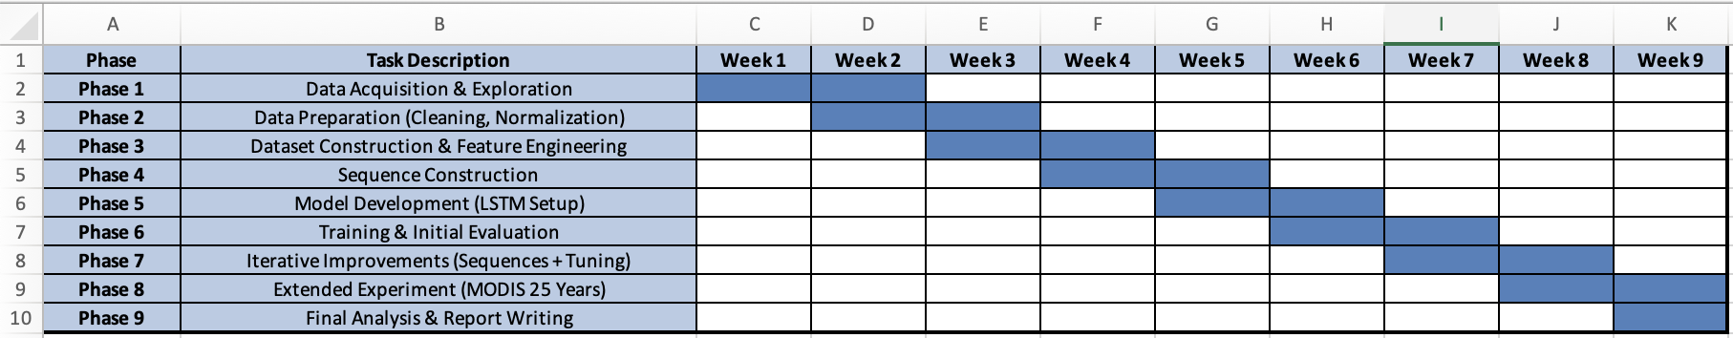
Project Management
We have 9 main phases:
Iterative Workflow
Continuous refinement of:
dataset structure
sequence length
model architecture
Multiple experiments run per configuration
Decisions based on averaged results (MAE/RMSE)
Conflict Management
Model instability across runs → solved using multiple executions + averaging
Sequence length trade-off:
6 weeks → best numerical results
8 weeks → best visual realism
→ both analyzed and justified
Data alignment issues (Sentinel vs MODIS) → resolved via temporal synchronization
SnowFLOWS: Spatio-Temporal Snow Forecasting using Satellite Data
Notes:
The project followed an iterative workflow with continuous refinement of data, model, and experiments over time.
Challenges such as model variability, sequence trade-offs, and data alignment were handled through repeated runs, averaging results, and synchronization.

Slide 10
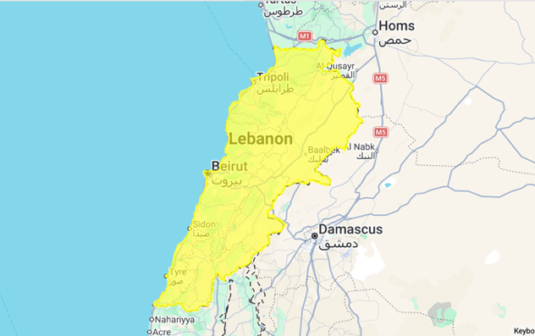
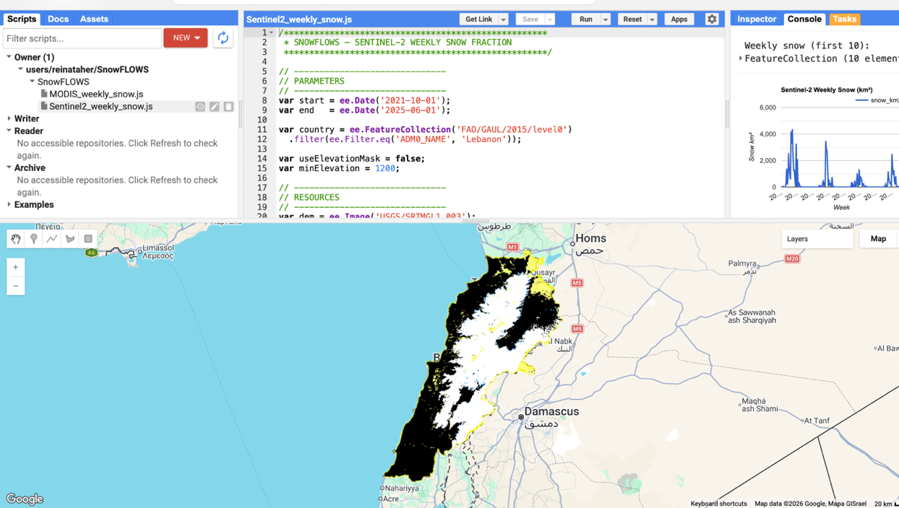
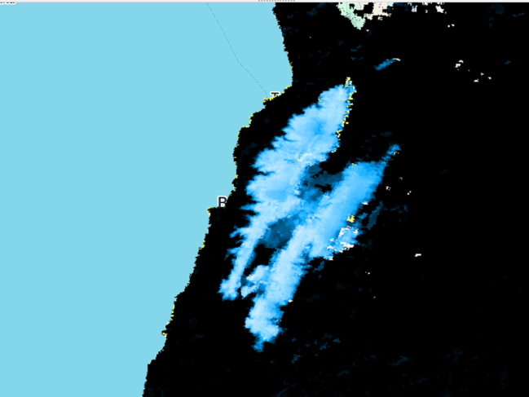
Solution Implementation Study Area & Data Sources
Study area: Lebanon (FAO/GAUL boundaries)
Satellite data:
Sentinel-2 (10m, high spatial resolution)
MODIS (500m, high temporal frequency)
Meteorological data: ERA5 (temperature, precipitation)
Time span: 2016–2025
Cloud Masking
NDSI Threshold = 0.4
SnowFLOWS: Spatio-Temporal Snow Forecasting using Satellite Data
Notes:
Now we move into the solution implementation, where we start building the full system step by step.
We first define our study area, which is Lebanon, using satellite-based geospatial boundaries.
On this slide, we can see the raw satellite view, followed by snow maps generated from MODIS and Sentinel-2 imagery processed in Google Earth Engine.
For Sentinel-2, we applied snow extraction using the Normalized Difference Snow Index, then performed cloud masking and used a threshold of 0.4 to classify snow pixels.
This gives us the first reliable snow representations that will feed into our forecasting pipeline.

Slide 11
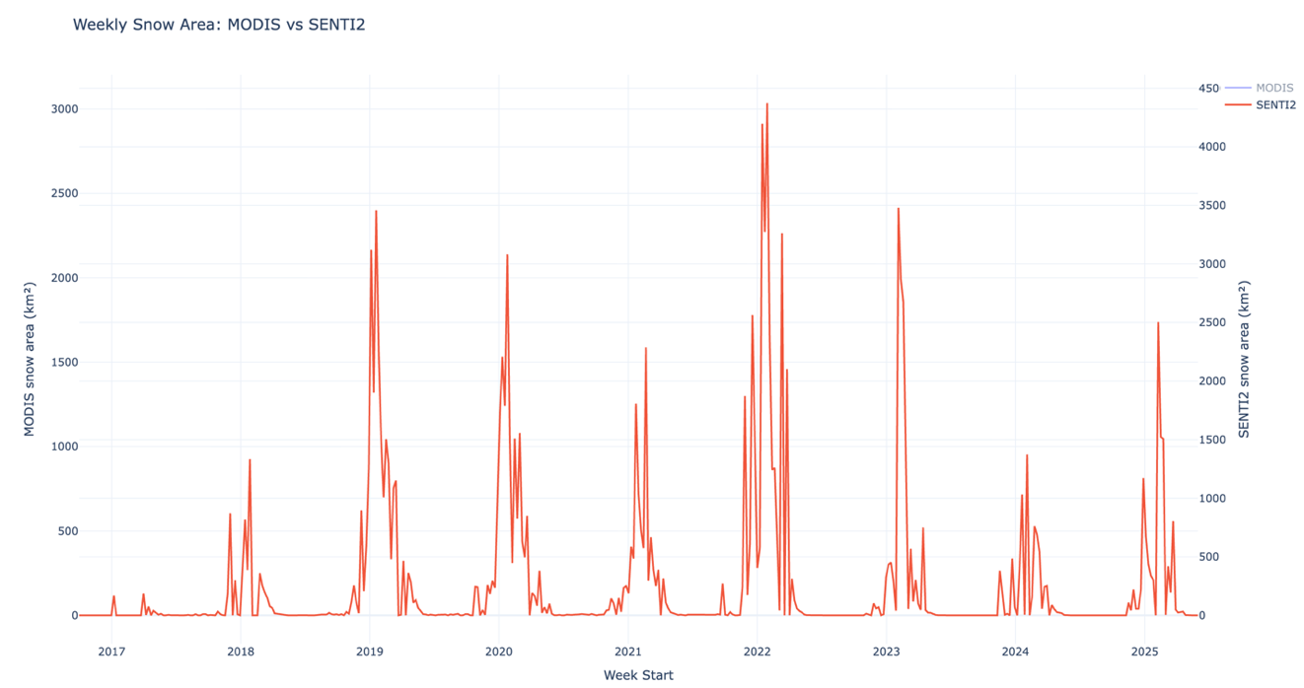
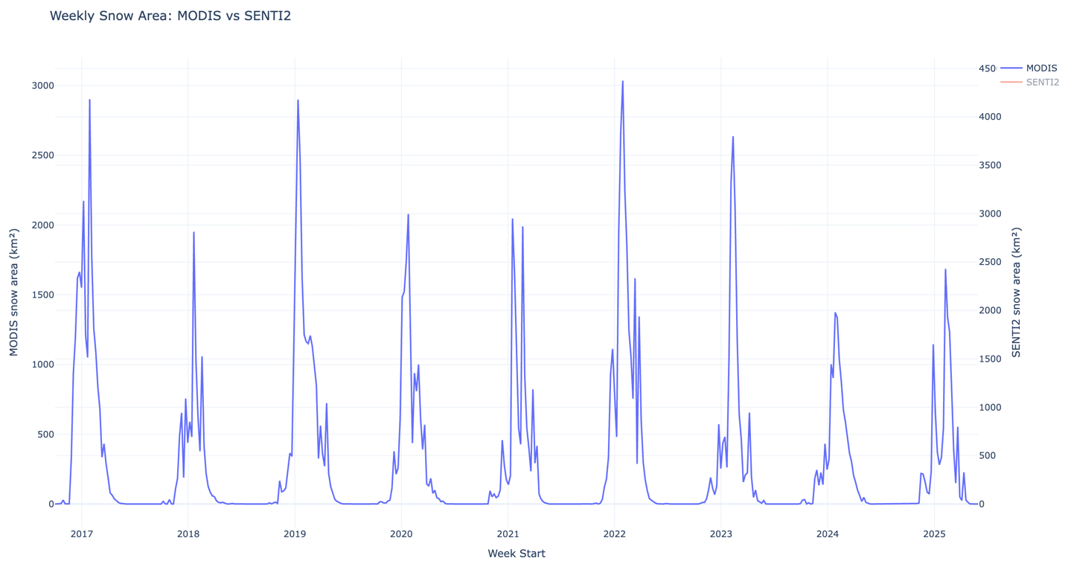
Time Series (MODIS/Senti-2)
Weekly aggregation
2016–2025
Strong seasonal pattern
MDP26-19
SnowFLOWS: Spatio-Temporal Snow Forecasting using Satellite Data
11
Notes:
After snow extraction, we built the weekly time-series in Python by cleaning and merging the exported data.
We then visualized snow cover over time, where we clearly observe a strong seasonal pattern with winter peaks and summer melting.
This step was important because it confirmed that our extracted signal is consistent and meaningful before moving into modeling.

Slide 12
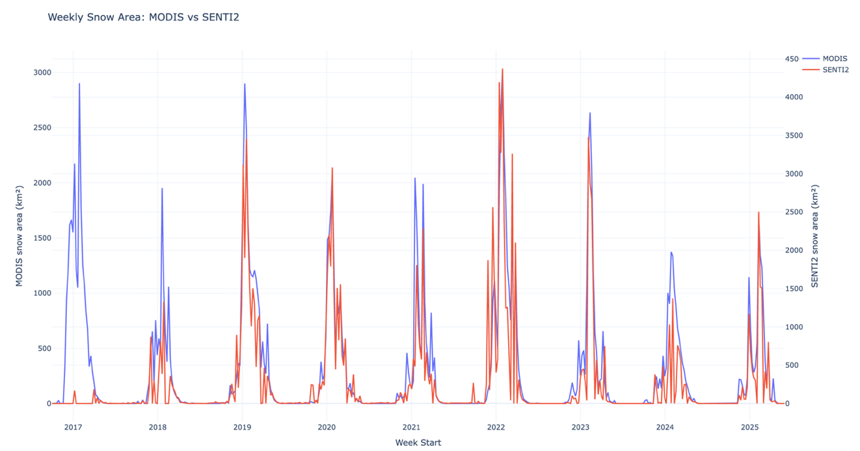
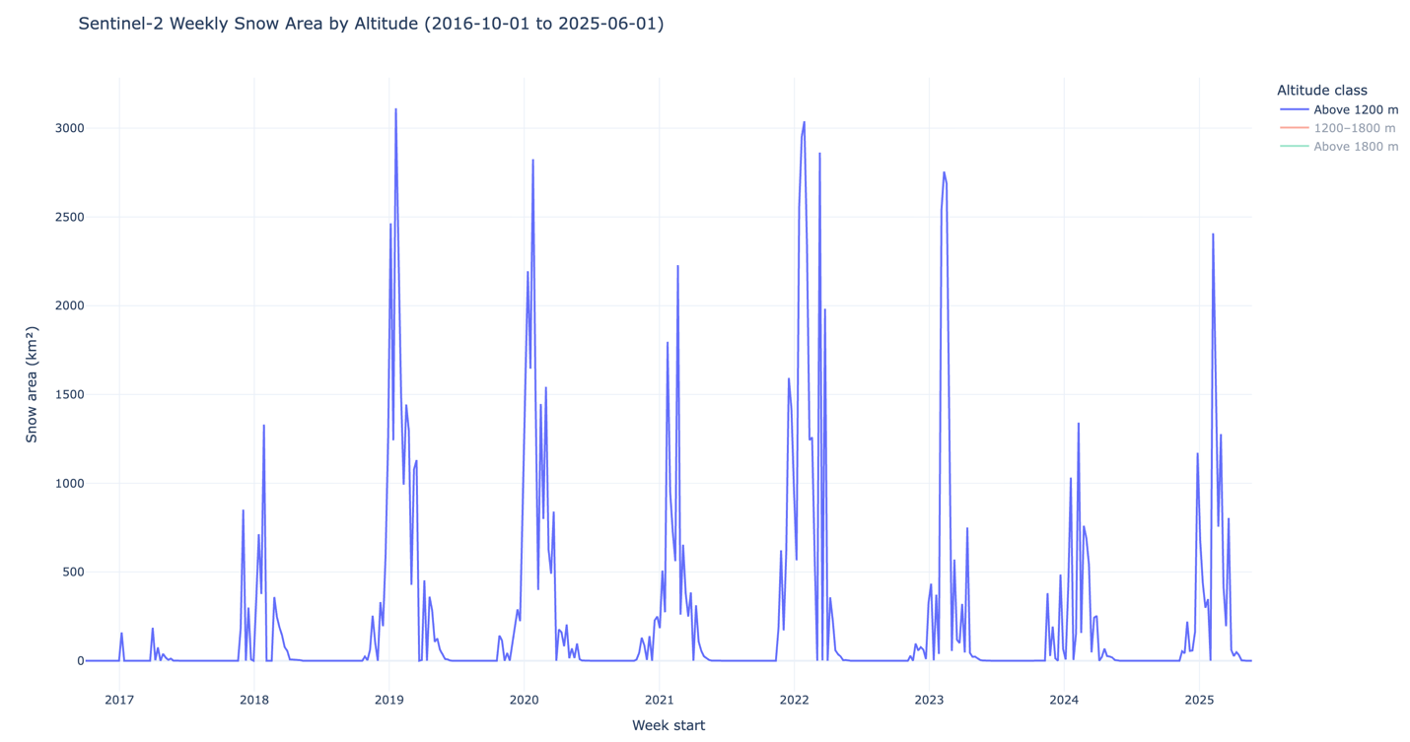
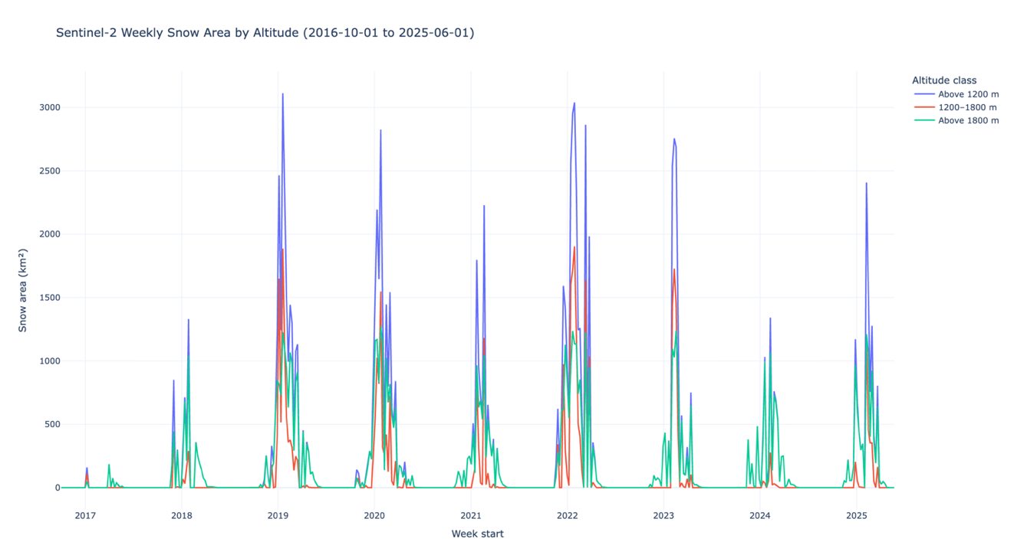
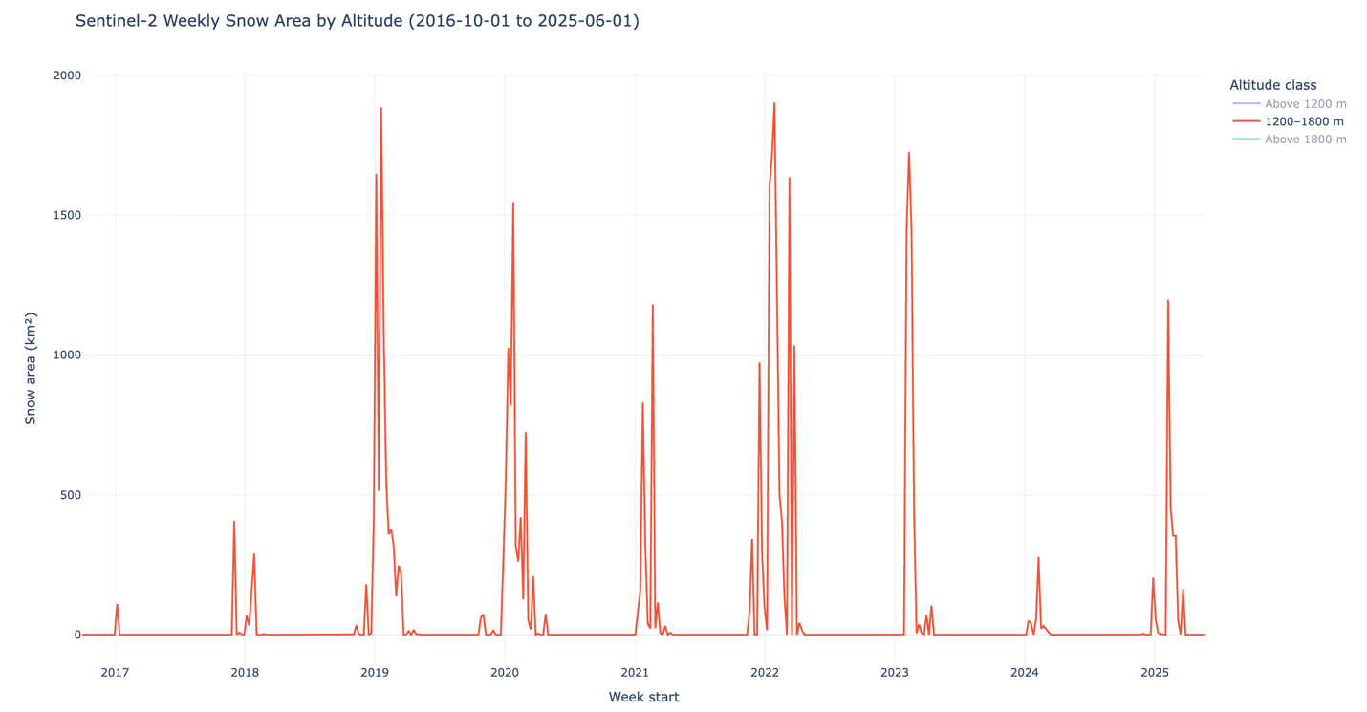
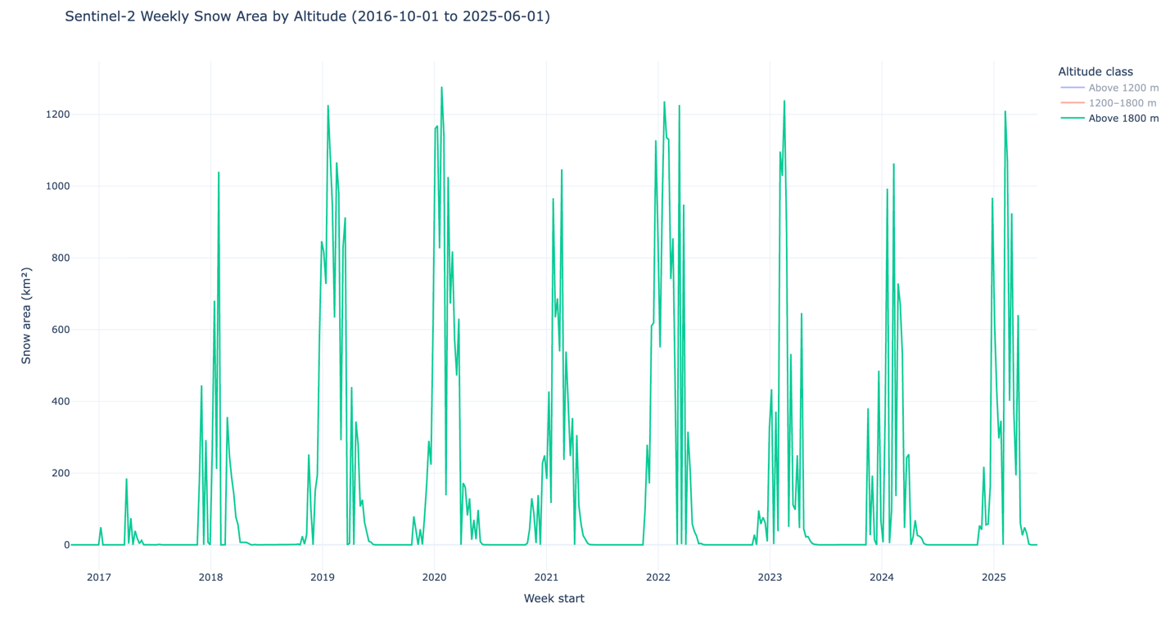
Data Understanding
MODIS = smoother (time)
Sentinel = detailed (space)
Higher altitude = longer snow persistence
MDP26-19
SnowFLOWS: Spatio-Temporal Snow Forecasting using Satellite Data
12
Notes:
Here we combine two important perspectives to better understand the snow signal before modeling.
First, the comparison between MODIS and Sentinel-2 confirms that both datasets capture the same seasonal snow behavior. MODIS appears smoother due to its daily observations, while Sentinel-2 is more detailed but slightly noisier because of cloud gaps and lower revisit frequency.
Then, we introduced altitude-based analysis for Sentinel-2. The idea here is that snow is strongly influenced by elevation, so we split the region into different altitude ranges to better understand how snow behaves in mountainous areas.
This helps us validate the physical consistency of the data, and later justifies why altitude-related features are included in our forecasting model.

Slide 13
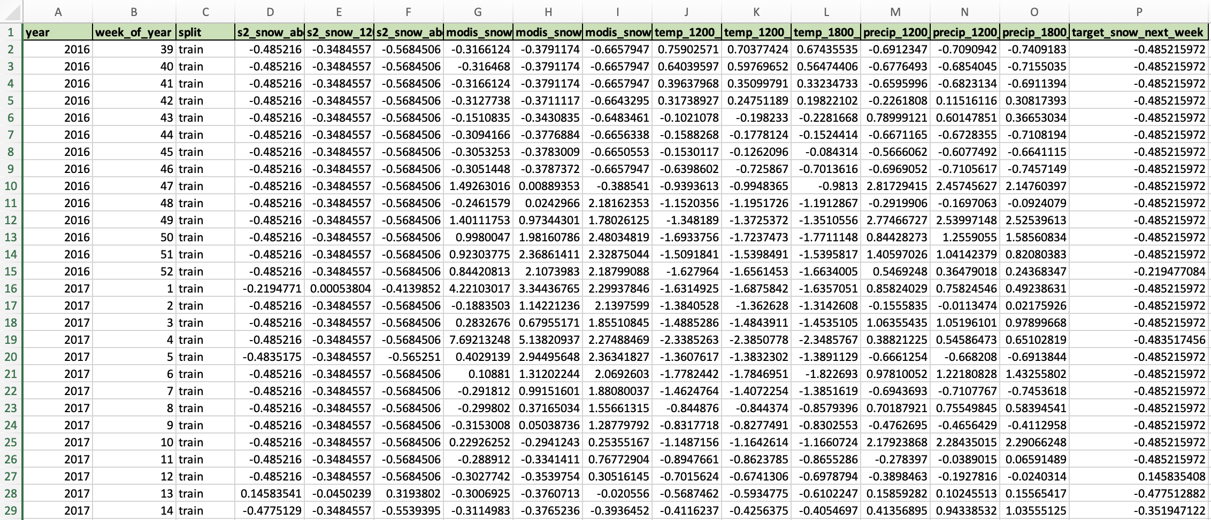
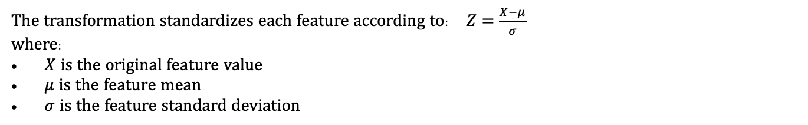
Dataset + Features + Normalization
Feature Category | Variables
Seasonal encoding | week_sin, week_cos
Persistence | snow_last_week, snow_last_2weeks
Change dynamics | snow_change_ratio
Aggregated snow signal | snow_mean
Temporal derivatives | snow_gradient, snow_acceleration
Sentinel-2 snow coverage | 3 altitude bands
MODIS snow coverage | 3 altitude bands
Temperature | 3 altitude bands
Precipitation | 3 altitude bands
The transformation standardizes each feature according to: $Z=\frac{X−μ}{σ}$
where:
$X$ is the original feature value
$μ$ is the feature mean
$σ$ is the feature standard deviation
MDP26-19
SnowFLOWS: Spatio-Temporal Snow Forecasting using Satellite Data
13
Notes:
Here we build the final dataset that will be used as input for the model.
We first organize all our variables into a structured format, including satellite snow data, meteorological variables from ERA5, and altitude-based features. In total, we end up with 20 engineered features that describe both snow conditions and their driving factors.
Then, we define the target variable, which is the future snow cover we want to predict.
Finally, we apply Z-score normalization to standardize all features so they are on the same scale, which improves the stability and efficiency of model training.
At this stage, we obtain a clean, fully structured dataset ready for sequence modeling.

Slide 14
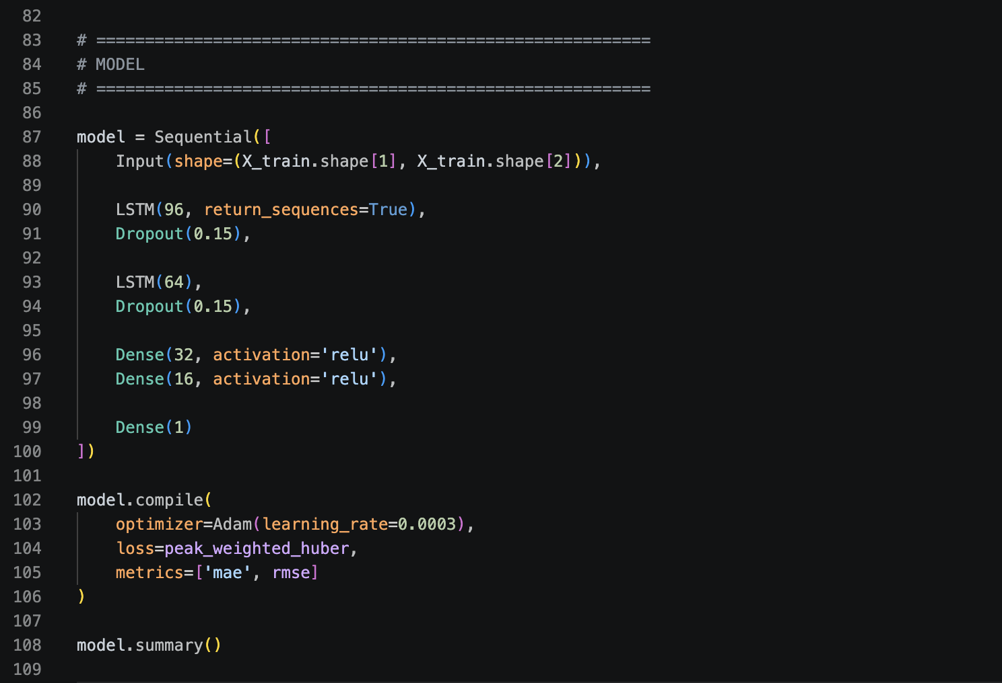
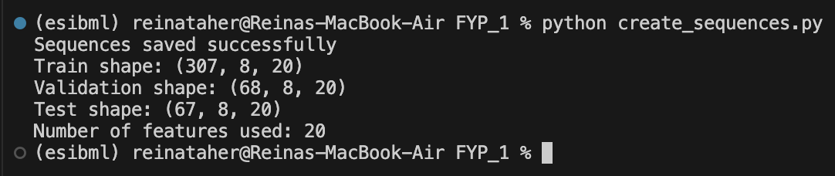
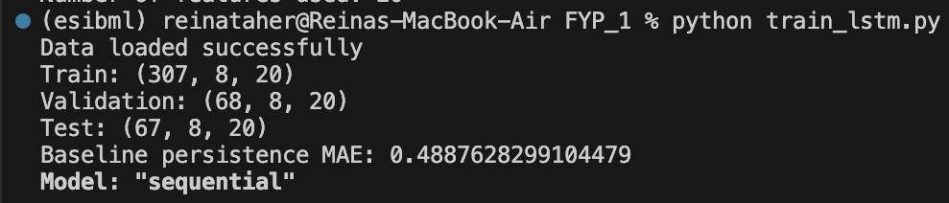
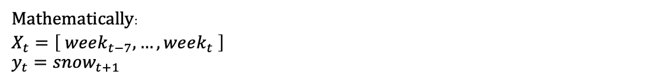
From Data → Model
[week1, week2, week3, …, week8]
Predict week9
Mathematically:
$$X_{t}=\left[ week_{t−7}, …, week_{t} \right]$$
$$y_{t}=snow_{t+1}$$
The dataset was therefore reshaped into 3D tensors:
(samples, time steps, features)
Time Steps = 8 weeks
Features = 20
Dataset Splitting
Dataset | Percentage
Training set | 70%
Validation set | 15%
Test set | 15%
Baseline: $snow_{t+1} ≈ snow_{t}$
MDP26-19
SnowFLOWS: Spatio-Temporal Snow Forecasting using Satellite Data
14
Notes:
Here we show how we move from raw data to a format that can be learned by the model.
Instead of using single weekly values, we transform the dataset into sequences. For example, we take 8 consecutive weeks as input, and we use them to predict the snow cover of the next week. This is illustrated here with the sliding window idea from week 1 to week 8 predicting week 9.
Mathematically, this becomes a supervised learning problem where each sample is a sequence of past observations mapped to a future value.
To make this possible, we reshape the dataset into 3D tensors: samples, time steps, and features. In our case, 8 time steps and 20 features.
We then split the dataset into training, validation, and test sets, and we verify the shapes directly in Python to ensure everything is correctly structured.
At this point, the data is ready to be fed into the LSTM model. We also define a baseline persistence model, which simply assumes the next value is equal to the current one, and we will later use it as a reference to evaluate how much the LSTM improves over a simple approach.

Slide 15
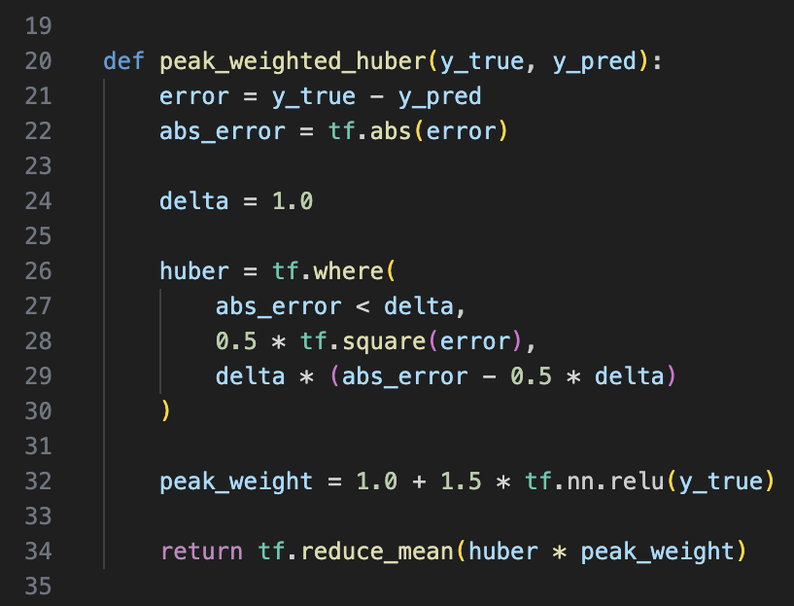
LSTM Model & Loss Function Design
Custom Loss Function
Peak-weighted Huber Loss
Combines MAE (robust) + MSE (sensitive)
Higher weight on extreme snow values
→ Improves learning of peak snow events
Why LSTM ?
Captures temporal dependencies
Handles sequential environmental data
Learns both short-term & long-term patterns
MDP26-19
SnowFLOWS: Spatio-Temporal Snow Forecasting using Satellite Data
15
Notes:
We chose an LSTM model because it is specifically designed for sequential data. In our case, snow evolution depends strongly on previous weeks, so the model needs to capture both short-term and long-term temporal dependencies.
This is why we use a stacked LSTM structure. The first layer with 96 units captures long-term patterns, and the second layer with 64 units refines more detailed temporal behavior. We also add dropout layers to reduce overfitting, followed by dense layers to map the learned features into the final snow prediction.
Now, regarding the loss function, we designed a custom Peak-Weighted Huber Loss.
The idea is that not all errors have the same importance. In snow forecasting, peak snow events are particularly important, so we give them higher weight. At the same time, the Huber loss ensures stable training by combining the advantages of MAE and MSE, making the model robust to outliers.
So overall, the architecture focuses on learning temporal dependencies, while the loss function ensures better sensitivity to critical snow peak events.

Slide 16
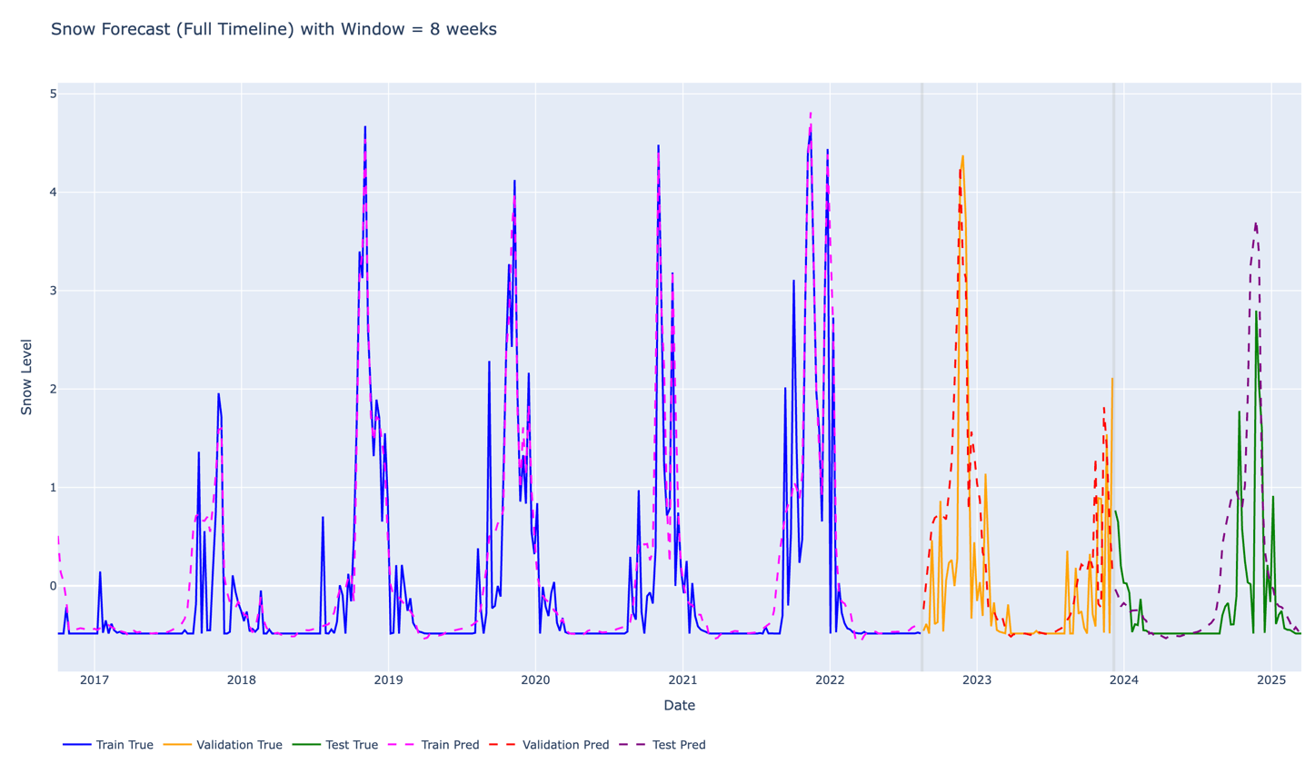
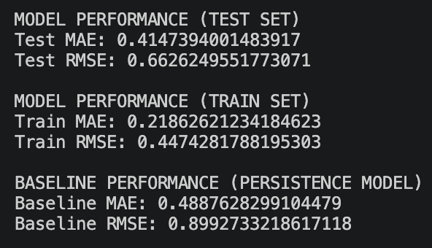
Best Model Example
For a sequence length of 8-week:
Key Observations
LSTM significantly outperforms the baseline model
Improvement is especially clear in RMSE reduction
Model generalizes well on unseen test data
Errors increase slightly on test set due to environmental variability
SnowFLOWS: Spatio-Temporal Snow Forecasting using Satellite Data
Notes:
To evaluate our model, we use two standard error metrics: MAE, which measures the average prediction error, and RMSE, which penalizes larger errors more strongly.
Here we show the results for one configuration, the 8-week sequence, which is our main example.
On the graph, we compare the real snow values with the model predictions over the full timeline. We can see that the model follows the overall seasonal pattern and captures most of the variations.
On the right, we also show the numerical results from the training run, including MAE and RMSE for both training and testing, and we also compare them to the baseline persistence model.
At this stage, this is one configuration among several we tested. In the next slide, we analyze different sequence lengths to understand how the amount of historical data affects model performance and to identify the best trade-off.

Slide 17
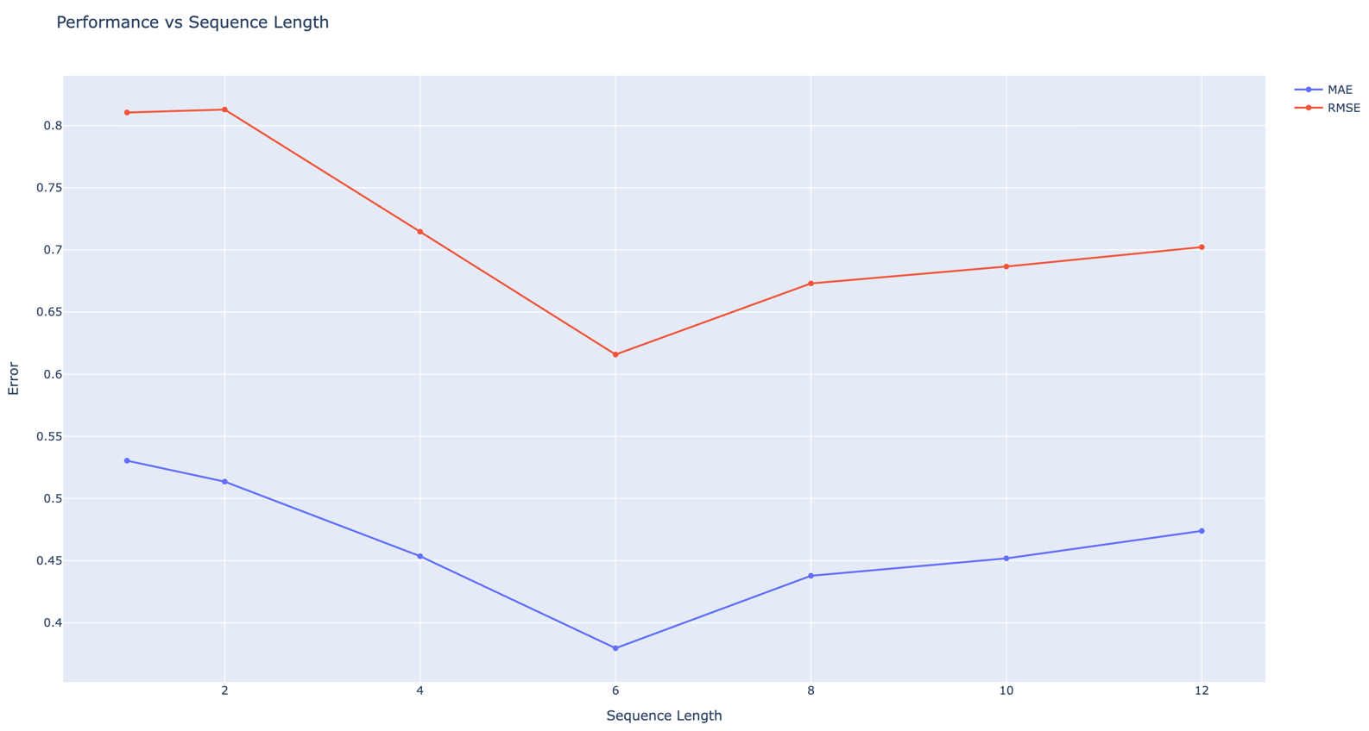
Results of Sequence Length Experiments & Trade-Off
Weeks | MAE
1 | high
6 | best
8 | slightly worse
Sequence (weeks) | MAE (mean) | MAE (std) | RMSE (mean) | RMSE (std)
1 | 0.530 | 0.011 | 0.811 | 0.010
2 | 0.514 | 0.014 | 0.813 | 0.014
4 | 0.454 | 0.018 | 0.715 | 0.018
6 | 0.380 | 0.012 | 0.616 | 0.015
8 | 0.438 | 0.046 | 0.673 | 0.047
10 | 0.452 | 0.046 | 0.687 | 0.048
12 | 0.474 | 0.057 | 0.702 | 0.058
MDP26-19
SnowFLOWS: Spatio-Temporal Snow Forecasting using Satellite Data
17
Notes:
Here we evaluate how the sequence length impacts model performance.
We tested multiple configurations from 1 to 12 weeks, while keeping the same model and training setup to ensure a fair comparison.
The graph shows how MAE and RMSE evolve with sequence length, and the table provides the exact values.
We observe that very short sequences lack sufficient temporal context, while longer sequences introduce more variability.
Numerically, the 6-week sequence achieves the lowest error values, indicating the best performance in terms of standard metrics.
However, these metrics alone do not fully capture forecasting quality, which is why we complement this analysis with visual evaluation.

Slide 18
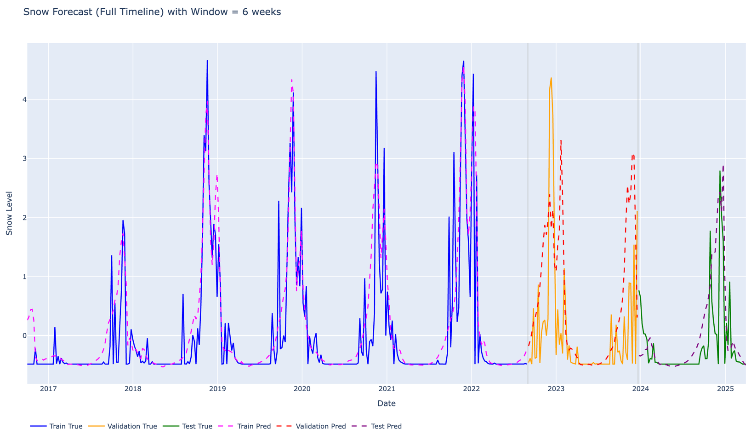
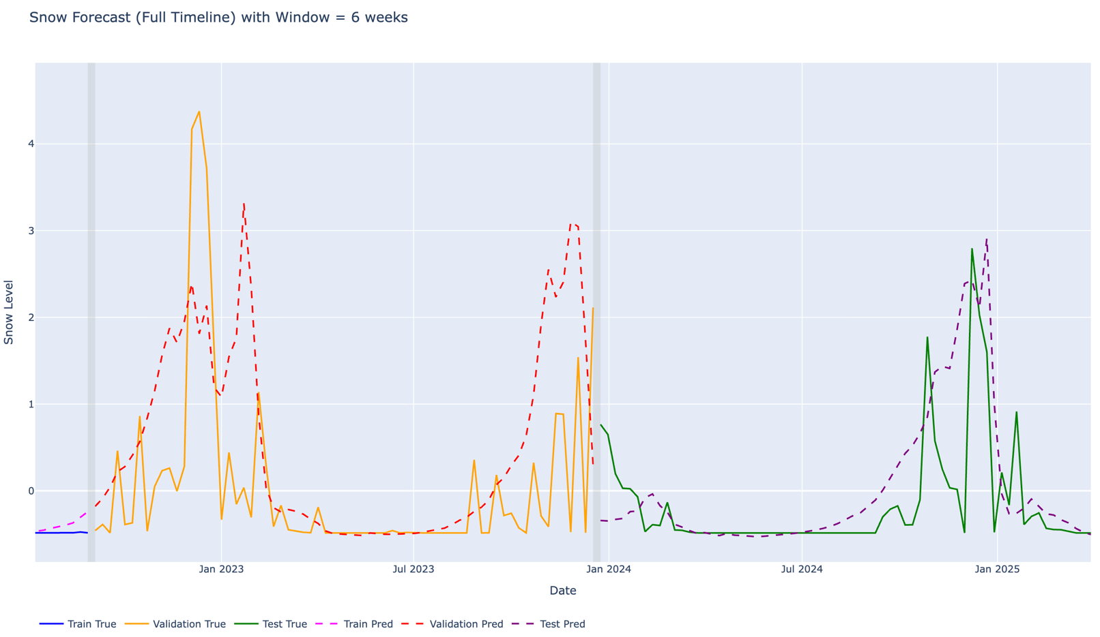
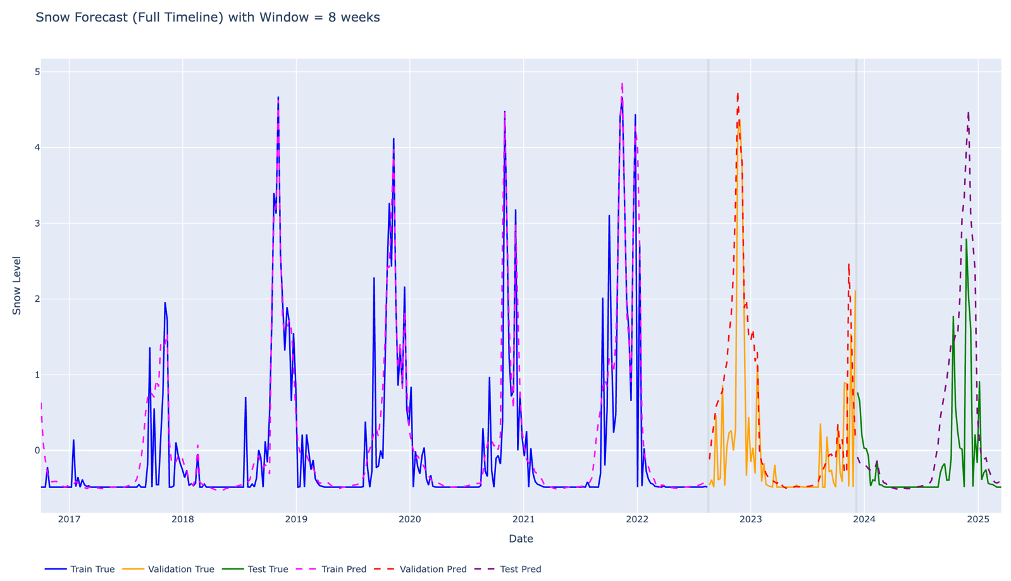
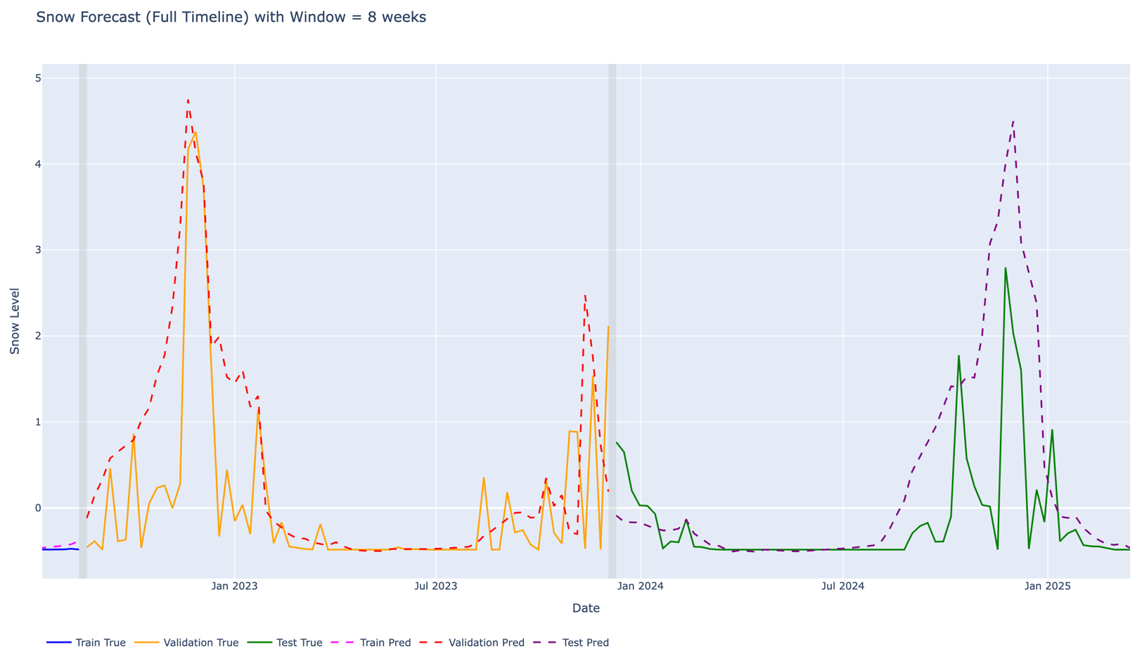
Results of Sequence Length Experiments & Trade-Off
MDP26-19
SnowFLOWS: Spatio-Temporal Snow Forecasting using Satellite Data
18
Notes:
Here we directly compare the 6-week and 8-week models.
While the 6-week model performs better numerically, the 8-week model produces smoother and more consistent predictions.
In forecasting, two important aspects are the timing of peak events and their amplitude.
We observe that the 8-week model better captures both the position and the intensity of snow peaks, which are critical for realistic forecasting.
So even if it is slightly less optimal numerically, it provides a more meaningful representation of snow dynamics.
This highlights the trade-off between numerical accuracy and temporal realism, and justifies why the 8-week configuration is particularly relevant.

Slide 19
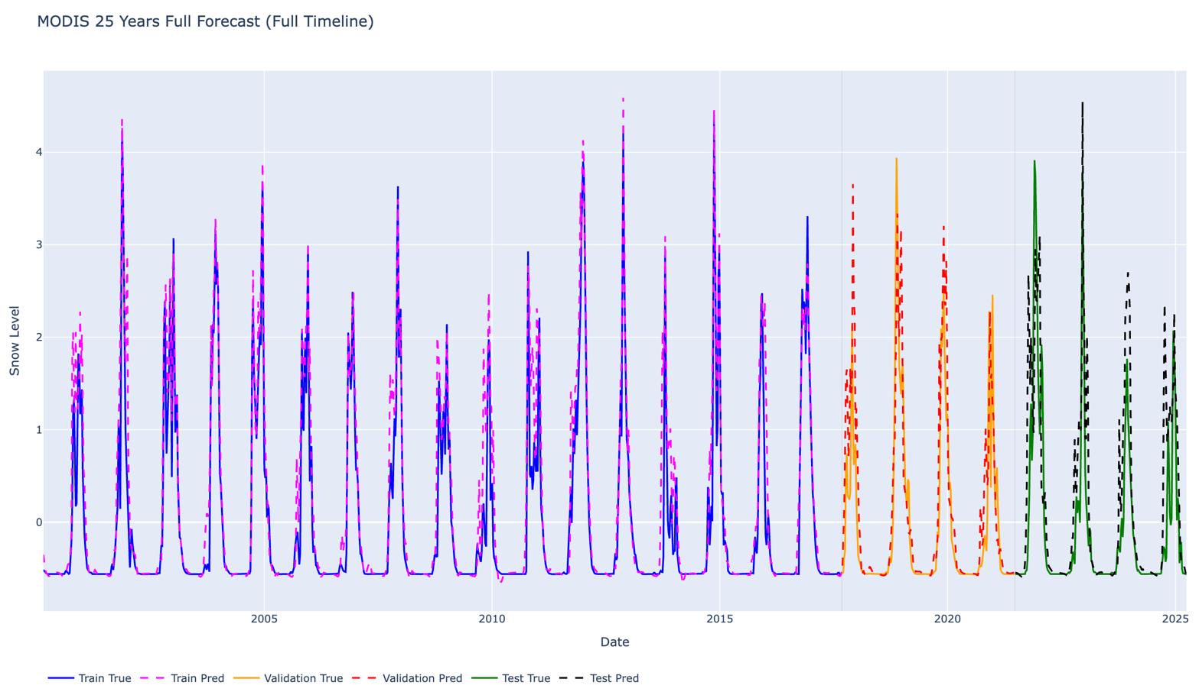
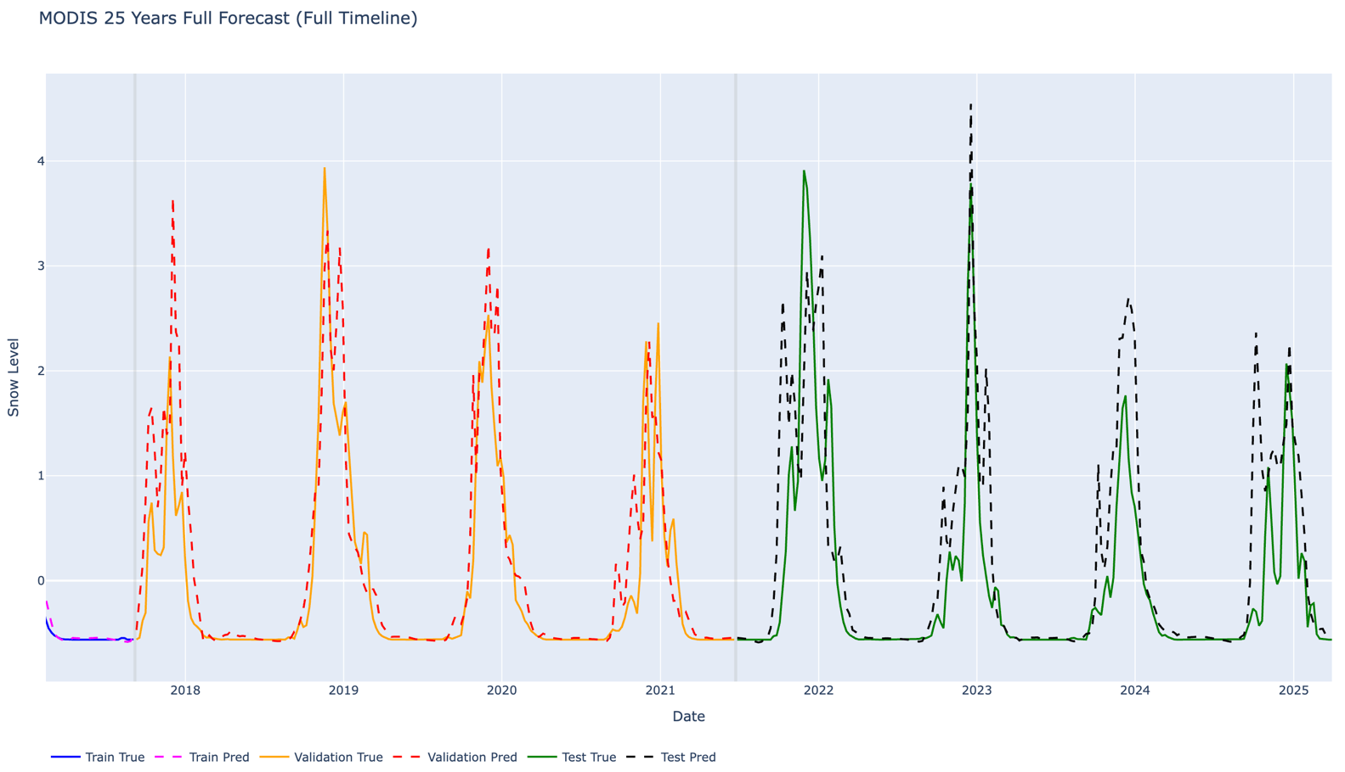
Long-Term Forecasting Experiment (MODIS 25-Years Dataset)
Objective
Test whether more historical data improves performance
Observations
Smoother long-term trends
Better seasonal consistency
Still noticeable prediction errors ( RMSE ≈ 0.6 )
→ More data improves stability, but does NOT eliminate forecasting errors
MDP26-19
SnowFLOWS: Spatio-Temporal Snow Forecasting using Satellite Data
19
Notes:
Here we extend the analysis using a long-term MODIS dataset of about 25 years.
The objective was to check whether having more historical data improves model performance.
We observe that the predictions become more stable and follow the seasonal trends more smoothly.
However, the error metrics remain relatively similar, with RMSE around 0.6, which shows that increasing data alone does not eliminate forecasting error.
At the same time, when we look at the graphs, we see a strong alignment between predicted and real values, especially in terms of peak timing and overall trend.
This highlights an important point: even with higher numerical errors, the model can still provide meaningful and realistic predictions.

Slide 20
Testing, Evaluation and Iterative improvements
Baseline Reference
Model Training
Quantitative Evaluation
Visual Validation
Comparison & Trade-off
Refinement & Selection
Persistence model
Establish minimum performance
Optimal window: 6-8 weeks
Balance stability & realism
Varying sequence length
1 → 12 weeks
Compare all configurations
Numerical vs visual
MAE (overall error)
RMSE (peak sensitivity)
Peak amplitude
Temporal alignment
Seasonal patterns
SnowFLOWS: Spatio-Temporal Snow Forecasting using Satellite Data
Notes:
Finally, this slide summarizes our iterative approach.
We didn’t rely on a single run — we started from a baseline, trained multiple models, evaluated them both numerically and visually, and compared the results.
Based on this, we refined our choices, especially the sequence length, until reaching the best trade-off.

Slide 21



Solution Impact
Environmental Impact
Improved monitoring of snow cover dynamics
Better understanding of water resources availability
Supports climate change analysis in Lebanon
Societal Impact
Better preparedness for snowfall events
Supports road safety & accessibility
Helps authorities in decision-making
Economic Impact
Supports winter tourism (ski resorts)
Helps agriculture planning (water from snowmelt)
Reduces uncertainty in resource management
SnowFLOWS: Spatio-Temporal Snow Forecasting using Satellite Data
Notes:
Our solution has environmental, societal, and economic impacts.
It improves snow monitoring and understanding of water resources, supports better preparedness for snowfall events, and helps decision-making.
It can also benefit sectors like tourism and agriculture by reducing uncertainty in snow and water availability.

Slide 22


Limitations & Future Work
Limitations
Trade-off between sequence lengths (6 vs 8 weeks)
Limited temporal coverage of Sentinel-2 data
Difficulty capturing extreme snow peaks
Evaluation focused on MAE & RMSE
Project scope constrained by time
Future Work
Hybrid model combining Sentinel-2 + MODIS
Advanced architectures (Attention / Transformers)
Additional evaluation metrics
Extend dataset
Integrate physical constraints into ML models
SnowFLOWS: Spatio-Temporal Snow Forecasting using Satellite Data
Notes:
This project has several limitations that are important to acknowledge.
First, we observed a trade-off in sequence length selection, where no single configuration optimizes all aspects of performance. We were also limited by the temporal coverage of Sentinel-2 data, and by the difficulty of capturing extreme snow peaks.
Regarding evaluation, we focused on MAE and RMSE mainly due to time constraints, although other indicators could provide a more complete assessment.
These limitations highlight that our model is not a final solution, but rather an intermediate step.
For future work, we aim to improve the system by combining Sentinel-2 and MODIS into a hybrid model, exploring more advanced architectures like attention or transformers, and introducing additional evaluation metrics.

Slide 23


Conclusion
Key Achievements
Built a complete snow forecasting pipeline
Integrated multi-source data (Sentinel-2, MODIS, ERA5)
Developed and optimized an LSTM model
Outperformed baseline methods
Main Findings
Snow dynamics are complex and nonlinear
Trade-off between accuracy and realism
Performance depends on model design, not only data quantity
SnowFLOWS: Spatio-Temporal Snow Forecasting using Satellite Data
Notes:
This project allowed us to build a complete snow forecasting pipeline using multi-source data and an optimized LSTM model, achieving better performance than baseline methods.
We showed that snow dynamics are complex and nonlinear, and that improving performance is not only about increasing data, but also about choosing the right modeling approach and temporal representation.

