Slide 1
SnowFLOWS: Generative Spatio‑Temporal Modelling of Snow Cover Dynamics Using Satellite Imagery
MDP26-19
Presented by:
Carla Youness (232771)
Nour el Saghir (230520)
Reina Taher (230134)
Ali Mansour (231039)
Hassan Dakhlallah (222814)
Supervised by:
Dr. Laurent Drapeau
Dr. Youssef El Bakouny
ESIB Multidisciplinary Project
April, 2026
Notes:
Good morning. Today we present SnowFLOWS, a project focused on modeling and forecasting snow cover dynamics in Lebanon using satellite imagery and deep learning. We will walk you through the full engineering pipeline, from raw satellite data to predictive LSTM modeling and evaluation.

Slide 2




Introduction .Spatio-Temporal Snow Forecasting using Deep Learning and Satellite Data
Project Team & Multidisciplinary Context
Computer & Communications Engineering (CCE) students
Collaboration between data processing, modeling, and system design
Project Context
Snow cover plays a critical role in water resources in Lebanon
Monitoring snow dynamics is essential for environmental and economic planning
Problem Statement
Difficulty in accurately forecasting snow evolution over time
Limited temporal coverage (Sentinel-2) vs limited spatial resolution (MODIS)
High variability of snow behavior in mountainous regions
Engineering Challenge
Design a system capable of modeling complex spatio-temporal snow dynamics
Integrate multi-source satellite data
Capture nonlinear temporal dependencies using machine learning
SnowFLOWS: Spatio-Temporal Snow Forecasting using Satellite Data
Notes:
We are a team of Computer and Communications Engineering students working on a snow forecasting system using satellite data and deep learning. Our project focuses on modeling snow evolution over time, which is important for water resources and environmental monitoring. Snow forecasting is a complex engineering problem because it involves nonlinear behavior, multiple influencing factors, and no direct analytical solution. It requires combining satellite data, time-series analysis, and machine learning techniques. This motivates the need for an engineered solution capable of learning temporal patterns and producing reliable forecasts.

Slide 3

Project Objectives and Outcomes
Project Objectives
Develop a snow forecasting system using satellite data
Model temporal dynamics of snow cover using LSTM networks
Analyze the impact of sequence length on prediction performance
Project Outcomes
Built a multi-source dataset (Sentinel-2, MODIS, meteorological data)
Achieved improved performance over baseline models
Identified trade-off between numerical accuracy and visual realism
Why ? Because …
Snow behavior is nonlinear and time-dependent
Traditional methods fail to capture complex temporal patterns
Deep learning enables data-driven modeling of environmental systems
Satellite Data
Forecast
Feature Engineering
LSTM Model
SnowFLOWS: Spatio-Temporal Snow Forecasting using Satellite Data
Notes:
The main objective of this project is to develop a snow forecasting system using satellite data and deep learning. We specifically focused on modeling temporal dynamics using LSTM networks and analyzing the impact of sequence length on performance. As outcomes, we successfully built a multi-source dataset, improved prediction performance compared to baseline models, and identified an important trade-off between numerical accuracy and visual realism.

Slide 4

Project Functional Requirements
Data Requirements
Extract satellite data (Sentinel-2, MODIS)
Ensure temporal consistency and alignment
Build structured time-series dataset
Model Requirements
Predict weekly snow cover
Capture temporal dependencies
Support sequence-based input (LSTM)
Feature Requirements
Integrate multi-source variables (snow, temperature, precipitation)
Encode seasonality (cyclical features)
Normalize data for stable training
Evaluation Requirements
Compare with baseline persistence model
Use MAE and RMSE
Analyze different sequence lengths
SnowFLOWS: Spatio-Temporal Snow Forecasting using Satellite Data
Notes:
These functional requirements define the complete system pipeline. We start from satellite data extraction, then construct features, build a sequence-based model, and finally evaluate performance using both numerical metrics and baseline comparison. This ensures that the system is not only predictive, but also properly validated.

Slide 5



Project Constraints
1. Data Constraints
Cloud coverage affecting Sentinel-2 observations
Limited temporal coverage of high-resolution Sentinel-2 data
Inconsistencies between Sentinel-2 and MODIS products
2. Technical Constraints
Trade-off:
High computational cost for training multiple LSTM configurations
Processing limitations for large multi-year satellite datasets
3. Model Constraints
Sensitivity to sequence length selection
Risk of overfitting with long sequences
Difficulty capturing extreme snow
peaks accurately
 | Spatial | Temporal
MODIS | Low | High
Sentinel-2 | High | Low
Standards Applied
ESA Copernicus Sentinel-2 data format compliance NASA MODIS data usage standards NDSI-based snow detection (remote sensing standard) Standard ML pipeline: normalization + train/test split
SnowFLOWS: Spatio-Temporal Snow Forecasting using Satellite Data
Notes:
Our solution is constrained by both data and modeling limitations. We face a trade-off between spatial resolution and temporal coverage, as well as computational constraints when training multiple models. Additionally, the model itself is sensitive to sequence length and struggles with extreme variations, which reflects the complexity of snow dynamics. We also followed established remote sensing and machine learning standards, including ESA and NASA satellite data formats, NDSI-based snow detection, and standard preprocessing practices such as normalization and train-test splitting.

Slide 6


Related Works
Approach | Strengths | Limitations | Suitability for Snow Forecasting
ARIMA | Simple, interpretable | Linear assumptions | Poor for nonlinear snow dynamics
Random Forest | Handles nonlinear data | No temporal memory | ! Limited for time series
LSTM (our choice) | Captures temporal dependencies | Needs tuning | Best suited
Key Insight
Snow forecasting requires modeling nonlinear temporal behavior
LSTM is more suitable for spatio-temporal satellite data
SnowFLOWS: Spatio-Temporal Snow Forecasting using Satellite Data
Notes:
We compared different approaches used in time-series forecasting. Classical models like ARIMA are limited due to linear assumptions, while machine learning methods like Random Forest do not capture temporal dependencies. LSTM was selected because it is specifically designed to learn sequential patterns, making it more suitable for snow dynamics modeling.

Slide 7
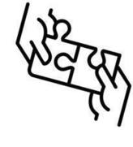
Solution Design Overview
Data Extraction
LSTM Model
Prediction
Preprocessing
Sequence Construction
Evaluation & Visualization
System Architecture
End-to-end spatio-temporal forecasting pipeline
Based on satellite data processing and deep learning modeling
Main Design Components
Data acquisition from Sentinel-2 and MODIS (Google Earth Engine)
Preprocessing and feature engineering pipeline
Sequence construction for time-series modeling
LSTM-based forecasting model
Evaluation using baseline and error metrics
Design Alternatives Considered
Statistical models (ARIMA)
Classical ML models (Random Forest, SVM)
Deep learning models (LSTM – selected approach)
Final Choice
LSTM selected due to its ability to model temporal dependencies and nonlinear behavior in snow dynamics
SnowFLOWS: Spatio-Temporal Snow Forecasting using Satellite Data
Notes:
This slide presents the overall solution design of SnowFLOWS. The system starts from satellite data acquisition, followed by preprocessing and feature engineering. The processed data is then structured into sequences and fed into an LSTM model to generate snow cover predictions, which are evaluated using both numerical metrics and visual analysis.

Slide 8
Solution Design Conceptual Model of SnowFLOWS System
Satellite Data
Data Cleaning
Feature Engineering
Normalization
Sequence Construction
LSTM Model Training
Prediction Output
Evaluation
Sentinel-2/ MODIS
Alignment
Snow lag features/ Snow ratio/ Seasonal encoding/ Altitude features
Z-score
1-12 weeks
Transforms raw satellite data into structured learning sequences
Captures temporal and spatial snow variability
MAE/ RMSE + Visualization
MDP26-19
SnowFLOWS: Spatio-Temporal Snow Forecasting using Satellite Data
Notes:
This conceptual model explains the internal workflow of SnowFLOWS in more detail. We transform raw satellite data into structured features, apply normalization, and construct temporal sequences that are used to train the LSTM model. The system then generates predictions which are evaluated using both numerical metrics and visual comparisons.

Slide 9

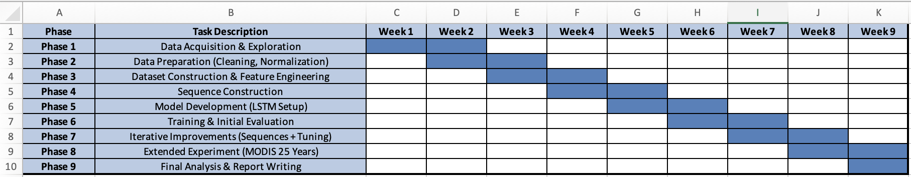
Project Management
We have 9 main phases:
Iterative Workflow
Continuous refinement of:
dataset structure
sequence length
model architecture
Multiple experiments run per configuration
Decisions based on averaged results (MAE/RMSE)
Conflict Management
Model instability across runs → solved using multiple executions + averaging
Sequence length trade-off:
6 weeks → best numerical results
8 weeks → best visual realism
→ both analyzed and justified
Data alignment issues (Sentinel vs MODIS) → resolved via temporal synchronization
SnowFLOWS: Spatio-Temporal Snow Forecasting using Satellite Data
Notes:
We followed an iterative engineering approach, where each phase of the project informed the next one. The project evolved from initial data exploration to model development, and then to multiple rounds of testing and improvement. We also adapted our planning during the project based on results, especially when testing different sequence lengths and datasets.

Slide 10
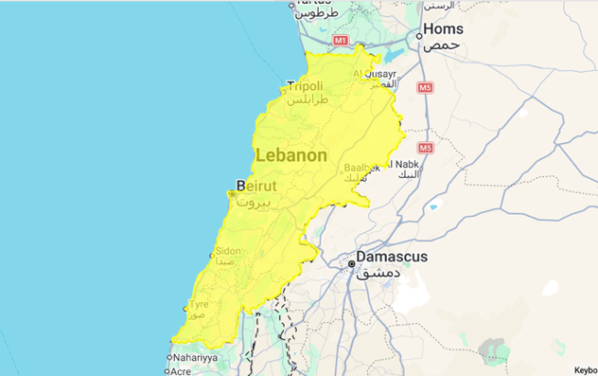
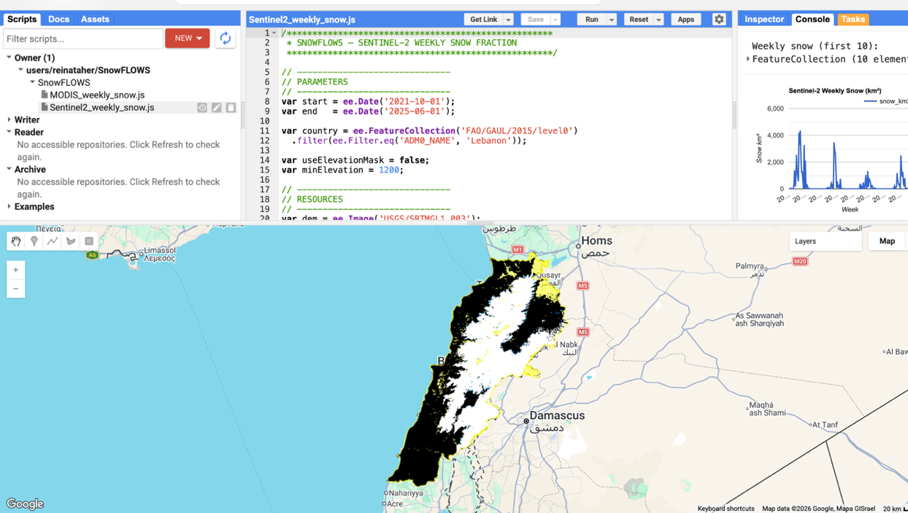
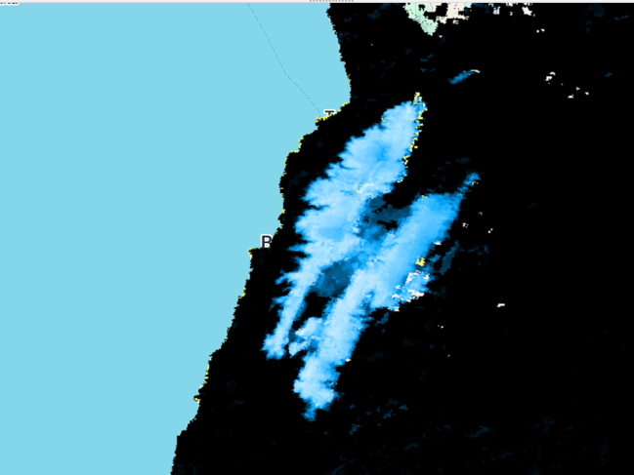
Solution Implementation Study Area & Data Sources
Study area: Lebanon (FAO/GAUL boundaries)
Satellite data:
Sentinel-2 (10m, high spatial resolution)
MODIS (500m, high temporal frequency)
Meteorological data: ERA5 (temperature, precipitation)
Time span: 2016–2025
Cloud Masking
NDSI Threshold = 0.4
SnowFLOWS: Spatio-Temporal Snow Forecasting using Satellite Data
Notes:
We defined Lebanon as our study area using FAO boundaries in Google Earth Engine. We combined three data sources: Sentinel-2 for high spatial resolution, MODIS for long-term temporal coverage, and ERA5 for meteorological variables. This multi-source setup forms the foundation of our snow modeling pipeline. We extracted snow using Sentinel-2 imagery and the Normalized Difference Snow Index. After cloud masking, we applied a threshold of 0.4 to classify snow pixels. This step transforms raw satellite images into structured snow masks used for quantitative analysis.

Slide 11
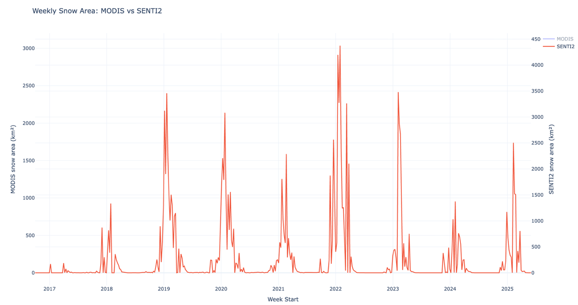
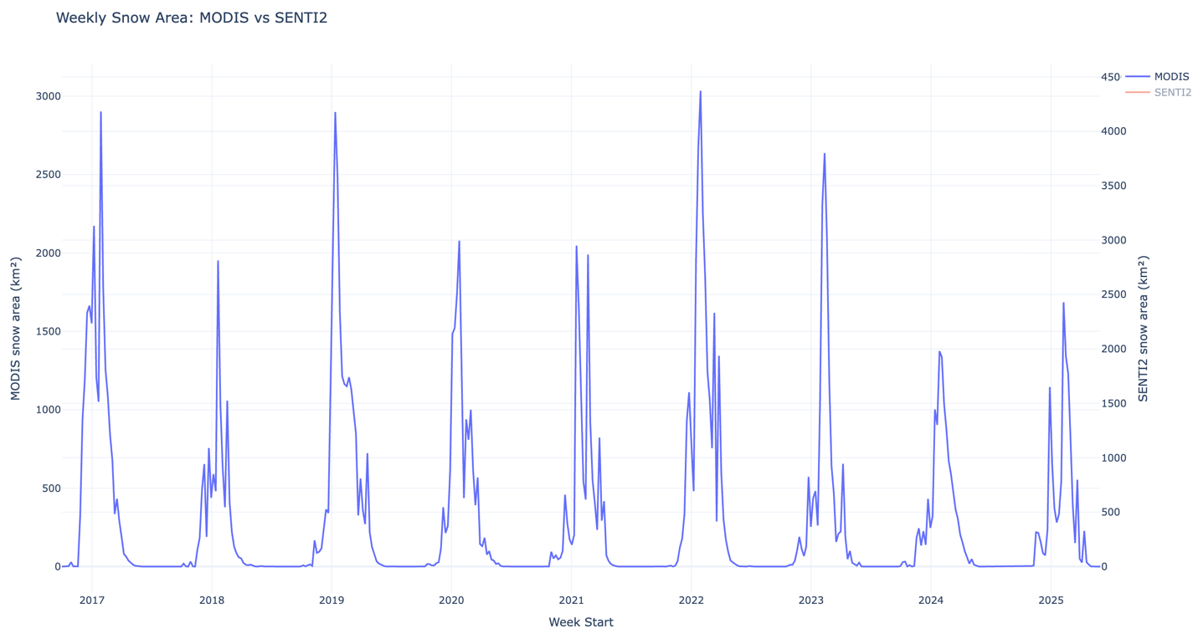
Time Series (MODIS/Senti-2)
Weekly aggregation
2016–2025
Strong seasonal pattern
MDP26-19
SnowFLOWS: Spatio-Temporal Snow Forecasting using Satellite Data
Notes:
This is where raw images become usable data. We clearly observe seasonal snow behavior.

Slide 12
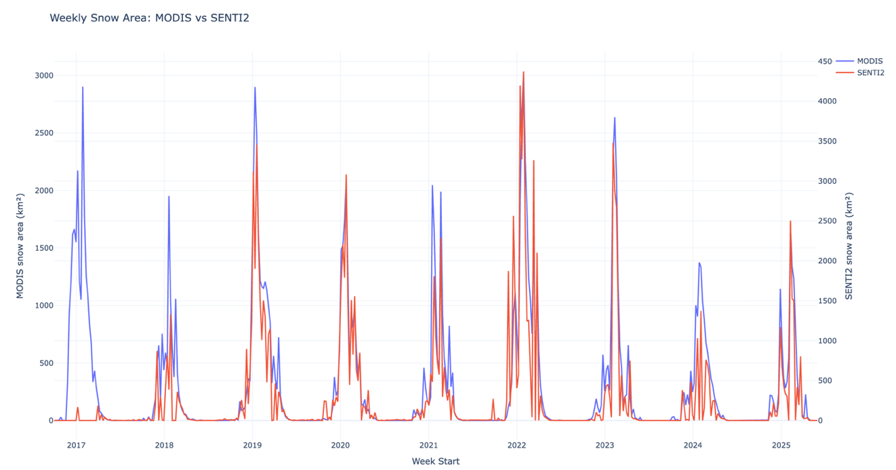
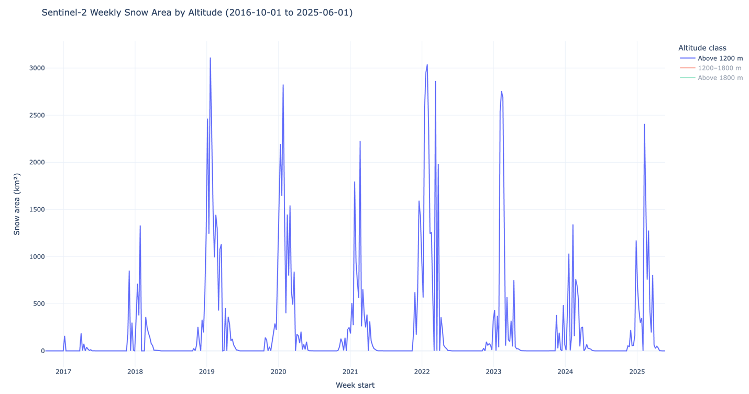
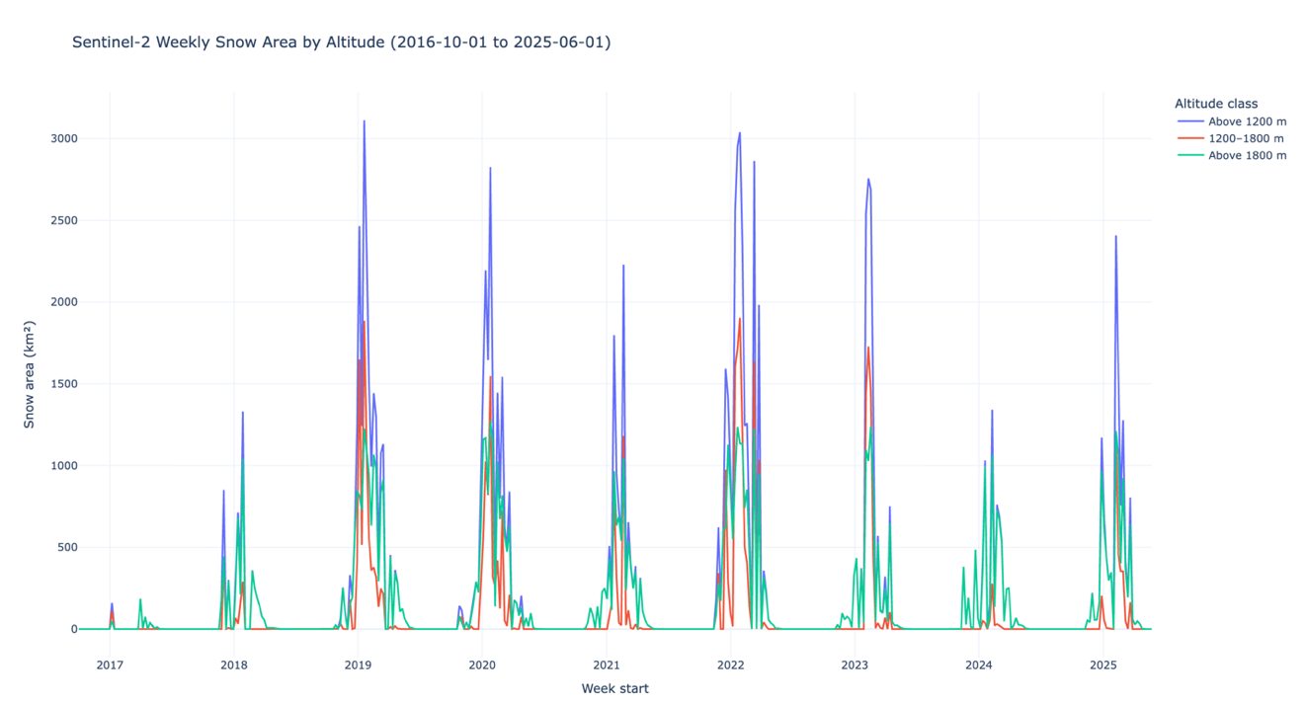
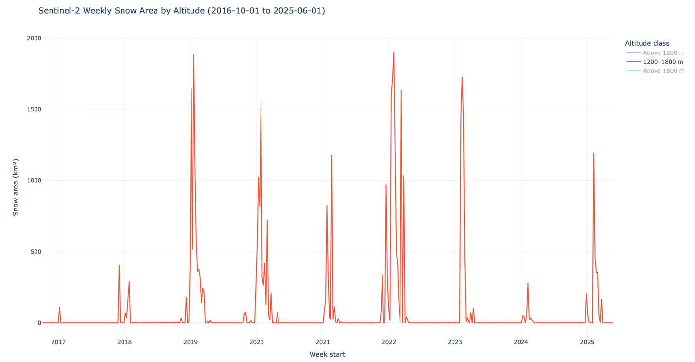
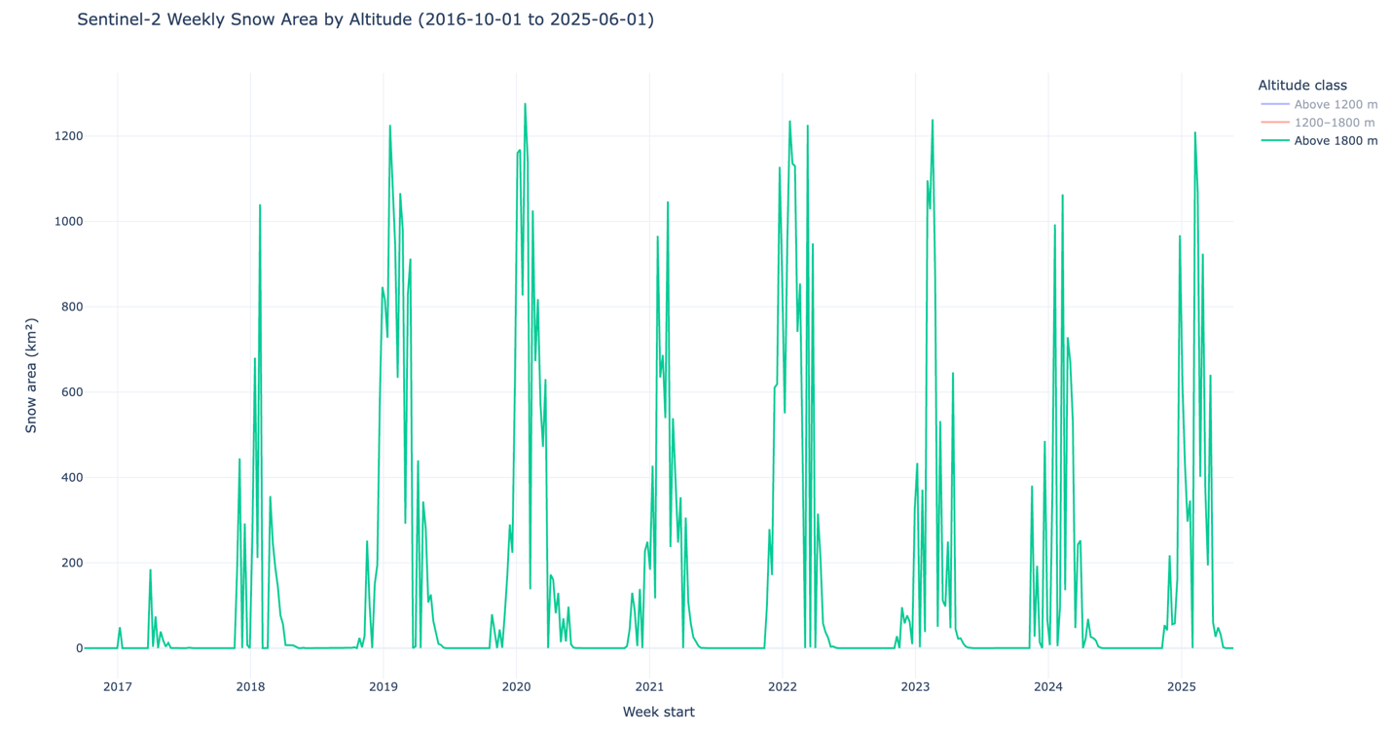
Data Understanding
MODIS = smoother (time)
Sentinel = detailed (space)
Higher altitude = longer snow persistence
MDP26-19
SnowFLOWS: Spatio-Temporal Snow Forecasting using Satellite Data
Notes:
We validate the physical meaning of our data: both sensors agree, and altitude strongly impacts snow behavior.

Slide 13
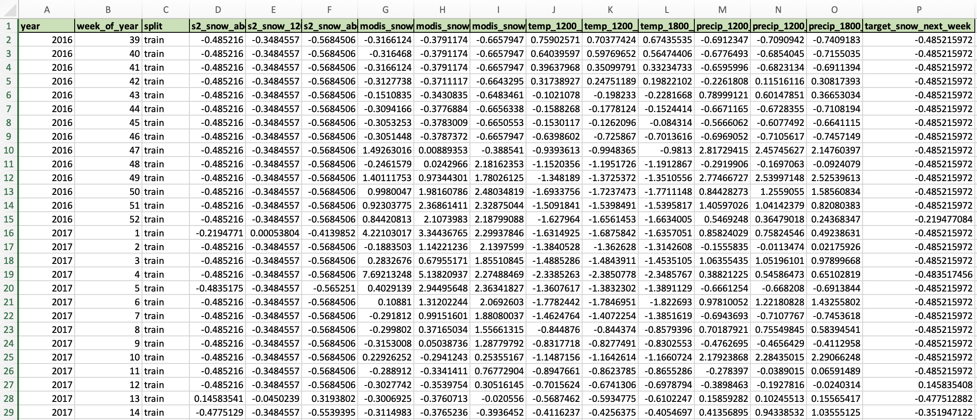
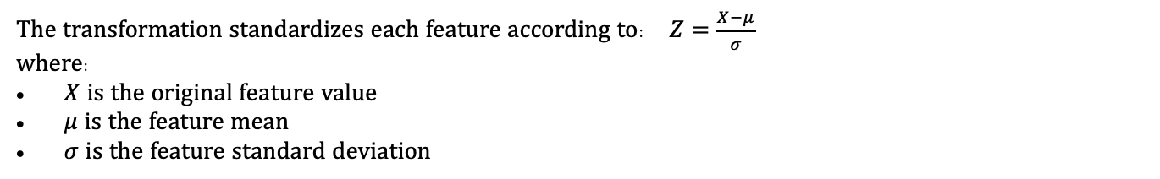
Dataset + Features
Feature Category | Variables
Seasonal encoding | week_sin, week_cos
Persistence | snow_last_week, snow_last_2weeks
Change dynamics | snow_change_ratio
Aggregated snow signal | snow_mean
Temporal derivatives | snow_gradient, snow_acceleration
Sentinel-2 snow coverage | 3 altitude bands
MODIS snow coverage | 3 altitude bands
Temperature | 3 altitude bands
Precipitation | 3 altitude bands
The transformation standardizes each feature according to: $Z=\frac{X−μ}{σ}$
where:
$X$ is the original feature value
$μ$ is the feature mean
$σ$ is the feature standard deviation
MDP26-19
SnowFLOWS: Spatio-Temporal Snow Forecasting using Satellite Data
Notes:
We combine satellite and meteorological data and engineer 20 features capturing snow dynamics and seasonality.

Slide 14
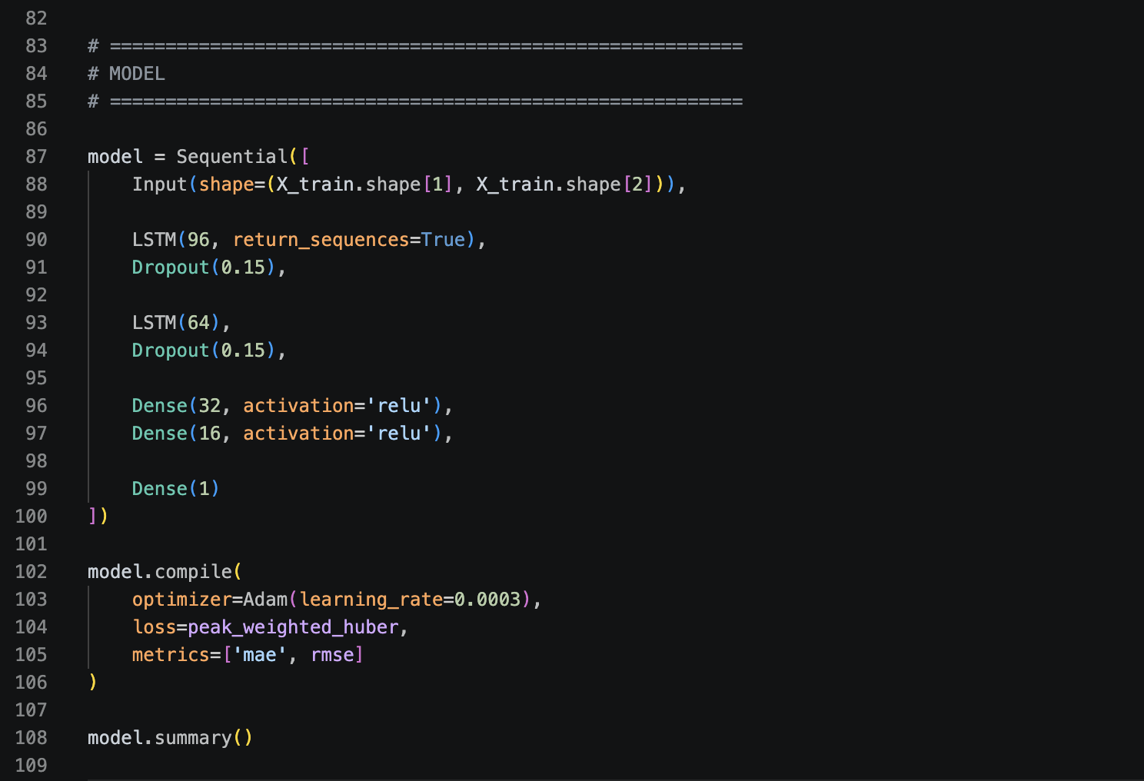
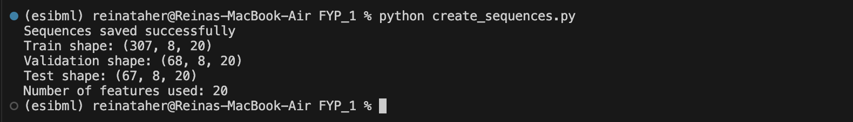
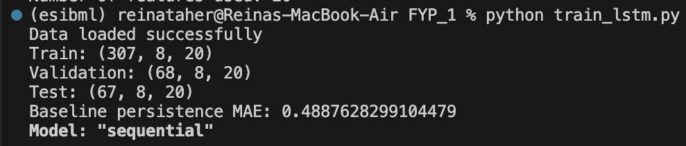
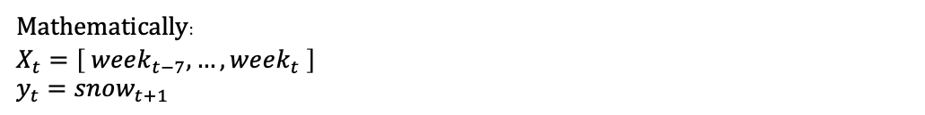
From Data → Model
[week1, week2, week3, …, week8]
Predict week9
Mathematically:
$$X_{t}=\left[ week_{t−7}, …, week_{t} \right]$$
$$y_{t}=snow_{t+1}$$
The dataset was therefore reshaped into 3D tensors:
(samples, time steps, features)
Time steps = 8 weeks
Features = 20
Dataset Splitting
Baseline: $snow_{t+1} ≈ snow_{t}$
Dataset | Percentage
Training set | 70%
Validation set | 15%
Test set | 15%
Notes:
We transform data into sequences and use LSTM to learn temporal dependencies. The baseline helps us measure real improvement.
This slide presents the LSTM model used for forecasting. We used a stacked architecture with dropout to prevent overfitting. The model takes sequences of past weeks as input and predicts the next week snow cover. We selected the Adam optimizer and Huber loss because they provide stable training and robustness to outliers in environmental data.

Slide 15
LSTM Model Implementation
Model Architecture
Two stacked LSTM layers for temporal feature extraction
Dropout layers to reduce overfitting
Dense layers for final prediction
Training Configuration
Optimizer: Adam
Loss function: Huber loss (robust to outliers)
Metrics: MAE and RMSE
Input format: 3D sequences (samples, time steps, features)
Sequence Learning Setup
Sliding window approach applied
Each input sequence represents past weeks of data
Output: next-week snow cover prediction
Model Objective
Learn nonlinear temporal dependencies in snow evolution
Capture seasonal and short-term variability
MDP26-19
SnowFLOWS: Spatio-Temporal Snow Forecasting using Satellite Data
Notes:
This slide presents the LSTM model used for forecasting. We used a stacked architecture with dropout to prevent overfitting. The model takes sequences of past weeks as input and predicts the next week snow cover. We selected the Adam optimizer and Huber loss because they provide stable training and robustness to outliers in environmental data.

Slide 16
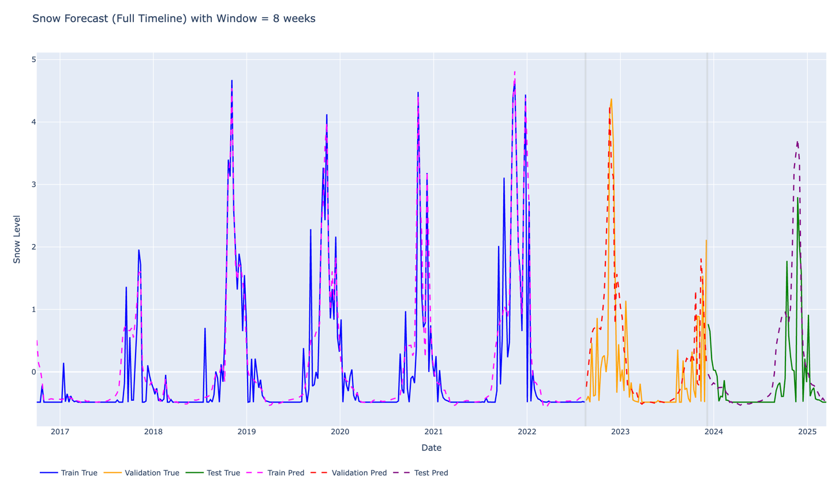
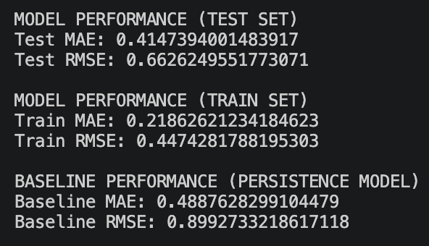
Best Model Example
For a sequence length of 8-week:
Key Observations
LSTM significantly outperforms the baseline model
Improvement is especially clear in RMSE reduction
Model generalizes well on unseen test data
Errors increase slightly on test set due to environmental variability
SnowFLOWS: Spatio-Temporal Snow Forecasting using Satellite Data
Notes:
We start by evaluating one configuration: the 8-week sequence which is our best model example. As we can see, the model closely follows the real snow evolution over time, including peak periods. In terms of performance, it significantly outperforms the baseline model, confirming that the LSTM captures temporal dependencies beyond simple persistence.

Slide 17
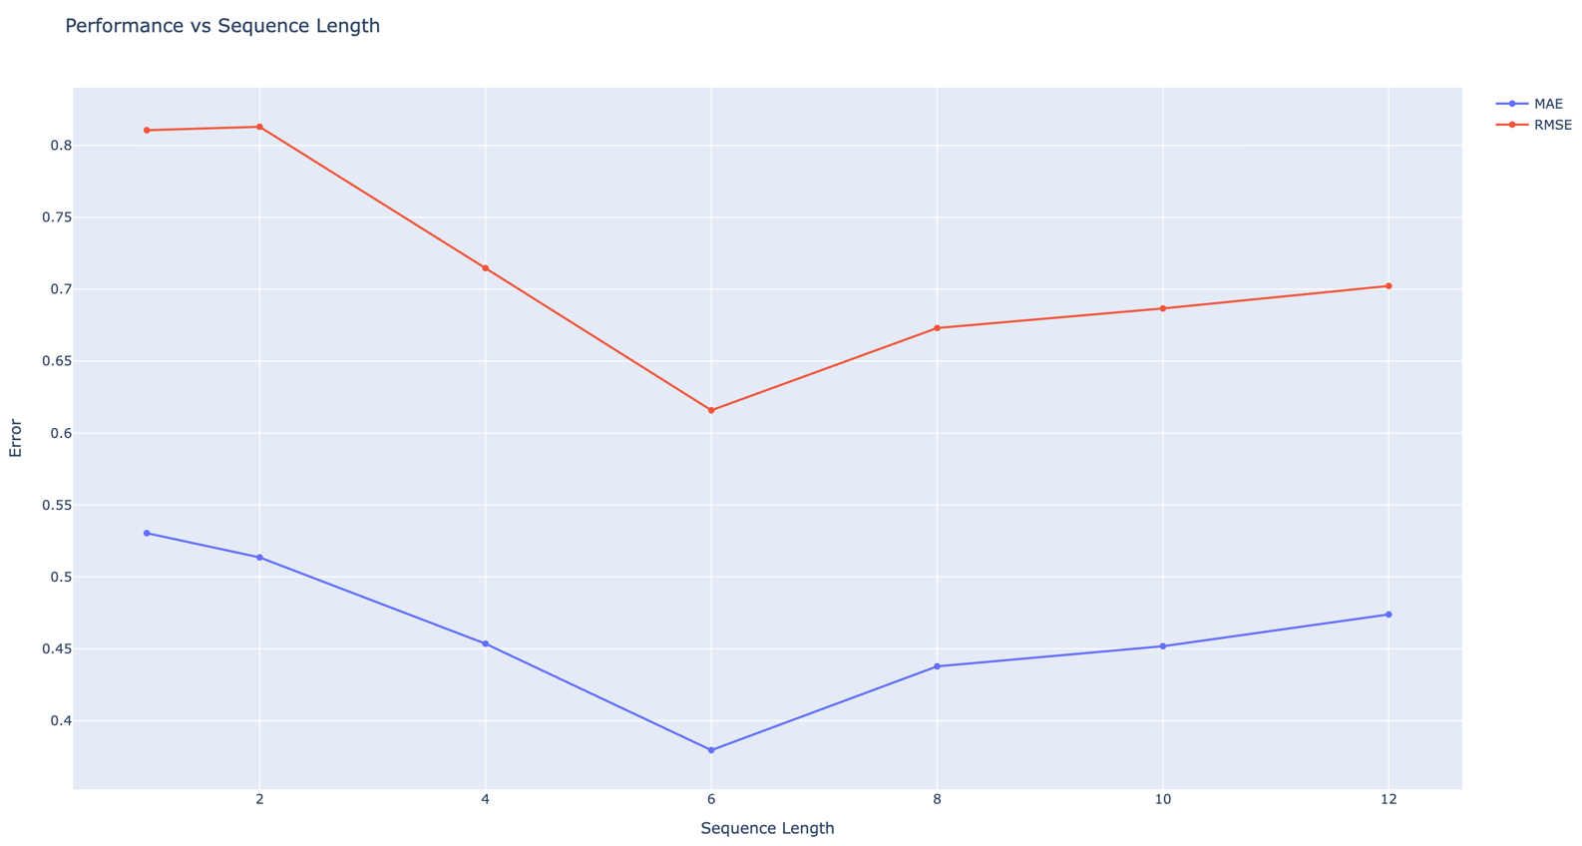
Results of Sequence Length Experiments & Trade-Off
Experimental Setup
Tested multiple LSTM configurations with different sequence lengths
Sequence lengths: 1, 2, 4, 6, 8, 10, 12 weeks
Same architecture and training settings for fairness
Key Findings
Very short sequences (1–2 weeks): insufficient temporal context
Medium sequences (4–6 weeks): best numerical performance
Longer sequences (8–12 weeks): smoother predictions but higher variability
Trade-off Observed
Numerical accuracy (MAE / RMSE) vs temporal realism
Best balance achieved around 6–8 weeks range
Conclusion
No single optimal sequence length
Performance depends on balance between stability and temporal memory
Weeks | MAE
1 | high
6 | best
8 | slightly worse
Sequence (weeks) | MAE (mean) | MAE (std) | RMSE (mean) | RMSE (std)
1 | 0.530 | 0.011 | 0.811 | 0.010
2 | 0.514 | 0.014 | 0.813 | 0.014
4 | 0.454 | 0.018 | 0.715 | 0.018
6 | 0.380 | 0.012 | 0.616 | 0.015
8 | 0.438 | 0.046 | 0.673 | 0.047
10 | 0.452 | 0.046 | 0.687 | 0.048
12 | 0.474 | 0.057 | 0.702 | 0.058
MDP26-19
SnowFLOWS: Spatio-Temporal Snow Forecasting using Satellite Data
Notes:
In this experiment, we tested multiple sequence lengths to understand how much historical information is needed for accurate snow forecasting. We found that short sequences lack sufficient context, while very long sequences introduce noise and instability. The best trade-off between accuracy and visual realism was generally found in the 6 to 8-week range.

Slide 18
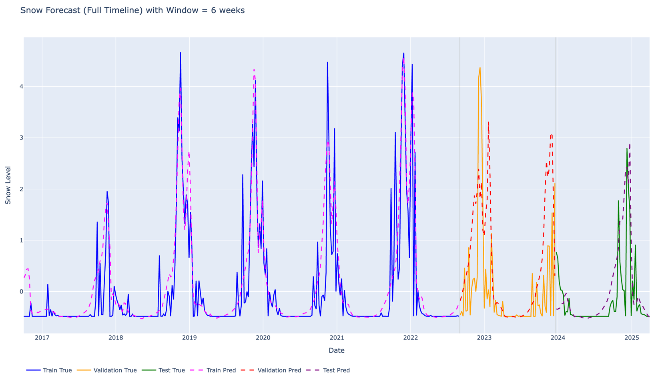
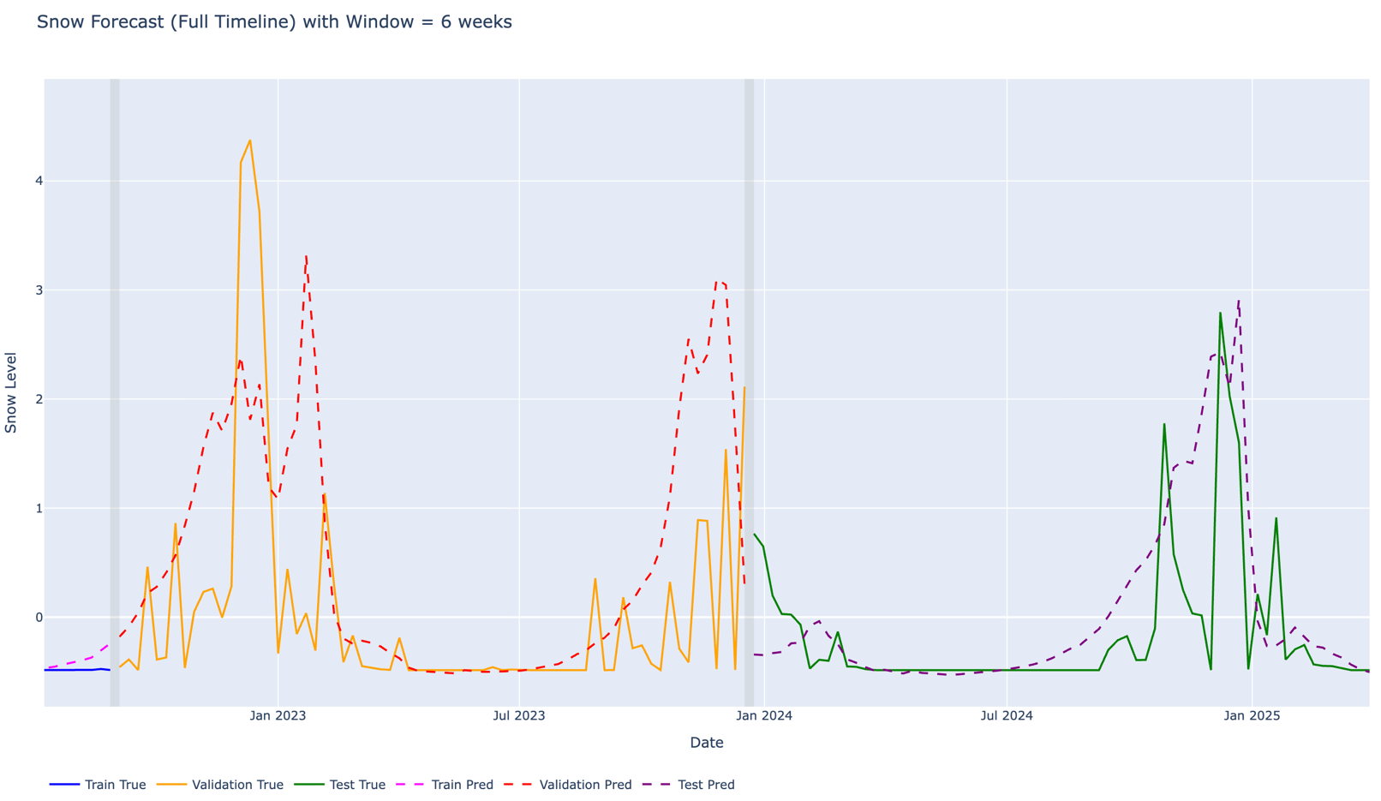
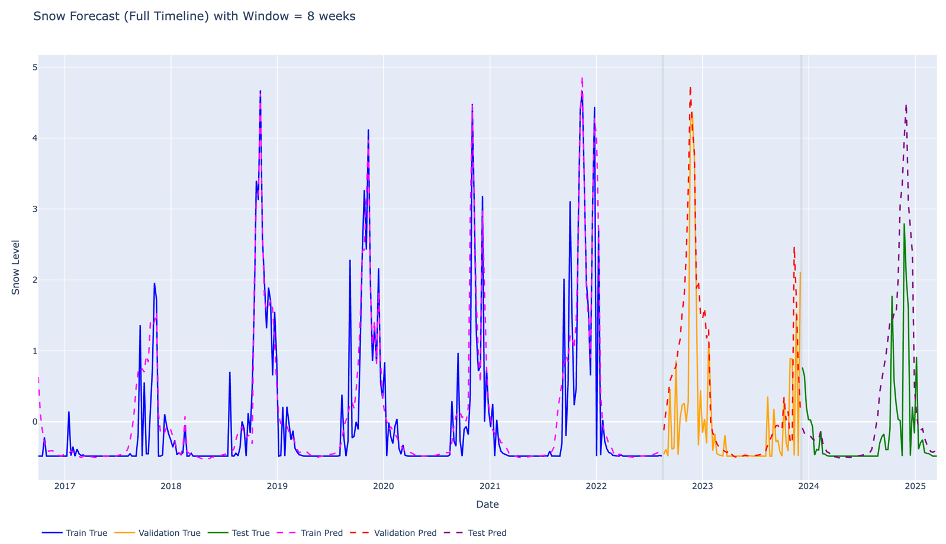
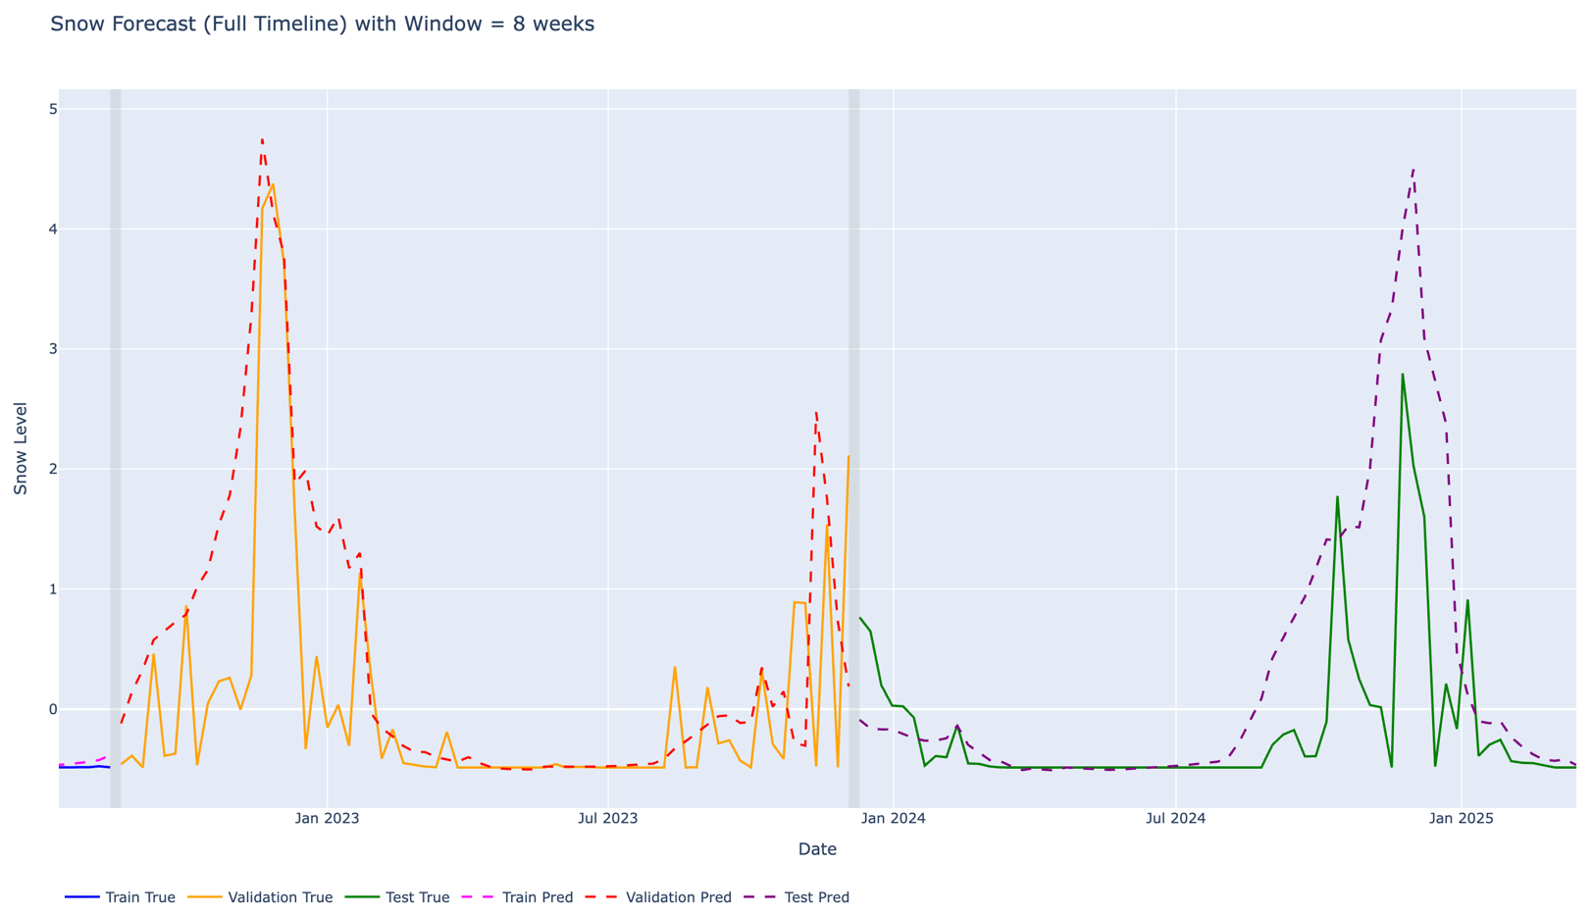
Results of Sequence Length Experiments & Trade-Off
Experimental Setup
Tested multiple LSTM configurations with different sequence lengths
Sequence lengths: 1, 2, 4, 6, 8, 10, 12 weeks
Same architecture and training settings for fairness
Key Findings
Very short sequences (1–2 weeks): insufficient temporal context
Medium sequences (4–6 weeks): best numerical performance
Longer sequences (8–12 weeks): smoother predictions but higher variability
Trade-off Observed
Numerical accuracy (MAE / RMSE) vs temporal realism
Best balance achieved around 6–8 weeks range
Conclusion
No single optimal sequence length
Performance depends on balance between stability and temporal memory
MDP26-19
SnowFLOWS: Spatio-Temporal Snow Forecasting using Satellite Data
Notes:
In this experiment, we tested multiple sequence lengths to understand how much historical information is needed for accurate snow forecasting. We found that short sequences lack sufficient context, while very long sequences introduce noise and instability. The best trade-off between accuracy and visual realism was generally found in the 6 to 8-week range.

Slide 19
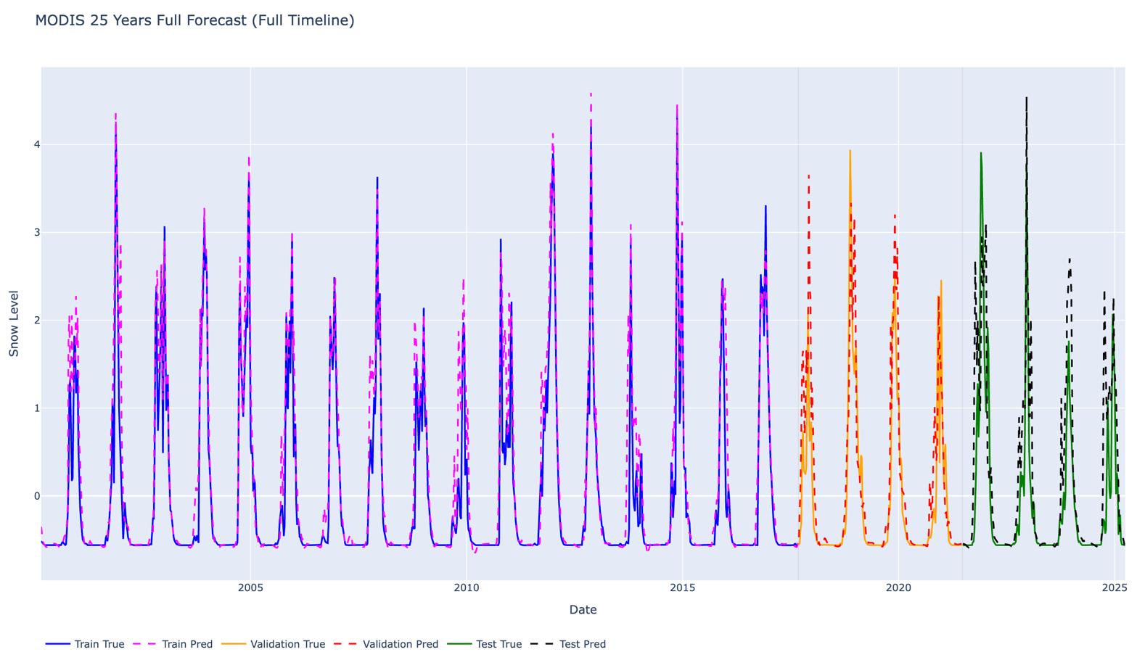
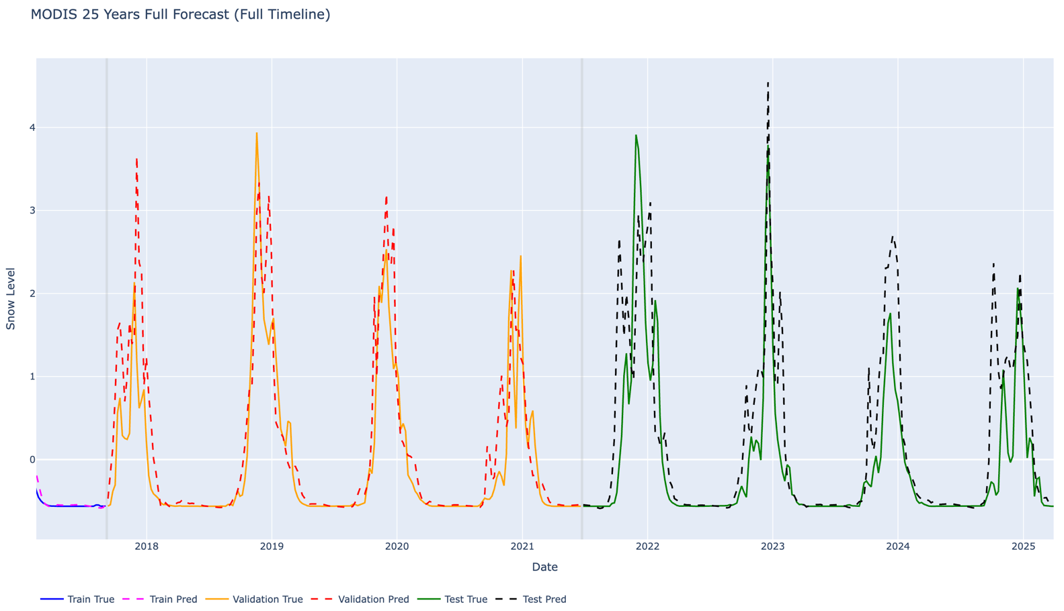
Long-Term Forecasting Experiment (MODIS 25-Years Dataset)
Objective
Test whether more historical data improves performance
Observations
Smoother long-term trends
Better seasonal consistency
Still noticeable prediction errors ( RMSE ≈ 0.6 )
→ More data improves stability, but does NOT eliminate forecasting errors
MDP26-19
SnowFLOWS: Spatio-Temporal Snow Forecasting using Satellite Data
Notes:
In this experiment, we tested our model on a long-term MODIS dataset covering approximately 25 years. We observed that increasing temporal coverage improves the smoothness and stability of predictions. However, even with more data, the model still struggles with extreme variations, showing that snow dynamics are inherently complex and not fully captured by data volume alone.

Slide 20
Testing, Evaluation and Iterative improvements
Evaluation Strategy
Performance metrics: MAE and RMSE
Comparison with baseline persistence model
Visual analysis of predicted vs actual snow cover
Testing Approach
Multiple sequence lengths evaluated (1 to 12 weeks)
Consistent training setup across experiments
Validation on unseen test data
Iterative Improvements
Adjustment of sequence length for optimal performance
Refinement of feature engineering and preprocessing
Model tuning (dropout, training stability)
Critical Evaluation
Strengths:
Good prediction of seasonal trends
Improved performance over baseline
Limitations:
Difficulty capturing extreme peaks
Sensitivity to data variability and sequence length
SnowFLOWS: Spatio-Temporal Snow Forecasting using Satellite Data
Notes:
We evaluated our model using both numerical metrics and visual analysis. We performed multiple experiments with different sequence lengths and refined our approach iteratively. While the model performs well in capturing general trends, it still faces challenges in predicting extreme peaks, which highlights the complexity of snow dynamics.

Slide 21
Solution Impact
Environmental Impact
Improved monitoring of snow cover dynamics
Better understanding of water resource availability
Contribution to climate change analysis
Societal Impact
Enhanced preparedness for winter conditions
Support for infrastructure management and emergency planning
Improved decision-making for public authorities
Economic Impact
Support for tourism sector (snow-dependent activities)
Better planning for agriculture and water usage
Reduction of uncertainty in resource management
Key Insight
Snow forecasting systems can support sustainable decision-making in mountainous regions
SnowFLOWS: Spatio-Temporal Snow Forecasting using Satellite Data
Notes:
This project has multiple impacts, especially in Lebanon where snow plays a key role in water resources. Accurate snow forecasting can help manage water availability, support tourism activities, and improve preparedness for extreme weather conditions. Overall, the system demonstrates how combining satellite data and machine learning can address real environmental challenges.

Slide 22
Conclusion
Key Achievements
Developed a spatio-temporal snow forecasting system
Successfully integrated multi-source satellite data
LSTM model outperformed baseline methods
Identified impact of sequence length on performance
Main Findings
Snow dynamics are highly complex and nonlinear
Trade-off between numerical accuracy and visual realism
Data availability significantly affects model performance
Perspectives / Future Work
Combine Sentinel-2 and MODIS in a unified model
Introduce additional evaluation metrics (peak & temporal accuracy)
Explore more advanced models or hybrid approaches
SnowFLOWS: Spatio-Temporal Snow Forecasting using Satellite Data
Notes:
In this project, we successfully developed a system capable of forecasting snow cover using satellite data and deep learning. We showed that while LSTM models improve performance over simple baselines, snow dynamics remain complex and difficult to fully capture. Future work could focus on combining spatial and temporal datasets and improving evaluation methods to better reflect real-world performance.

