Slide 1
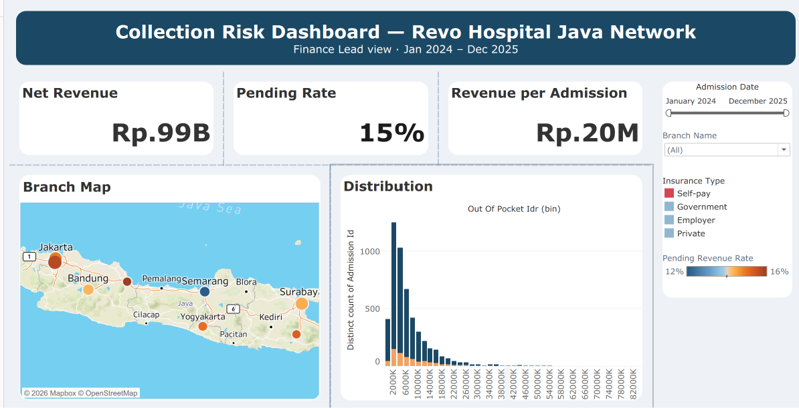
MILESTONE 1
Revenue Leakage at Revo Hospital
An analytical dashboard for the finance lead: tracking IDR 14.5 billion of revenue still uncollected across the Java network
DATAVIZ_JUN26_Reinaldy_Zulfananda_Arkaan_intermediate
Data Visualisation Intermediate Assignment · RevoU Full Stack Data Analytics · September 2026
Notes:
Replace firstname_lastname with your full name following the assignment format. Add the dashboard preview once Milestone 2 is built.

Slide 2
Dashboard Angle
MILESTONE 1
The single question this dashboard answers
Target user
Decision
Why it matters
Dashboard type
Finance lead of the Revo Hospital network, the owner of collection and cash flow decisions across branches.
Which patient segments and periods to chase first so pending revenue falls below the 10 percent tolerance.
IDR 14.5 billion is locked up, equal to 14.7 percent of revenue. That cash cannot fund branch operations.
Analytical. It is built to find causes and patterns, not to monitor daily activity.
Why analytical rather than strategic or operational
A strategic dashboard needs long-horizon targets and market benchmarks, neither of which exists in this dataset.
An operational dashboard needs daily data and immediate action, while the finest grain here is an admission with monthly patterns.
What the finance lead needs is to trace where receivables pile up, so the dashboard works as a diagnosis tool.
Notes:
The angle was chosen because pending payment is the one variable in this dataset that hits cash directly and can be acted on.

Slide 3
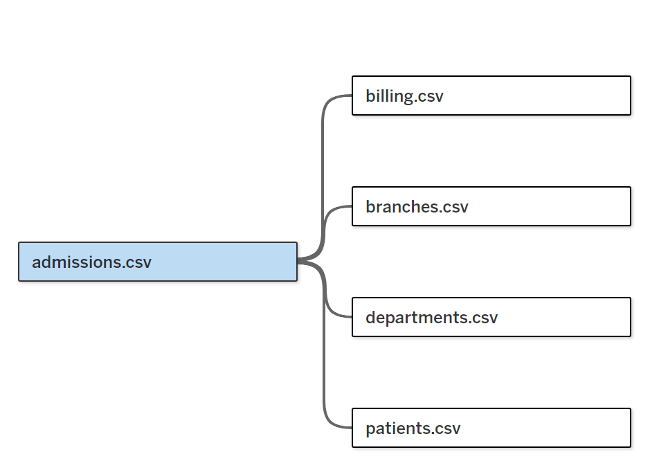
Data Preparation
Five tables, one fact table, grain of one admission per row
Table | Key | Why it is necessary
admissions | admission_id | The fact table. It sets the grain of the analysis and holds the admission date.
billing | admission_id | Source of net revenue, out of pocket, and payment_status. The core of the angle.
patients | patient_id | Supplies insurance_type, the main comparison dimension.
branches | branch_id | Branch identity and coordinates for geographic analysis.
departments | department_id | Service line context when tracing the source of receivables.
Data Model
Risk if the join is wrong
If billing were joined to patients without passing through admissions, each bill would duplicate once per visit. Total revenue would inflate and the pending rate would be wrong. The Grain Validation sheet confirms that the row count matches the count of distinct admission_id.
Relationship direction
billing 1 : 1 admissions
patients 1 : many admissions
branches 1 : many admissions
departments 1 : many admissions
Notes:
The grain is one row per admission. Every metric is computed at that grain.

Slide 4
Metrics & Logic
Five metrics, all pointing at the same question
Metric | Type | Why it is useful to the finance lead
Total Net Revenue | Aggregate | The denominator behind every ratio and the measure of network scale.
Uncollected Revenue | Aggregate | The rupiah value sitting idle. This is the number that gets acted on.
Pending Revenue Rate | Ratio | Compares branches and segments fairly regardless of their size.
Out of Pocket Ratio | Ratio | Tests whether a heavier patient burden is what drives bills into pending.
Revenue per Admission | Ratio | Separates revenue growth from volume out of growth from higher bill value.
Ratio requirement
Time-based requirement
Two metrics are ratios: Pending Revenue Rate and Out of Pocket Ratio.
Admission Month, built with DATETRUNC, splits Pending Revenue Rate into 24 monthly points.
Notes:
Avg Length of Stay was created and then dropped because it did not answer the collection question.

Slide 5
KPI Scorecard
Four numbers that size the problem
IDR 99B
IDR 15B
15%
IDR 20M
billion in net revenue over two years
billion in revenue still uncollected
pending revenue rate
million revenue per admission
Why a scorecard
Weaker alternative
The four numbers build context in layers. Revenue shows scale, uncollected shows the value at risk, the pending rate shows how severe that is in relative terms, and revenue per admission gives a reference point when the rate moves. Each card title is written as a finding, not as a metric name.
A summary table holding all four figures at once. Every value would carry equal weight, so the reader would not know which one is urgent, and the IDR 15 billion would lose its emphasis.

Slide 6
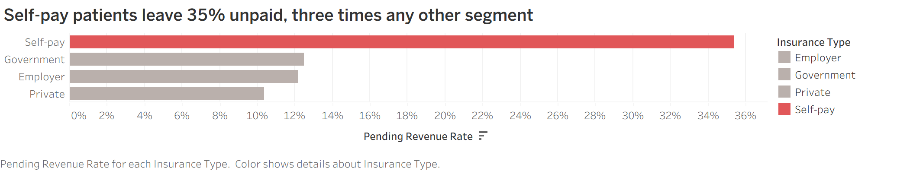
Comparison Chart
Self-pay patients leave 35% unpaid, three times any other segment
Purpose
Identify which patient segment leaves the most bills sitting in pending status.
Why a bar chart
Comparing bar length is the easiest read for a handful of unordered categories.
Weaker alternative
A pie chart. Pending rate is a ratio within each segment, not a share of one whole, so the slices would not add to 100 percent and would mislead. The gap between 35 percent and roughly 12 percent is also harder to judge by angle than by length.
Notes:
Red is used only on Self-pay as the exception; the other bars stay neutral grey.

Slide 7
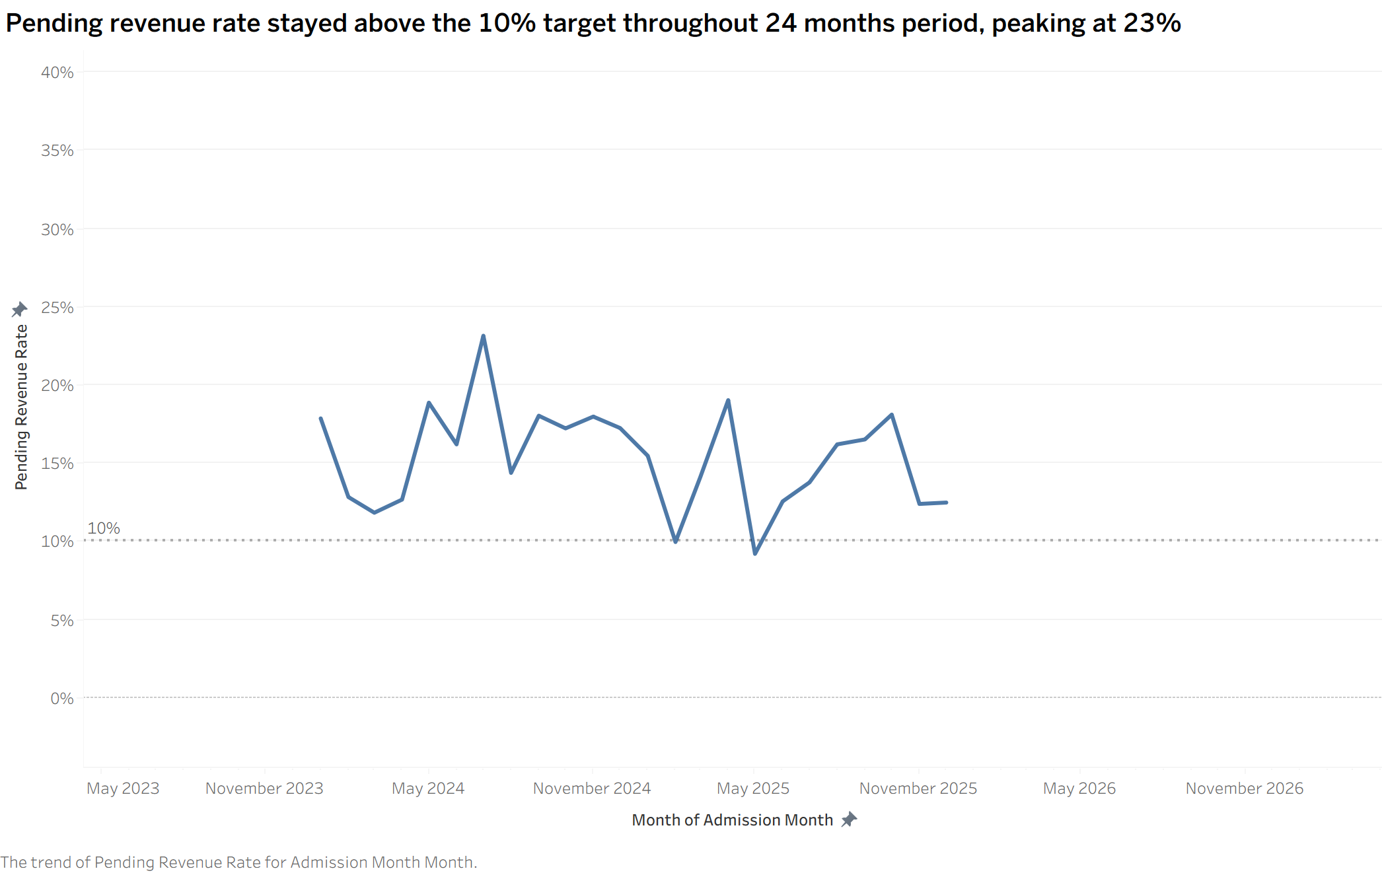
Trend Chart
Pending revenue rate stayed above the 10% target in 22 of 24 months, peaking at 23%
Purpose
Test whether the collection problem improves on its own or persists across time.
Why a line chart
A line carries continuity between months, and the 10 percent reference line makes the distance to target visible at once.
Weaker alternative
A monthly bar chart. Bars break the sense of flowing time and push the reader to compare months one by one, when the question is the direction over two years. A monthly percent difference was also tried and dropped, because one month with a small denominator spiked to 287 percent.
Notes:
Make sure the date pill uses Month with the year, so 2024 and 2025 are not stacked into 12 points.

Slide 8
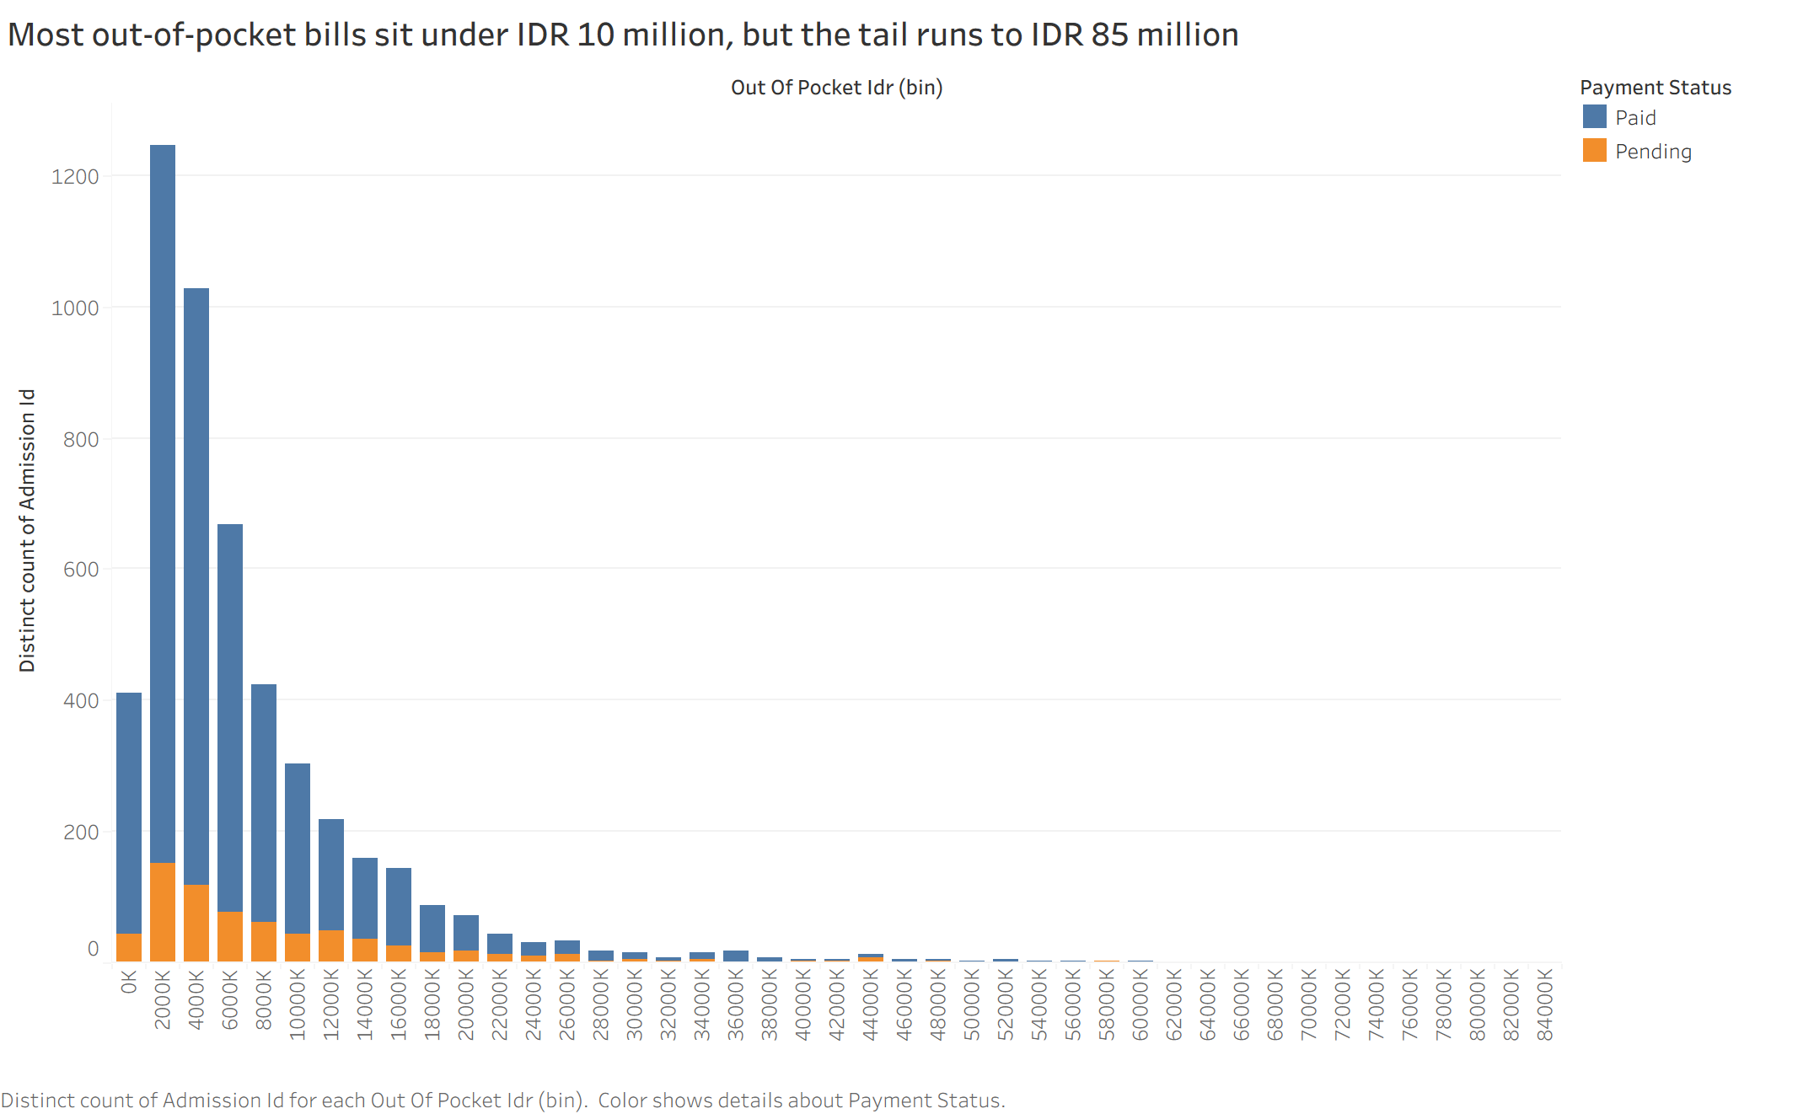
Distribution Chart
Most out-of-pocket bills sit under IDR 10 million, but the tail runs to IDR 85 million
Purpose
See how patient burden is spread and find the tail of large bills most at risk of going unpaid.
Why a histogram
A two million rupiah bin reveals the shape of the spread and the length of its tail, which an average hides.
Weaker alternative
A single average out-of-pocket KPI. One number conceals the tail reaching IDR 85 million, and those large bills are exactly the ones most likely to become receivables. A box plot is more compact but harder to read for a non-technical audience such as a finance lead.

Slide 9
Milestone 1 Status
Every mandatory building block is now in place in Tableau
5 tables
Relationships & grain
Above the minimum of 4
Admissions at the centre, one row per admission
5 metrics
4 KPI cards
Including two ratios and one monthly view
Above the minimum of 3
Comparison
Trend
Pending rate by insurance type, sorted
24 monthly points with a 10 percent reference line
Distribution
Chart titles
Out-of-pocket bins of two million rupiah
All written as findings rather than chart names

Slide 10
Milestone 2 Technical Build
Five advanced techniques layered on top of the Milestone 1 building blocks
LOD expression
Top 5 ranking
Two-year branch revenue that stays the same when filters change
Departments ordered by pending revenue rate
Running total
Branch map
Pending revenue added up by admission month
Eight branches plotted from latitude and longitude
Three filters
Seven insights
Admission date, branch name, insurance type
OBIPR findings close the deck
Grain unchanged
Published
Still one row per admission across every new view
public.tableau.com/views/CollectionRiskDashboardRevoHospitalJavaNetwork

Slide 11
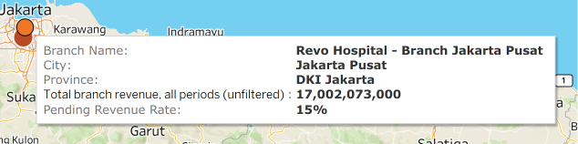
Level of Detail
Branch totals that stay fixed while the rest of the dashboard filters
Purpose
Keep each branch's full two-year revenue as a reference while the user filters a single month or segment.
Why the number stays fixed
It counts every month and segment, so filters do not move it. The tooltip labels it as unfiltered.
Weaker alternative
A plain SUM of net revenue. It shrinks with every filter, so the user loses the denominator and can no longer tell whether the filtered slice is a large or a small part of that branch. A table calculation would break in the same way, because it recomputes on whatever rows the filter leaves behind.

Slide 12
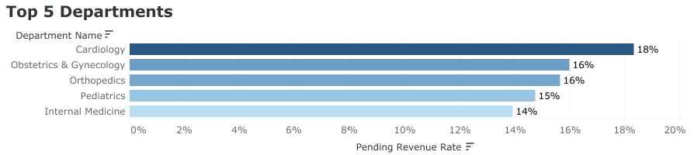
Ranking
Cardiology tops the pending rate at 18.3%, more than three points above the network average
Purpose
Narrow eight departments down to the five where receivables build up fastest.
Why a sorted bar
A Top 5 filter with a descending sort makes the order itself the message.
Weaker alternative
Showing all eight departments. The spread runs from 13 to 18 percent, so the lower half adds length without adding a decision. Ranking by rupiah instead of rate was also tested: it puts Oncology first at IDR 3 billion, which answers a different question about where the largest amounts sit.

Slide 13
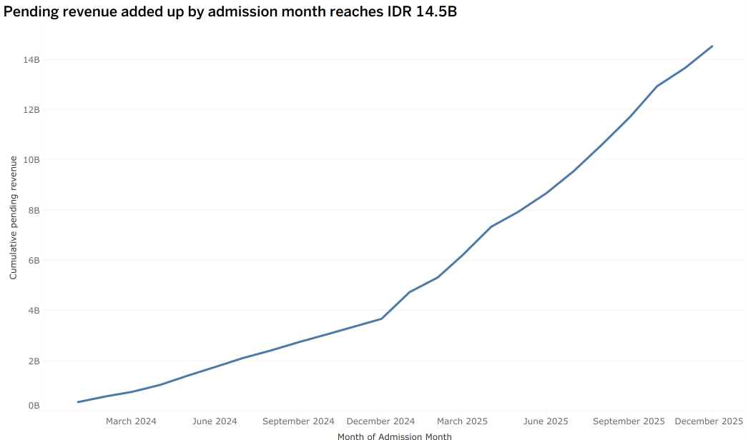
Table Calculation
Pending revenue summed by admission month reaches IDR 14.5 billion, climbing faster from 2025
Purpose
Show which admission months created the bills that are still pending, added up over time.
What it is and is not
A cumulative sum by admission month. Not a month-end receivable balance, the data has no payment date.
Weaker alternative
Monthly pending revenue on its own. Each bar looks small, and the reader never sees that bills admitted in 2024 already make up about IDR 4 billion of what is pending today, before the 2025 volume surge tripled the monthly intake.

Slide 14
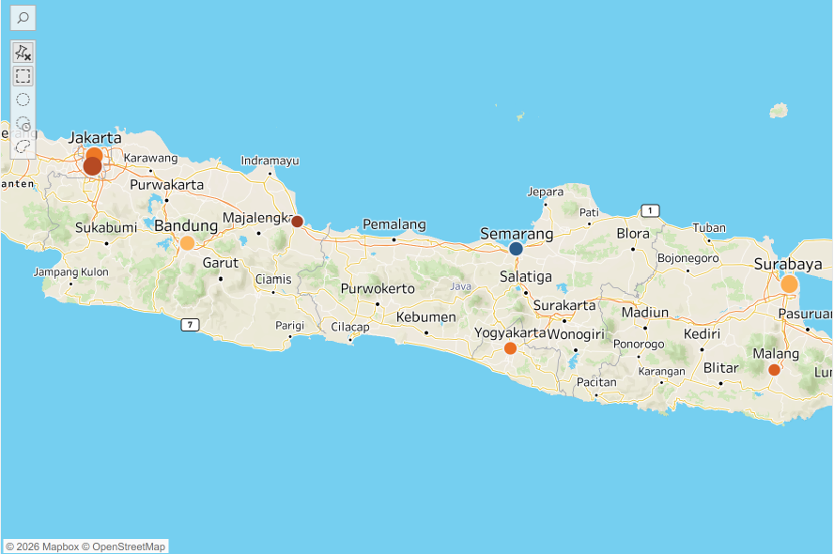
Map Chart
Geography is not the problem: every branch sits between 12% and 16% pending
Purpose
Test whether the collection problem is concentrated in one city or spread across the Java network.
Why a symbol map
Colour carries the pending rate and size carries branch revenue, so scale and risk read in one glance.
Weaker alternative
A filled map shaded by province. Branches are points, not territories, so shading a whole province would credit a rate to areas the hospital does not serve. The flat spread is the finding here, and it moves the fix from branch management to network-wide payment policy.

Slide 15
Dashboard Interaction
Three filters, one of them a date range, applied across every worksheet
Filter | Type | What it lets the finance lead do
Admission Date | Range of dates | Isolate a quarter or the 2025 surge and see whether the pending rate moved with it.
Branch Name | Multiple values | Check one branch against the network band of 12 to 16 percent.
Insurance Type | Multiple values | Remove Self-pay and confirm the remaining segments sit near 12 percent.
Applied to all worksheets
Reading order
Every filter uses All Using This Data Source, so one selection moves the KPI cards, the map and all four charts together.
KPI cards first, then segment and geography, then the time and ranking views that explain where the backlog sits.

Slide 16
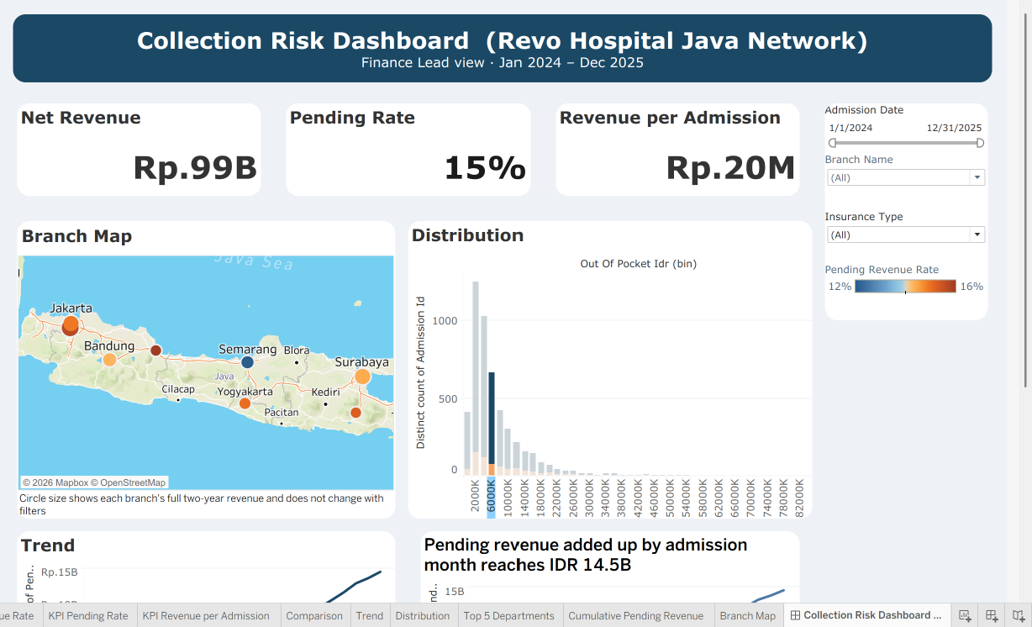
Final Dashboard
Both halves of the final dashboard, eight views driven by the same three filters
Layout hierarchy
Row one sizes the problem, row two locates it, row three explains it over time and by department.
Interaction flow
Filters sit in a fixed right rail, so they stay in reach while the lower rows are scrolled.
Trade-off accepted
The canvas is 1200 by 1100, so the lower rows need a short scroll. Compressing everything into one screen would have shrunk the map and the histogram below a readable size, and the three KPI cards plus the segment chart already carry the headline before any scrolling happens.

Slide 17
MILESTONE 2
Insights
Seven OBIPR findings with observation, business impact, priority and action
Insight | Observation | Business impact | Priority and action
Self-pay drives the gap | 35% unpaid against 10 to 13% for insured segments | 13% of admissions but 30% of all pending revenue, about IDR 4B | High. Deposit or payment plan for bills above IDR 20M
The backlog is systemic | All eight branches sit between 12% and 16% pending | No single branch fix recovers the money, the IDR 14.5B is spread across every site | High. Change payment policy at network level
Volume multiplies exposure | Monthly revenue tripled from IDR 2B to IDR 6B | New pending revenue grew from about IDR 300M to IDR 900M a month | Medium. Scale the collections team with volume
Cardiology and Oncology lead | Cardiology has the highest rate at 18% | The two departments hold about IDR 6B, 40% of all pending revenue | High. Structured instalments in both departments
Large bills fail more often | Median bill IDR 6M, tail up to IDR 85M | Bills above IDR 20M are 6% of cases but 23% of pending revenue | High. Financial counselling above IDR 20M
Patients carry too much | 39% of gross charges fall on the patient | About IDR 40B of charges depend on household ability to pay | Medium. Widen insurer partnerships
It never resolved itself | Above the 10% target in 22 of 24 months, peak 23% | At the 10% target the backlog would be IDR 10B, so about IDR 5B is excess | High. Monthly review against the 10% target

Slide 18
Closing Reflection
What worked, what was traded away, and what the next version would change
What worked
What worked
One angle held across all eight views, so no chart is decorative
Chart titles written as findings, which shortened the walkthrough
Trade-off
Trade-off
The distribution keeps its long tail, so the axis stays wide
The map earns little space, but it proves the risk is not geographic
Next version
Next version
Add a department by segment cross view to pinpoint the worst cell
Add an ageing bucket once a payment date column is available
Next version
Open question
Publish a narrower layout for the same eight views
Whether a deposit rule would also reduce Self-pay admissions

Slide 19
END OF REPORT
Thank you
Reinaldy Zulfananda Arkaan · September 17, 2026
DATAVIZ_JUN26_Reinaldy_Zulfananda_Arkaan_Intermediate_M1M2
Linkedin : https://www.linkedin.com/in/reinaldy-zulfananda-arkaan-30567a179/
Live dashboard on Tableau Public
https://public.tableau.com/views/CollectionRiskDashboardRevoHospitalJavaNetwork_17896636711850/CollectionRiskDashboardRevoHospitalJavaNetwork?:language=en-US&publish=yes&:sid=&:redirect=auth&:display_count=n&:origin=viz_share_link

