Slide 1
REVOU FULL STACK DATA ANALYTICS · BATCH JUN26 · WEEK 1
Why Is Corporate
Segment Profit Falling?
RevoShion sales grew 20.4% last year, but profit in the Corporate segment dropped 13.6%. This deck works through why.
Reinaldy Zulfananda Arkaan · 10 July 2026
[W1 JUN26 UBP] Reinaldy Zulfananda Arkaan_Intermediate
Linkedin : https://www.linkedin.com/in/reinaldy-zulfananda-arkaan-30567a179/

Slide 2
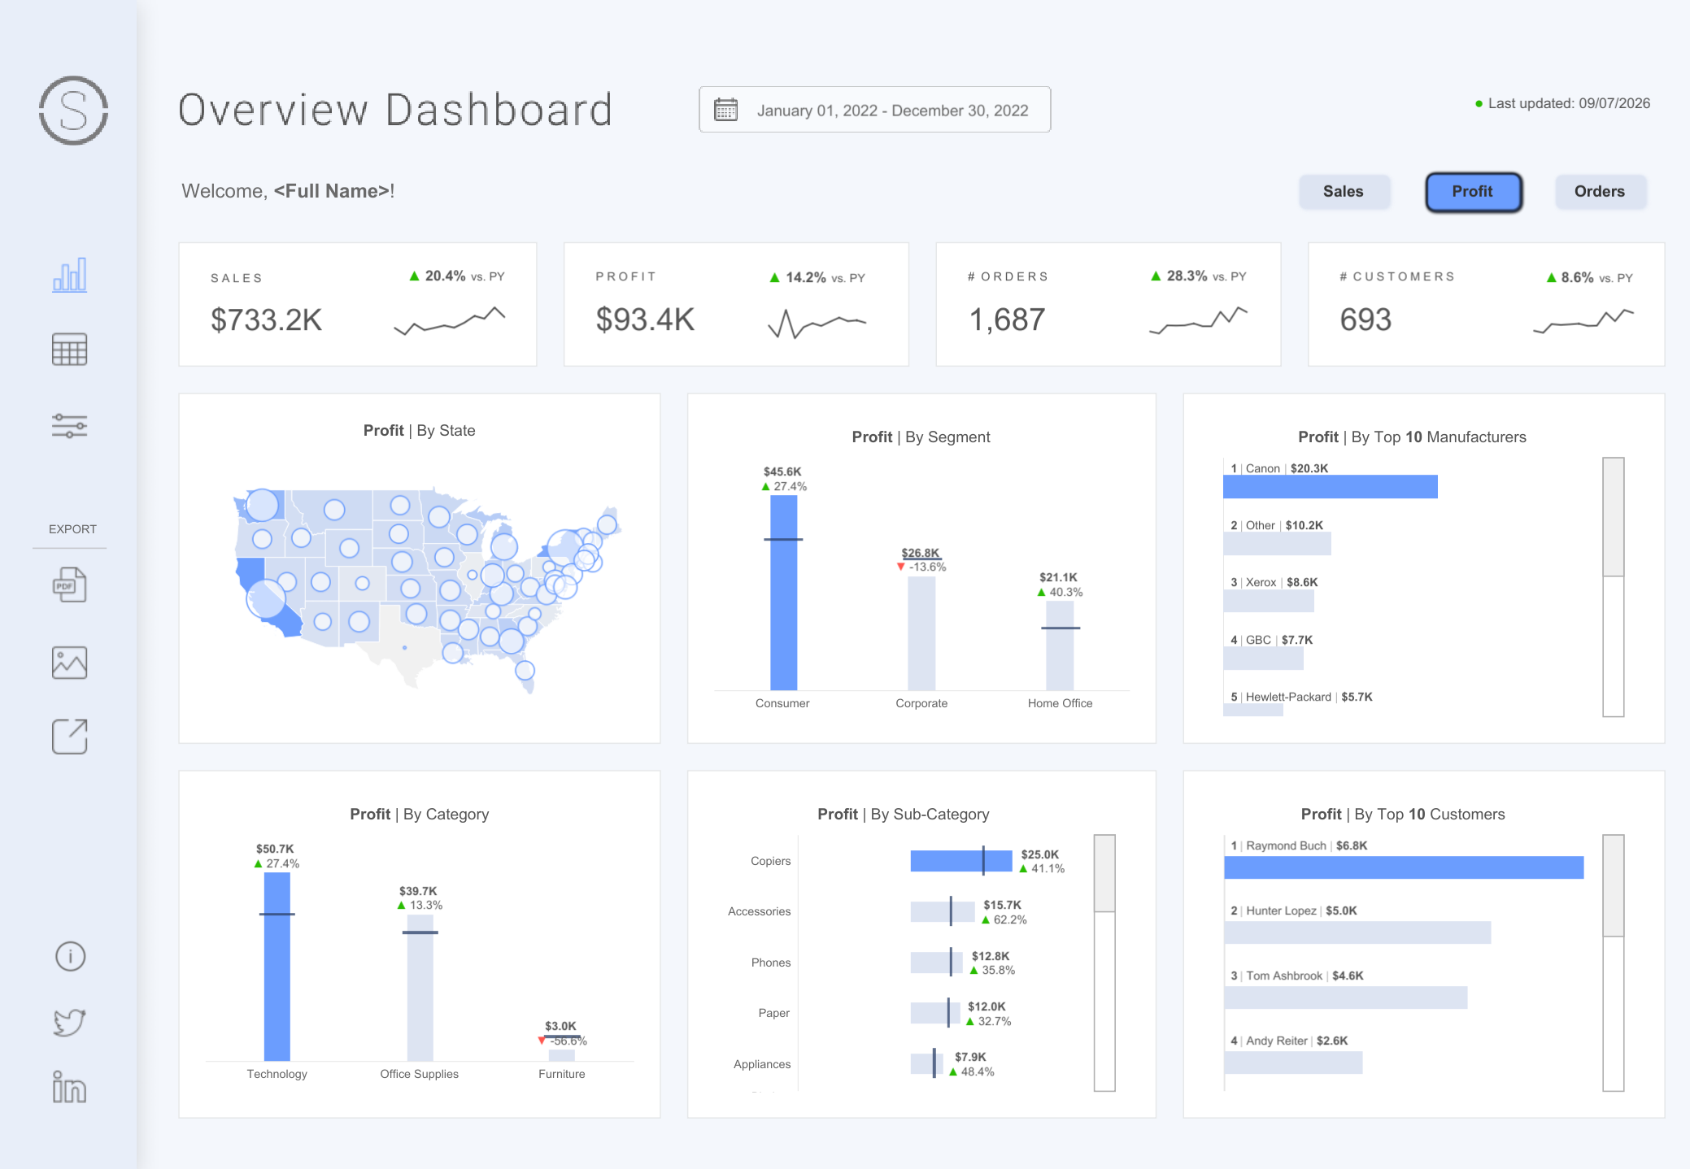
DASHBOARD
This analysis is based on a publicly available dataset and does not reflect real-world financial or business insights.
Revoshion is a fictional entity, and the results presented here are purely for educational purposes.
URL :
https://public.tableau.com/views/SuperstoreDashboard_16709573699130/SuperstoreDashboard?:language=en-US&_gl=1*1uzi50u*_ga*MTYxNzc0NjI4Ni4xNzQ2NTM2NTQ2*_ga_8YLN0SNXVS*czE3NDk0NDAxOTIkbzY1JGcxJHQxNzQ5NDQwMTkyJGo2MCRsMCRoMA..*_gcl_au*NjY4MDc3NTUxLjE3NDY1MzY1NDYuMTY5NjQyODYzNi4xNzQ3ODM4MjExLjE3NDc4MzgyMTI.&:sid=&:redirect=auth&:display_count=n&:origin=viz_share_link
2

Slide 3
DARCI
Who decides, who owns it, and who needs to hear about it.
 | Role | Who
D | Decider | Head of Sales
A | Accountable | Corporate Sales Manager
R | Responsible | Data Analyst
C | Consulted | Marketing Manager, Finance Manager
I | Informed | C-Level
3

Slide 4
Problem Identification
How can the Corporate segment increase its profit by 10% over the next 2 months after experiencing a 13.6% profit decline despite an increase in sales?
4

Slide 5
Objective
To identify the key factors contributing to the 13.6% decline in Corporate segment profit despite sales growth, and propose recommendations to improve Corporate profit by 10% over the next 2 months.
5

Slide 6
Root Cause Analysis (Issue Tree)
Product Mix
What is being sold
• Furniture over-weighted in Corporate orders
• Negative-margin sub-categories (Tables, Bookcases)
• Higher contribution from low-profit Furniture products.
Pricing & Discount
At what price it is sold
• Corporate customers may receive higher discounts, reducing profit margins.
• Discount policies may not sufficiently protect profit margins.
• Discount used to hit sales targets, not profit targets
Corporate Profit
−13.6% YoY
Customer Behaviour
How it is bought
• Order frequency up (+28.3%) but customers flat (+8.6%)
• Smaller average basket per Corporate order
• Revenue concentrated in a few high-leverage accounts
Cost to Serve
What it costs to deliver
• Operational costs may increase as order frequency grows.
• Furniture products may incur higher fulfillment costs.
• Furniture products may generate higher operational costs.
6

Slide 7
Hypothesis
Root Causes | Hypothesis | Prioritization
Product Mix (Furniture) | Furniture is the primary driver of the Corporate profit decline. | High
Product Mix (Low-Margin SKUs) | Sales growth is driven by low-margin products. | High
Customer Behaviour | Corporate profit depends on a small number of key accounts. | Medium
Cost to Serve | Rising fulfilment, shipping and return costs on Furniture erode profit per order. | Medium
Pricing & Discount | Excessive volume discounts to Corporate reduce the profit margin. | High
7

Slide 8
Metrics
Prioritized Hypotheses | Metrics | Reasoning
Furniture drives the Corporate profit decline. | Gross profit margin % of Furniture in Corporate | Furniture is the only category in decline (-56.6%). Margin tells us if it is being sold below cost.
Sales growth comes from low-margin products. | Profit per $1 of sales, by category | Sales rose 20.4% while profit rose only 14.2%, so the mix is thinning margin.
Excessive discounts erode Corporate margin. | Average discount rate % per Corporate order | A discount ceiling is the fastest lever and can be enforced within one quarter.
Corporate profit depends on a few key accounts. | Revenue share % of the top 10 Corporate accounts | Canon alone holds $20.3K of profit, so a handful of buyers can push for discounts.
Cost to serve rises with order frequency. | Profit per order, plus average order value | Orders rose 28.3% but customers only 8.6%, so each order is getting smaller.
8

Slide 9
Key Insights from the Dashboard
Segment
Corporate is the only segment with negative profit growth, down 13.6% to $26.8K, while Consumer grew 27.4% and Home Office 40.3%.
Category
Furniture is the only category in decline, down 56.6% to $3.0K, while Technology grew 27.4% and Office Supplies 13.3%.
Margin
Sales grew 20.4% but profit only 14.2%. That six-point gap means margin is thinning while demand holds up.
Orders and accounts
Orders rose 28.3% while customers rose only 8.6%. Canon alone holds $20.3K of profit, so the buyer base is narrow.
9

Slide 10
OBIPR
Observation | Business Impact | Isolation | Prioritization | Recommendation
Furniture profit fell 56.6% to $3.0K, the only category in the red. | The single biggest drag on Corporate profit. | Compare margin per Furniture sub-category, Corporate only. | High Biggest impact. Needs margin data first. | Delist or reprice Tables and Bookcases for Corporate.
Sales grew 20.4% but profit grew only 14.2%. | Margin thins on every extra dollar of revenue. | Compare discount rate by segment and margin per discount band. | High An internal policy change, so it is the fastest lever. | Cap Corporate discounts at 15% and require approval above that.
Orders rose 28.3% while customers rose 8.6%. | The same accounts order more often, so profit per order falls. | Track average order value and profit per order, Corporate vs Consumer. | Medium Easy to enforce, but it only lifts order economics. | Set a minimum order value and bundle low-margin items.
Canon holds $20.3K of profit and the top customer $6.8K. | A few accounts hold enough weight to push for discounts. | Measure revenue share of the top 10 accounts. | Medium A durable fix, but slow to show up in profit. | Run a B2B acquisition programme to widen the base.
10

Slide 11
Key Takeaways
Top root causes
Furniture profit collapse, low-margin sales mix, excessive discounting, and dependence on a few key accounts.
What the data shows
Corporate is the only losing segment and Furniture the only losing category. Whether the two are connected still needs segment-level data.
What must be verified
Transaction-level discount rates, margins for Tables and Bookcases, and revenue share of the top 10 accounts.
Sequenced action
Start with a cap on discounts. Fix the Furniture assortment next, then order economics, and widen the account base last.
11

Slide 12
BUSINESS IMPACT STATEMENT
Capping discounts, repricing the Furniture assortment, and rewarding order value over order volume should bring Corporate profit back to growth without giving up the 20.4% sales momentum RevoShion already has.
−13.6%
≥ +5%
5
2 quarters
Corporate profit today
Target YoY profit growth
Hypotheses to validate
To first margin recovery
12

Slide 13
Thank You
Reinaldy Zulfananda Arkaan · 10 July 2026
[W1 JUN26 UBP] Reinaldy_Zulfananda_Arkaan_Intermediate
Linkedin : https://www.linkedin.com/in/reinaldy-zulfananda-arkaan-30567a179/
Reinaldy Zulfananda Arkaan · 10 July 2026
[W1 OCT25 UBP] Reinaldy_Intermediate
Reinaldy Zulfananda Arkaan · 10 July 2026
[W1 OCT25 UBP] Reinaldy_Intermediate
13

