Slide 1
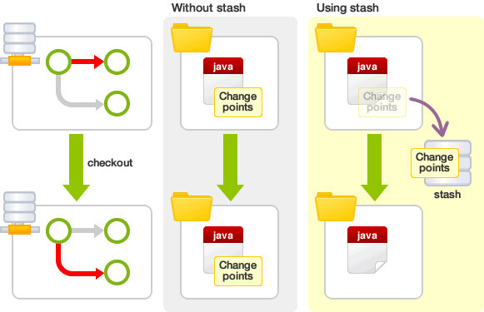
Some more git commands
Git cherry-pick : Apply the changes introduced by some existing commits
Git worktree-Manage multiple working trees
Git stash
Git rerere - Reuse recorded resolution of conflicted merges

