Slide 1


Walking
Cycling

Slide 2


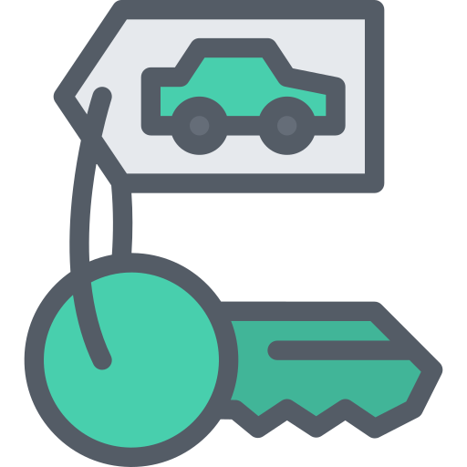




Car
Version 1
Car
Version 2
Carsharing
Park & Ride
Version 1
Park & Ride
Version 2

Slide 3









Public transport
General
Version 1
Public transport
General
Version 2
Public transport
Local
Version 1
Public transport
Train
Version 1
Public transport
Train
Version 2

Slide 4
Public transport
General
Version 3
Public transport
Local
Version 2
Public transport
Train
Version 3

