Slide 1

Code update
Code Repository
Start CI
Build
Test
Results
Local development & debug
CI Pipeline
Return CI results

Slide 2
Keil MDK
CLASSIC EMBEDDED DEVELOPMENT
Sensor
Input Interface
Signal Conditioning
Optimized ML Model
Output Interface
SDS Data Capturing
Audio
Video
ML MODEL DEVELOPMENT (MLOps)
Search
Model
Compress
Model
Train
Model
Weight clustering
Quantize
Model
Compile
Model
Validate
Model
Optimized ML Model
Data
Use-Case
Arm tools integrate here
Arm Ecosystem Partners
Notes:
But how is such an Edge AI application developed? Let’s take a look.
An Edge AI Device has a classic embedded part that integrates an Optimized ML Model. The classic embedded software interfaces to the sensor, audio or video input of your device, and contains DSP algorithms for signal conditioning. And of course, the output interface.
For the ML Development you need real-world data. Arm offers the SDS software component for data capturing which we will demonstrate in a dedicated webinar later this year. The data is fed into the MLOps system and Edge Impulse is one of our partners in this space.
In the MLOps system, you specify your use-case, and a model searcher helps identifying the right model. Afterwards, compression, training, clustering, and quantization is applied to the model to fit it into the memory of constrained edge devices. Finally, this is compiled, validated, and delivered to the classic embedded development flow for integration.
Edge Impulse will now show us how this works in practice with their system. Over to you Alessandro!

Slide 3
Ethos-U Optimized Software Flow for Tensorflow/PyTorch
github.com/Arm-Examples#edge-ai-and-machine-learning
HOST (OFFLINE)
TARGET / DEVICE
ML Model
Quantization & Optimization
CMSIS-NN
Optimized Kernels
Cortex-M
CPU
ML Runtime
Ethos-U Driver
Ethos-U
NPU
Vela Compiler
(Optimize for Ethos-U NPU)

Slide 4
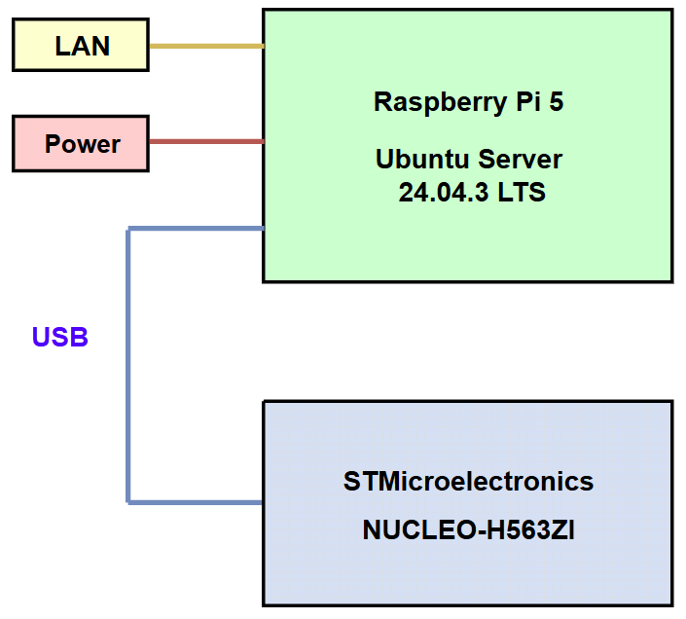
Installed tools and software:
pyOCD for flash download and test execution
CMSIS-Toolbox for software pack installation
DFP and BSP software packs for flash programming and debug connection
SDSIO-Server (optional) for running test using SDS-Framework
Example test target board:
Connects via CMSIS-DAP debug adapter or ST-Link to Raspberry Pi 5 for flash download and test execution
Additional USB connection may be used for SDSIO-Server (optional)

