Slide 1
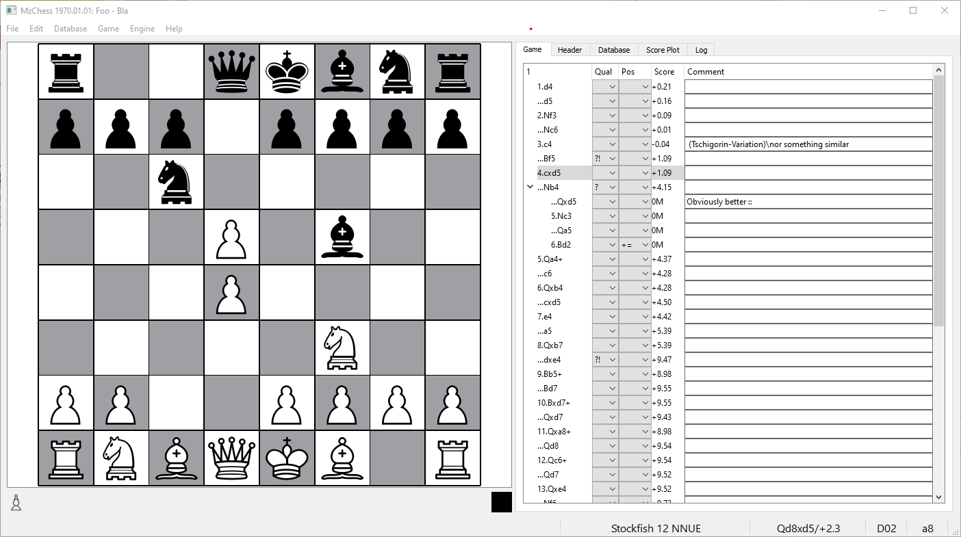
position
position NAG
score [pawns]
annotation NAG
last move
material
next turn
info/error
engine
hint/score
ECO code
square

Slide 2
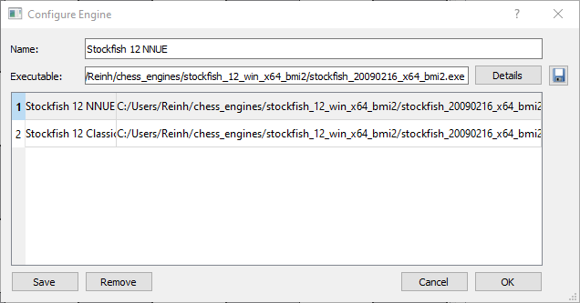
show/select engine options
save actual settings
file dialog
remove selected engine

Slide 3
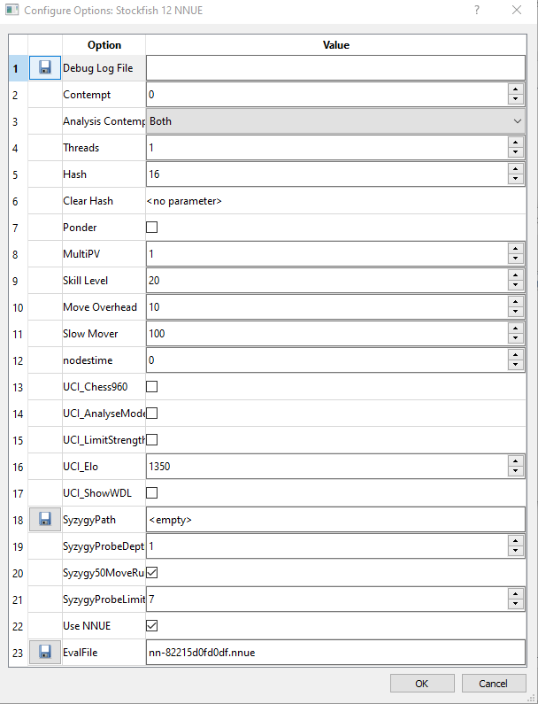
type: combo
type: button
type: check
type: spin
type: string
file dialog

Slide 4
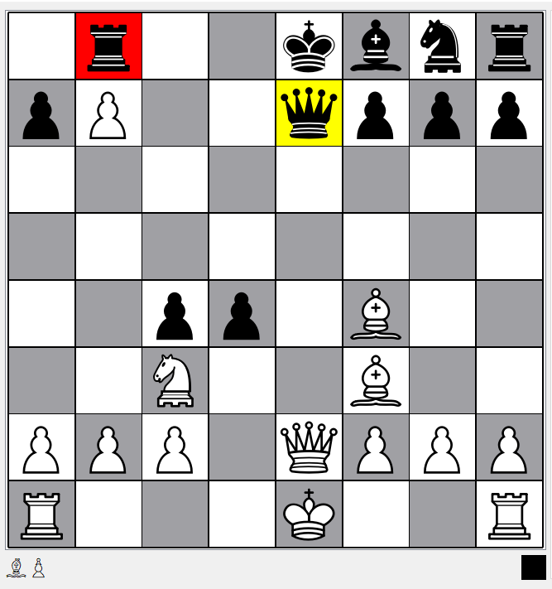
potential
loss of a rook

Slide 5
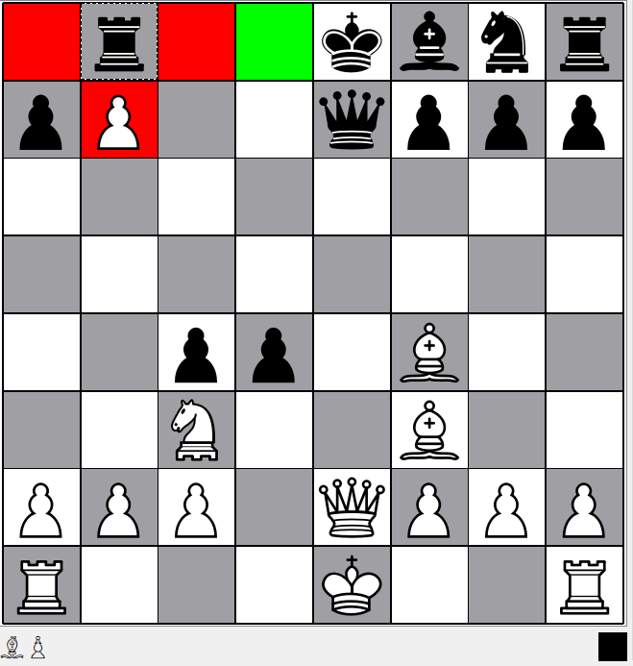
best move ???

Slide 6
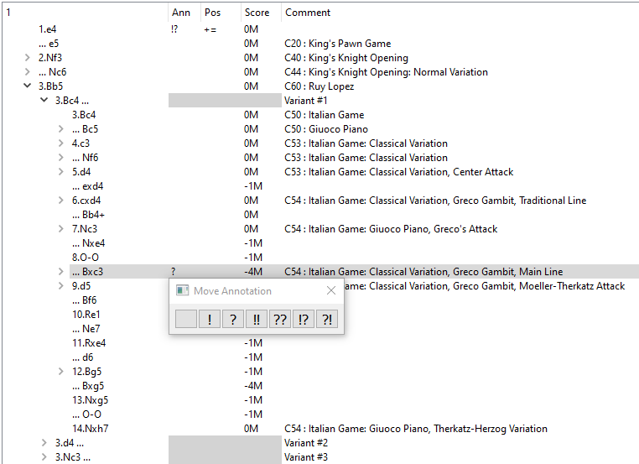
move annotation
score
position
variant
starting comment
variant
starting node
material score
comment
popup editor
move

Slide 7
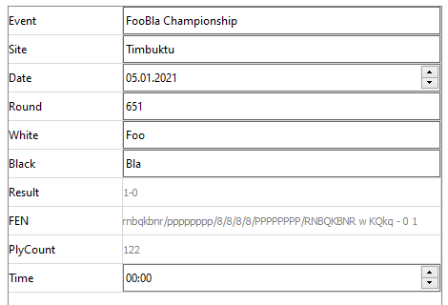
header element
editable value
date
7-tag roster
readonly value
time

Slide 8
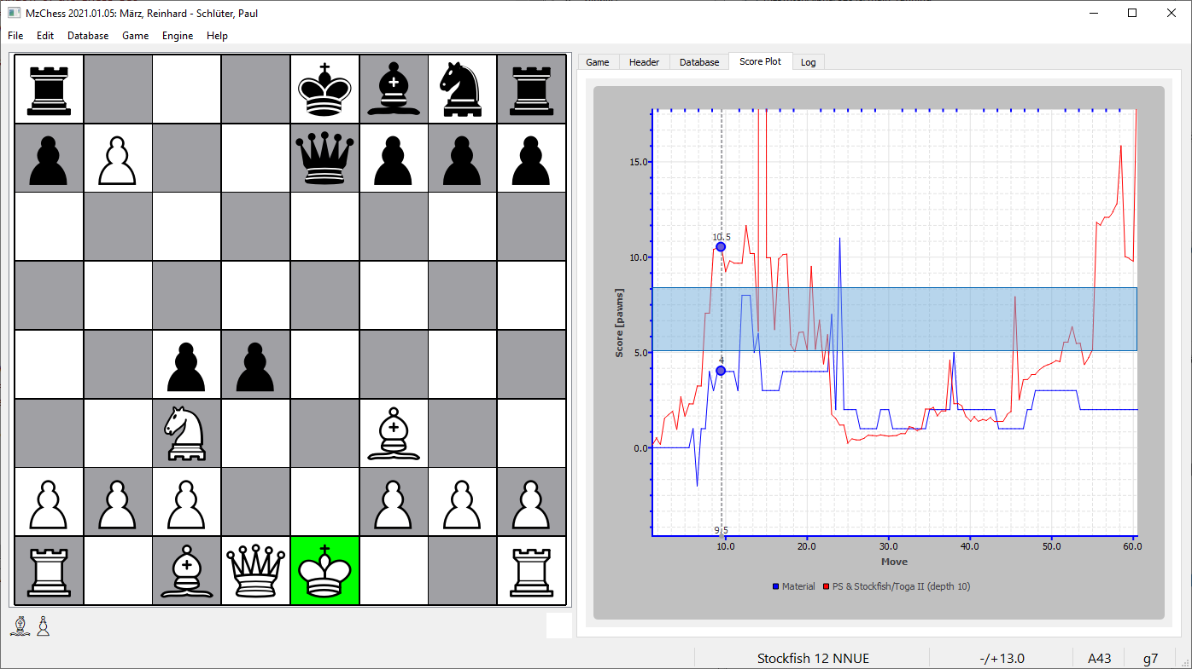
engine score
zoom-in range
material score
position

Slide 9
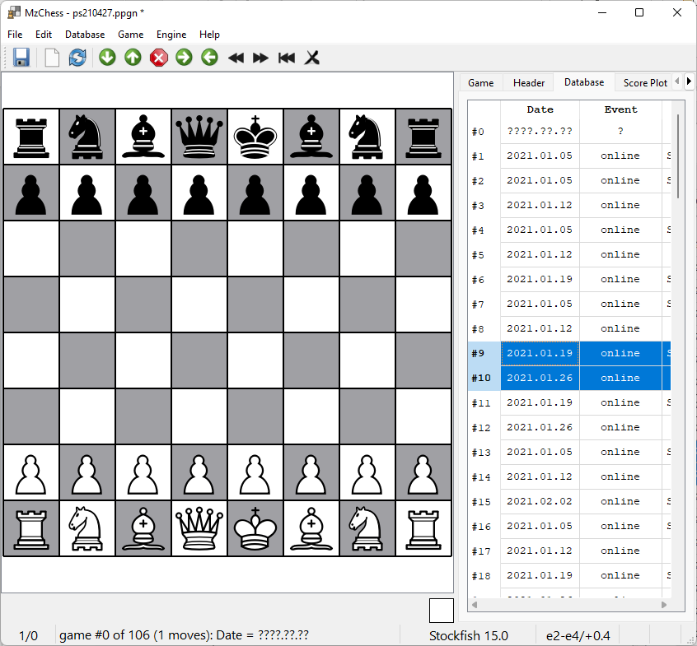
column header
Rows dragged
Rows to be
moved

