Slide 1

Group 3: Reinier Andrew, Minh Tran, Kylie Collins, Khin Kyaw

Slide 2

Solar Energy
Solar energy refers to the energy from the sun.
The sun has produced for billions of the years and it is the most important of energy for all life forms.
It is a renewable source of energy unlike non renewable sources such as fossil fuels.
The main benefit of solar energy is that it does not produce any pollutants is one of the cleanest source of energy.

Slide 3
Solar Energy
According to the Australian Renewable Energy Agency, solar power generates approximately 10% of Australia’s electricity and is one of the fastest growing energy generation types in Australia. https://arena.gov.au/renewable-energy/solar/
As of January 2022, more than 30% of Australian households had rooftop solar power installed.
There are 2 types of solar power technologies – photovoltaic and solar thermal. In our study we concentrated on photovoltaic as this is what is used for household solar panels.
Our objective was to analyze the data within the solar energy industry and identify regions in Australia with the highest potential for growth.

Slide 4

Data Sources:
Australian PV Institute
Australian Postcodes - a community sourced Database

Slide 5




Technologies used:
SQL
Python Flask
HTML, CSS & Javascript
JS Libraries: D3, leaflet, plotly & chart

Slide 6
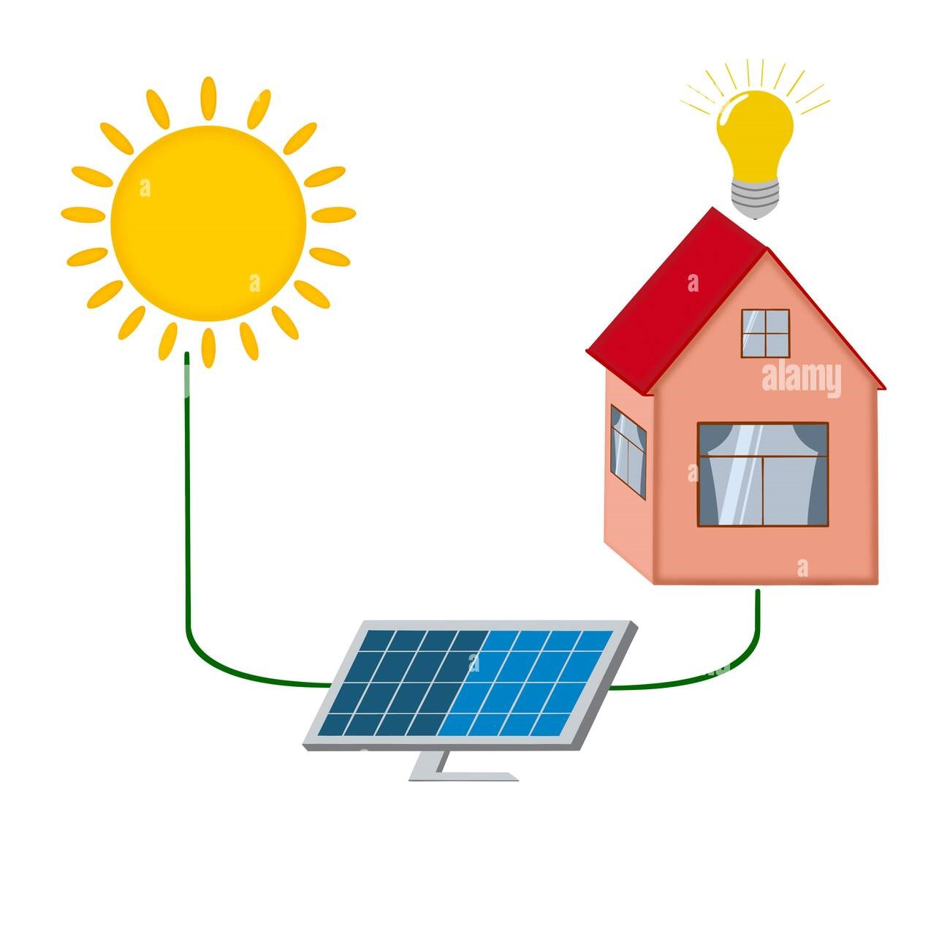
Content:
Top 10 suburbs with potential capacity in each state
Overall number of dwellings installations available for in each state
Current installations vs estimated dwellings in each state
Current capacity vs potential kw capacity in each state & postcode
Show number of installations in each postcode & region
Show average capacity per dwelling & installation in each postcode against the Australian average

Slide 7
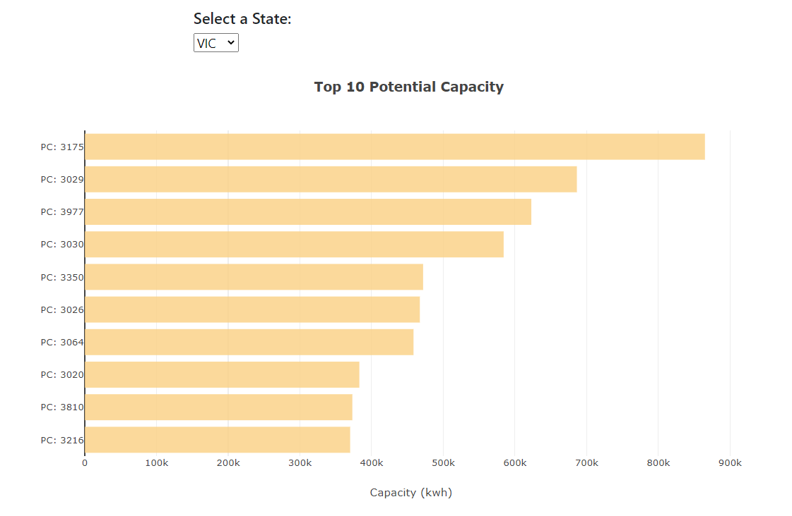
Top 10 Potential Capacity Bar Chart

Slide 8
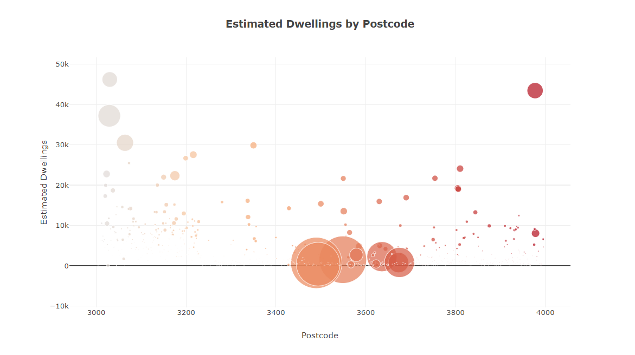
Estimated Dwelling by Postcode

Slide 9
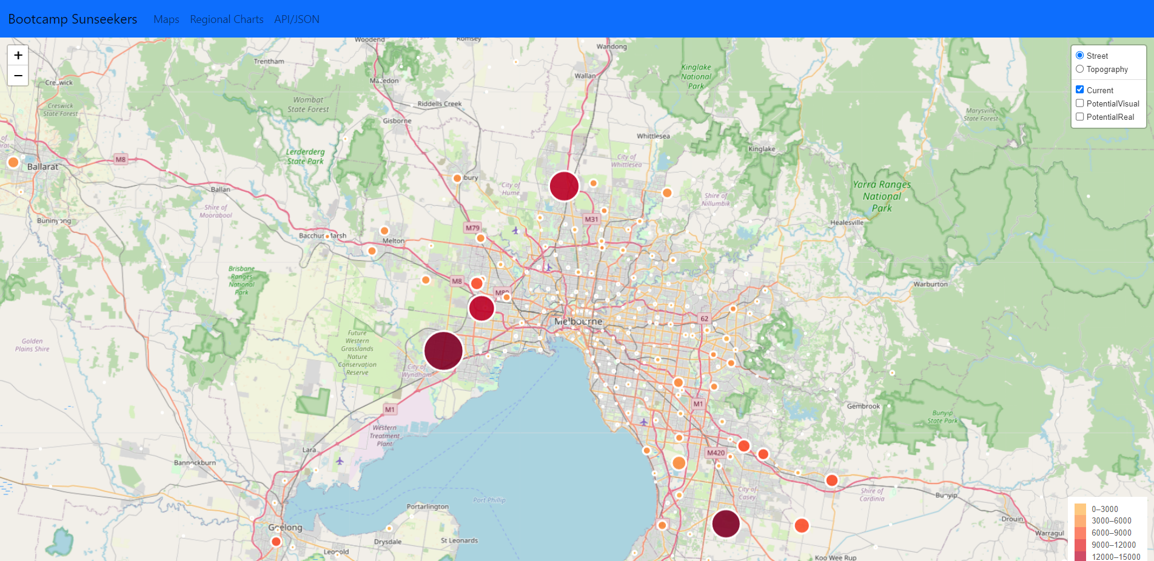
Map

Slide 10
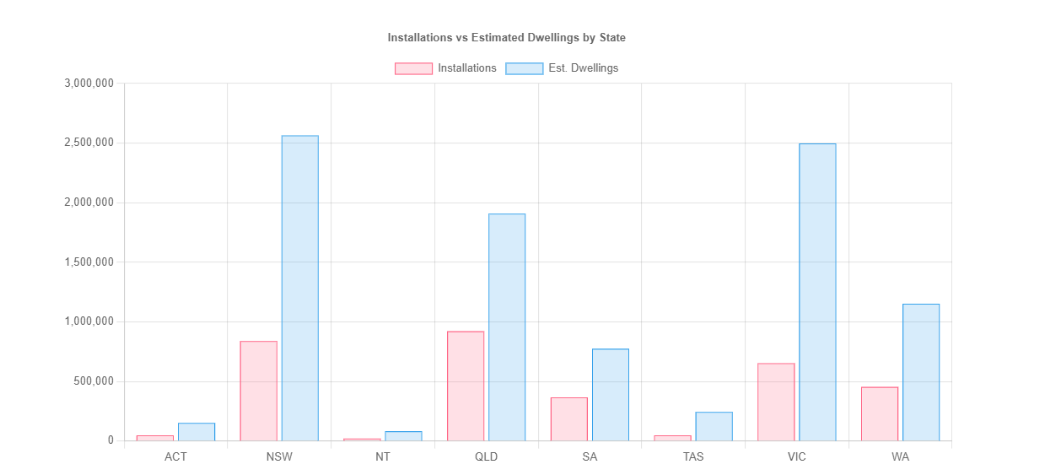
Chart - Installations vs Dwellings by State

Slide 11


