Slide 1
Validating Efficiency of the Forward-Forward Algorithm
COMP3035 Discovery Project
Kevin Reyes & Gabriel Schussler
Western Sydney University
Spring 2024
Notes:
[Kevin] “Hello everyone. I'm Kevin, and with me is my project partner Gabriel. We’ll be presenting our research on validating the efficiency of the Forward-Forward Algorithm, a novel approach to neural network training proposed by Geoffrey Hinton.

Slide 2
Aim
Evaluate Geoffrey Hinton’s Forward-Forward (FF) algorithm vs traditional Backpropagation (BP)
Goal: Compare computational efficiency and resource usage
Notes:
[Kevin]: Our aim for this project was to explore and evaluate the computational efficiency and resource usage of the Forward-Forward algorithm compared to traditional backpropagation in a simple supervised learning.

Slide 3
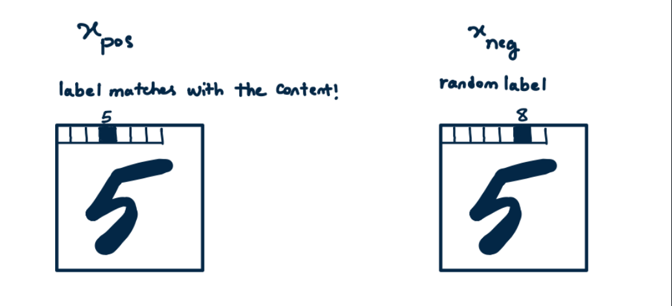
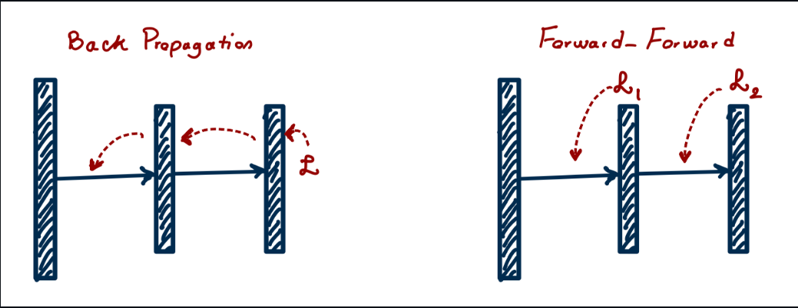
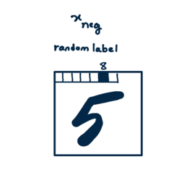
Motivation
Backpropagation
Computationally intensive
Biologically implausible
Forward-Forward
Eliminate forward-backward passes
Image: https://github.com/aqbewtra/pytorch_forward_forward
Notes:
[Kevin] The challenge we're addressing today is fundamental to machine learning. Backpropagation, while effective, is computationally intensive and doesn't reflect how biological neural networks function. The FF, on the other hand, presents an interesting alternative. Instead of the traditional forward-backward cycle, it uses two forward passes - one for positive samples and one for negative samples of the data. We hypothesized that this approach could achieve similar accuracy while being more computationally efficient.

Slide 4
Methodology
MNIST dataset
3 Fully connected hidden layers
1000 ReLUs
Control
50 epochs
97% accuracy
Metrics
GPU Utilisation
GPU Power Draw
GPU Memory Usage
Notes:
[Kevin] For our methodology, we implemented both algorithms using PyTorch and tested them on the MNIST dataset of handwritten digits. The data is prepared by appending the one-hot-encoded class label to the start of the image. For the positive sample, it’s label would match the datapoint, while in the negative sample, a random label is appended.
[Gabe] We built two identical neural networks, each with three layers and 1000 neurons per layer. To ensure a fair comparison, we conducted two types of tests: one running both models for 50 epochs, and another training each model until they reached 97% accuracy. Throughout these tests, we carefully monitored GPU utilization, power consumption, and memory usage.

Slide 5
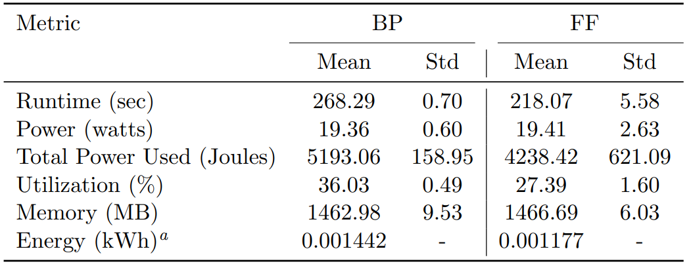
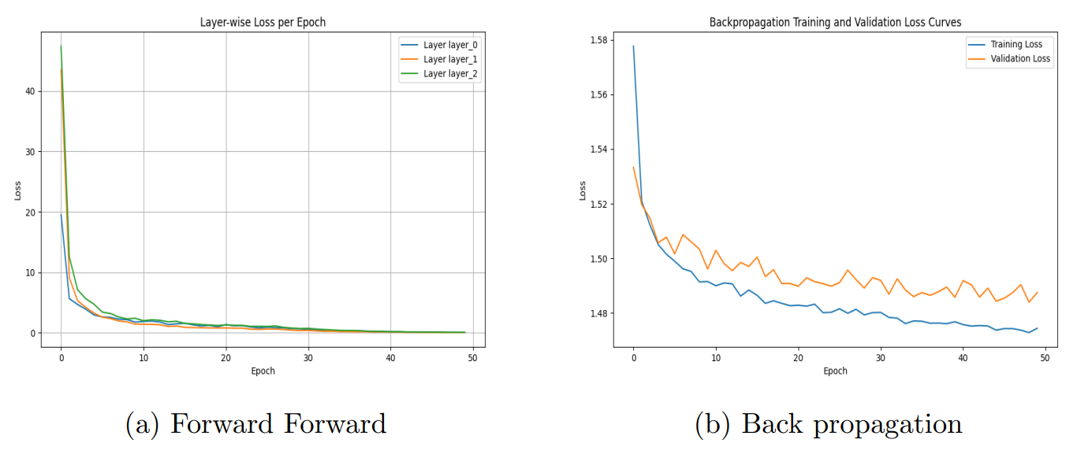
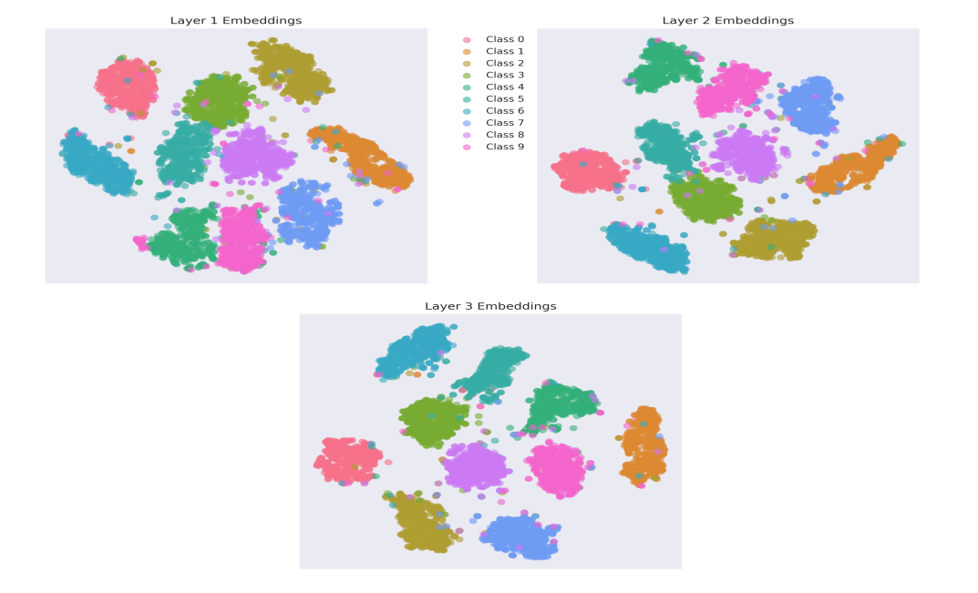
Key Findings
FF faster than BP
20% lower power consumption
Lower GPU utilisation
Notes:
[Gabe] Our findings were quite interesting. The Forward-Forward algorithm consistently outperformed backpropagation in several key metrics. Most notably, FF reached our target accuracy threshold 50 seconds faster than traditional backpropagation. We observed a 20% reduction in power consumption, and GPU utilization was significantly lower at 27.39% compared to backpropagation's 36.03%. What's particularly encouraging is that these efficiency gains didn't come at the cost of accuracy – Forward Forward showed similar learning patterns.
Additionally, we can see from the t-SNE visualization of the Forward Forward’s layer embeddings confirm our expectations about the model’s trained parameters – it is effectively learning the correct representation of the test data.

Slide 6
Limitations & Implications
Implementation
Gaming GPU instead of HPC
Code improvements
FF for resource-constrained environments
Embedded devices
IoT
Notes:
[Gabe] These results essentially agree with Hinton’s paper proposing the FF algorithm and its exciting implications, particularly for resource-constrained environments like embedded devices and internet of things systems, where computational efficiency and power consumptions are critical factors.

Slide 7
Future work
Other architectures
CNNs
RNNs
Transformers
Complex datasets
CIFAR
FMNIST
Notes:
[Kevin] As we look to future work, we're particularly interested in testing the algorithm's performance with different neural network architectures, like convolutional and recurrent neural networks and especially in Transformer based models. We would also like to expand this work to more complex datasets like CIFAR AND Fashion MNIST to further explore the capabilities of the Forward-Forward algorithm.
[Kevin] In conclusion, while backpropagation remains the industry standard, our research demonstrates that the Forward-Forward algorithm offers a promising alternative, especially in scenarios where computational resources are limited and believe this work contributes to the ongoing evolution for more efficient neural network training methods . Thank you for time.

Slide 8
Thank you.
Notes:
[Gabe] Thank you.

