Slide 1
THE TEAM
MEMBER 1
MEMBER 3
Karthik
Jay
MEMBER 2
MEMBER 4
Jun Ming
Pin Shien

Slide 2





CLIMATE CHANGE
WHAT
WHO
A change in global or regional climate patterns.
Everyone. Climate change is caused by human
activity.
EFFECTS
SOLUTION
Hotter temperatures. More health risks.
Poverty and displacement , etc.
Everyone has to play their part
to combat climate change.

Slide 3





STATISTICAL FACTS
DEATH TOLLS
SEVERITY
Researchers predict climate changes
to cause an approximate additional
250 000 deaths yearly by 2030-2050.
The number of reported natural disasters due
to weather has tripled since the 1960s.
HUMAN HEALTH
RISING TEMPERATURES
Over 40% of the world’s population lives within
60 miles of the coast and are risk due
to rising sea levels globally.
In the United States, they forecast the mean
Annual temperature to rise by 2.51 Celsius in
2040-2059.

Slide 4





WASTE
LAND POLLUTION
OCEAN POLLUTION
Out of 3 million tonnes of plastic,
95% of it is discarded after a
single use. Less than 12% is recycled.
The waste directly chokes and smothers
a host of marine animals and habitats. It also
takes hundreds of years to break down.
SOLUTION 1
SOLUTION 2
Curb the production of plastic,
especially of the single-use variety.
Ramp up recycling efforts.

Slide 5





OUR SOLUTION-TRASHMINATOR
PROCESS 1
PROCESS 2
Trashminator is an AI that goes
around tracking trash.
The area with plenty of trash will be identified
and marked.
PROCESS 3
PROCESS 4
Then, the area will be displayed on the website
for volunteers to see.
The volunteers will then make their way there
to do whatever that is necessary.

Slide 6




SUMMARY
COMBAT
WEBSITE
Trashminator combats climate change by
reducing, recycling waste.
Easy to navigate.
EFFECTIVENESS
ENRICHING EXPERIENCE
Empower people to contribute through a simple action.
By actively playing a part, volunteers will grow
to understand the importance of this simple gesture.

Slide 7
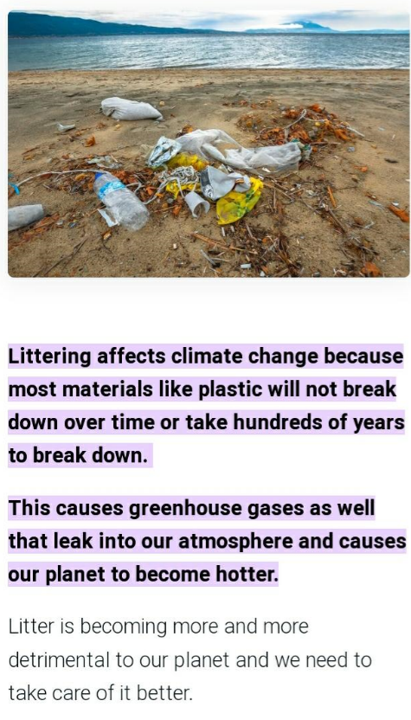
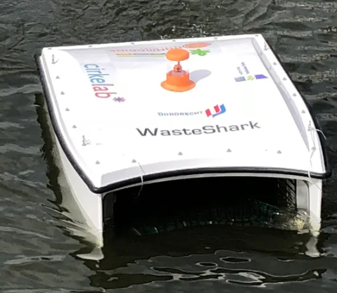
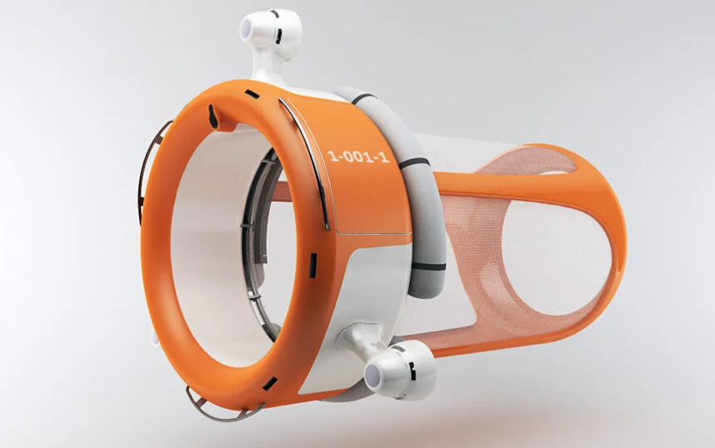
Future Insights
We believe that our software can be used to build robots that will be sent underwater to detect trash and dispose it properly so it would not hurt marine life and cause green house gases that will leak into the atmosphere.
https://www.thinkingsustainably.com/littering-affect-climate-change

